Slide 1
Welcome to the Oddball Number Game.
You can move through the instructions by clicking “Next”

Slide 2
In this game, you will see a set of three digits.
They can be the digit 0, 1, 2, or 3.

Slide 3
Each digit will appear in either the first, second, or third position.
Here the “0” is in the first position.
0 _ _

Slide 4
Each digit will appear in either the first, second, or third position.
Here the “0” is in the second position.
_ 0 _

Slide 5
Each digit will appear in either the first, second, or third position.
Here the “0” is in the third position.
_ _ 0

Slide 6
Each trial will have an oddball digit which is different from the
other two digits.
Your job is to pick out which digit is the oddball.
100

Slide 7

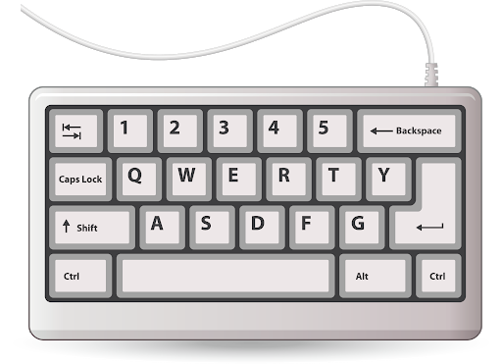
Press the key on the keyboard for which digit corresponds to the oddball.
Using your left hand, place your:
ring finger on the “1” key (for when the oddball is the digit 1)
middle finger on the “2” key (for when the oddball is the digit 2)
index finger on the “3” key (for when the oddball is the digit 3)

Slide 8
In this game you will encounter two types of trials:
matching AND mismatching trials.

Slide 9
For matching trials, the position of the oddball on the screen will
be the same as the location of the key you must press:
For example, here the digit 1 is the oddball AND is in the first position
(The correct response is to press 1)
100

Slide 10
For mismatching trials, the position of the oddball on the screen will
be the different from the location of the key you must press:
For example, here the digit 1 is the oddball BUT is in the second position
(The correct response is to press 1)
212

Slide 11
The “+” indicates the start of a new trial that is about to appear on
the screen.
+

Slide 12
Here is the first type of a matching trial.
+

Slide 13
Here is the first type of a matching trial.
(The correct response is to press 1)
100

Slide 14
Here is the second type of a matching trial.
+

Slide 15
Here is the second type of a matching trial.
(The correct response is to press 2)
020

Slide 16
Here is the third type of a matching trial.
+

Slide 17
Here is the third type of a matching trial.
(The correct response is to press 3)
003

Slide 18
You will now practice performing the matching trials.
If you take too long to respond or select an incorrect response,
you will get feedback on the correct response.

Slide 19
Nice job! Now you will learn the mismatching trials.
Here is an example.
+

Slide 20
Here is an example of a mismatching trial.
(The correct response is to press 1)
313

Slide 21
Here is another example of a mismatching trial.
+

Slide 22
Here is another example of a mismatching trial.
(The correct response is to press 2)
332

Slide 23
Here is a third example of a mismatching trial.
+

Slide 24
Here is a third example of a mismatching trial.
(The correct response is to press 3)
311

Slide 25
You will now practice performing the mismatching trials.
If you take too long to respond or select an incorrect response,
you will get feedback on the correct response.

