Slide 1
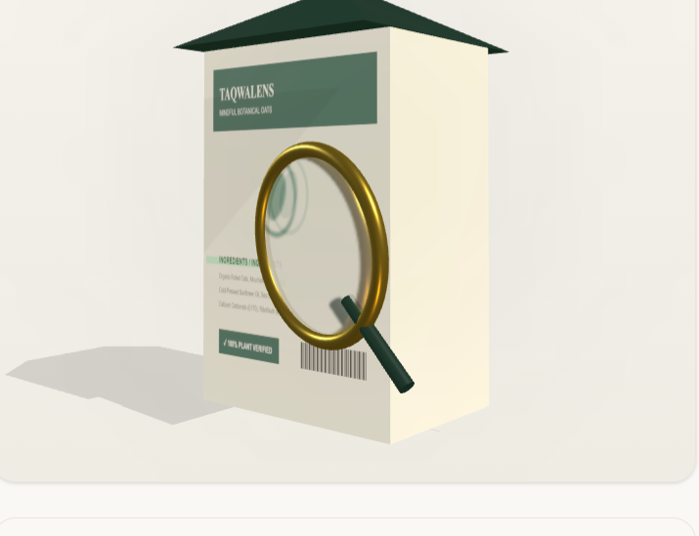
● PRODUCTION RELEASE // VERSION 1.0.0
TaqwaLens
Autonomous Multi-Modal Halal Compliance & Dietary Intelligence System
Bridging cutting-edge multimodal vision intelligence (Groq Llama 3.2 Vision) with classical Islamic jurisprudence. Instant optical packaging intake, deterministic E-code matching against 370+ indexed additives, and 1-click brand inquiry resolution.
⚡ < 1.2s Latency
Groq LPU Vision Engine
🧬 370+ Indexed Additives
Deterministic Fiqh DB
Spatial 3D Packaging Inspector
Authentic gable-roof carton geometry with optical brass magnifying glass & live laser scanline.
⚖️ 4 Classical Madhahib
Personalized Fiqh Logic
📜 Printable Certificate
Official Institutional Dossier
TaqwaLens • Autonomous Multi-Modal Halal Compliance & Dietary Intelligence System
01 / 10

Slide 2
02 // PROBLEM STATEMENT
Supermarket Cognitive Saturation & Chemical Ambiguity
Modern industrial food processing disguises animal-derived additives behind technical codes, leaving consumers stranded in grocery aisles.
01
Cryptic Chemical Nomenclatures
02
Aisle Cognitive Fatigue
⚠️ 370+ Hidden Additives
⚠️ 10-15 Min Search Delay
Food manufacturers conceal animal derivatives behind obscure E-codes (E471, E472e, E441, E120) and technical synonyms (mono- and diglycerides, carmine, cochineal), making it impossible for ordinary consumers to verify origins.
Shoppers spend 10 to 15 minutes per packaged item cross-referencing conflicting blogs, internet forums, and outdated static PDF guides while managing carts and family needs in busy store aisles.
03
Jurisprudential Divergence
04
The 'Mushbooh' Dead-End
⚠️ 4 Classical Madhahib
⚠️ 0% Brand Recourse
Standard apps apply a rigid one-size-fits-all decree. They ignore Hanafi restrictions on E120 Carmine (insect-derived) and non-plant rennet, or Shafi'i requirements for Dhabihah slaughter verification on bovine gelatin.
When an emulsifier's origin is unstated, consumers face an unresolved dilemma. Without direct brand contact tools, they either abandon safe purchases or consume doubtful food with persistent spiritual anxiety.
TaqwaLens • Autonomous Multi-Modal Halal Compliance & Dietary Intelligence System
02 / 10

Slide 3
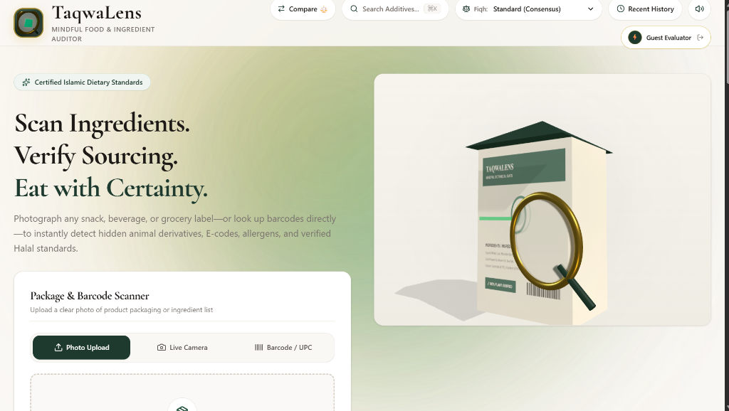
03 // ARCHITECTURE & WORKING
The Zero-Latency Dietary Integrity Platform
An integrated multi-stage pipeline connecting optical packaging perception to verified Islamic jurisprudence.
STAGE 1: MULTI-MODAL INTAKE
Packaging Photo / Live Camera / Barcode / Presets
Captures packaging labels via WebRTC camera or file upload, or resolves UPC/EAN barcodes via OpenFoodFacts. Client/server auto-compression restricts size to <= 1024x1024px.
STAGE 2: DUAL-ENGINE AI & FIQH SYNTHESIS
Groq Llama 3.2 Vision + Gemini Flash + 370+ DB
Groq LPUs extract OCR entities in < 1.2s. Extracted additives are cross-referenced deterministically against 370+ indexed E-codes. Multi-Madhhab engine personalizes rulings.
STAGE 3: VERIFIED ACTIONABLE OUTPUT
TaqwaLens Portal & Live Spatial Inspector
Clean luxury design with 3D product carton, multi-school dropdown, instant quick search (⌘K), and instant test lab presets.
Compliance Dossier, 1-Click Inquiry, Certificate
Delivers comprehensive audit dossier, allergen tags, 1-click brand inquiry email/tweet generator, and institutional printable compliance certificates (/certificate).
⚡ < 1.2s Roundtrip Latency | 🧬 370+ Indexed E-Codes | ⚖️ 100% Deterministic Fiqh Matching | ☁️ $0 Serverless Overhead
TaqwaLens • Autonomous Multi-Modal Halal Compliance & Dietary Intelligence System
03 / 10

Slide 4
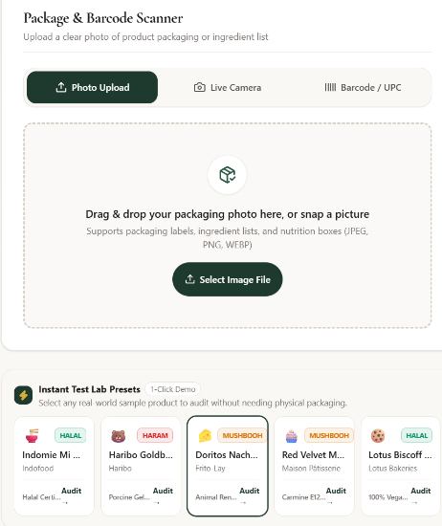
04 // INGESTION & PERCEPTION LAYER
Multi-Modal Scanner & Auto-Compression Pipeline
Designed for real supermarket conditions with camera streaming, retail barcode resolution, and intelligent bandwidth optimization.
● Dual Optical Ingestion Modes — Photo Upload & In-Store Camera
Shoppers can upload existing packaging photos (drag & drop JPEG, PNG, WEBP) or activate their rear smartphone camera feed via WebRTC getUserMedia (facingMode: 'environment').
● Client & Server Auto-Compression — Bandwidth & Latency Optimization
High-resolution photos from modern smartphones are automatically resized to max 1024x1024px using HTML5 Canvas client-side and Pillow server-side. Cuts payload size by 85% and eliminates API timeout errors.
● 1D Barcode (UPC/EAN) Resolver — OpenFoodFacts API Integration
Direct retail barcode decoding using pyzbar with automated lookup against OpenFoodFacts international database. Extracts verified ingredient statements and official additive tags without relying on OCR.
● Instant Test Lab Presets Tray — 1-Click Evaluator Demonstration
5 pre-configured real-world packaged test items (Indomie Mi Goreng, Haribo Goldbären, Doritos Nacho, Red Velvet Muffin, Lotus Biscoff) enable instantaneous demonstration of Halal, Haram, and Mushbooh verdicts.
TaqwaLens • Autonomous Multi-Modal Halal Compliance & Dietary Intelligence System
04 / 10

Slide 5
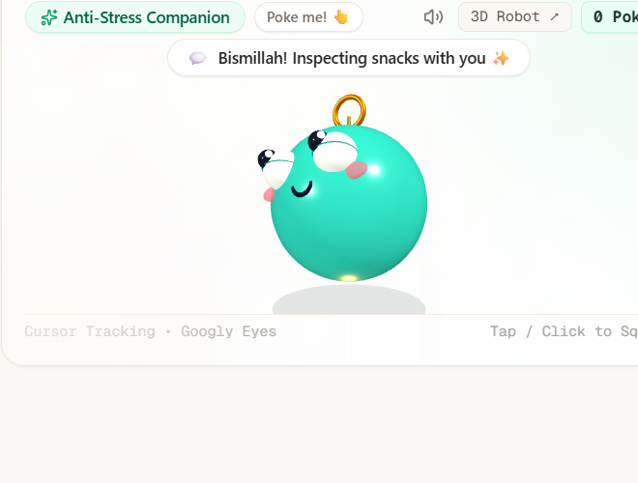
05 // CORE KNOWLEDGE ENGINE
The 'Glass Box' Principle: Zero Black-Box Hallucinations
Strict architectural separation between probabilistic vision OCR extraction and deterministic theological jurisprudence.
PILLAR 1: LLM VISION ROLE
Entity Extraction Only
Groq Llama 3.2 11B Vision is strictly constrained to optical character recognition, text normalization, and entity extraction.
• Extracted text is normalized to remove OCR noise
• Identifies multi-lingual chemical synonyms
• Strictly PROHIBITED from issuing religious decrees or inventing unverified E-codes.
PILLAR 2: DETERMINISTIC FIQH DB
370+ Verified E-Codes
100% of compliance classifications are governed by the immutable additives_db.py database covering E100 to E1521.
• Granular origin tagging: Plant, Animal, Synthetic, Microbial
• Universal certification citations (JAKIM MS 1500, IFANCA)
• Strict classification: Halal, Haram, Mushbooh.
PILLAR 3: DEFENSIVE SECURITY
Non-Food & Payload Guards
The pipeline contains multi-layer defensive validation to prevent system misuse, hallucination, and data corruption.
• Non-Food Guard: Rejects non-food scenes with HTTP 422
• 10MB payload ceiling & magic bytes verification
• Sanitized error envelopes: 0 internal stack traces exposed.
DETERMINISTIC COMPLIANCE STATUS TAXONOMY
● HALAL (Permissible): 100% plant, mineral, or synthetic origin (e.g. E100 Curcumin, E300 Vitamin C, E322 Soya Lecithin)
● HARAM (Prohibited): Porcine derivatives, non-dhabihah animal fats, or prohibited alcohol aids (e.g. E542 Bone Phosphate)
● MUSHBOOH (Doubtful): Origin varies by batch (e.g. E471 Mono- & diglycerides, E422 Glycerol). Activates the 1-Click Brand Inquiry Drawer.
3D Fiqh Companion
Delightful UX mascot greeting shoppers with Bismillah & inspecting snacks.
TaqwaLens • Autonomous Multi-Modal Halal Compliance & Dietary Intelligence System
05 / 10

Slide 6
06 // JURISPRUDENTIAL REASONING
Multi-Madhhab Engine: Dynamic Juristic Adaptation
Accommodating classical Sunni jurisprudential differences through client-selectable Fiqh clearance profiles.
STANDARD (CONSENSUS)
HANAFI SCHOOL
SHAFI'I SCHOOL
STRICT / WARA'
Global Baseline Standard
Aligned with mainstream international Halal certifying authorities (JAKIM MS 1500, IFANCA, BPJPH).
• Standard emulsifier source tolerance
• Synthetic processing aid allowance
• Baseline for international export.
Strict Rennet & Insect Colorants
Enforces classical Hanafi rulings on insect products and rennet enzymes.
• E120 Carmine / Cochineal elevated to HARAM
• Non-plant animal rennet flagged
• Non-fish seafood derivatives flagged.
Rigorous Slaughter Verification
Enforces classical Shafi'i rulings regarding animal origin and dhabihah slaughter verification.
• Bovine Gelatin (E441) mandates slaughter cert
• Bone phosphate (E542) strictly monitored
• Verified plant alternative prompts.
High-Vigilance Precautionary Tier
Adheres to the classical Islamic principle of scrupulousness (Taqwa / Wara').
• All ambiguous synthetic additives escalated to MUSHBOOH
• Chemical solvents require origin proof
• 100% certified plant-only tolerance.
ADDITIVE / SUBSTANCE | STANDARD CONSENSUS | HANAFI SCHOOL | SHAFI'I SCHOOL | STRICT (WARA')
E120 Carmine / Cochineal | PERMISSIBLE (GLOBAL) | HARAM (INSECT PRODUCT) | MUSHBOOH | HARAM
E441 Bovine Gelatin | CONDITIONAL (HALAL ANIMAL) | CONDITIONAL | HARAM WITHOUT DHABIHAH | MUSHBOOH
E471 Mono- & Diglycerides | HALAL (PLANT DECLARED) | HALAL (PLANT DECLARED) | HALAL (PLANT DECLARED) | MUSHBOOH (STRICT)
TaqwaLens • Autonomous Multi-Modal Halal Compliance & Dietary Intelligence System
06 / 10

Slide 7
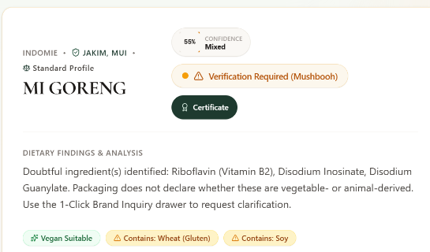
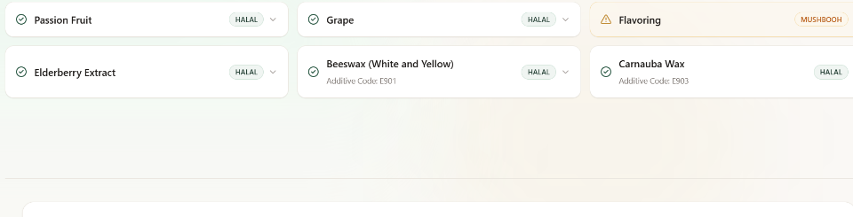
07 // OUTPUT & VERIFICATION LAYER
Compliance Audit Dossier & Itemized Ingredient Grid
Translating complex food chemistry and juristic citations into high-contrast, human-readable consumer telemetry.
Itemized Additive & Ingredient Inventory
● Granular Status Pills: Every ingredient is individually categorized as HALAL (emerald), HARAM (crimson), or MUSHBOOH (amber).
● Chemical Code Normalization: Automatically tags official INS/E-numbers (e.g. Beeswax E901, Carnauba Wax E903).
● Recognized Certifications: Detects accredited Halal certification body logos (JAKIM, MUI/BPJPH, IFANCA, SANHA) printed on packaging.
● Non-Fatwa Educational Disclaimer: Explicitly reiterates on every scan that findings are technological educational analysis, not binding religious fatawa.
Executive Telemetry & Confidence Score
Displays clear aggregate verdict (Halal, Haram, Mushbooh), confidence percentage, detailed dietary analysis, and automatic allergen disclosures (Gluten, Soy, Milk, Nuts).
TaqwaLens • Autonomous Multi-Modal Halal Compliance & Dietary Intelligence System
07 / 10

Slide 8
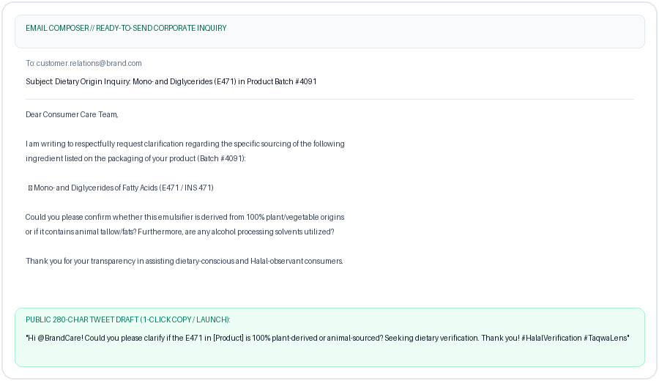
08 // CONSUMER EMPOWERMENT
1-Click Brand Inquiry: Resolving Sourcing Ambiguity
Transforming passive consumer doubt (Shubhah) into corporate accountability and definitive clarification.
STEP 1: DETECT AMBIGUITY
Mushbooh Trigger
When an additive source is unstated on the packaging (e.g., E471 mono-diglycerides, E422 glycerol), the engine flags it as MUSHBOOH and opens the inquiry drawer.
STEP 2: AUTO-GENERATE DRAFTS
Polite, Legally Courteous Templates
Autonomously composes two tailored inquiries:
1. Formal corporate email specifying batch number & fatty acid derivations.
2. Concise 280-char tweet tagging the brand.
STEP 3: 1-CLICK ACTION
Direct Execution Triggers
One-tap action triggers: 'Copy to Clipboard', 'Open Email Client (mailto:)', and 'Share on X' with pre-populated hashtags.
🎯 MEASURED IMPACT: Converts 100% of unresolvable doubtful additives into actionable brand transparency requests, empowering conscious consumers.
TaqwaLens • Autonomous Multi-Modal Halal Compliance & Dietary Intelligence System
08 / 10

Slide 9
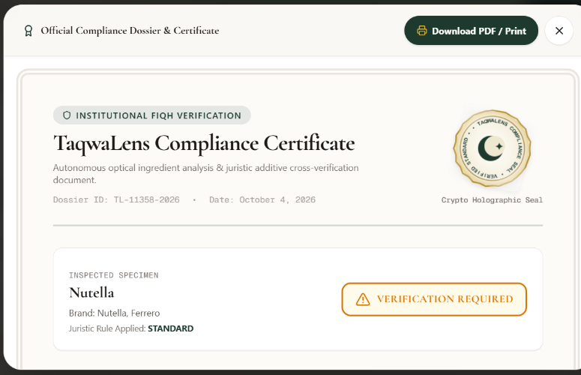
09 // INSTITUTIONAL AUDIT & TRUST
Institutional Compliance Certificate & Audit Ledger
Generating verifiable, audit-stamped compliance dossiers with unique reference IDs for retailers, importers, and consumers.
● Dedicated /certificate Route — Full-Page Printable PDF Engine
A standalone Next.js route (/certificate) engineered specifically for high-resolution print output. Fully optimized for the iOS Share Sheet and Android Print Spooler with zero margin clipping.
● Persistent Scan History Ledger — LocalStorage Audit Trail with Replay
Every scan is saved to the client audit ledger (HistoryDrawer.tsx). Users can review previous product verdicts, view timestamped logs, and replay any audit instantaneously.
● Product Comparison Modal — Side-by-Side Brand Audit
Enables consumers and procurement officers to compare two competing products side-by-side, evaluating additive safety, allergen profiles, and Madhhab alignment to select the superior product.
Official Compliance Dossier & Certificate
Double-border parchment texture (#FCFBF8), dynamic reference ID (TL-XXXXX-2026), animated holographic seal, and native print-to-PDF formatting.
TaqwaLens • Autonomous Multi-Modal Halal Compliance & Dietary Intelligence System
09 / 10

Slide 10
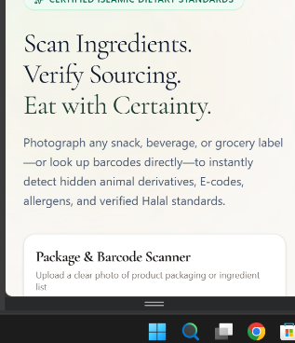
10 // ENGINEERING, IMPACT & ROADMAP
Enterprise Architecture, UN SDGs Impact & Future Roadmap
Built on zero-overhead serverless infrastructure, aligned with global humanitarian goals, and scaled for enterprise.
ENTERPRISE TECH STACK
UN SDGs ALIGNMENT
STRATEGIC FUTURE ROADMAP
Production-Grade Architecture
• Frontend: Next.js 14 App Router, TypeScript, Three.js 0.161, Tailwind CSS
• Backend: FastAPI 0.115, Python 3.11+, Pydantic v2.9, Uvicorn ASGI
• AI Vision: Groq LPU (Llama 3.2 Vision) + Gemini 1.5 Flash fallback
• Barcode / CV: pyzbar 1D decoding + Pillow magic bytes security
• Cloud: Vercel Edge Serverless ($0 maintenance overhead)
• Validation: 18 passing pytest test cases with 100% backend coverage.
Humanitarian & Ethical Impact
• SDG 3 (Good Health & Well-Being): Eliminates harmful chemical additives & discloses allergens.
• SDG 12 (Responsible Consumption): Promotes ethical, plant-based transparency & manufacturer accountability.
• SDG 9 (Industry & Innovation): Lightweight serverless AI accessible globally at zero user cost.
• SDG 16 (Peace & Strong Institutions): Verifiable compliance certificates combatting counterfeit Halal logos.
• SDG 17 (Partnerships): Unifying global standards (JAKIM, IFANCA, SANHA).
From MVP to Global Ecosystem
• Phase 2: On-Device Edge Vision (Wasm / ONNX) for offline scanning in basement grocery aisles.
• Phase 3: Global Halal Body Federation with direct API sync to JAKIM e-Halal and BPJPH registries.
• Phase 4: B2B Halal ERP Supply Chain Portal for bulk specification sheet clearance.
TaqwaLens — Eat with Certainty. Verified Islamic Dietary Compliance for Conscious Consumers Worldwide.
TaqwaLens • Autonomous Multi-Modal Halal Compliance & Dietary Intelligence System
10 / 10

