Slide 1
Parallel MODFLOW 6
Jarno Verkaik

Slide 2
Content
Compiling and linking with MPI
Preparing model
Running model
More advanced options

Slide 3
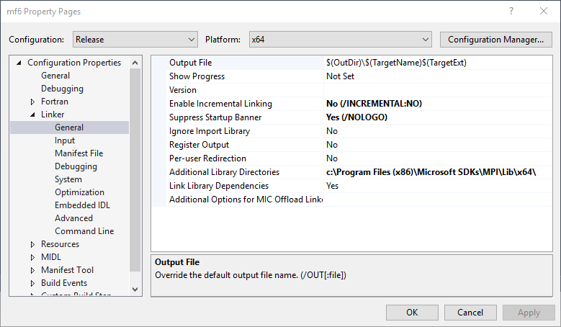
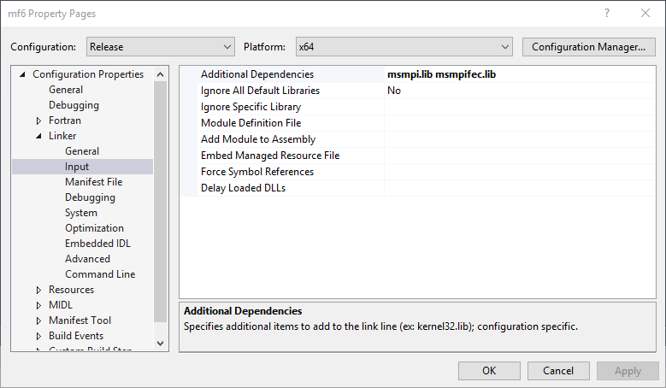
Compiling and linking
Source: https://github.com/verkaik/modflow6-parallel.git
Windows: install Microsoft MPI (or MPI-CH)
Visual Studio:

Slide 4
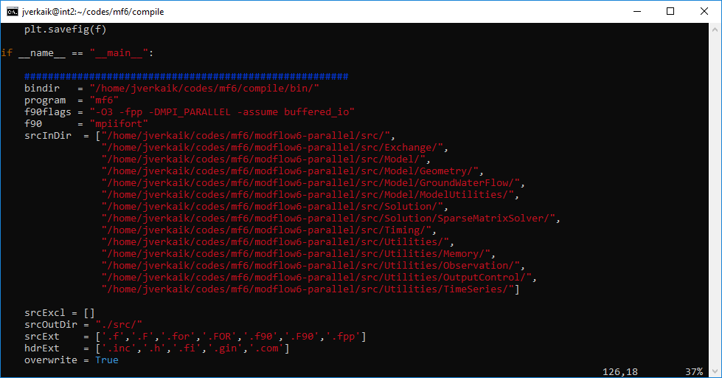
Compiling and linking
Linux: e.g. mpiifort using OpenMPI or MicroSoft MPI (see e.g. module load avail)
Generate makefile with makegen.py:

Slide 5

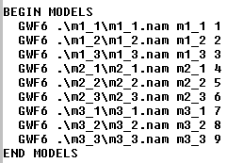

Preparing model (mfsim.nam)
Set number of cores in mfsim.nam:
Assign each GWF model uniquely to a processor core:

Slide 6

Running model
Linux: use batch script, e.g. slurm
Windows: using MicroSoft MPI
Number of cores

Slide 7



More advanced options
Coarse grid correction preconditioner (also supported for serial run): In mfsim.nam: solmodels.asc.wrp: solmodels.asc:
Assign to processor core

Slide 8


More advanced options
Block Jacobi preconditioner:
Default for parallel, also supported for serial
For testing parallel vs. serial to check if linear solver convergence matches
Enable this option in IMS-file:
IMS option for viewing linear convergence:

Slide 9
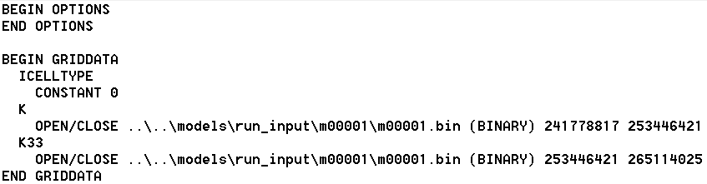
More advanced options
Direct acces binary read for reducing number of (transient) files:
Start position in bytes
End position in bytes
1 file for all binary bulk data
Begin = position 1

Slide 10
More advanced options
Mover is supported (no additional input is required).
Multiple solutions are supported in parallel, where each solution corresponds to a MPI communicator group

