Slide 1
RTMS Timer Data Mining
Leonardo Ji - APPLIED DATA MINING (BIA 6301)
Notes:
Good evening, everyone, my final project topic is RTMS timer data mining.

Slide 2
Problem?
The RTMS (Response Time Measurement System) timer data was produced from actual user interacting with software user interface when background service collect data at real time.
Want to understand who are our users, what workflows do they use the most (timer 1 -> timer 2, timer 3), and what pages are slow.
Notes:
The data for home works all worked very well for the particular models we wanted to use.
I thought it would be very interesting to collect some real time data, bigger data set, and test it.
I work on software used by hospital doctors and nurses to manage resources, write documentation, discharges. RTMS timer data is collected at real time. User clicks are tracked and response time are saved to a database. From this data I want to understand user profiles, user workflows, and what caused slowness.

Slide 3
Data
One week worth of data exported from a timer tool
1,000,000 rows, 24 columns
Timer name
User Principal
Elapsed time
End date time
Domain
Node name
Application name
Notes:
I exported the data set on April 24th. It contains the timer data from the week of April 17th. It just happened to be exactly one million rows 277MB of data. Some of the useful columns are list here.

Slide 4
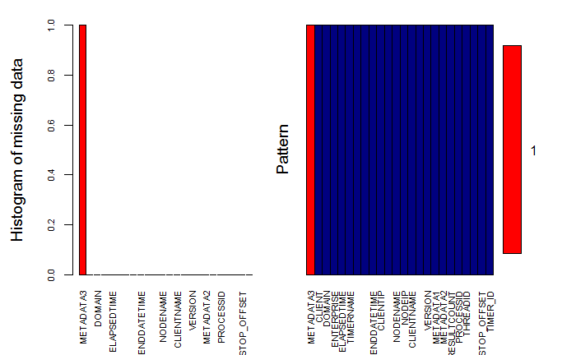
Data Cleaning
Notes:
First step data cleaning. I have to remove some attributes are empty or missing. Here is a Aggregations for missing values plot from VIM package. The red are missing values.

Slide 5
Data wrangling
Remove outliers (negative response time and greater than 200)
Convert timer data to user transaction data
Convert timer data to a user timer frequency data.
Convert character date time to number of seconds from a begin date time
Notes:
I found class example on how to write data to a transaction then read it, and I found way to combine user and timer name to user timer frequency data. Convert end date time string to a number made regression run faster. I will get into the details next.

Slide 6
Unsupervised Learning
Target variable is unknown
Try to find patterns from timer data
Methods:
Hierarchical clustering
Association rules
K-means
Notes:
For this project I spent most time on unsupervised learning methods. I used hierarchical clustering, association rules Apriori, and k-means clustering.

Slide 7
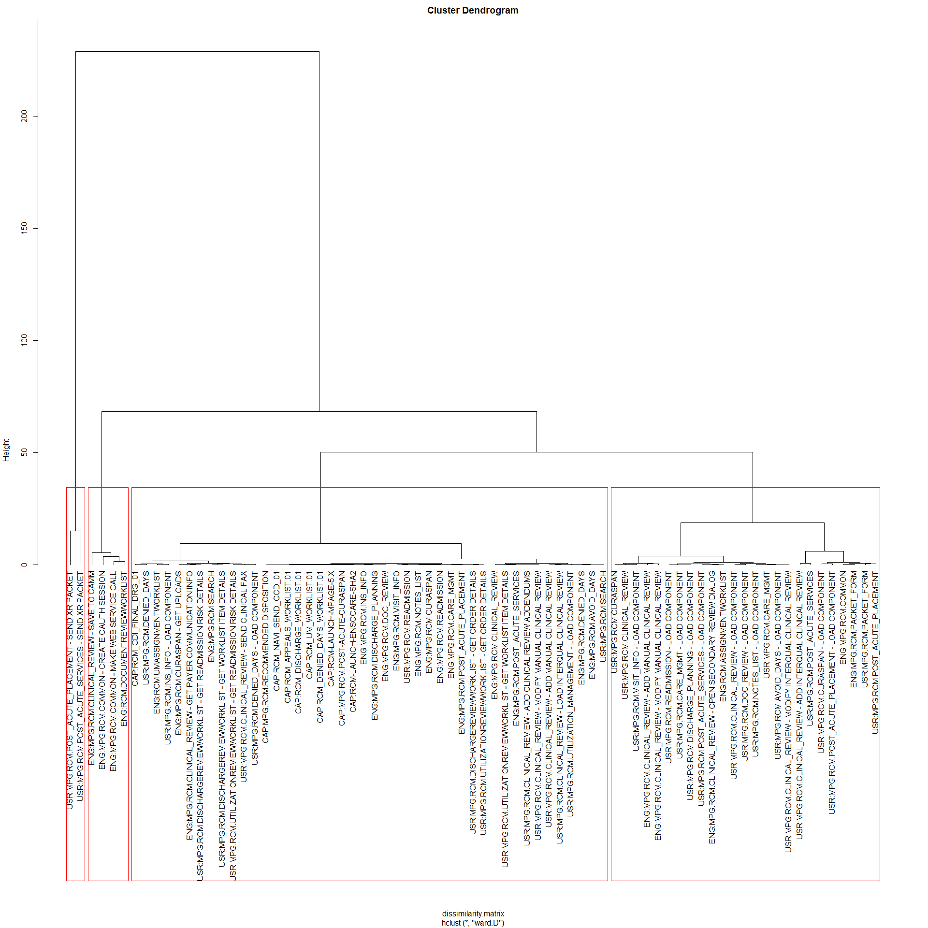
Hierarchical clustering dendrogram of Average timer time
Notes:
Use aggregate function to get average time per timer name. Then I create a dendrogram by average time per timer name. I picked k = 4 from reading the dissimilarity matrix height.
The left most group are two upload report timer, the next four are larger data load, the third group from left are CAP timer which does not track time, the fourth group are faster timers.

Slide 8
Association rule by Apriori on User sessions
Total of 11,375 unique users, 75 unique timers
For each user:
Find all unique timer names
Paste names together
Add to user list
Writes to transaction file then reads it
Notes:
In order to do association rule, I need to convert to user transaction data. I create a empty data frame of one column. Then for each user I get unique timer names then paste them together and insert it to the data frame.
With 11,375 user transaction data set I can run Apriori on it.

Slide 9
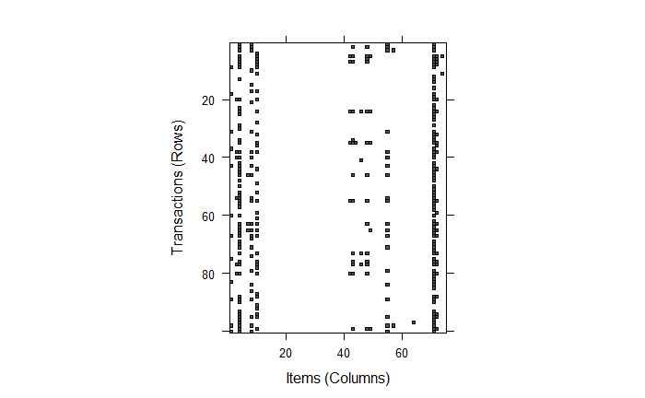
Sample 100 Transactions
Notes:
This is a sample of 100 transactions. Rows are 11,375 users, columns are 75 timers. There are some of the timers never used, some used almost every time. It is a sparse matrix.

Slide 10
Rules
LHS | RHS | Support | Confidence | Lift
MODIFY MANUAL CLINICAL REVIEW | UTILIZATION_MANAGEMENT - LOAD COMPONENT | 0.12 | 0.99 | 1.25
Notes:
The result of Apriori gives us rules. Relative Support is the frequency, Confidence measures how often is the rule correct. Lift measures how much more likely someone do something relative to typical rate given user perform another task.
Relative Support = Count(X)/N is the frequency.
Confidence(X->Y) = (support(X,Y))/(support(X))
Lift = Confidence/Support

Slide 11
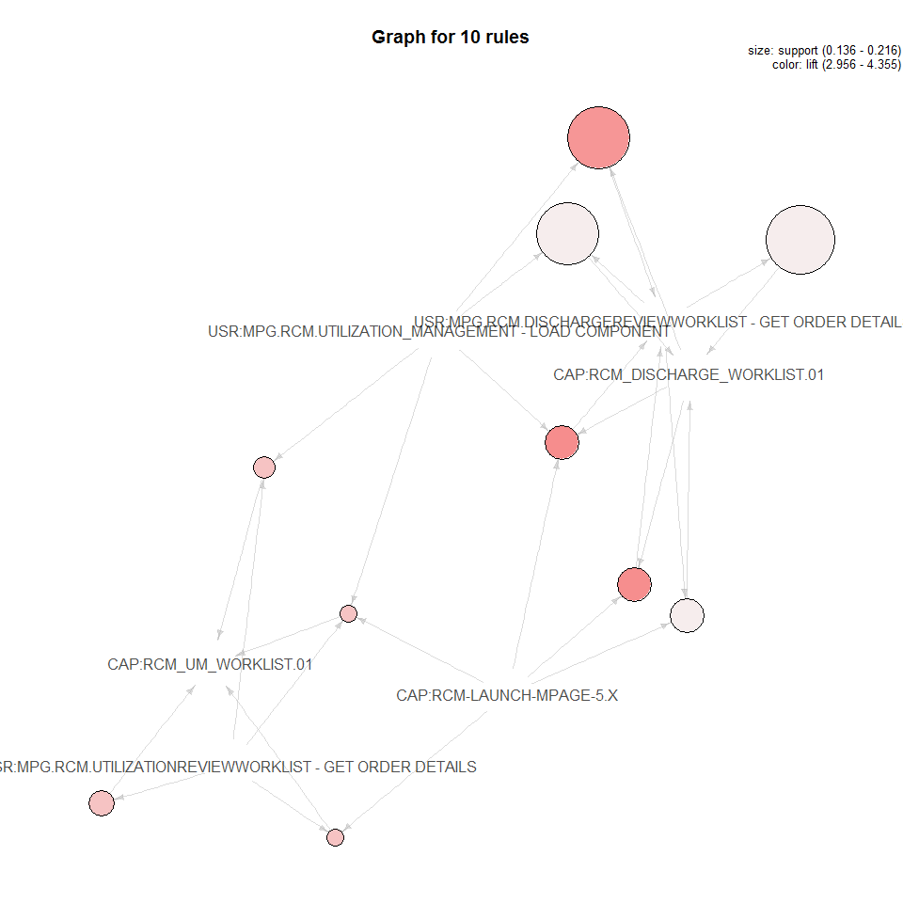
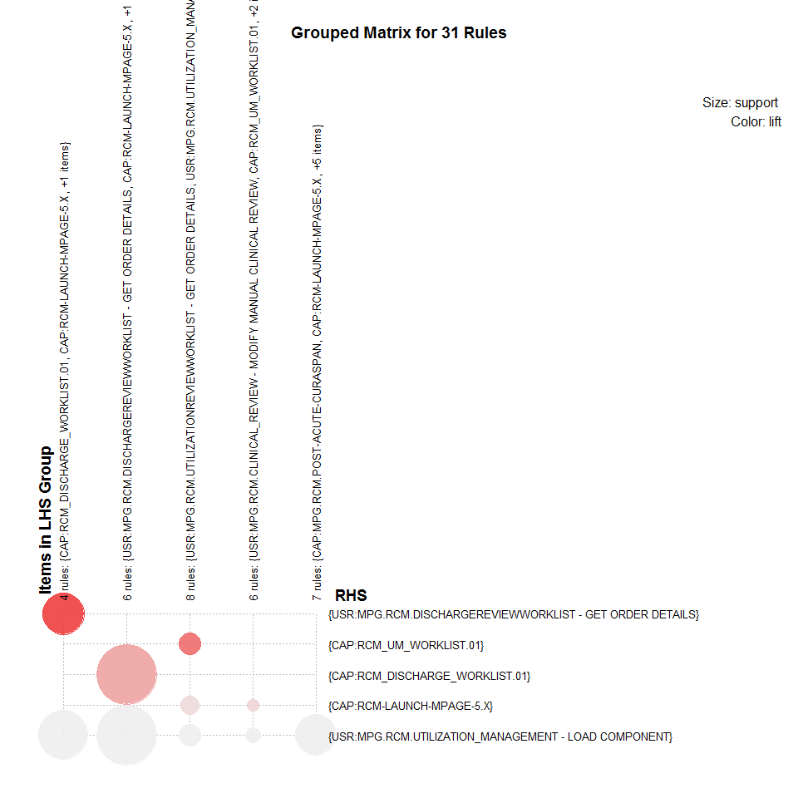
Top 10 of 31 Rules (support = 0.1, confidence = 0.9, minlen = 2)
Notes:
Here are visualizations of the top ten rules out of 31 returned. Color is the lift. The darker the color the higher lift.

Slide 12
KMean Clustering by user timer frequencies
Combine to user timer to frequencies
Create a sparse matrix of 11,375 users and 75 timers
Get table property of a dense matrix user and timer
Use cbind() to combine columns and rows
Add frequencies from table property
Notes:
We know users use a few of the timers much more than others. I want to create user profiles from user timer frequencies. First I need to create a sparse matrix of 11,375 user and 75 timers. I used cbind method to combine columns and rows. Then add frequencies from the user timer name table properties.

Slide 13
Tested K = 3 to 9
Use visualization (all looks good)
Examine the Separation and Cohesion ratios (k =9)
Use the “Elbow Method” (k = 3)
Use pseudo-F statistic (k = 3)
Use FPC library’s Kmeansruns (bestk = 3)
Notes:
I will test the number of clusters from 3 to 9. I will use five methods to find K: use visualization, examine Betweeness ratio (find highest) and Withinss ratio (find lowest), create “Elbow method” graphs from sum of betweenss and sum of withiness, use pseudo-F statistic to find the largest value, use FPC library to return best k. I end up picked K = 3.

Slide 14
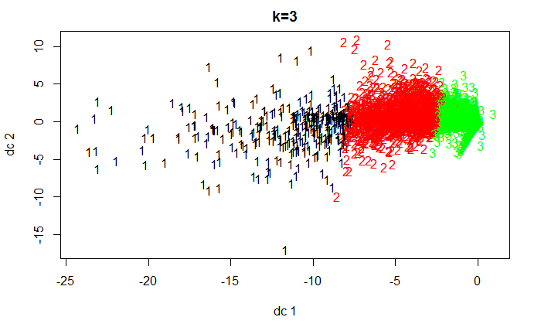
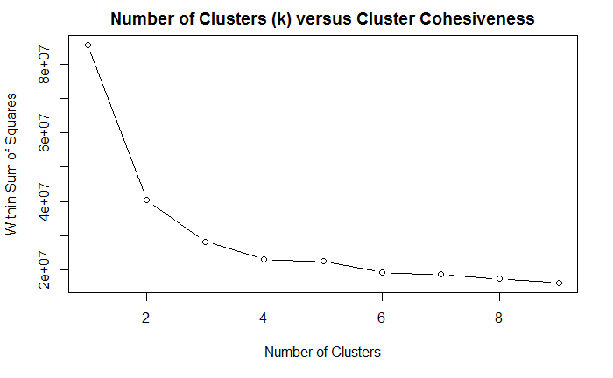
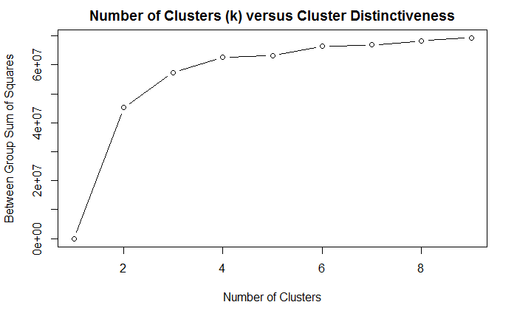
Picked K = 3
Notes:
The first plot shows three distinctive clusters. The elbow plot shows k = 3 and k = 6 are good selections.

Slide 15
Clustering user Profiles
Segment 1 (9120): Casual users. Load component pages 14 times per week. Do not use any other worklist or app like other two groups. Regular physicians or nurses.
Segment 2 (320): Heavy users. Use utilization review worklist 34 times per week, write Interqual review 21 times per week, send fax 10 times per week. Utilization Review nurses.
Segment 3 (1953): Medium users. Use discharge worklist 13 times per week more than UM Worlist, use discharge app Curaspan 7 times per week. Discharge nurses.
Notes:
The three clusters makes sense because we have three user profiles. The casual users are doctors and nurses that most likely only read those pages.
The heavy users who are utilization review nurses that use clinical review functionalities. The median users who are discharge nurses that use it only to discharge patients.

Slide 16
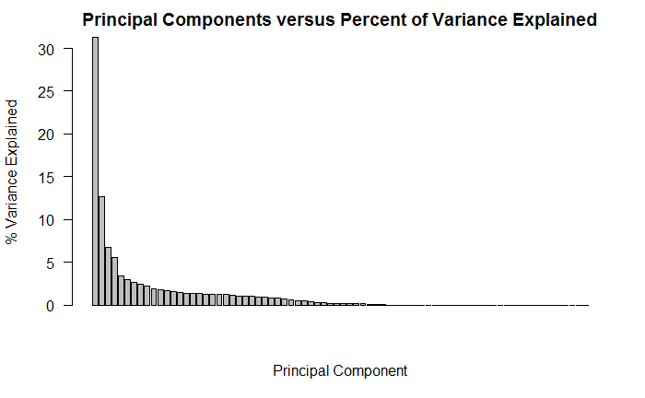
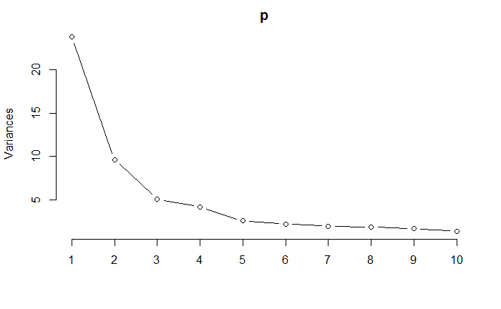
PCA on user profiles (76 principal components select k =3)
Notes:
There are 75 timers in user transactions can we use PCA to reduce dimensions. Curse of dimensionality come into play.
PCA helps reduce the number of variables/dimensions from the model. Can we use a few principal components then apply clustering to the user data?
Variance explained graphs show first few PCA components explains most of the difference. Elbow plot picks 3 PCA components.

Slide 17
PCA cluster profiles
Group 1 (11,370) General users
Group 2 (4) Three Engineers one test Engineer
Group 3 (1) Another Engineer on our team (Anchorman of the movie dataset)
Notes:
PCA was able to pick up four engineers and one test engineer from 11,375 users. In a sense, test engineers are testing our pages much differently than average users.

Slide 18
supervised Learning
Classification slowness (response time > 2 seconds)
Decision Tree, Logistic Regression, Naïve Bayes to predict slowness.
Create a dummy variables for response time > 2 seconds
Caret package to divide to training and validation sets
Create numeric dummy variables from date to time.
Notes:
So far I tried all three unsupervised learning methods. Next I want to use supervised learning method to classify slowness defined as greater than 2 seconds. First I want to use decision tree on data set. Next I create dummy variables from decision tree, and convert date time to a number of seconds from begin date time for logistic regression model. Next I used Naïve Bayes to fit the data set.

Slide 19
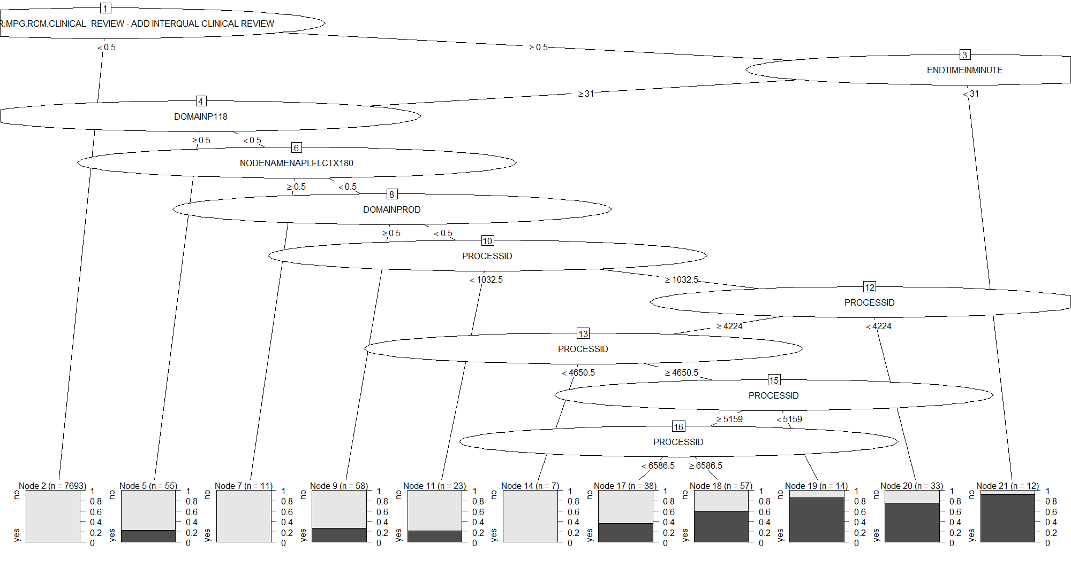
Decision Tree 10 cross validations
Notes:
Here is the decision tree model using 10 cross validations. The decision tree shows the timer name, end date time nodes are causing slowness. Obviously certain timer care slower just because the amount of data. Maybe certain time of the date with heavy usage cause slowness, certain nodes have better hardware or connections than others.

Slide 20
Prediction results
Models | Accuracy | Sensitivity | Specificity | Kappa
Rpart 10 CV | 97.8% | 31.1% | 99.3% | 37.8%
Naïve Bayes | 97.7% | 0 | 100% | 0
Logistic Regression | 99.8% | 11.1% | 99.8% | 18.3%
Notes:
Here are results of three classification models. Notice the sensitivity are pretty low but overall accuracy is high. This is because most of timers are within 2 seconds. So it is harder to predict those small percentage of timers that are greater than 2 seconds. Kappa ratio shows Decision Tree is a OK model.

Slide 21
Summary
We can clearly see three groups of clustering users (general users, discharge nurses, utilization review nurses). PCA divides user further to regular users vs engineers and testers.
Apriori on user transaction data gives us typical user workflows with high confidence and lift (strong rules).
Timer date times, nodes can cause slowness. Classification models has high Accuracy rate but not high Sensitivity rate. Picking the threshold of “2 seconds is too slow” is arbitrary.
Notes:
We can see three groups of clustering users. PCA even picked up test engineers vs regular users.
Apriori on user transaction data gives us predictable user workflow with high confidence and lift.
With different thresholds I can get different models. Most of the timers are less than 2 seconds. Accuracy and specificity is high. If I move the threshold lower then I will have a higher sensitivity model.

Slide 22
Eric Siegel’s “predictive analytics” book
“Many people came up with (often good) ideas...but translating those words into a mathematical formula is the complicated part....Our background in engineering and software was key. In this contest, there was a fine line between a bad idea and a bug in the code. Often you would think that the model was simply bad because it didn’t yield the expected results, but in fact the problem was a bug in the code. Having the ability to write code with few bugs and the skill to actually find the bugs before giving up on the model is something that definitely helped a lot….Compared to what most people think, this was more of an engineering contest than a mathematical contest.” - Team PragmaticTheory on Netflix Challenge
Notes:
As I was learning data mining in this class I remember reading Eric Siegel’s “Predictive Analytics” book. I spent a lot of time debugging my code, reading documentation, googling for answers. It is very time consuming and I will keep remember this quote from “PragmaticTheory” and don’t give up my code too early.

