Slide 1
runATH Pipeline Configurations
Methods to setup runATH Configurations
Date
25 April 2018
Version / status
/Draft-WIP

Slide 2
Cross Browser Reporting
Akash Vangani

Slide 3
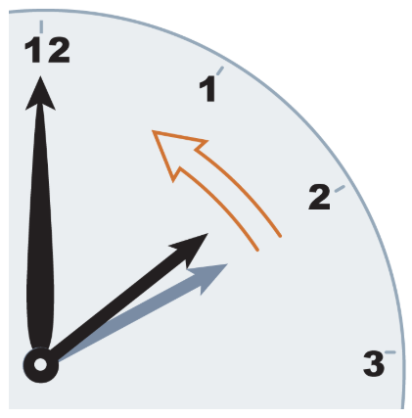





PREVIOUS LANDSCAPE
CURRENT LANDSCAPE
FUTURE LANDSCAPE
1 Job:1 Browser
1 Job:1 Browser
1 Job: N Browsers
80%
84%
WIP
# of browsers
# of browsers
# of browsers
1
2
4
60
Automation time in mins
Automation time in mins
WIP
Automation time in mins
95
Manual time in mins
1200
Manual time in mins
300
600
Manual time in mins
1
Automation report per browser
Automation report per browser
Automation report per browser
2
1

Slide 4
FUTURE AUTOMATION SCOPE
OS
(Windows
Mac-OS)
Single Report
Browserstack Cloud
STAGE
Test Case
BROWSERS
(Chrome
Firefox
Safari
IE)
PROD
BROWSER-VERSIONS
(N-Versions)
We can leverage new level of testing and generate one report.
Multi-Environment
Multi-OS
Multi-Browser
Multi-Browser Version

Slide 5
ATH Job Configuration
Purpose:
Entrypoint for all ATH jobs - Enable any job specific settings
Purpose:
Enable settings for all (1) envs, (2) testSuites for all jobs unless param is passed from invoker
Purpose:
Run ATH Tests
No job / env specific settings
Jenkins Job Folders
Acceptance
Test
Folder
runATHEnvJob
runATHEnv
runATH
Jobs
Folder
runATHParamWrapper
Maapi-test Folder
Purpose:
Enable settings for ATH dev test related job folders
Used for testing pipeline changes and significant paramset changes across versions

Slide 6
1 – YAML config structure – order of preference
1 – Use “testCase” configuration parameters if present:
pipeline: browserstackChromeVersion: 66 testGroups: - name: "Windows-Chrome" browserstackBrowser: "Chrome" browserstackChromeVersion: 67 testCases: - name: “First Test”
browserstackChromeVersion: 68
browserstackChromeVersion will result in 68 when running the testCase
2 – Use “testGroup” configuration parameters if present:
pipeline: browserstackChromeVersion: 66 testGroups: - name: "Windows-Chrome" browserstackBrowser: "Chrome" browserstackChromeVersion: 67 testCases: - name: “First Test”
browserstackChromeVersion will result in 67 when running the testCase
3 – Use overall pipeline global config if present:
pipeline: browserstackChromeVersion: 66 testGroups: - name: "Windows-Chrome" browserstackBrowser: "Chrome" testCases: - name: “First Test”
browserstackChromeVersion will result in 66 when running the testCase

Slide 7
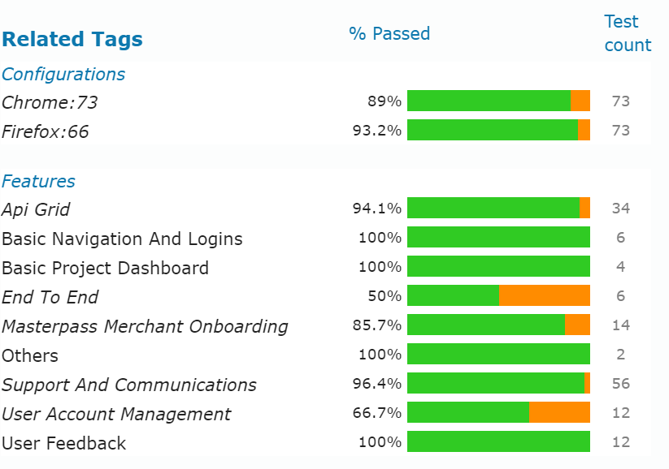
FUTURE REPORT

Slide 8
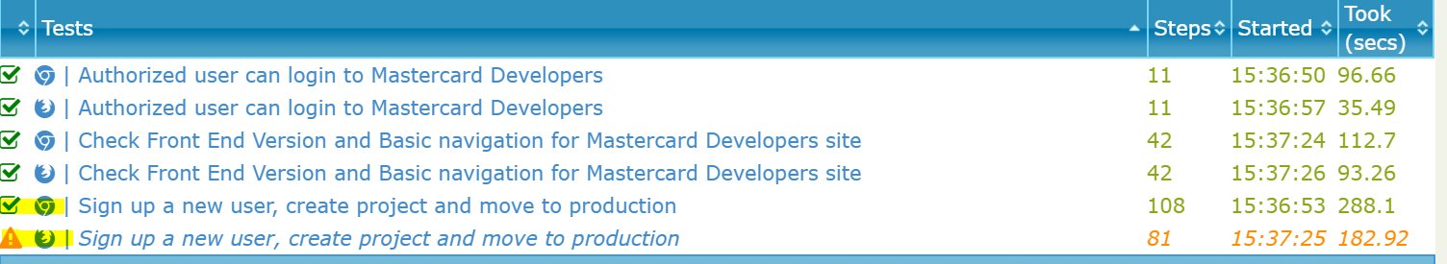
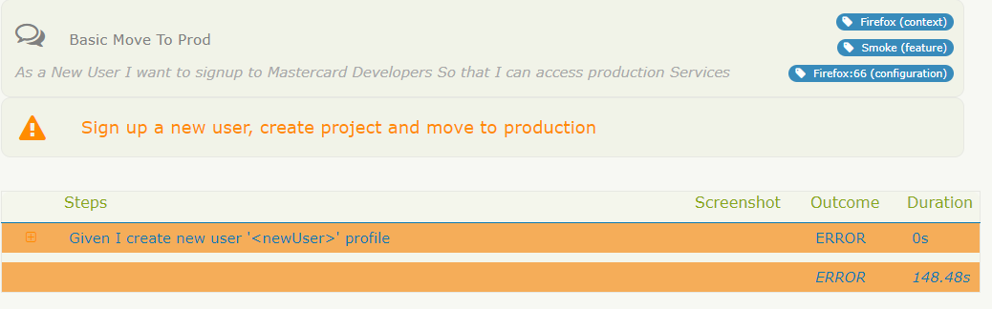
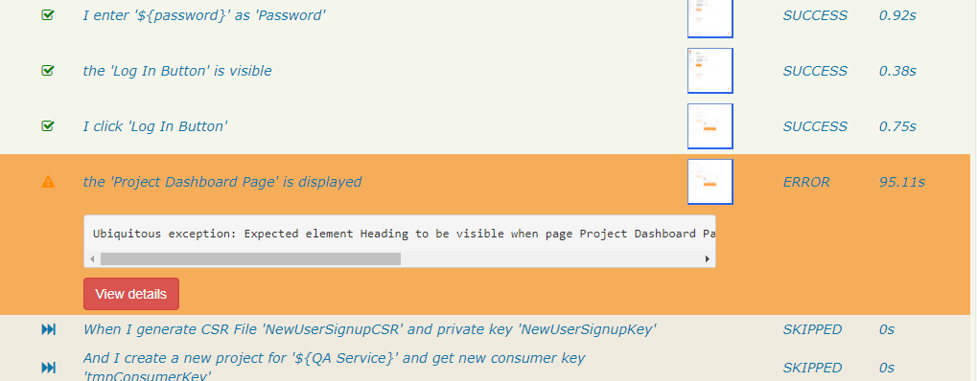
MULTI PLATFORM REPORT USE TO COMPARE TEST RESULTS ACROSS DIFFERENT CLIENT BROWSER PLATFORMS

Slide 9


