Slide 1
TRIVIA MAZE 1.0
TCSS 504 (Winter 2023)
Jesse Flores
Ji Lu
Xiying Long
Notes:
Greeting to audience from team members

Slide 2
Project Overview
Graphical User Interface (GUI) game named “Trivia Maze”
Model, View, Controller (MVC) Design Pattern
SQLite Database
Load and Re-load (pickling)
Notes:
The Project is aimed to delivering a graphical user interface (GUI) game named “Trivia Maze” to the player.
Maze is composed of different size of rooms. By default, the maze is set to 5x5 room.
Each door in the room will be connected to 1 question. Player can choose to answer the question or use golden key (but only 1 time opportunity). It’s player’s choice where and when do use it.
To win the game, player has to make their way from entrance to exit.
If all doors are locked and run out of key. Game will be terminated.
Model, View, Design Pattern(next slide)
All questions have to be saved to SQLite database.
Load and Re-load will be covered by Jesse.

Slide 3
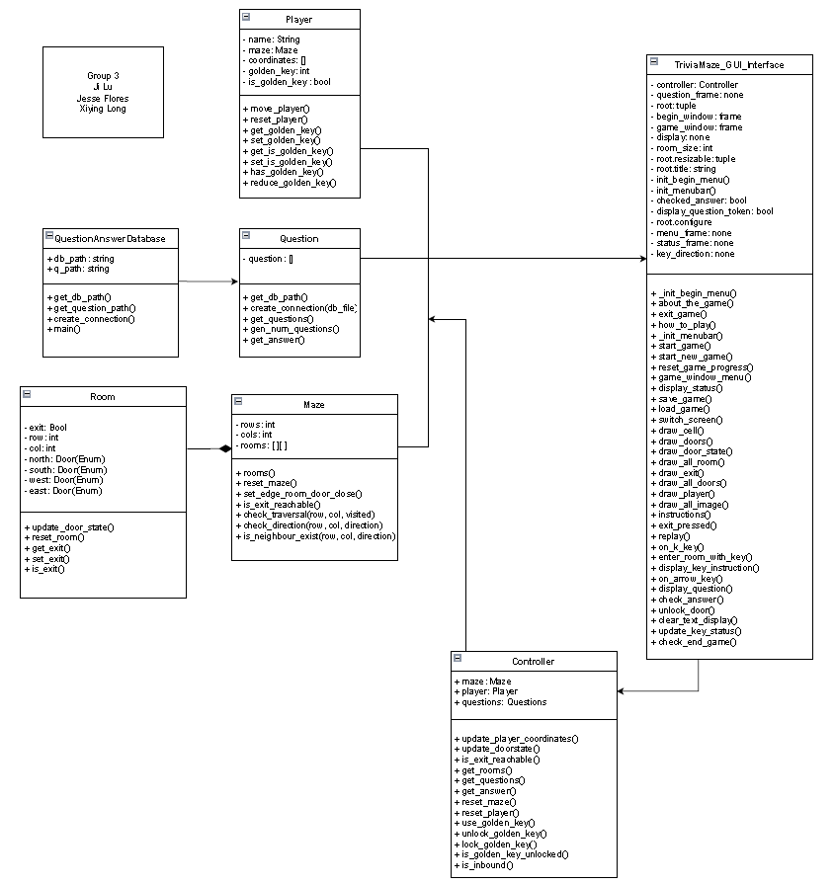
UML Diagram
View
Model
Controller
Notes:
MVC is used to separate the application logic into 3 interconnected components.
Model: left 5 classes. It will provides an interface to retrieve, update ,and delete data and other operations related to data.
View: is responsible for rendering the data and providing an interface for the player to interact with the application. It retrieves data from model and sends players input back to the controller.
Controller: served as an intermediary between Model and View. Receiving player’s input via view, interacting with Model to retrieve and update data, and sends data back to the View for rendering.

Slide 4
Project Demo
Live demo
Winning scenario
Losing scenario
Golden key feature
Notes:
Re-assigning command for “Instruction” to “how_to_play” method.
Demo without background music.
While demo, show win, lose scenarios and golden key features
Full speed demo without presenting.

Slide 5
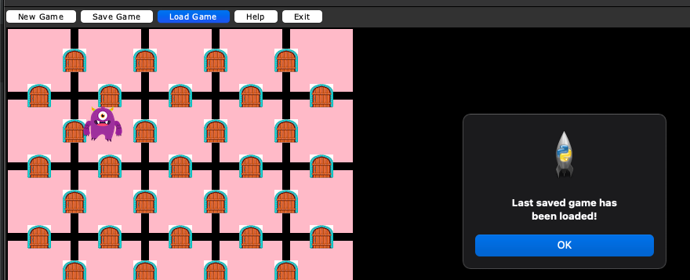
Save and Re-load (pickling)
We used pickle to save and load data to .pkl file.
Add menu buttons for save and load game.
Feedback for loading and saving game.
Notes:
1. Save and Re-load functions while showing the demo.

Slide 6
Problems and Future Work
Problems:
Git conflicts
Compatibility

Slide 7
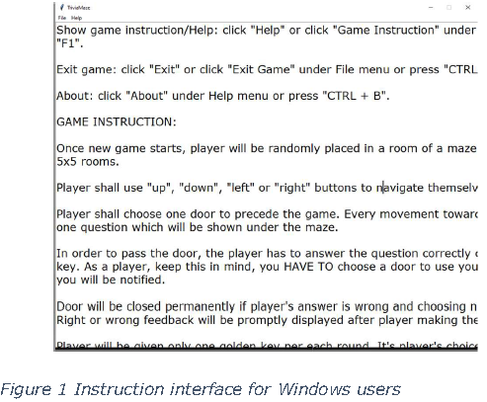
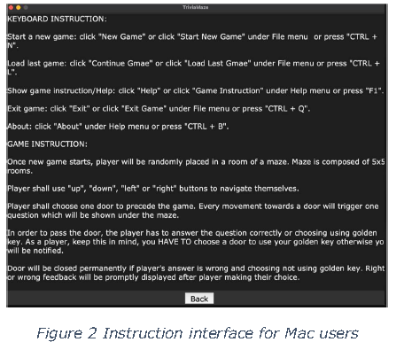
Problems and Future Work

Slide 8
Problems and Future Work (Cont’d)
Future Work:
Difficulty level
Legend

Slide 9
Lesson Learned
GUI
SQLite Database
Pivotal Tracker
Toggle
MVC Pattern
Communication
Teamwork

Slide 10
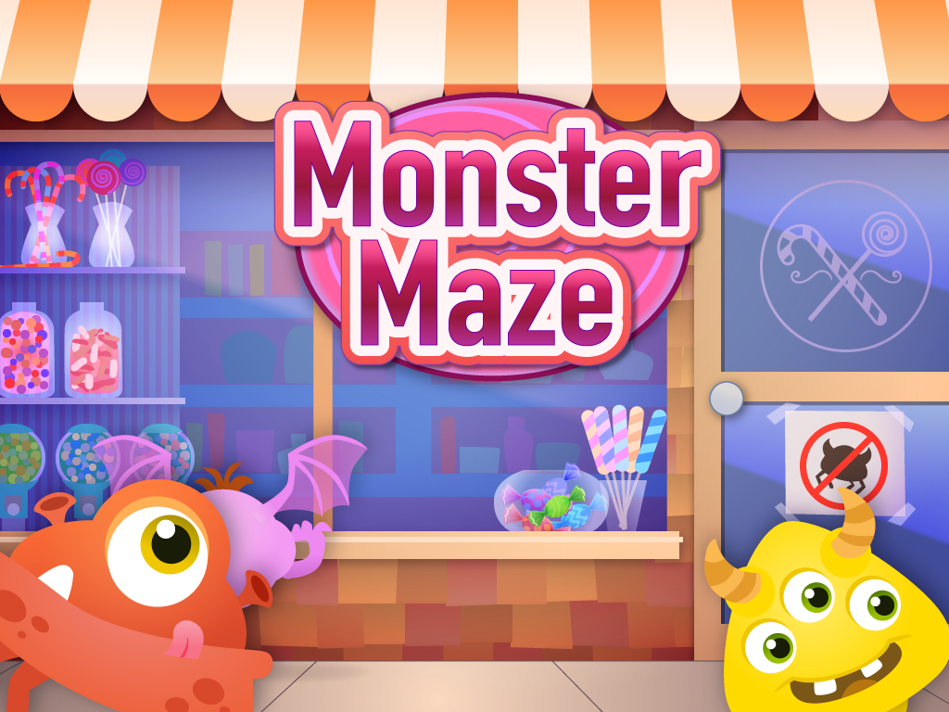
Question/Comments?

