Slide 1
Predict Ames House Prices
Laurie Janssen
BA 280

Slide 2
Objective and Purpose
Achieve 80% model performance for Ames housing sale prices
Tools
Excel to see range of values by attribute
PowerBI machine learning model

Slide 3
Process
Started with 26 variables
Reduced variables
Top predictors
Above ground living area and lot area
Exterior quality average/typical (TA)
Year built and remodel added
2-3 car garage
1st floor and total basement sqft
Overall quality is 8
PowerBI low correlation variables
MSzoning
Lotfrontage
Condition 1, 2, exterior, bsmt
Bldgtype
Roof or house style
Bsmt SF or fintype2
Centralair and electrical
Garage yrbuilt, finish and area
Pool, fence, and misc
Month sold

Slide 4
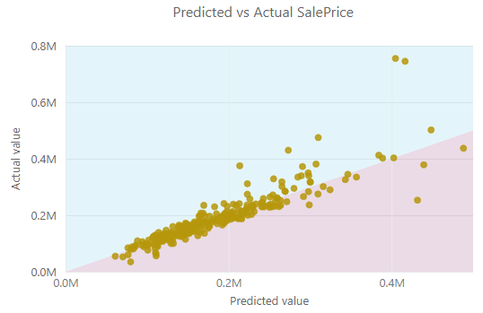
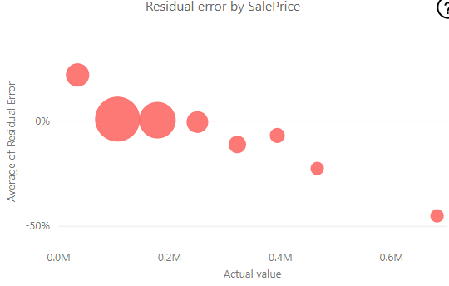
Final Model Results = 80%

Slide 5
Questions?

