Slide 1
Precision Medicine: Integrated and Relational Database Design Concept
Lei Jiang
Liang Huang

Slide 2
Precision Medicine/ Personalized Medicine
Delivers individually tailored therapy based on the patient’s disease subtype (Servant et al., 2014).
Selects the most effective cancer treatments based on biomarkers.
Genomic testing
Used to identify patient’s gene expression profiles to determine the corresponding sensitive targeted therapies.

Slide 3
Precision Medicine/ Personalized Medicine
Delivers individually tailored therapy based on the patient’s disease subtype (Servant et al., 2014).
Selects the most effective cancer treatments based on biomarkers.
Genomic testing
Used to identify patient’s gene expression profiles to determine the corresponding sensitive targeted therapies.

Slide 4
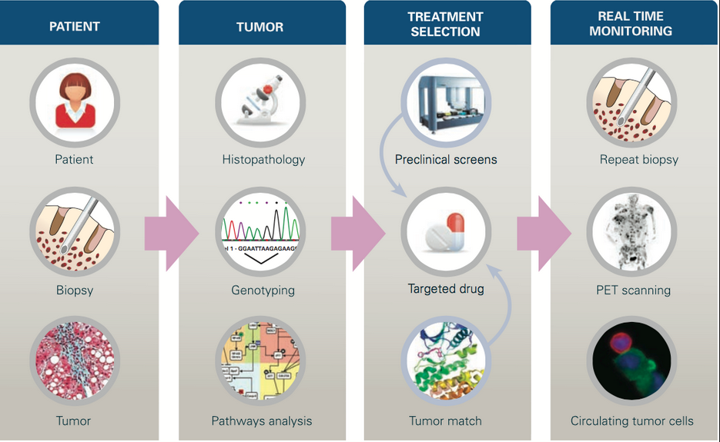
Precision Medicine

Slide 5
Precision Medicine

Slide 6
Precision Medicine
Biotechnology + Data Science
-> Actionable Insights

Slide 7
Advantages of Precision Medicine
Avoids unnecessary treatments, reduces toxicity, and significantly improves outcome.
Actionable insights to prevent, diagnose (early detection) and treat diseases.
Potential to find cure for currently lethal diseases.
Machine learning allows predict drug response and develop diagnostics.

Slide 8
Advantages of Precision Medicine
Avoids unnecessary treatments, reduces toxicity, and significantly improves outcome.
Actionable insights to prevent, diagnose (early detection) and treat diseases.
Potential to find cure for currently lethal diseases.
Machine learning used in precision medicine allows predict drug response and develop diagnostics.

Slide 9
Clinical Use of Genomic Testing on Biomarkers
Standard in use:
Oncotype DX:
Breast cancer
Colon cancer
Prostate cancer
Chemotherapy, Radiation, Aggressive Treatment, or Surgery
Over 1 million patients tested in more than 90 countries

Slide 10
Clinical Use of Genomic Testing on Biomarkers
Standard in use:
Oncotype DX:
Breast cancer
Colon cancer
Prostate cancer
Chemotherapy, Radiation, Aggressive Treatment, or Surgery
Over 1 million patients tested in more than 90 countries

Slide 11
Clinical Use of Genomic Testing on Biomarkers
PD-L1 expression testing: for Lung cancer (Mascaux et al. 2018)
Biomarkers for Immunotherapies
Becoming standard:
Biomarkers for Pancreatic Cancer (Dimitrakopoulos et al. April 3rd, 2019)

Slide 12
Clinical Use of Genomic Testing on Biomarkers
PD-L1 expression testing: for Lung cancer (Mascaux et al. 2018)
Biomarkers for Immunotherapies
Becoming standard:
Biomarkers for Pancreatic Cancer (Dimitrakopoulos et al. April 3rd, 2019)

Slide 13
Motivation for Data Integration
Current Lack of Integrated Data Source
Existing Bioinformatics Databases are mostly single omics.
ENCODE, UCSC Genome Browser, and Cancer Genome Atlas project (TCGA).
A few integrative DB
The Multi-Omics Profiling Expression Database (MOPED)
Includes transcriptomics and proteomics information from publicly available studies on model organisms and humans
Genotype-Tissue Expression (GTEx) (on-going effort)
Includes Gene expression data(WES, RNA-sq), QTLs (mapping biomarker with phenotype), histology images (clinical).

Slide 14
Motivation for Data Integration
Current Lack of Integrated Data Source
Existing Bioinformatics Databases are mostly single omics.
ENCODE, UCSC Genome Browser, and Cancer Genome Atlas project (TCGA).
A few integrative DB
The Multi-Omics Profiling Expression Database (MOPED)
Includes transcriptomics and proteomics information from publicly available studies on model organisms and humans
Genotype-Tissue Expression (GTEx) (on-going effort)
Includes Gene expression data(WES, RNA-sq), QTLs (mapping biomarker with phenotype), histology images (clinical).

Slide 15
Motivation for Data Integration
Current Lack of Integrated Data Source
Existing Bioinformatics Databases are mostly single omics.
ENCODE, UCSC Genome Browser, and Cancer Genome Atlas project (TCGA).
A few integrative DB
The Multi-Omics Profiling Expression Database (MOPED)
Includes transcriptomics and proteomics information from publicly available studies on model organisms and humans
Genotype-Tissue Expression (GTEx) (on-going effort)
Includes Gene expression data(WES, RNA-sq), QTLs (mapping biomarker with phenotype), histology images (clinical).

Slide 16
Motivation for Data Integration
-Integration of multiple data sources provides more information for more accurate clustering analysis.
Integrated the clinical, genomic, and transcriptomic data
Performed integrative clustering
Classified triple-negative breast cancers into more subtypes and suggested precision treatment strategies accordingly (Jiang et al. 2019).
-Deep learning usually requires extremely large training sample size and rich features from multiple sources. Integrated data add complexity for model training, enable finer distinctions.

Slide 17
Motivation for Data Integration
-Integration of multiple data sources provides more information for more accurate clustering analysis.
Integrated the clinical, genomic, and transcriptomic data
Performed integrative clustering
Classified triple-negative breast cancers into more subtypes and suggested precision treatment strategies accordingly (Jiang et al. 2019).
-Deep learning usually requires extremely large training sample size and rich features from multiple sources. Integrated data add complexity for model training, enable finer distinctions.

Slide 18
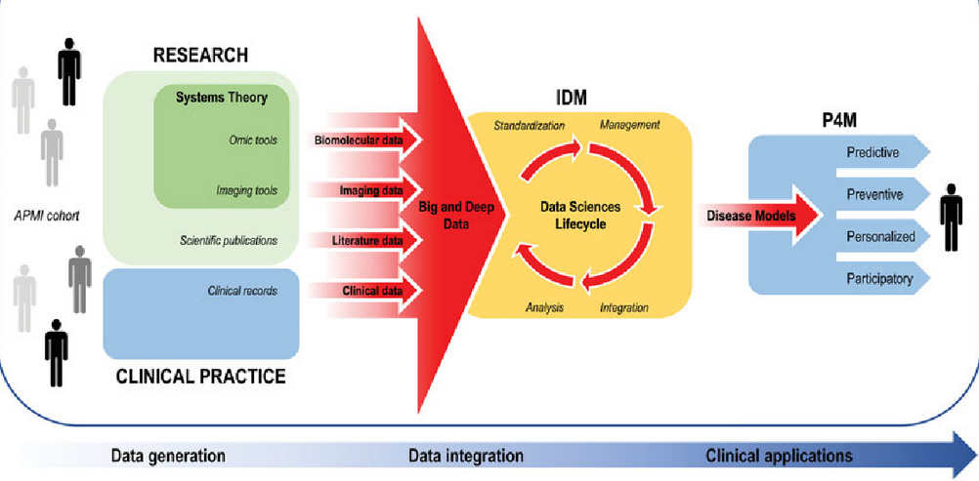
Motivation for Data Integration

Slide 19
Integrated Relational Database Approach
Most biological databases are in “flat files” format that are not easy to integrate with external data sources.
Relational databases allow integration of diverse types of information and efficient management of these large datasets.

Slide 20
Integrated Relational Database Approach
Most biological databases are in “flat files” format that are not easy to integrate with external data sources.
Relational databases allow integration of diverse types of information and efficient management of these large datasets.

Slide 21
Integrated Relational Database Approach
Queryable
Integrate all the related data in one query and extract or subset the data for deeper analysis.
Improve the efficiency for storing and querying the data.

Slide 22
Challenges
Large-scale of Data
Create a smaller size database to prove the concept
Dramatic Increase in Genomics Data.
Next Generating Sequencing (NGS) technology making sequencing of human genomes cost effective. The cost falls from 10 million dollars a decade ago to 1 thousand dollars today.
Enormous amount of data generated from genomic tests.
Existing genomics database Sequence Read Archive (SRA) grows 10,000 times in the last decade.

Slide 23
Challenges
Large-scale of Data
Create a smaller size database to prove the concept
Dramatic Increase in Genomics Data.
Next Generating Sequencing (NGS) technology making sequencing of human genomes cost effective. The cost falls from 10 million dollars a decade ago to 1 thousand dollars today.
Enormous amount of data generated from genomic tests.
Existing genomics database Sequence Read Archive (SRA) grows 10,000 times in the last decade.

Slide 24
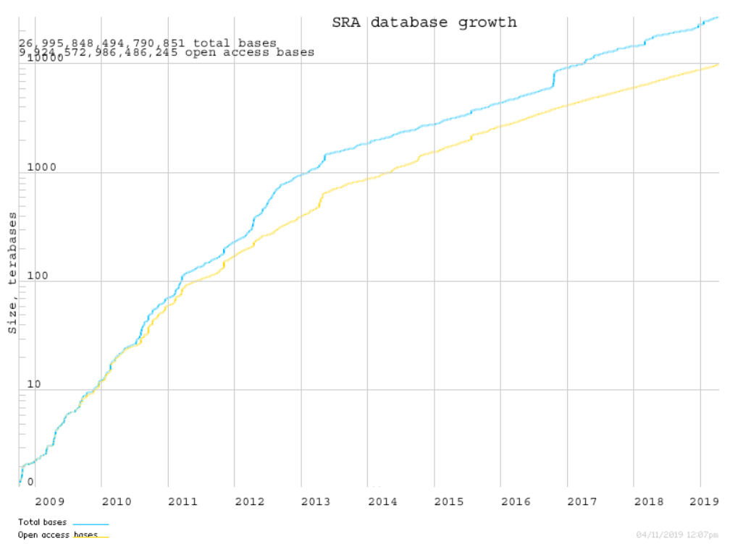
SRA growth

Slide 25
Challenges
Hard to access patient genotyping and phenotyping data due to privacy concern
simulated data
Various non-trivial datatypes -- VCF and BAM, a lot of data munging to get data from various Datatypes, File formats.
Biological data has extremely flexible schema. Normalization for biological data is impractical.

Slide 26
Challenges
Hard to access patient genotyping and phenotyping data due to privacy concern
simulated data
Various non-trivial datatypes -- VCF and BAM, a lot of data munging to get data from various Datatypes, File formats.
Biological data has extremely flexible schema. Normalization for biological data is impractical.

Slide 27
Methodology
Design the ER diagram
Normalization
Entities for a simplified data model
GenoType data, Biopsy data, PhenoType and Gene_Info.
Data Definition Language (DDL)
Data Manipulation Language(DML)
Populate patient genotyping data by simulated data (R code in Appendix).
Populate patient biopsy data from online data source.

Slide 28
Methodology
Design the ER diagram
Normalization
Entities for a simplified data model
GenoType data, Biopsy data, PhenoType and Gene_Info.
Data Definition Language (DDL)
Data Manipulation Language(DML)
Populate patient genotyping data by simulated data (R code in Appendix).
Populate patient biopsy data from online data source.

Slide 29
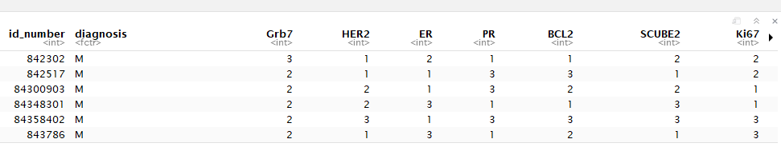
Methodology
Simulate the genomic test results data:
569x21 matrix for patients genomic test dataset with gene expression levels/Copy number range from 1-3. (All cancer patients data, so we do not have 0 value since it means no cancer. we do not know the actual underlie distribution though. so just used a normal distribution)
HER2-scores: The HER2 expression was scored using the HercepTest criteria. The HER2-score was based on a 0 to 3+ scale. 0 corresponded to tumour cells that were completely negative, 1+ corresponded to faint perceptible staining of the tumour cell membranes, 2+ corresponded to moderate staining of the entire tumour cell membranes and 3+ indicated strong circumferential staining of the entire tumour cell membranes creating a fishnet pattern. (Carlsson et al. paper in 2004. HER2 expression in breast cancer primary tumours and corresponding metastases)

Slide 30

Methodology
Simulate the genomic test results data:
569x21 matrix for patients genomic test dataset with gene expression levels/Copy number range from 1-3. (All cancer patients data, so we do not have 0 value since it means no cancer. we do not know the actual underlie distribution though. so just used a normal distribution)
HER2-scores: The HER2 expression was scored using the HercepTest criteria. The HER2-score was based on a 0 to 3+ scale. 0 corresponded to tumour cells that were completely negative, 1+ corresponded to faint perceptible staining of the tumour cell membranes, 2+ corresponded to moderate staining of the entire tumour cell membranes and 3+ indicated strong circumferential staining of the entire tumour cell membranes creating a fishnet pattern. (Carlsson et al. paper in 2004. HER2 expression in breast cancer primary tumours and corresponding metastases)

Slide 31
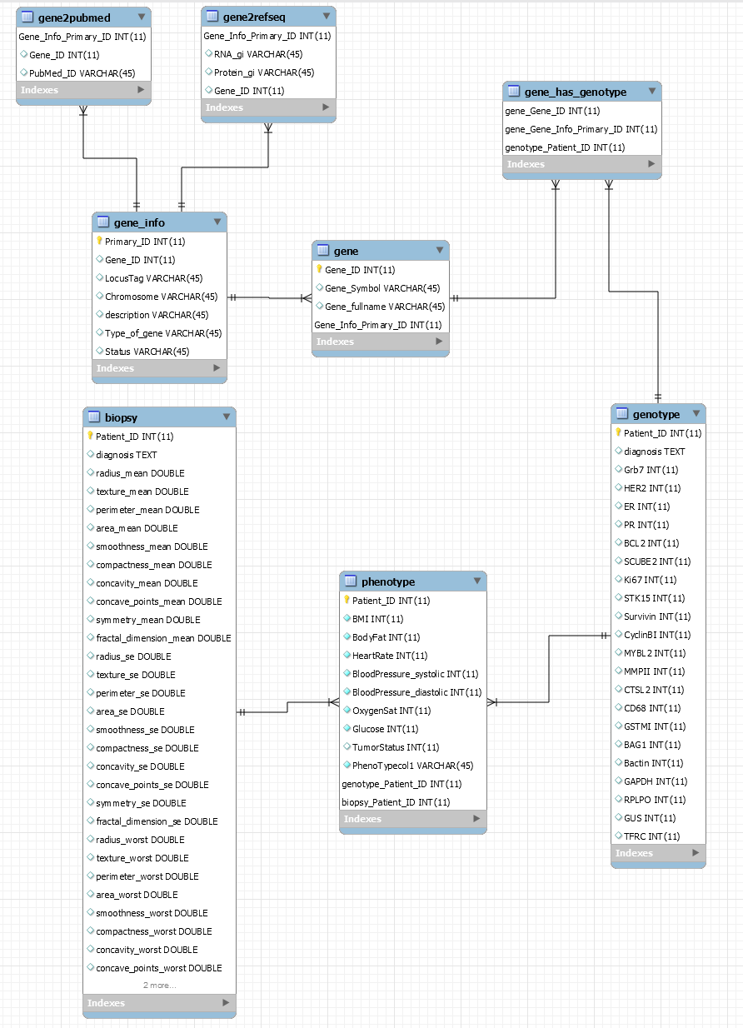
Results

Slide 32
Demonstration
SELECT *
FROM (SELECT * FROM biopsy) b
JOIN (SELECT * FROM genotype) g
ON b.Patient_ID = g.Patient_ID
WHERE HER2=2
GROUP BY g.diagnosis
ORDER BY g.BCL2 DESC LIMIT 10;

Slide 33
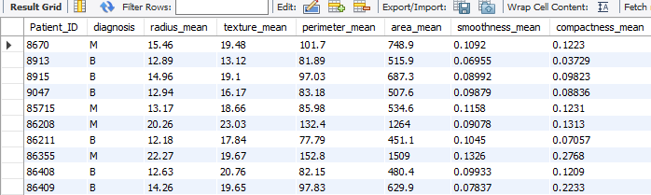
Patient_ID diagnosis

Slide 34
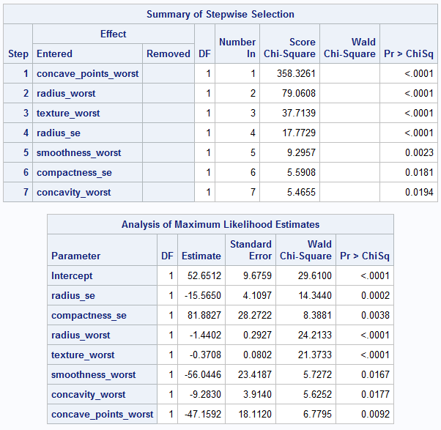
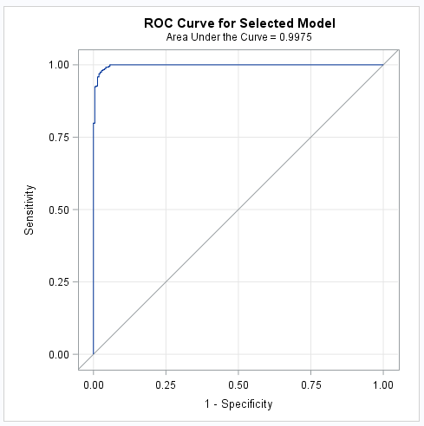
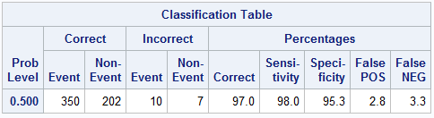
Logistic Regression Stepwise variable Selection

Slide 35
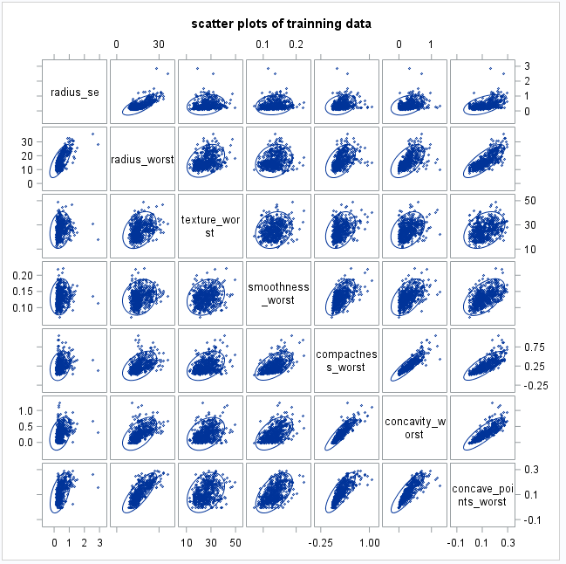
Scatter plots of selected variables

Slide 36
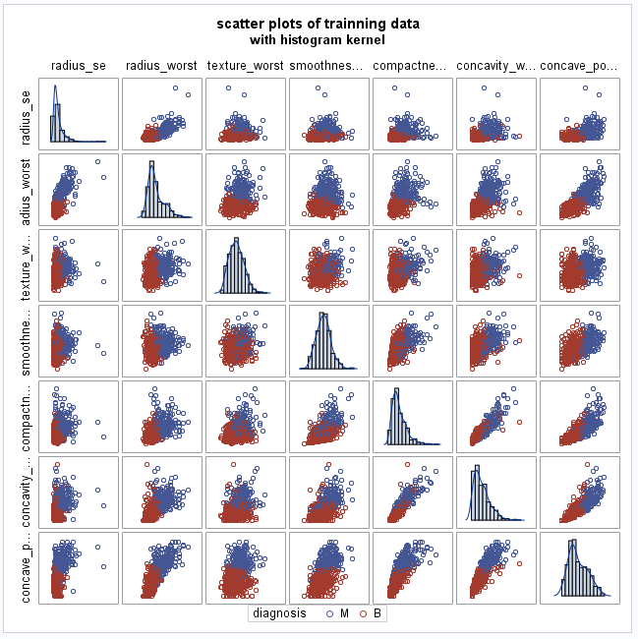
Scatter Plots of selected variables

Slide 37
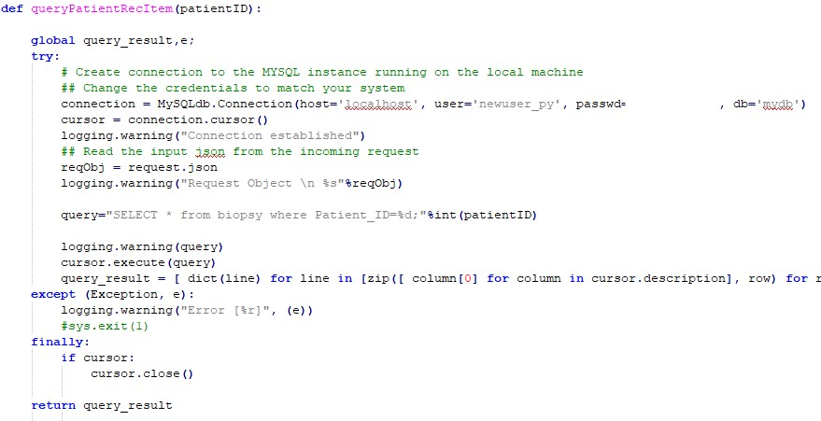
queryPatientRecItem(patientID)

Slide 38
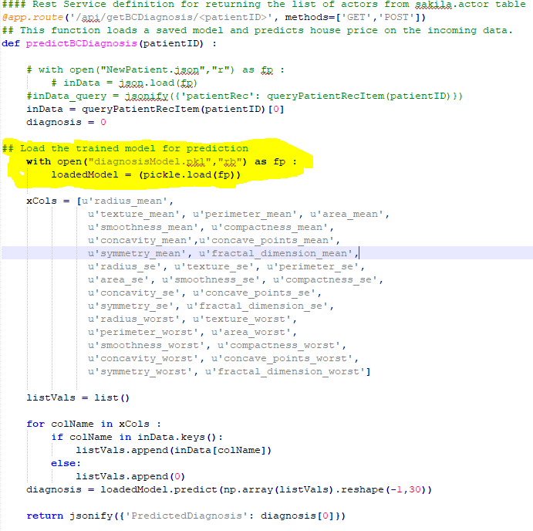
predictBCDiagnosis(patientID)

Slide 39
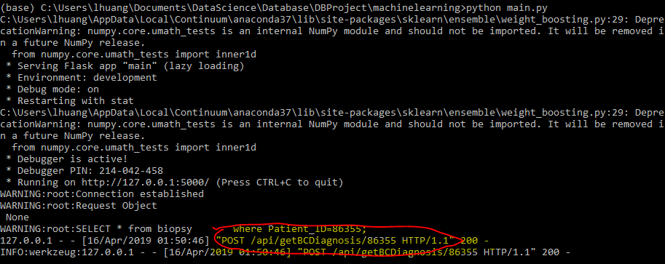
main.py "POST /api/getBCDiagnosis/86355 HTTP/1.1"

Slide 40
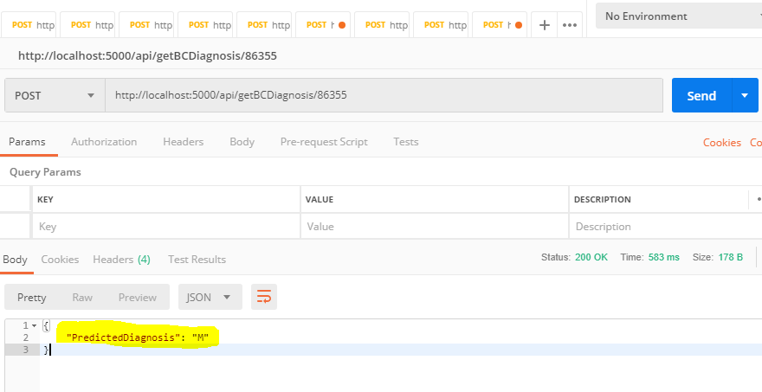
http://localhost:5000/api/getBCDiagnosis/86355

Slide 41
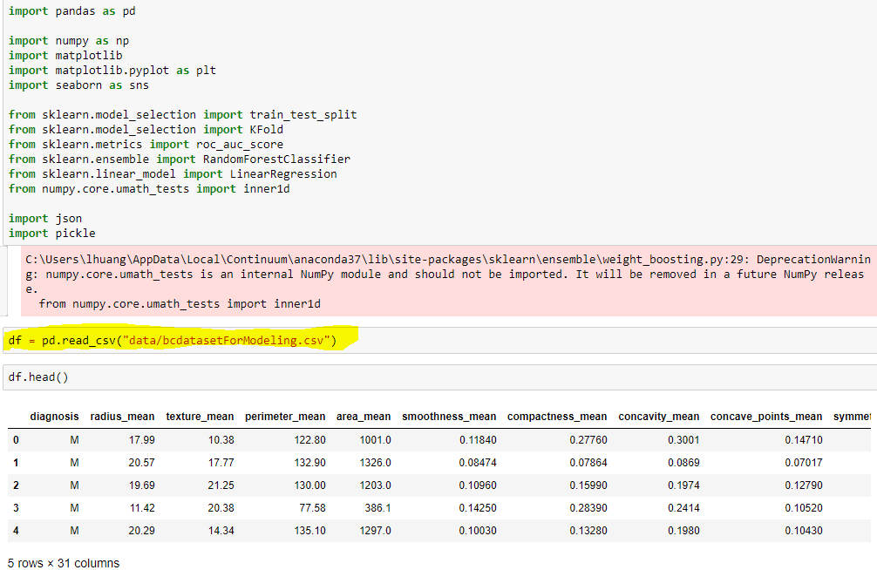
Modeling

Slide 42
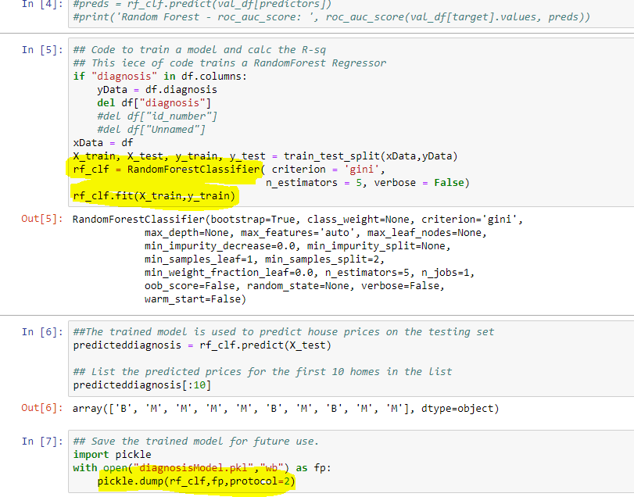
Modeling

Slide 43
CONCLUSIONS
Successfully designed the ER diagram and use normalization techniques to improve the efficiency for storing and querying the data.
Populated the database with patient genotyping data by simulation and patient biopsy data from online data source.
Demonstrated the database function by writing SQL queries to extract or subset for deeper analysis.

Slide 44
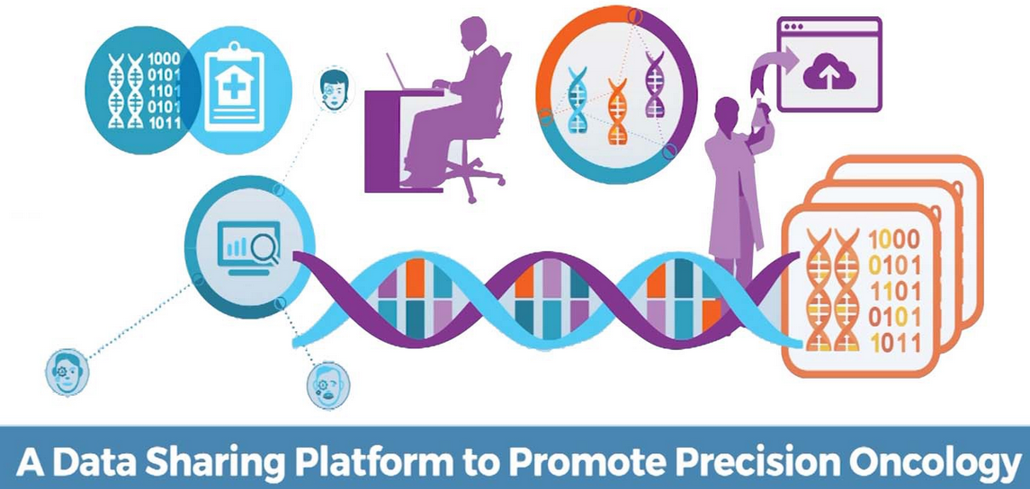
CONCLUSIONS
Online Prediction Platform (REST API) for Breast Cancer diagnosis.
Deployed machine learning model (RandomForestClassifier) for breast cancer diagnosis prediction.

Slide 45
CONCLUSIONS
Significance of our database :
Real-world application of DB knowledge.
Data science helps generating value from data.
Gain personalized biological information to diagnose and optimize treatment decisions for many types of cancers.
Potentially aid in biomarker or drug discovery. Easy to retrieve useful information for further analysis such as deep learning algorithms.

Slide 46
NEXT STEP
For real life large datasets, we need to utilize cloud computing such as AWS or Google Cloud Platform.
Cloud-based AutoDeepLearning Platform for integrative analysis of NGS, WES, and clinical data to predict the subtypes of cancer (DNNClassifier in TensorFlow).
Integrate from more data sources
Proteomics
Environmental factors
DietType
Excerises habit
More outside database
TCGA
OMIM
Genotype-Tissue Expression (GTEx)
Time series database
Liquid biopsy technology (non-invasive and only need 5 ml blood draw) allows for monitoring the ctDNA change before and after operation/treatment
Minimal residual disease (MRD) detection: routine clinical practice in acute lymphoblastic leukemia (ALL).
Evaluate the efficacy of innovative drugs.

Slide 47
NEXT STEP
For real life large datasets, we need to utilize cloud computing such as AWS or Google Cloud Platform.
Cloud-based AutoDeepLearning Platform for integrative analysis of NGS, WES, and clinical data to predict the subtypes of cancer (DNNClassifier in TensorFlow).
Integrate from more data sources
Proteomics
Environmental factors
DietType
Excerises habit
More outside database
TCGA
OMIM
Genotype-Tissue Expression (GTEx)
Time series database
Liquid biopsy technology (non-invasive and only need 5 ml blood draw) allows for monitoring the ctDNA change before and after operation/treatment
Minimal residual disease (MRD) detection: routine clinical practice in acute lymphoblastic leukemia (ALL).
Evaluate the efficacy of innovative drugs.

Slide 48
NEXT STEP
For real life large datasets, we need to utilize cloud computing such as AWS or Google Cloud Platform.
Cloud-based AutoDeepLearning Platform for integrative analysis of NGS, WES, and clinical data to predict the subtypes of cancer (DNNClassifier in TensorFlow).
Integrate from more data sources
Proteomics
Environmental factors
DietType
Excerises habit
More outside database
TCGA
OMIM
Genotype-Tissue Expression (GTEx)
Time series database
Liquid biopsy technology (non-invasive and only need 5 ml blood draw) allows for monitoring the ctDNA change before and after operation/treatment
Minimal residual disease (MRD) detection: routine clinical practice in acute lymphoblastic leukemia (ALL).
Evaluate the efficacy of innovative drugs.

Slide 49
NEXT STEP
For real life large datasets, we need to utilize cloud computing such as AWS or Google Cloud Platform.
Cloud-based AutoDeepLearning Platform for integrative analysis of NGS, WES, and clinical data to predict the subtypes of cancer (DNNClassifier in TensorFlow).
Integrate from more data sources
Proteomics
Environmental factors
DietType
Excerises habit
More outside database
TCGA
OMIM
Genotype-Tissue Expression (GTEx)
Time series database
Liquid biopsy technology (non-invasive and only need 5 ml blood draw) allows for monitoring the ctDNA change before and after operation/treatment
Minimal residual disease (MRD) detection: routine clinical practice in acute lymphoblastic leukemia (ALL).
Evaluate the efficacy of innovative drugs.

Slide 50
ACKNOWLEDGMENT
We would like to thank James Clay for the preliminary work.
And we are very honored to get initial guidance of this project from Dr. George Bell.
We would like to thank Dr. Engels and all the students in Database class for the semester. We learned a lot!

