Slide 1



2018
酷天气
Android第3组
周文彬 钟虎 李静波 周河江

Slide 2
CONTENTS
Start
Process
End

Slide 3
S
T
A
R
T

Slide 4
What has been chosen
项目名称 | 酷天气
项目成员 | 周文彬 钟虎 李静波 周河江
项目描述 | 浏览天气； 浏览新闻资讯， 并且实现用户注册登录注销功能
ADD TO OUR TEAM
ADD TO OUR TEAM
ADD TO OUR TEAM
In this part you should describe your business to the investor. You have to make sure he can make it clear
In this part you should describe your business to the investor. You have to make sure he can make it clear
In this part you should describe your business to the investor. You have to make sure he can make it clear

Slide 5
Early Stage
Metaphase
Later Stage
策划阶段，需求分析，分析设计
It’s most important in all.
编码阶段，实现需求分析中的功能，测试每个实现的功能，UI美化
In this part, you can show your exquisite skills
集成测试阶段，交付项目成果
It does not mean that everything is ok. There are much unbelievable events waiting for you.

Slide 6
At the beginning
Everyone has different roles and was distributed with different work.
Role of member
周文彬小组长，钟虎系统分析师，李静波产品经理兼需求分析师，周河江CM兼需求分析师
Division of labor
周文彬小组长负责项目进度编码，钟虎完成分析设计，李静波，周河江完成需求分析，测试等工作

Slide 7
P
R
O
C
E
S
S

Slide 8
Analysis And Code
后期维护
需求分析
功能编码
项目交付
策划阶段
集成测试
分析设计
IT is our best state
按照流程走。每个人分一些任务。在每一个阶段都事情做。

Slide 9
CODE
BUG
write
debug
不停的寻找，不停的尝试，不停的完成
每一次尝试都不停的有bug，心情那个纠结；每一次解决bug，心情有事无比的舒畅

Slide 10
F
E
N
D

Slide 11
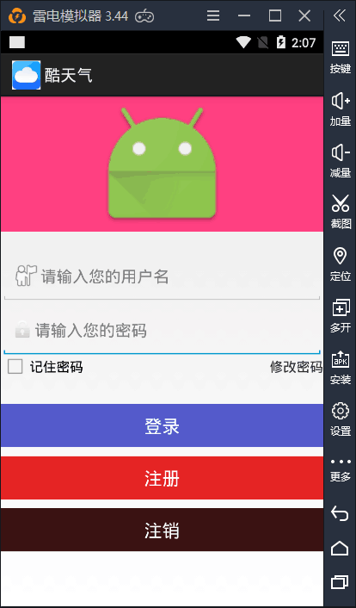
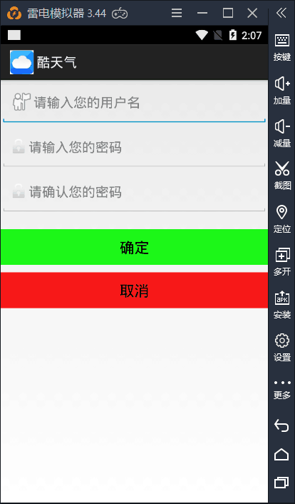
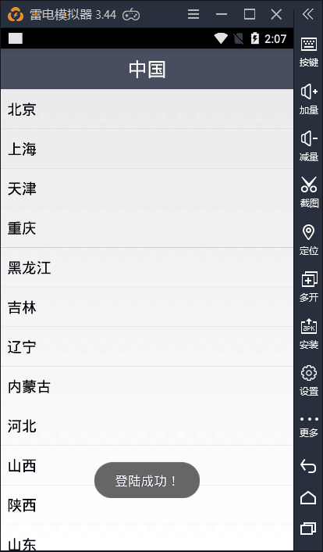
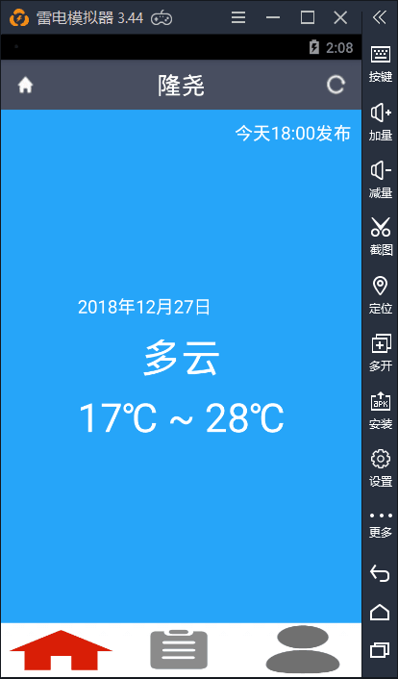
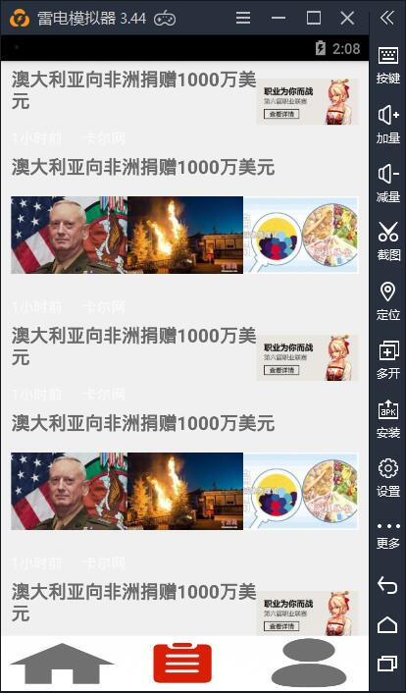
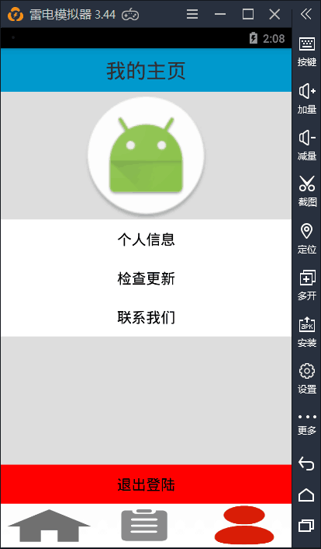
Achievements
F

Slide 12
Summery
Basic Knowledge
Professional Skills
了解一个新的东西，对Android开发更加熟练
一次次的课程学习，不如一次实践来的实际，实地的开发，很快的增进自己的技能，变得更加娴熟
Team Work
Attitude
增进自己的团队意识，学会team work，树立一个个小目标，向着大目标迈进
面对不会的，坚持学习，向人请教，求助网络，不要浪费时间。磨练自己的脾气。

Slide 13
THANK YOU
Android
第三组
Four short words sum up what has lifted most successful individuals above the crowd a little bit more.

