Slide 1
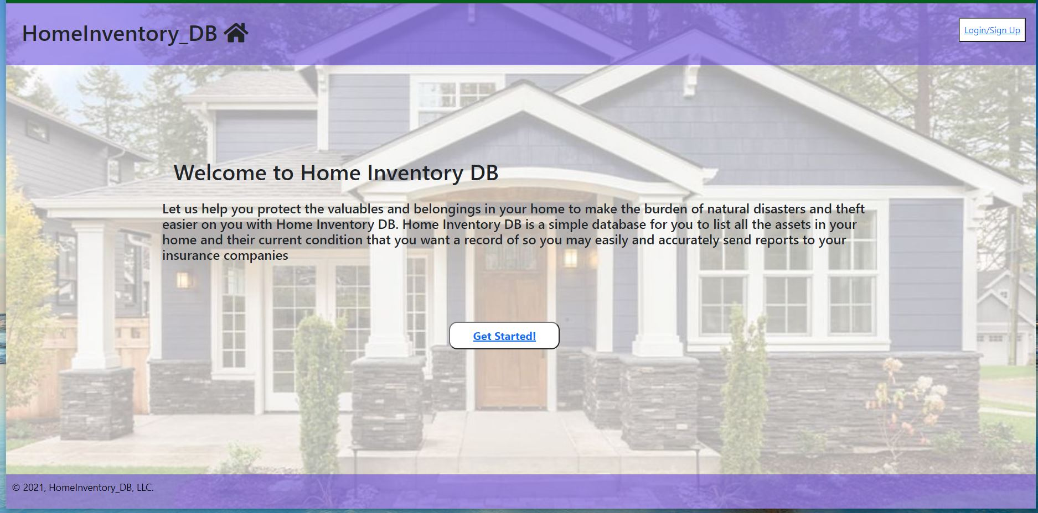

Slide 2

A home is much more than a place to live. It’s where we feel safest and where we cultivate our lives. One of the biggest violations is a stranger forcing their way in and taking your possessions. Not just your possessions, but the things that belong in the museum of your life.
Unfortunately, the makers behind Home Inventory know from first hand experience how devastating it can be to have your privacy violated and irreplaceable items looted. After an event like this happens, the last thing you want to do is deal with insurance.

Slide 3

Easily keep track of everything in your home with HomeInventory_DB. We make it so you can know at all times the current value of the items in your home.
We came up with the idea for HomeInventory_DB when the group first sat down, discussed project ideas, and found out we all had similar stories of wanting to just keep track of everything in our homes.
Though our user story isn’t completely unique, it’s useful and something everyone can unite on. No matter where you live, you should insure the items in your home. HomeInventory_DB does exactly this.

Slide 4
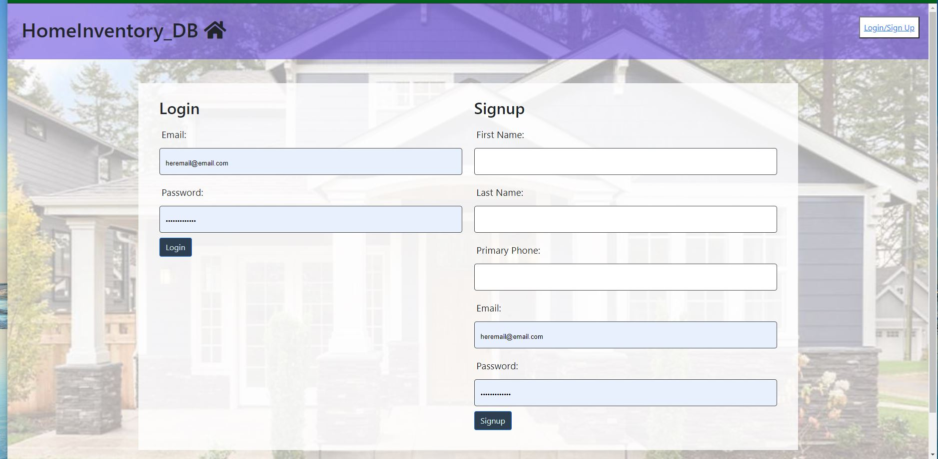

Slide 5
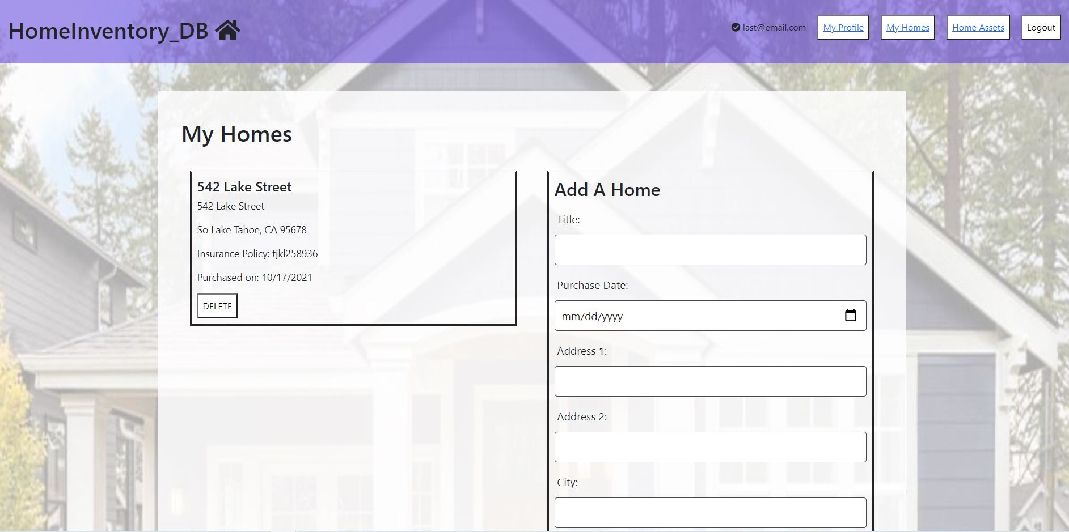

Slide 6
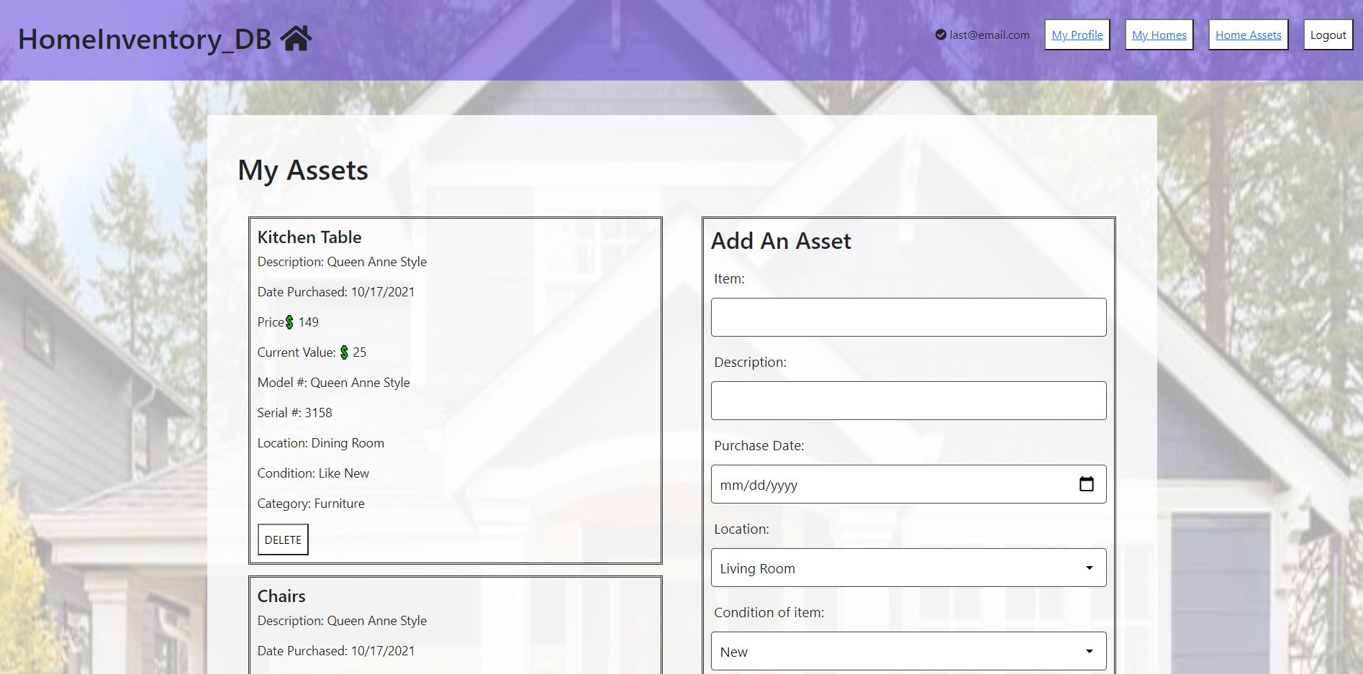

Slide 7
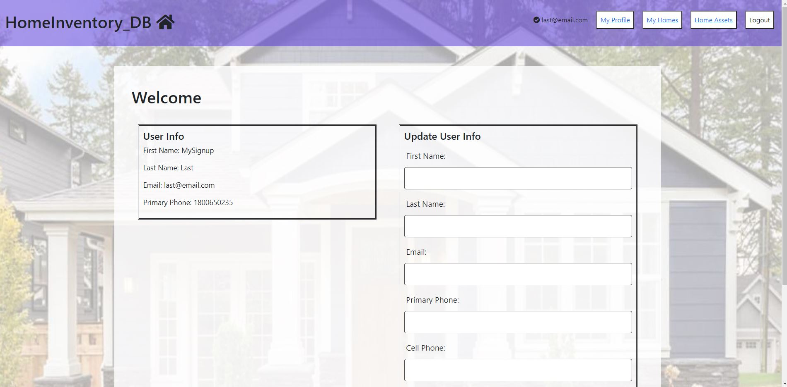

Slide 8

For future developments, we plan for the following items:
We would like to see more design flair when it comes to an app that’s more aesthetically pleasing.
Reporting so that the user can print a pdf or download the data in csv formation or spreadsheet. When a user goes to type in their location, they will be able to choose their city and location from a dropdown menu.
Currently we only have assets linked to users, not specific homes. Moving forward we would like to link assets to homes and users.
Include photograph of the assets, & home.
Better security and the ability for a user to change their password.
Ability to scan receipts to keep a copy and enter the info into the asset record.
Update the "Homes" to include storage locations and Business locations.
Reporting so that the user can print a pdf or download the data in csv formation or spreadsheet.
Interfaces with sites for appraisal values for assets and home values.
Query options so the user can choose what they want to query.
Include a place to mark if the item is donated to a charity and the name of the charity for tax purposes

Slide 9

https://powerful-dawn-85424.herokuapp.com/
https://github.com/ljbrewer/HomeInventory

