Slide 1
ETHOS A Project with Privacy by Design
Indiana University
L Jean Camp
&
Kay Connelly • Lesa Huber • Kalpana Shankar

Slide 2


Slide 3
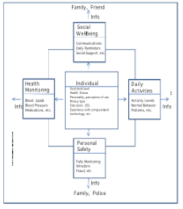
Domains

Slide 4
Goals
Data minimizing design
Clear statements of the design goals
User empowerment in the ability to have three settings: on, off and mute.

Slide 5
Empowerment
On: full functionality.
Pause: the device is on but not sending any information.
Off: others are notified that it is off.

Slide 6
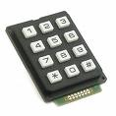

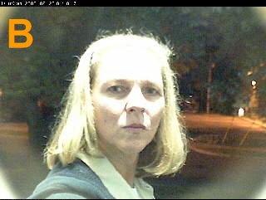
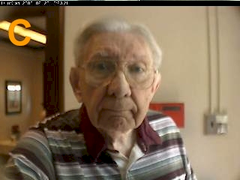
Control

Slide 7
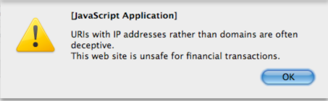
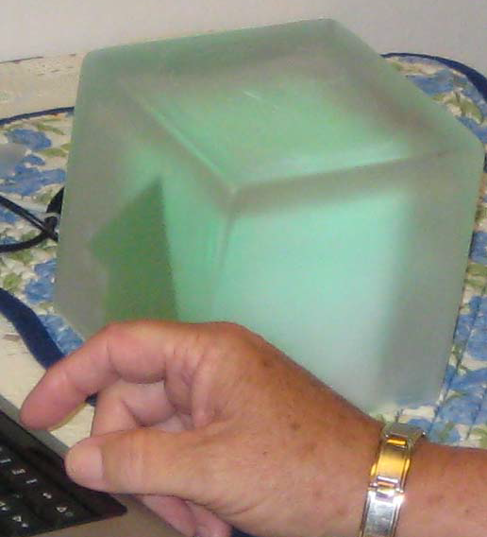

Transparency

Slide 8
What Matters?
Activity
Granularity
Perceived utility
Control

Slide 9
Conclusions
Minimize data
Make control meaningful
Make control usable
Empower, don’t overwhelm

