Slide 1

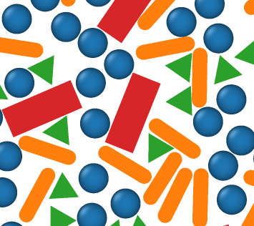

(a)
plan simulation
define problem
baseline parameter?
tunable parameter?
analyze data
dimension?
particles shape?
ensemble?
order?
density?
run simulation
simulation engine?
(b)
ColPackAgent
knowledge
tool
colpackMCP
colpack.skill
MCP tool:
-setup problem -run simulation
-plan simulation -analyze data
SKILL.md
-setup -execute
-plan - analyze
initialize
compress
sample
MC engine
colpack.py
workflow scripts

