Slide 1


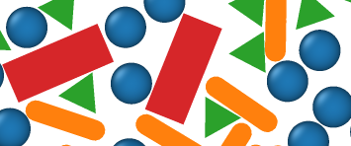

ColPackAgent
LLM
tool
knowledge
colpack MCP
colpack skill
colpack.py
MCP tool:
problem setup
plan simulation
run simulation
analyze data
SKILL.md
references:
-setup -execute
-plan - analyze
workflow scripts
MC engine
initialize
compress
sample

Slide 2
ColPackAgent
LLM
tool
knowledge
colpack MCP
colpack skill
colpack.py
MCP tool:
problem setup
plan simulation
run simulation
analyze data
SKILL.md
references:
-setup -execute
-plan - analyze
workflow scripts
MC engine
initialize
compress
sample

