Slide 1

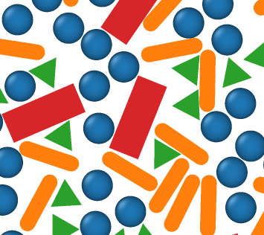

tool
ColPackAgent
knowledge
colpack MCP
colpack skill
MCP tool:
-setup problem -run simulation
-plan simulation -analyze data
SKILL.md
-setup -execute
-plan - analyze
initialize
compress
sample
MC engine
colpack.py
workflow scripts

