Slide 1
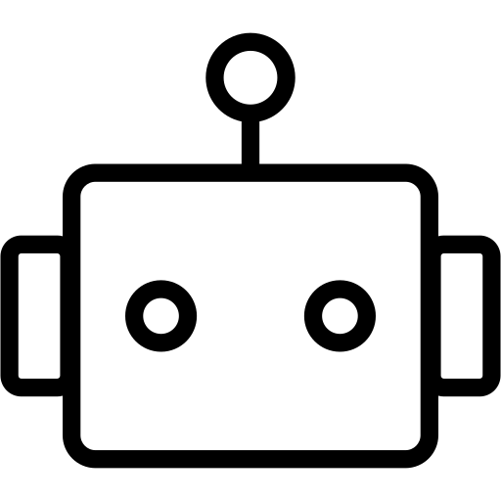

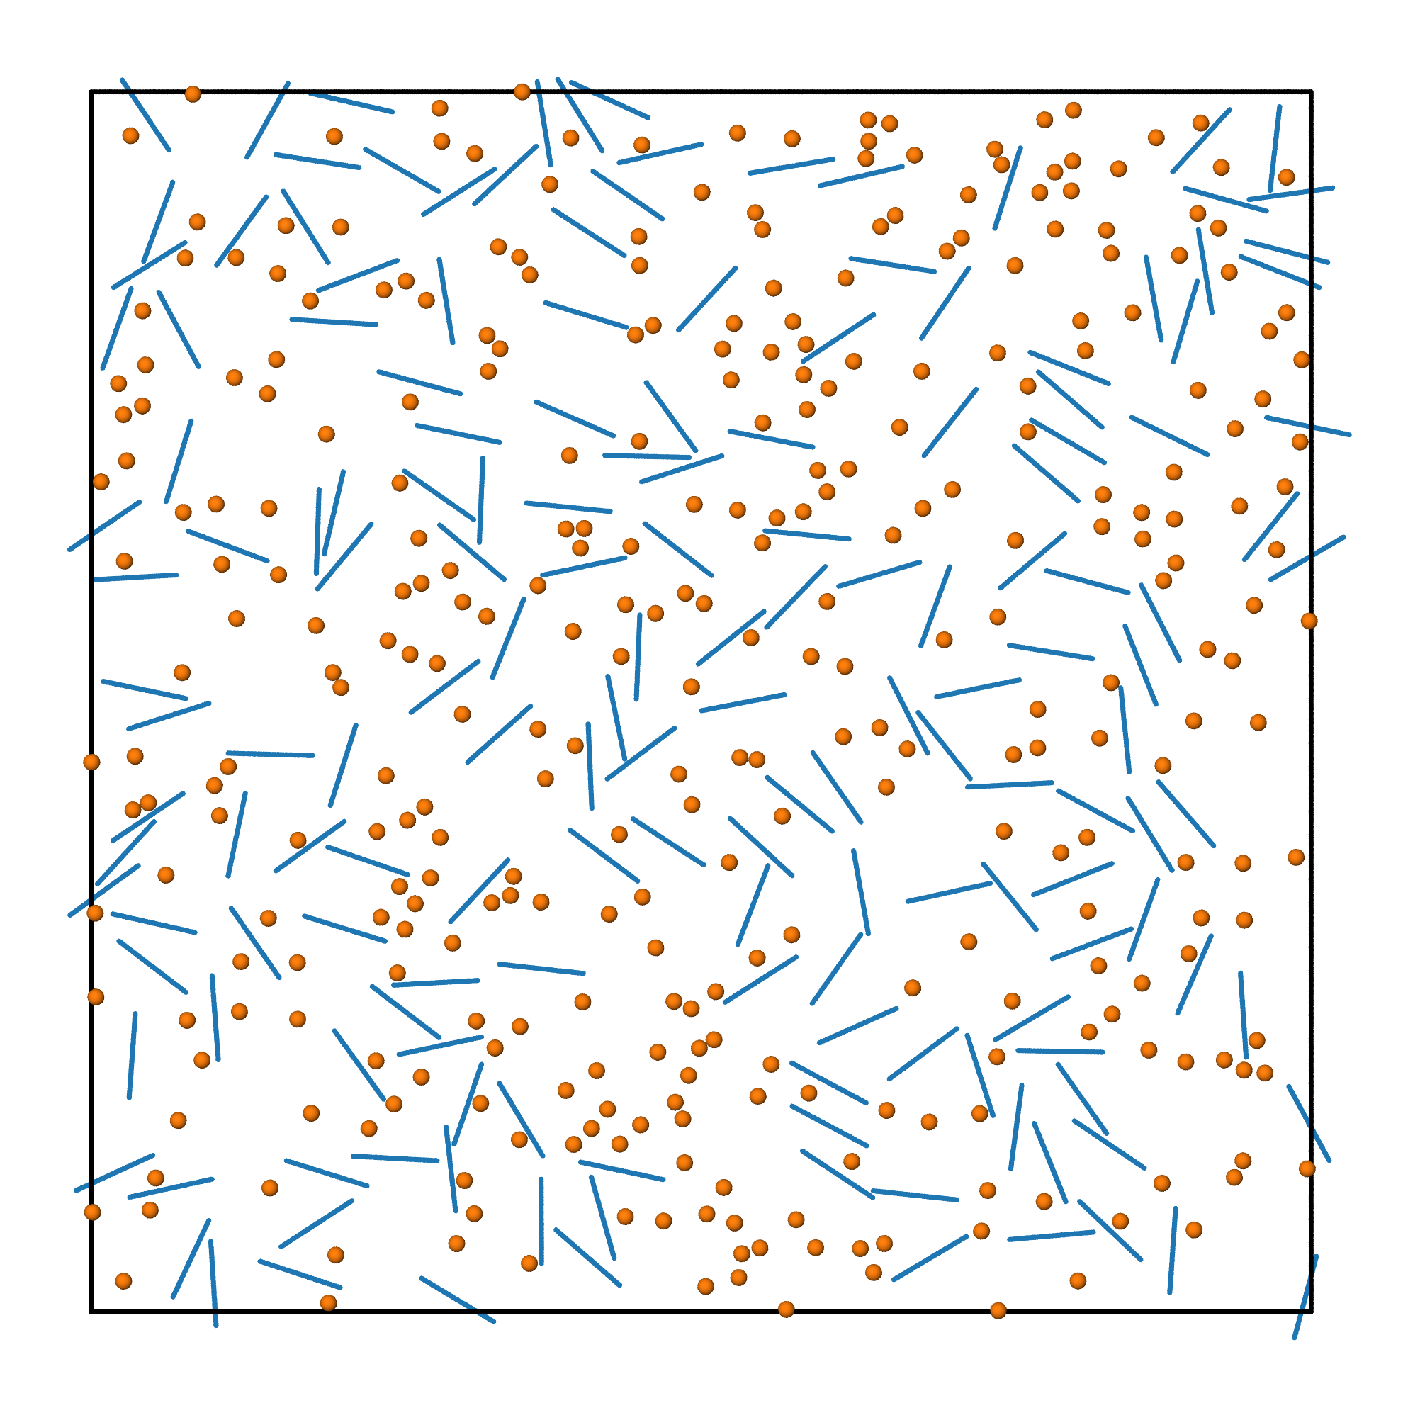
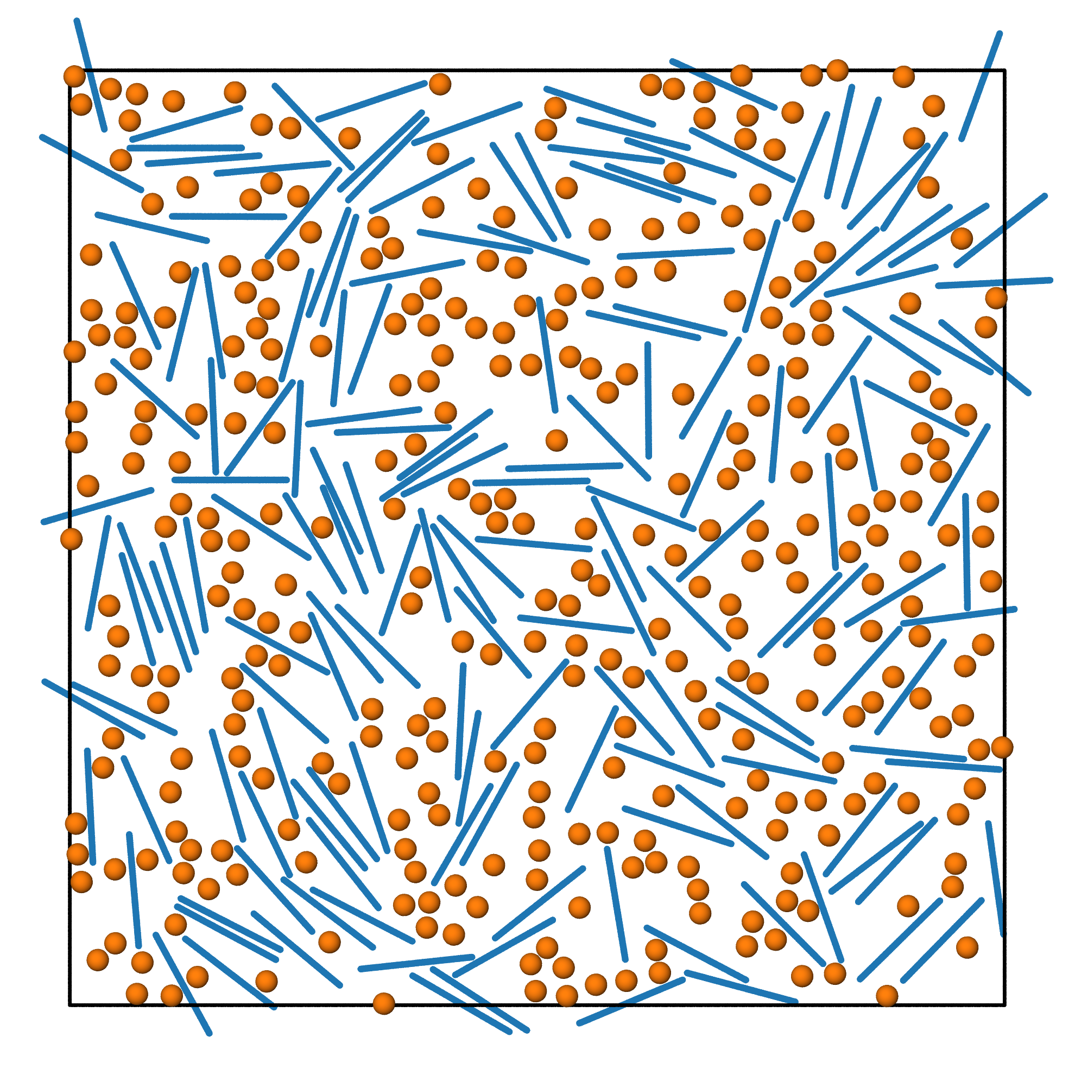
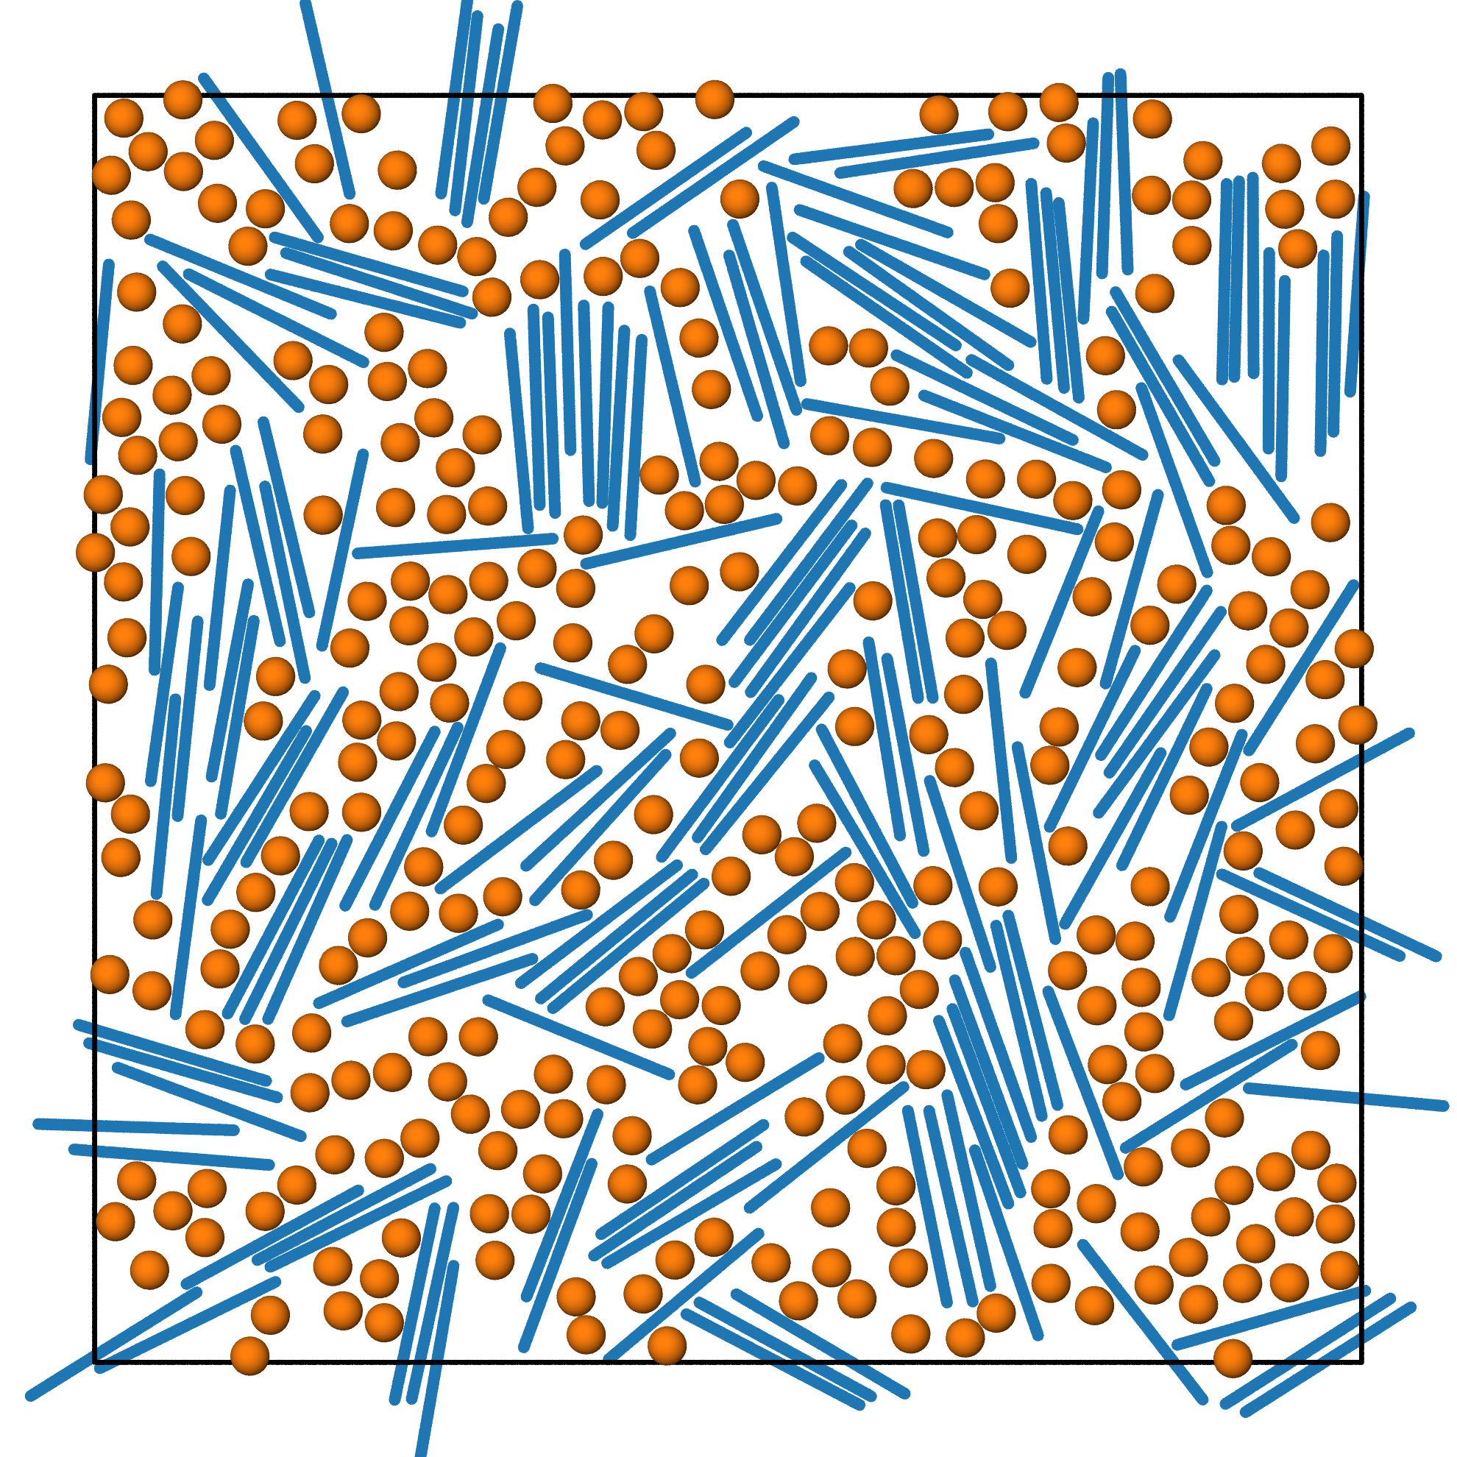
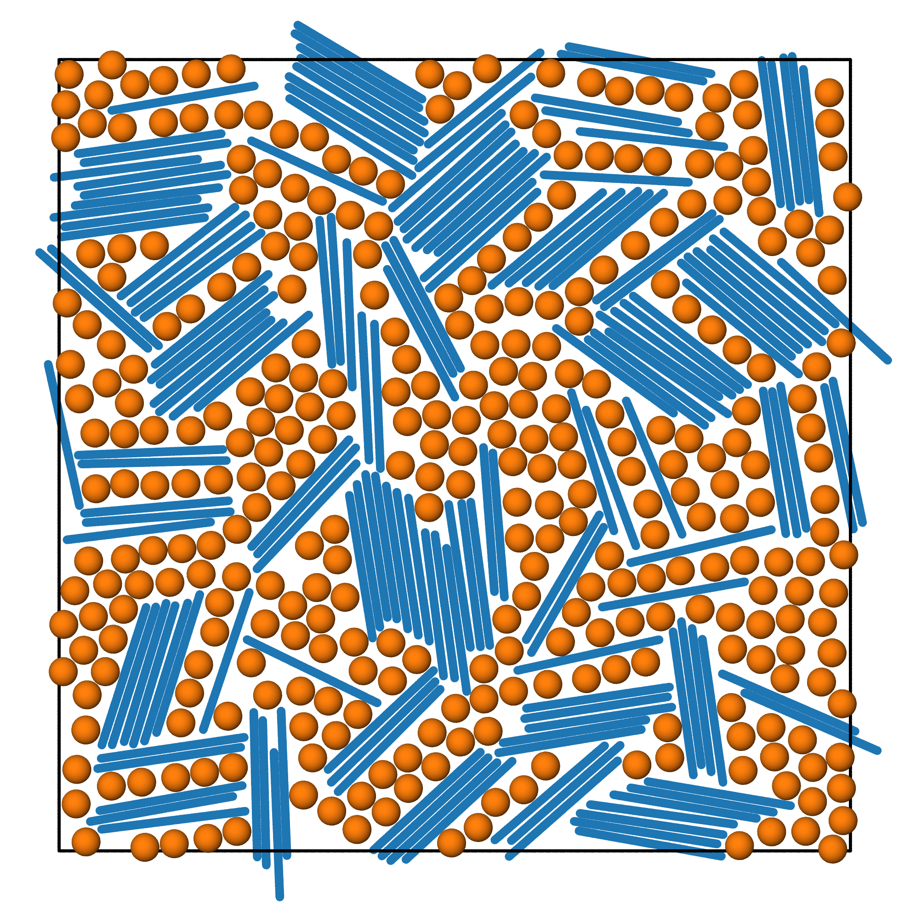
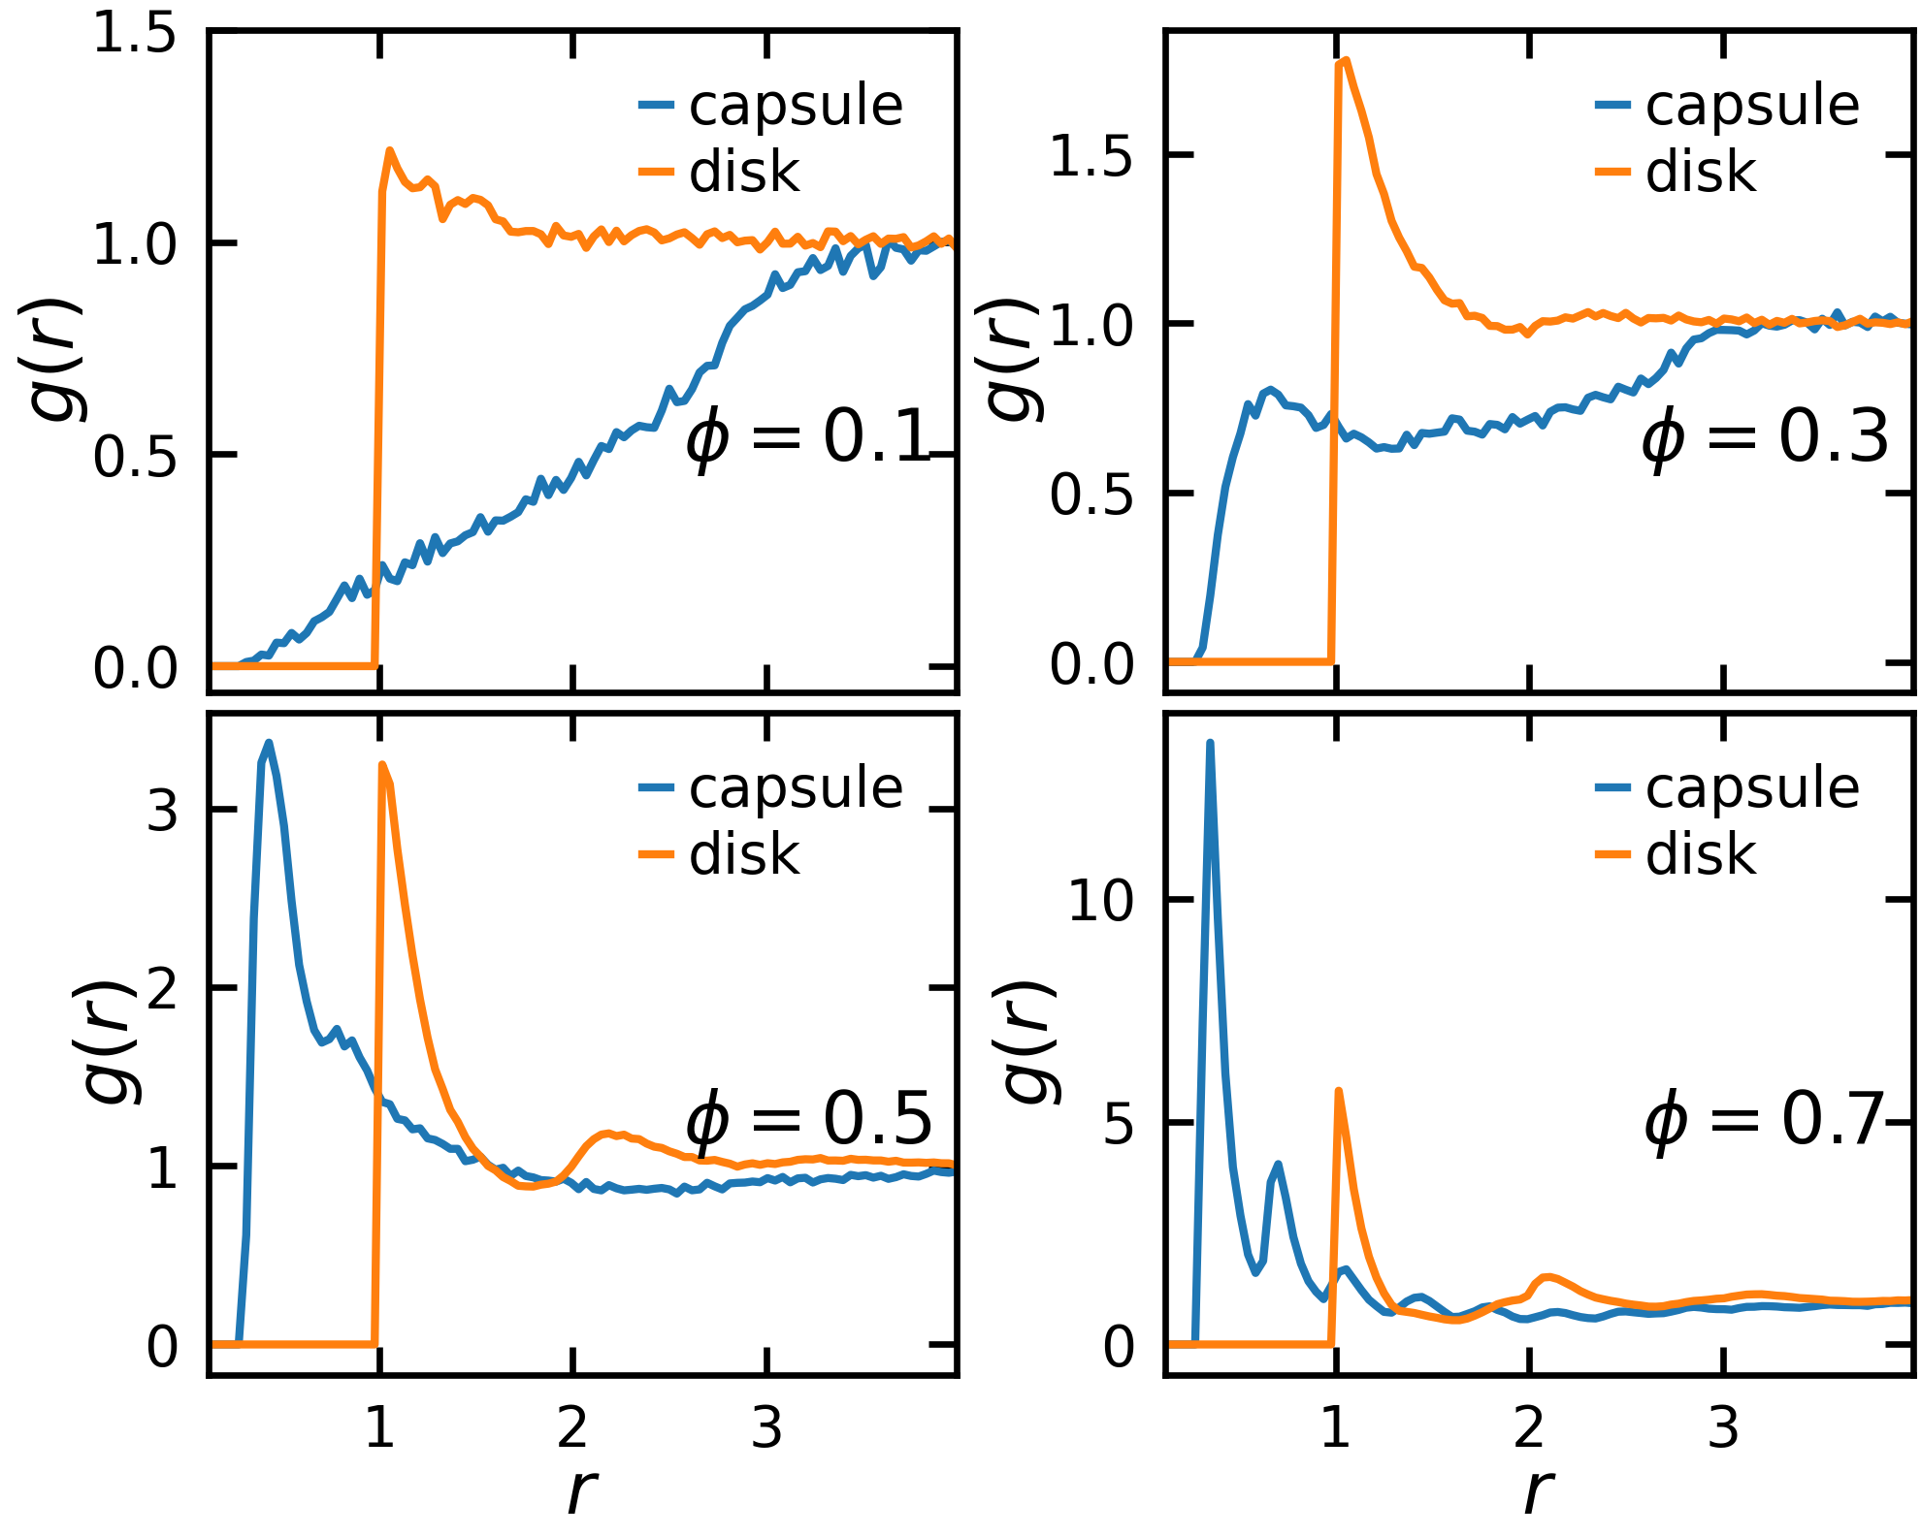
(a)
Prompt:
Please run end-to-end simulations: set up a 2D NVT simulation for mixture of capsule and disk particles with total 500 particles. The capsule should be length 5 and diameter 0.3. Use relative volume fraction 1 for the disk. Let's test four volume fraction [0.1, 0.3, 0.5, 0.7] with sample steps 100000
ColPackAgent
setup
plan
execute
(b)
run0
run1
…
setup.json
plan.json
…
analyze
(c)
(d)

