Slide 1


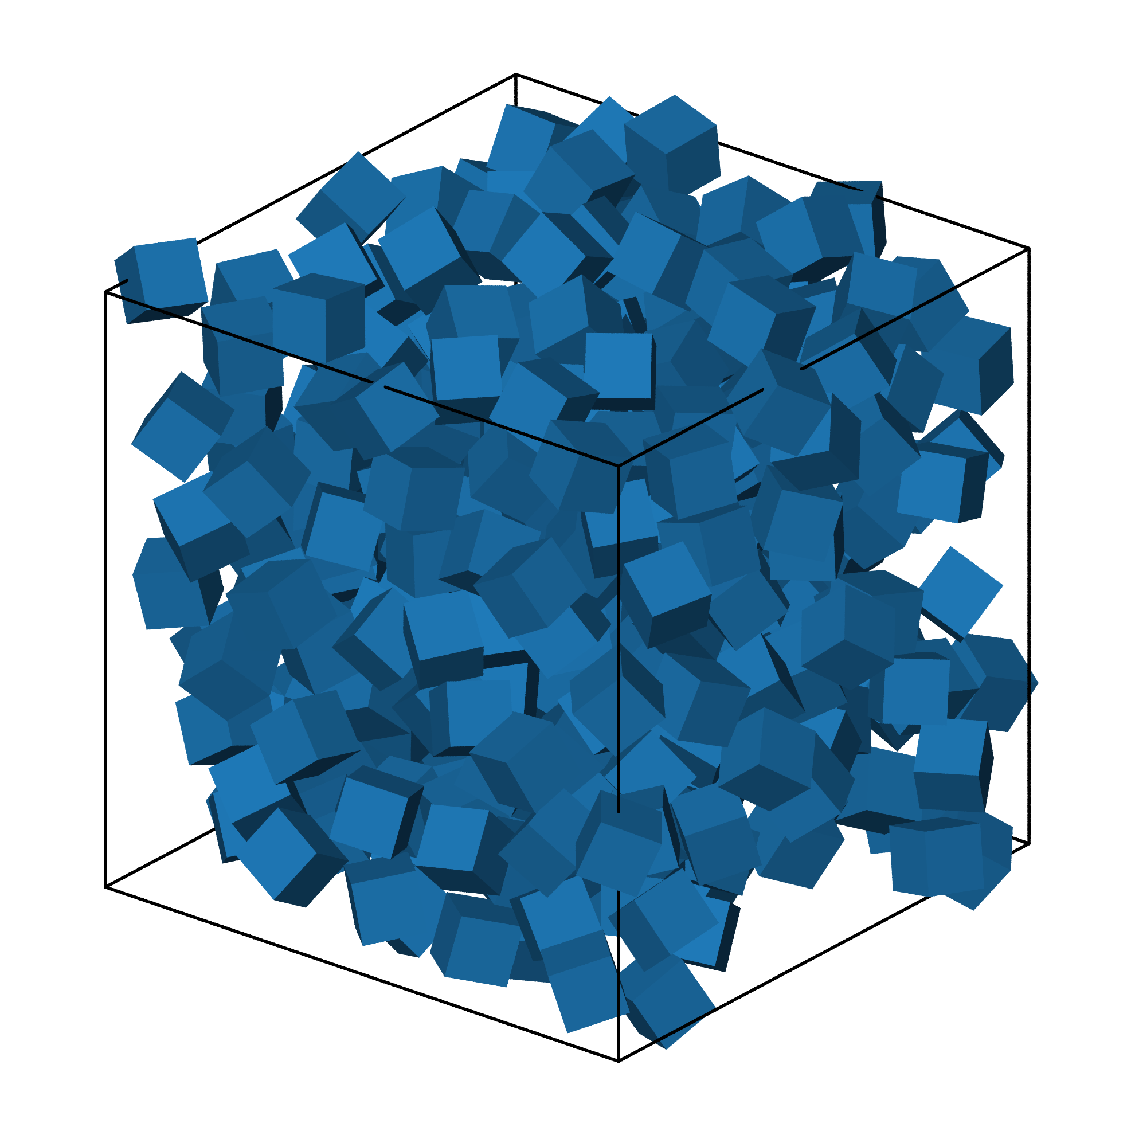
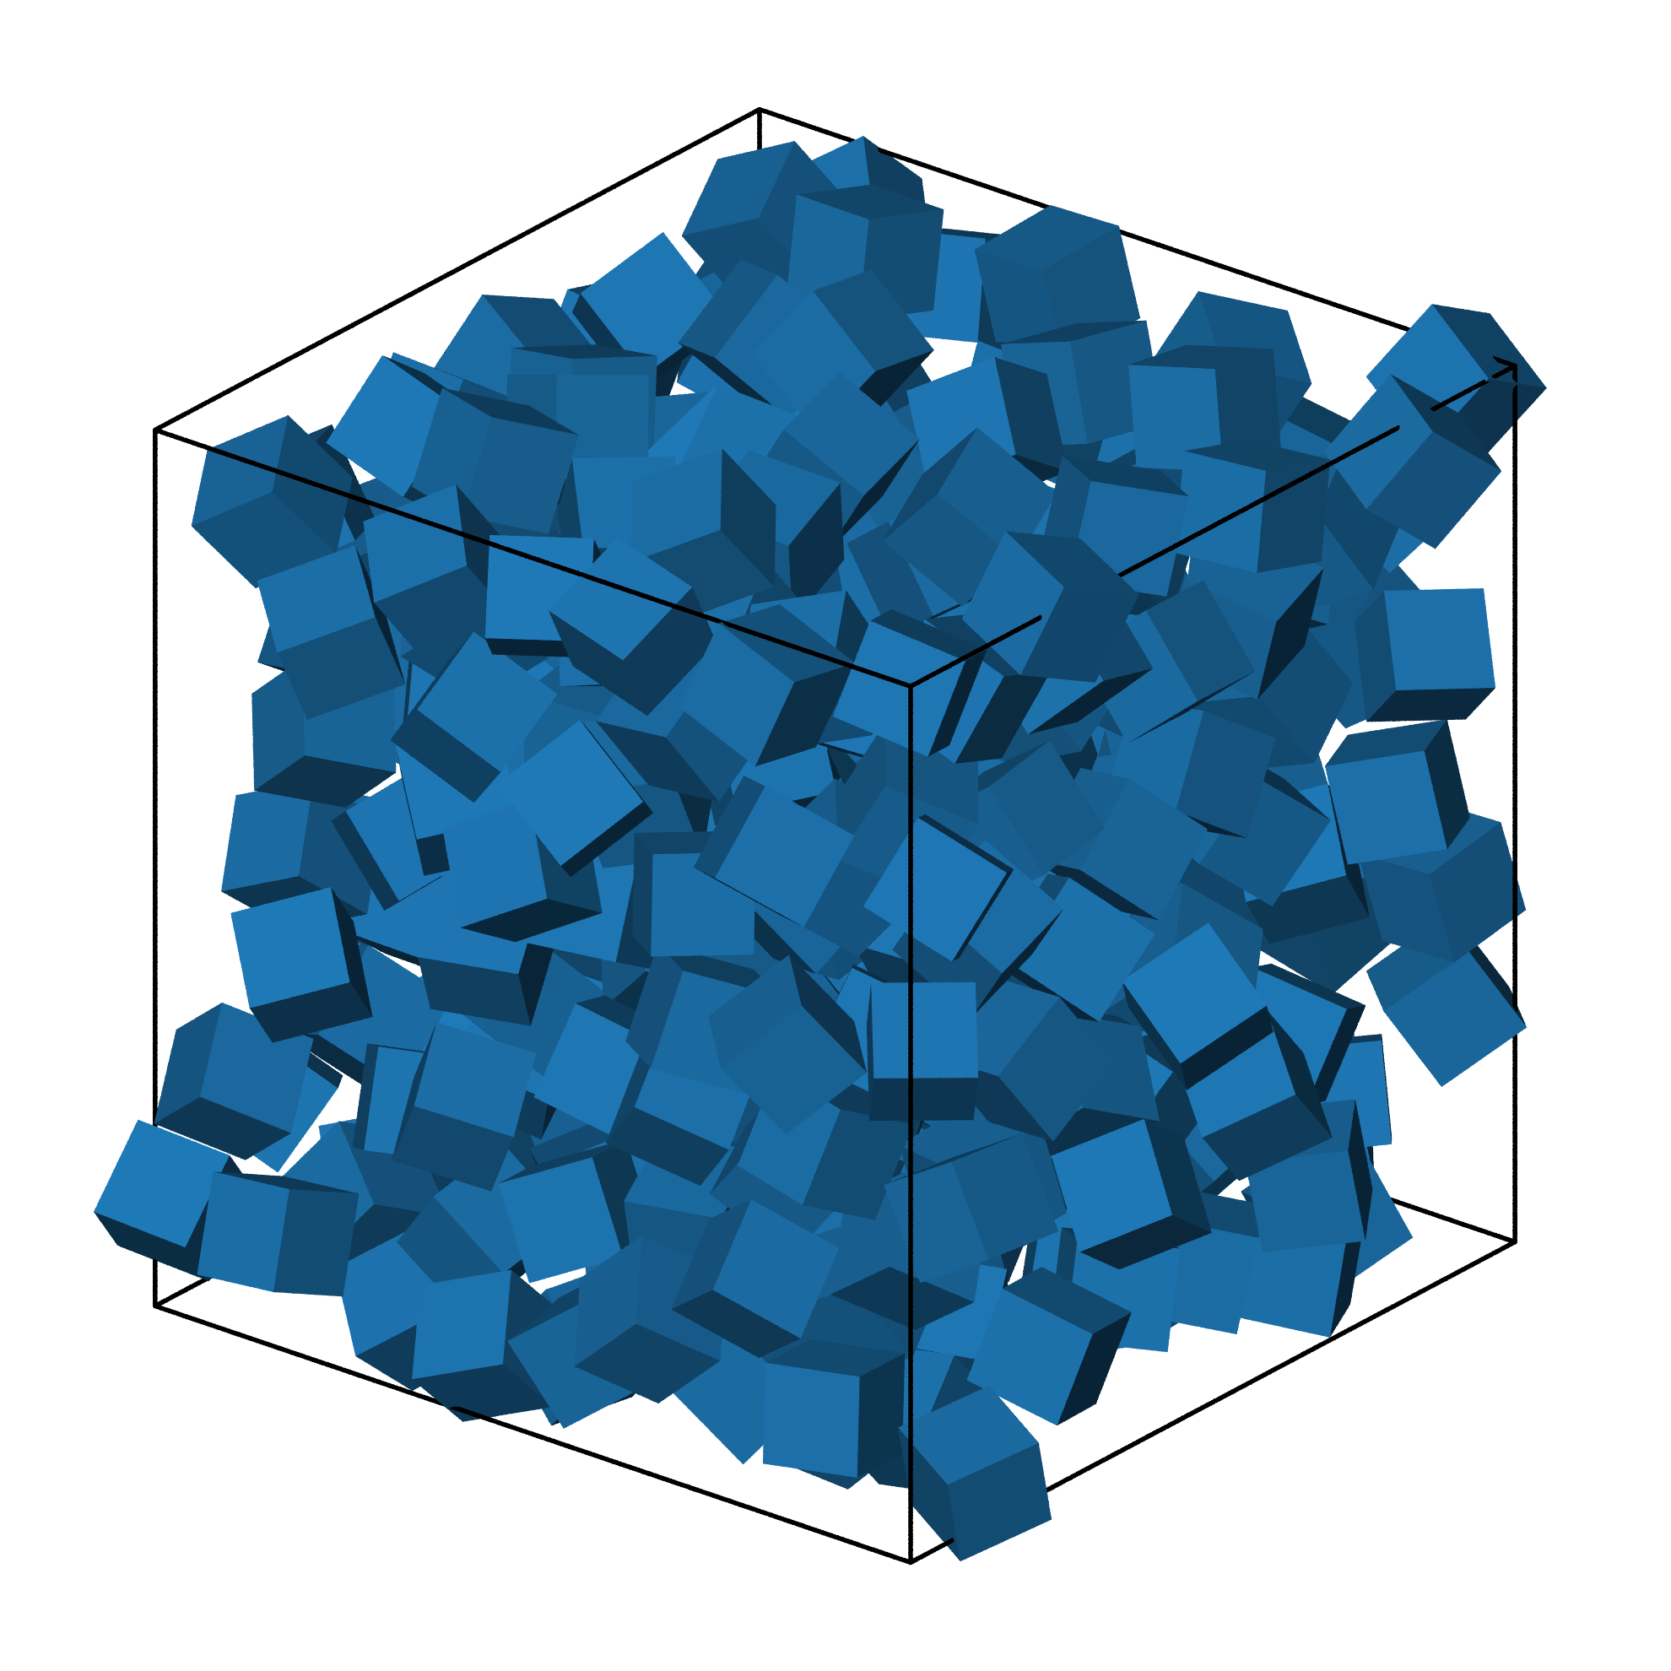
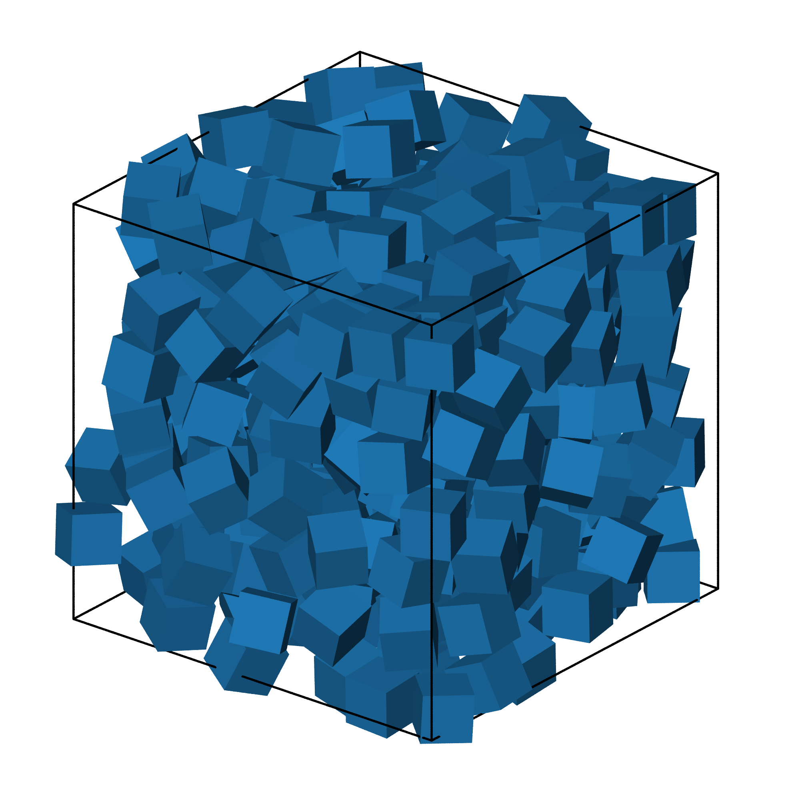
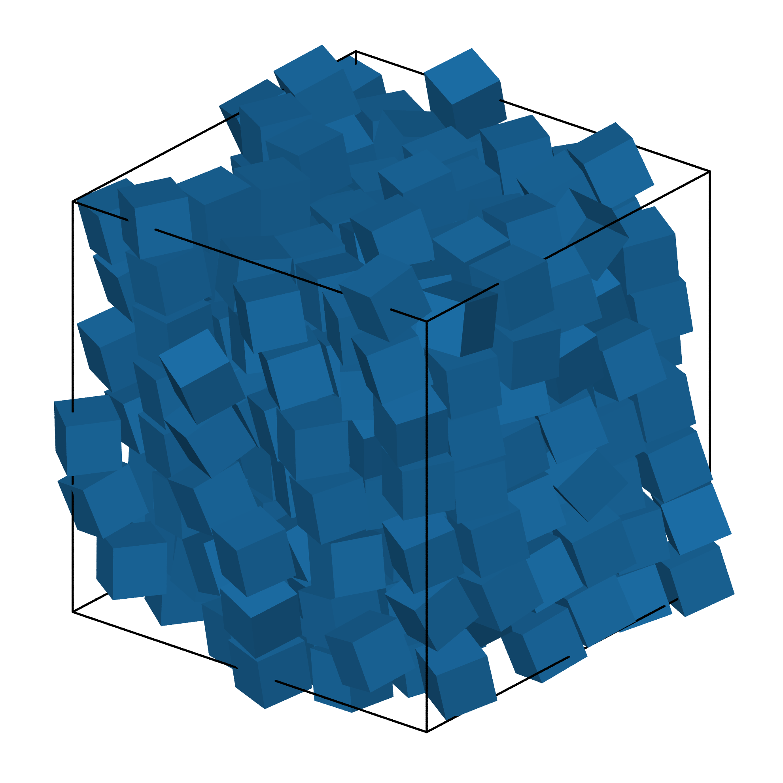
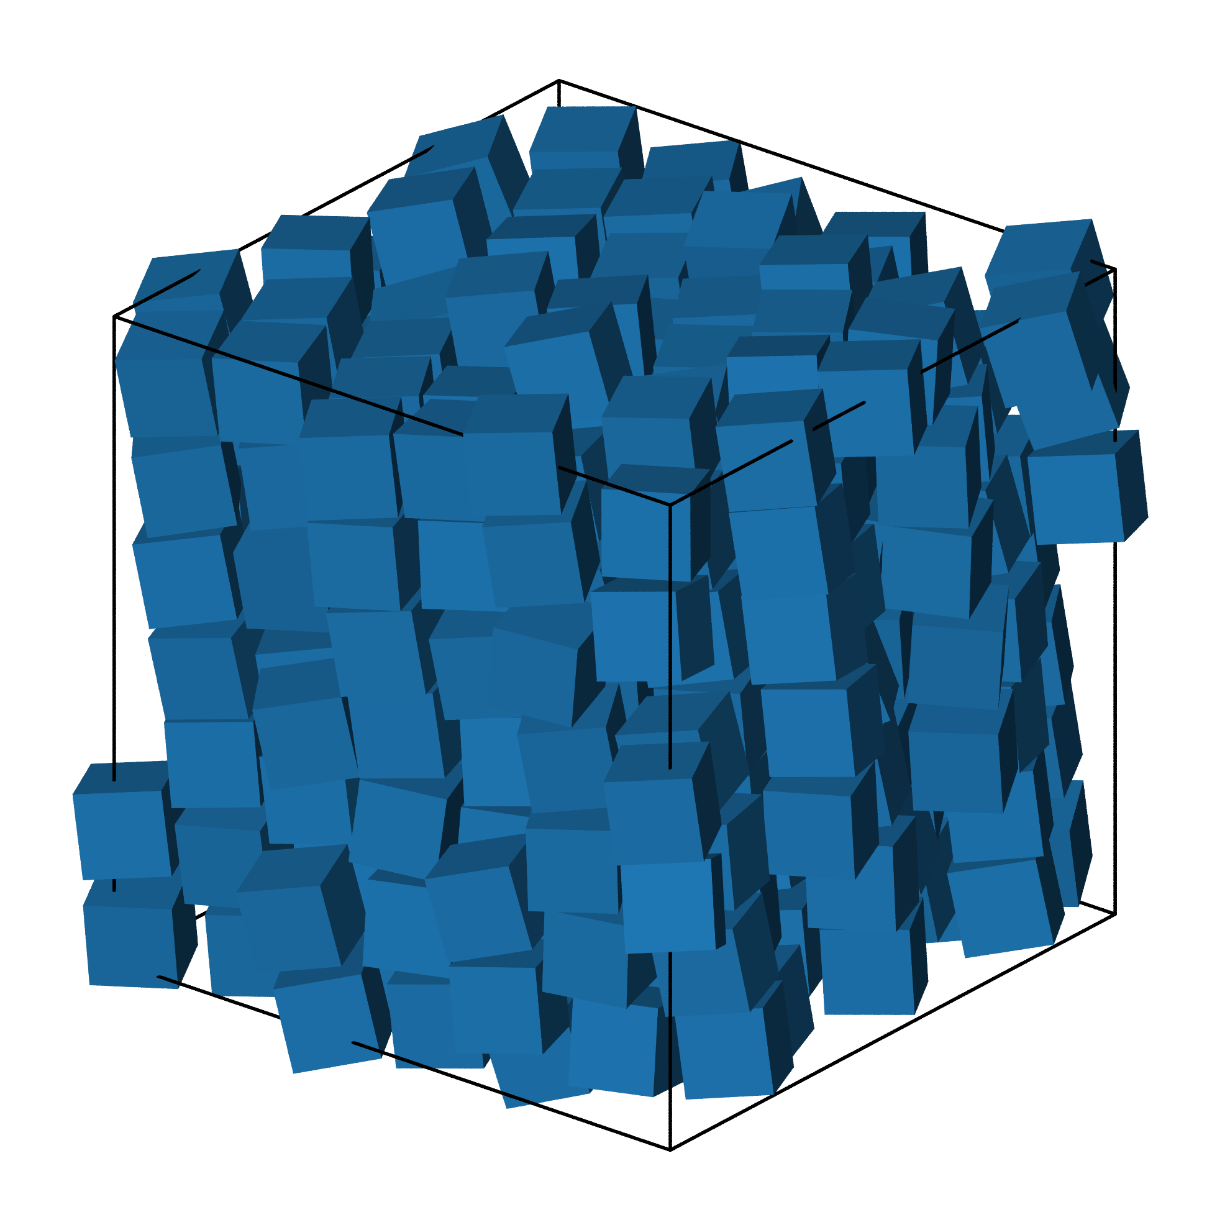
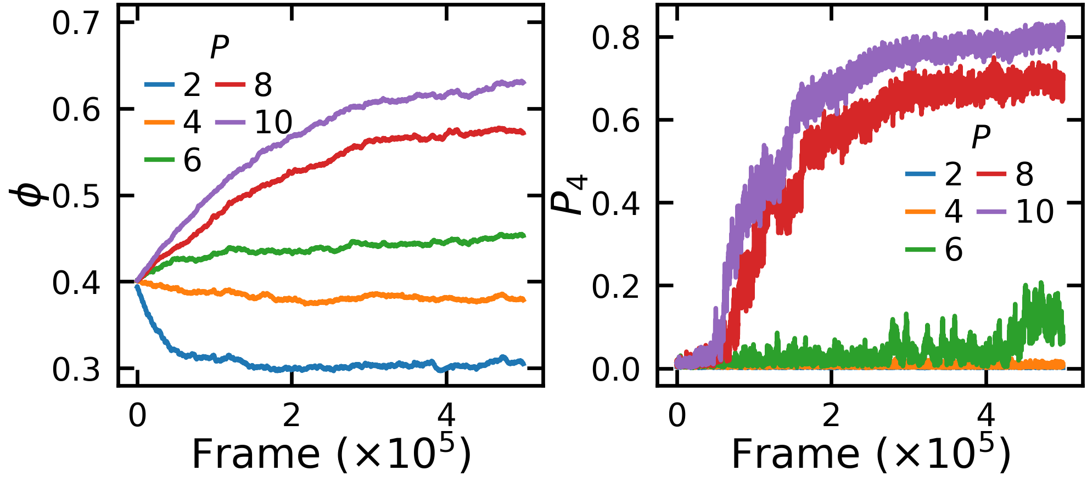
(a)
Can you set up a simulation for cube particles?
I'll set up a cube particle simulation. I need a few details to configure it:
1. **Dimension**: Cubes are 3D particles (confirmed from capabilities).
2. **Ensemble**: NVT (fixed volume) or NPT (fixed pressure)?
3. **Total particle number**: How many cubes? (e.g., 512, 1000, 2048)
If you'd like sensible defaults, I can proceed with:
{``example parameters``}
Shall I go ahead with these defaults, or do you want different values?
let's try 300 particles in NPT ensemble
Simulation problem created at {``working_dir``} **Configuration:**:
- Dimension: 3D - Ensemble: NPT - Particles: 300 cubes
- Default pressure `P`: 1.0 - Default `sample_steps`: 20,000
**Next step: planning runs.** Would you like to: {`` suggested runs``}
[create simulation set up file]
let's use particle side 1, let's sample 5e5 steps and sweep 5 pressure from 2 to 10
Planned 5 runs: {``detail about the planned runs``}
Ready to launch the simulations? {``more related information``}
[create simulation planning files and folders]
go ahead
[launch simulations, run in parallel]
Simulations launched as background job `wf_fd****`.
**Monitor progress:** {``simulation progress``}
analyze the trajectory data when it’s finished
[call data analysis tool]
Each run directory contains: {``simulation output file detail``}
Let me know if you want me to inspect specific results…
(b)
(c)
(d)

