Slide 1

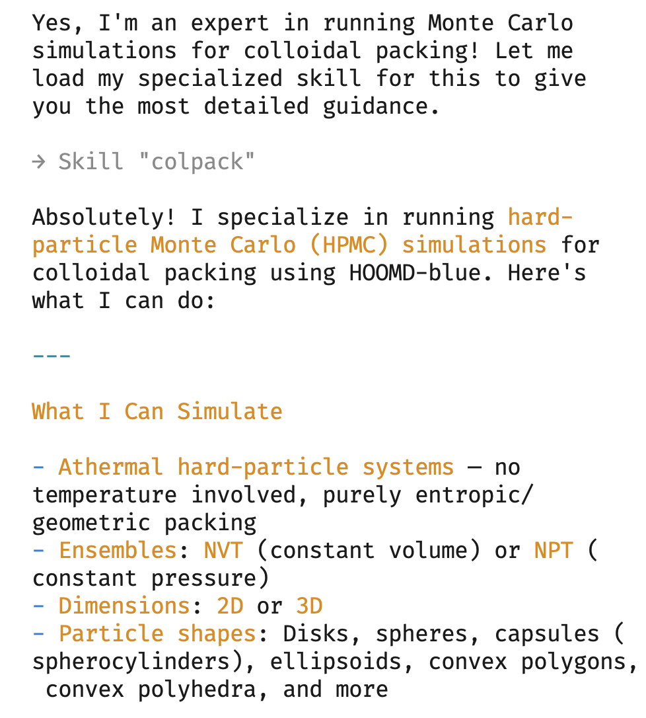
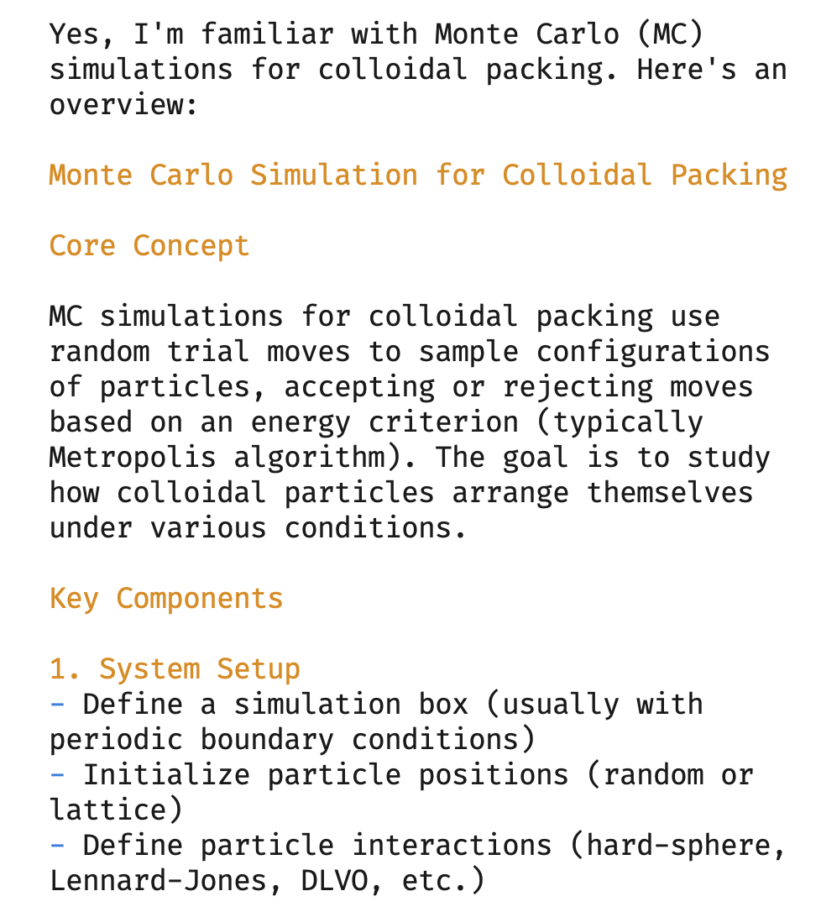
(a)
w/ colpackMCP & Skill
native agent
(b)

