Slide 1
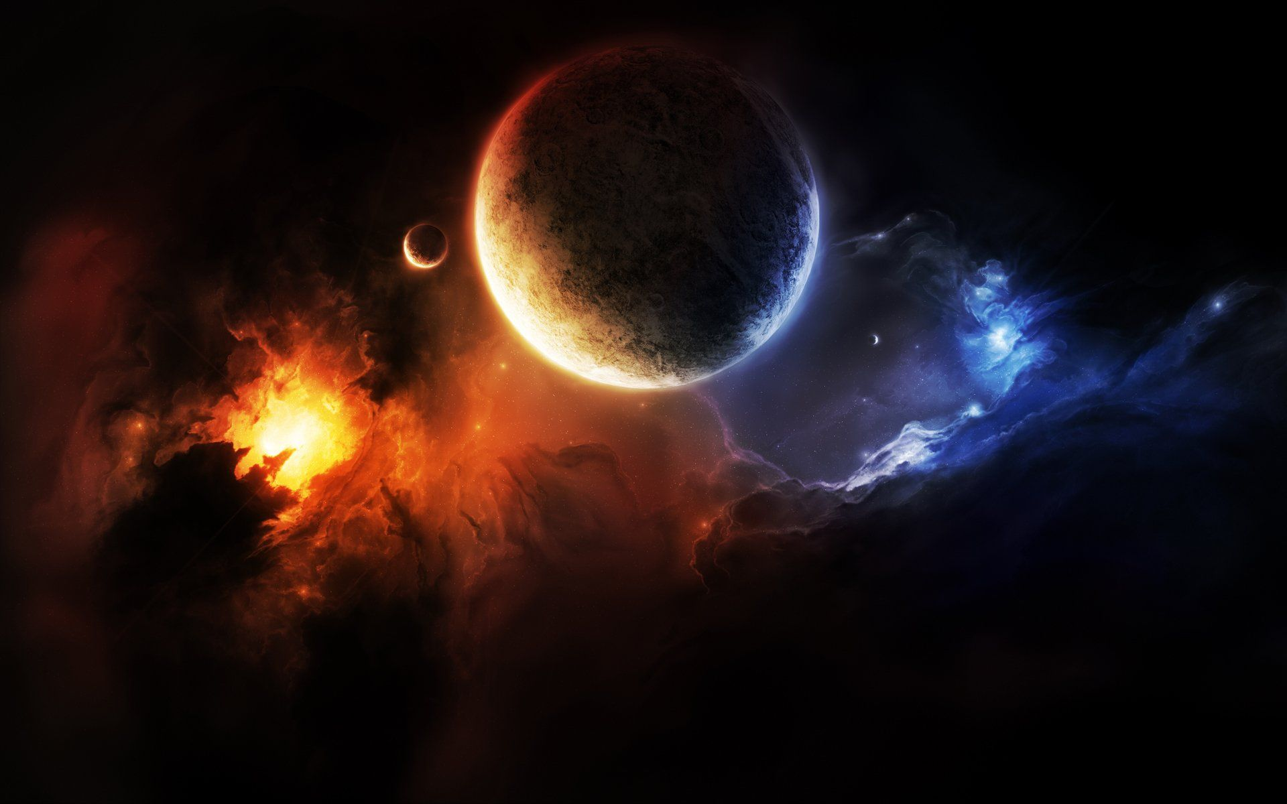

Space Exploring
A website about the Solar System and Mars rovers
Intended users: children and teenagers
Interesting
Interactive
Informative
Created by Olena and Mateus, explorers and developers

Slide 2
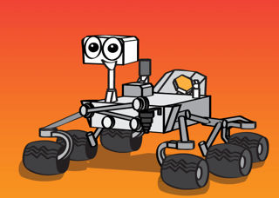
User story
As a user I want to:
learn about space and Mars rovers
view images from Mars
take a quiz to test my knowledge about the Solar System

Slide 3
Demo

Slide 4
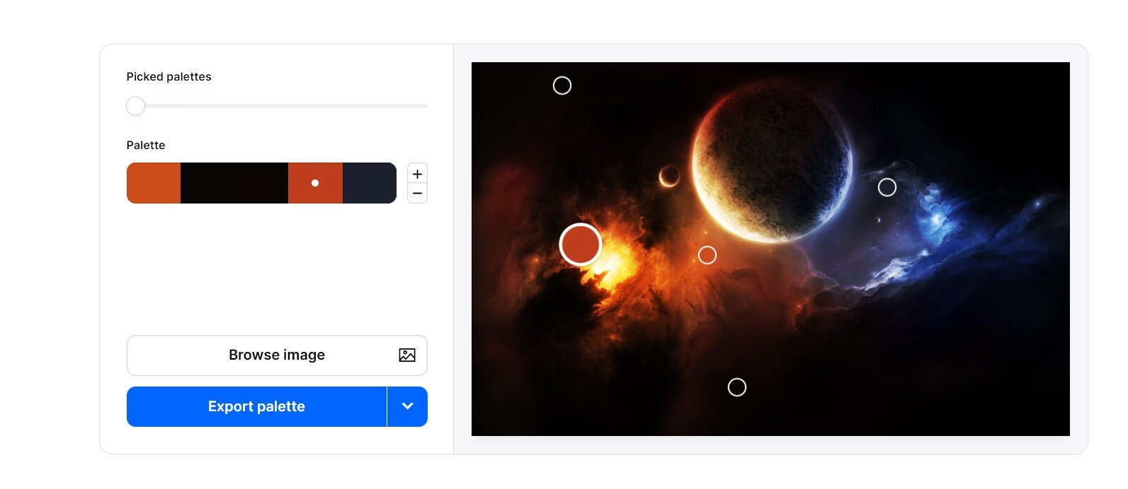
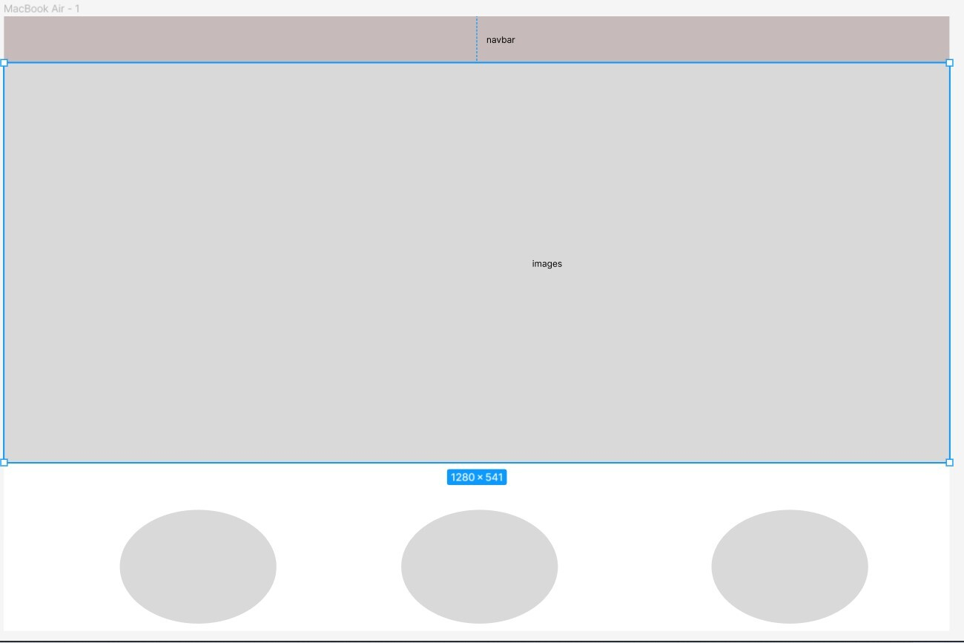
Design
Design (Figma)
Colour scheme (Coolors.co)
Images (https://unsplash.com)
Content (NASA and
Arizona State University website)

Slide 5
Technologies, techniques and APIs
JavaScript
Bootstrap
CSS
jQuery
Ajax
Font Awesome
NASA Open API
The Solar System OpenData
Agile environment

Slide 6
What went well
learnt about GitHub flow and are able to solve merge conflicts
retrieved data from the APIs
applied media queries
were able to reach an agreement on content, colour scheme, layout and features
worked collaboratively as a team and at the same time independently without limiting each other’s freedom and creativity
learnt more about the Solar System
Challenges
our website doesn’t work as expected on Safari and mobile screen
at first, the images were not displayed when deployed to GitHub pages
customise bootstrap
estimation of the time needed to implement features and ideas
difficulties with finding quality images of the correct size

