Slide 1

IT 334 – DevOps Engineering on AWS Cloud
Project – Building a Highly Available, Scalable Web Application
Group X: Žehak Nora
Ljiljić Mirna
Bartula Luka
Musa Harun
Date:
13th of June 2025
Teacher: Dzenana Dzevlan

Slide 2
Business scenario overview
Problem Statement:
Example University's student records web application experiences performance issues during peak admissions
Current system cannot handle thousands of concurrent users
Need for high availability and scalability
Solution Requirements:
Functional CRUD operations with no delay
Load balanced, scalable architecture
High availability (limited downtime)
Secure database access
Cost optimization
High performance under variable loads
Notes:
You can also go more in depth about the design considerations and trade-offs that you made.

Slide 3
Solution overview
High-Level Description:
Multi-tier web application hosted on AWS
Decoupled architecture with separate web and database layers
Managed database service
Load balancing for traffic distribution
Design Considerations:
AWS Well-Architected Framework principles
Cost optimization within lab budget constraints
Security best practices
Notes:
Explain at a high level what you have built.
For example: “I built a web application for a company to host their blog.“
Talk about why you chose certain parts of the solutions and any tradeoffs that you made. Focus on how you designed the solutions and how you applied the AWS Well-Architected Framework as part of the process (AWS Well-Architected Framework: https://docs.aws.amazon.com/wellarchitected/latest/framework/welcome.html).
For example: “I configured load balancers and auto scaling to make the application highly available and reliable.”
Include the use cases that you are addressing. Think about who your users are and how they would want to interact with your solution to solve their problem.
For example: “Users can view, upload, edit, and delete blog posts. Administrators can approve blog posts.”
Talk about the use cases that you addressed as part of the minimum viable product (MVP) that you scoped and built.
Note:
An above-bar description is concise and includes the most important benefits. For example: “The solution allows customers to quickly upload, store, and search large catalogs of images and videos in Amazon S3.”
A below-bar description is too detailed or not specific. For example: “Our solution analyzes media files.”

Slide 4
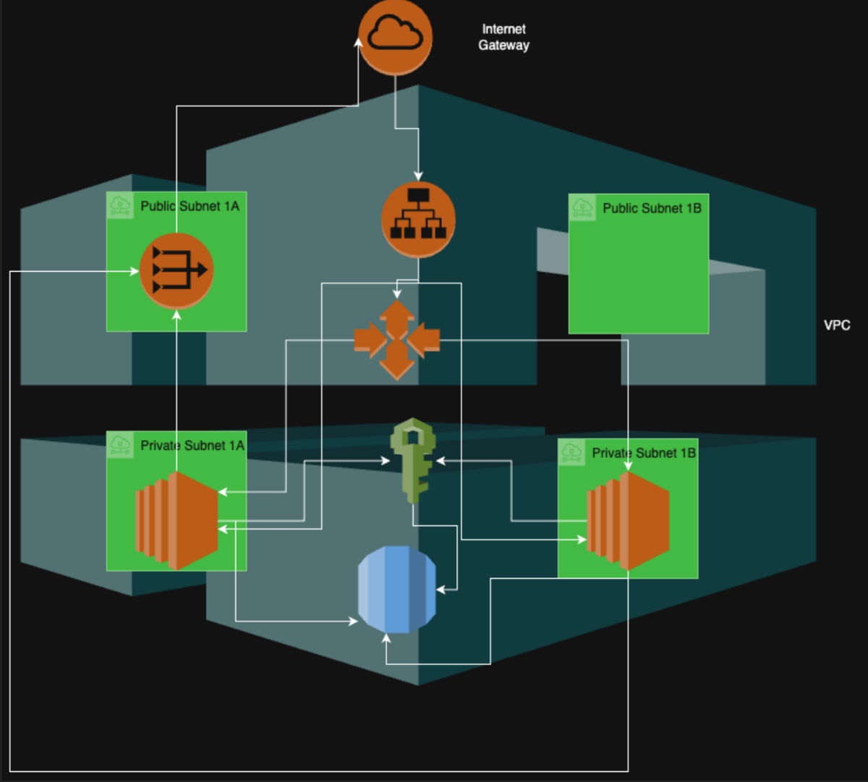
Architecture diagram of the solution : EXAMPLE
Why This Architecture Works
High Availability :
Public/private subnets in both AZ 1A and 1B ensure no single point of failure.
Security:
Web servers (EC2) and database (RDS) are isolated in private subnets.
ALB in public subnets acts as a secure entry point.
Scalability:
Auto Scaling launches EC2 instances in private 1A/1B based on demand.
Cost Control:
Minimal NAT Gateway usage (public subnets handle internet traffic).
Notes:
Note: Remove this slide from your final presentation.
This example architecture diagram shows a solution to configure a webhook to link Git with AWS. You can find this example in the Toolkits for PowerPoint at https://aws.amazon.com/architecture/icons.

Slide 5
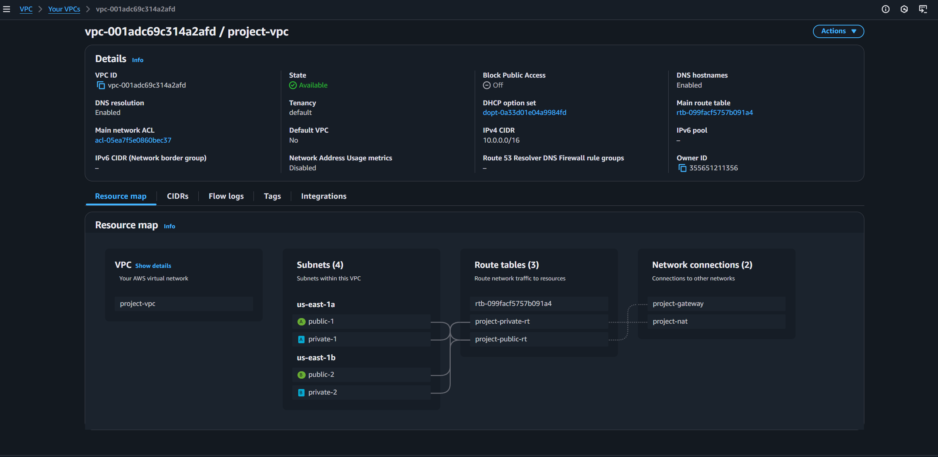
Demo
.​
Notes:
For the demo, guide the audience through the two to three most important benefits of the solution and how it addresses the requirements.
Your demo materials can be screen captures, recordings, or to show AWS console.

Slide 6
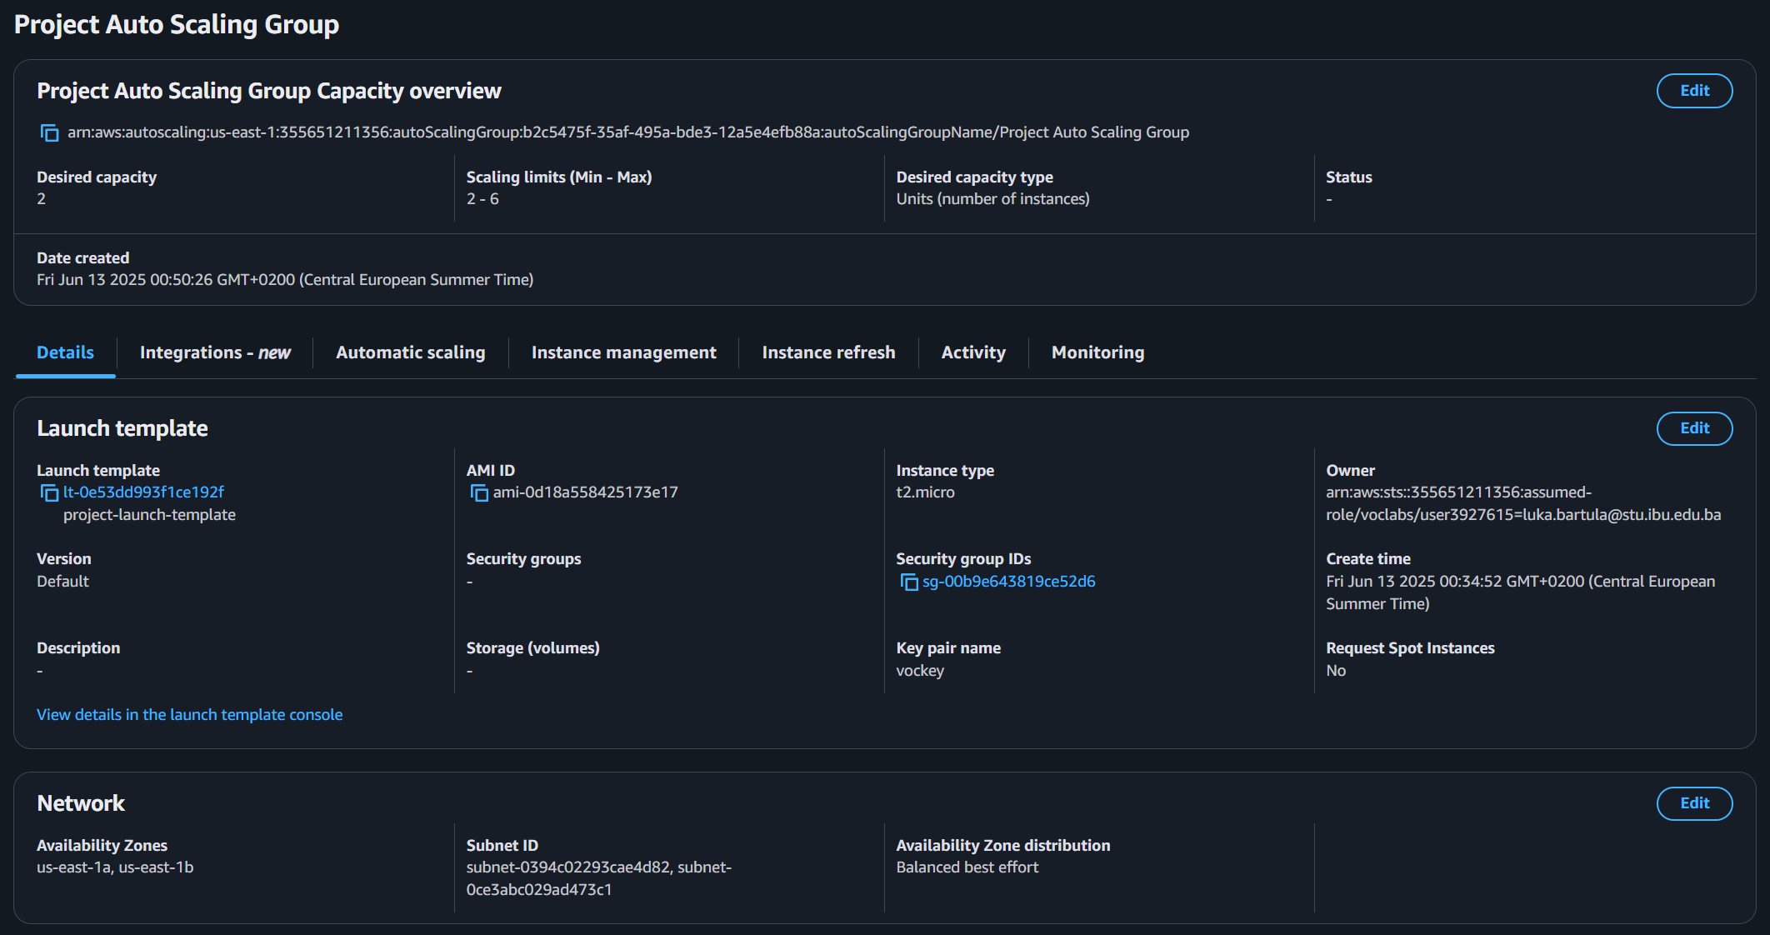
Demo
.​
Notes:
For the demo, guide the audience through the two to three most important benefits of the solution and how it addresses the requirements.
Your demo materials can be screen captures, recordings, or to show AWS console.

Slide 7
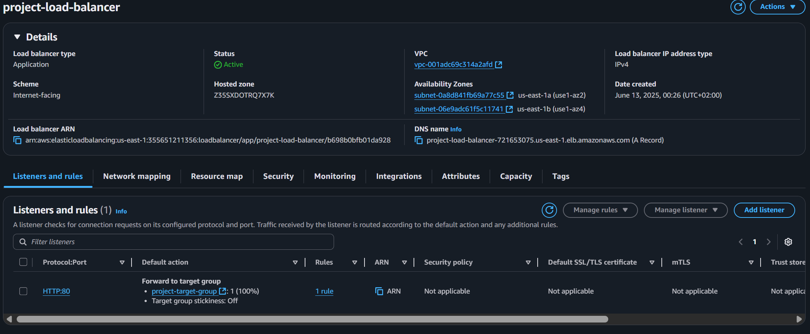
Demo
.​
Notes:
For the demo, guide the audience through the two to three most important benefits of the solution and how it addresses the requirements.
Your demo materials can be screen captures, recordings, or to show AWS console.

Slide 8
Lessons learned
Challenges Overcome: RDS Migration Issues : EC2 instances failed to fetch user data from RDS after migration. Helpful Resources: AWS Documentation RDS Troubleshooting Guide, AWS Academy course labs on EC2, VPC, RDS, and Auto Scaling New Skills Developed: Infrastructure Debugging, Used VPC Flow Logs to trace blocked traffic between EC2 and RDS, IAM Fine-Tuning, Created custom policies to grant EC2 instances read-only access to Secrets Manager, Database Migration, Learned mysqldump and mysql client commands to transfer data to RDS. Next Steps: Enhance Security, Implement HTTPS via ACM certificates, Restrict ALB access to university IP ranges.
Notes:
Describe any challenges that you encountered and how you overcame those challenges.
For example: “I got stuck when I was creating an EC2 instance to host the application. I used the resources that were listed in the instructions to walk myself through the process to create a new EC2, and I was able to complete the task. The links to labs in other courses were very helpful.”
Describe any new skills that you learned from this project.
For example: “I learned how to set up auto scaling correctly so my resources were automatically adjusted and allocated at the lowest possible cost.”
Discuss any future, out-of-scope use cases in the next steps.
For example: “I would like to scale out the web application so that multiple departments can use it.”

Slide 9

Questions?

Slide 10
THANK YOU!

