Slide 1
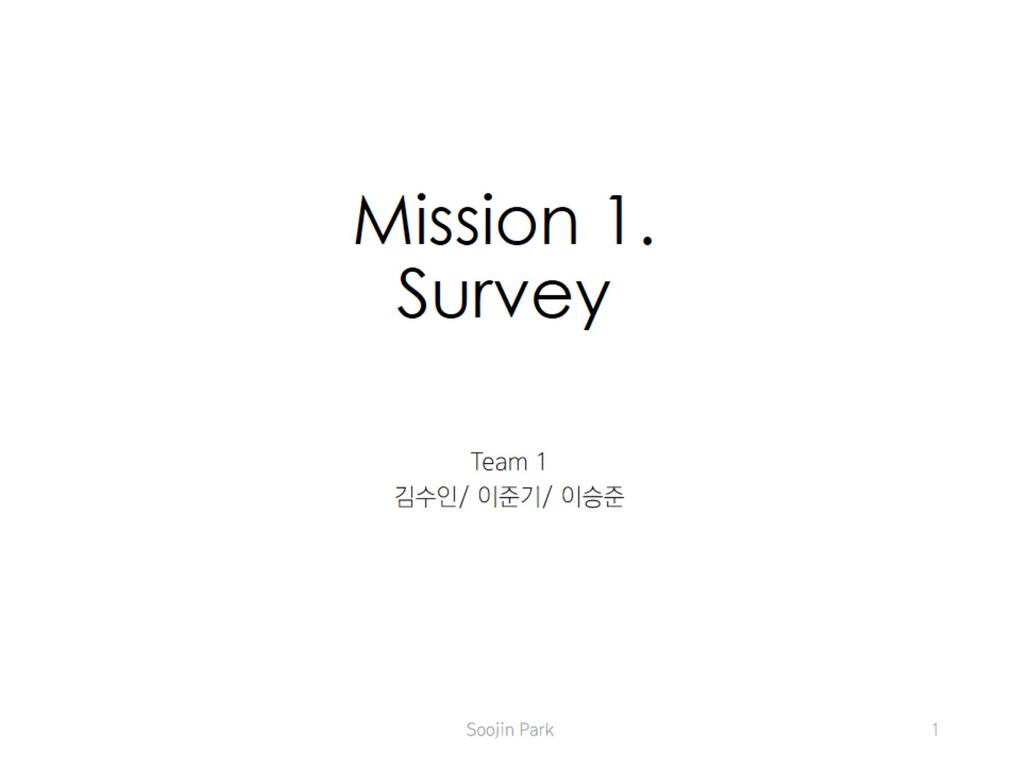
Mission 1. Survey

Slide 2
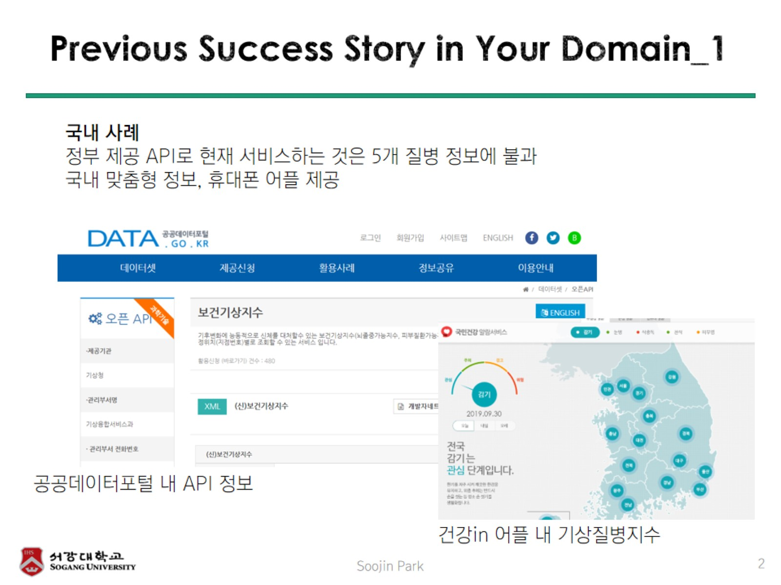
Previous Success Story in Your Domain_1

Slide 3
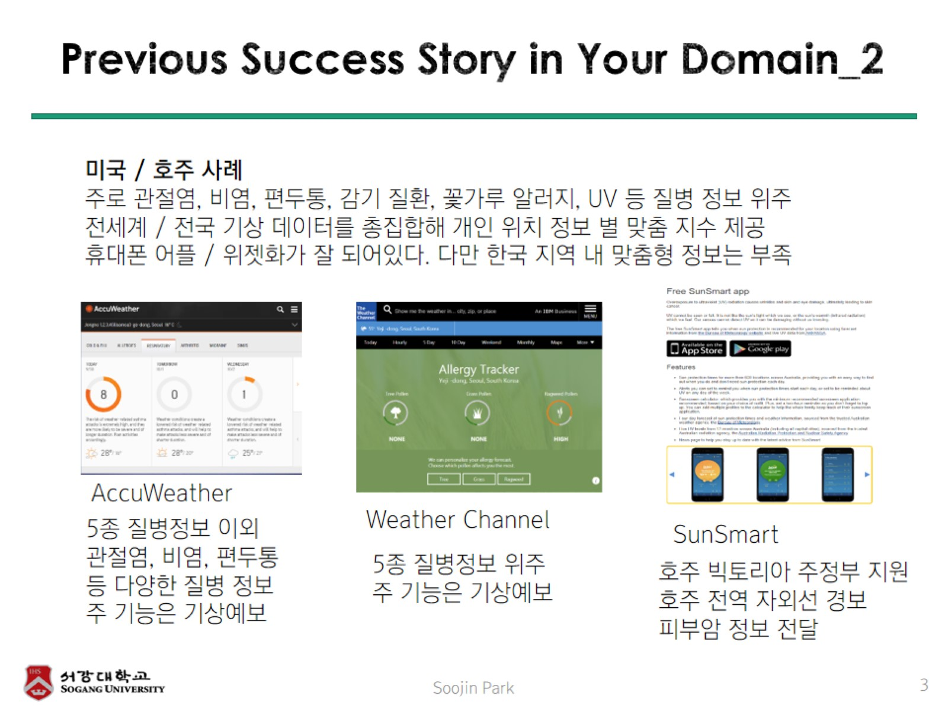
Previous Success Story in Your Domain_2

Slide 4
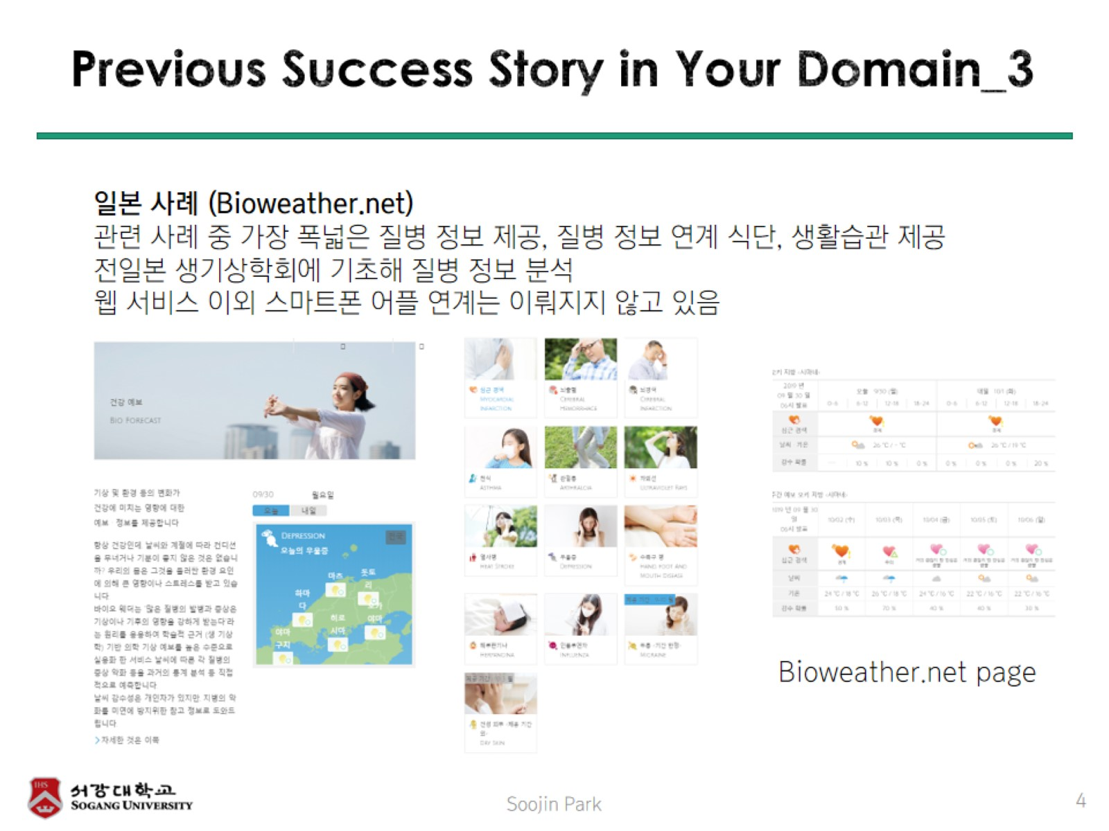
Previous Success Story in Your Domain_3

Slide 5
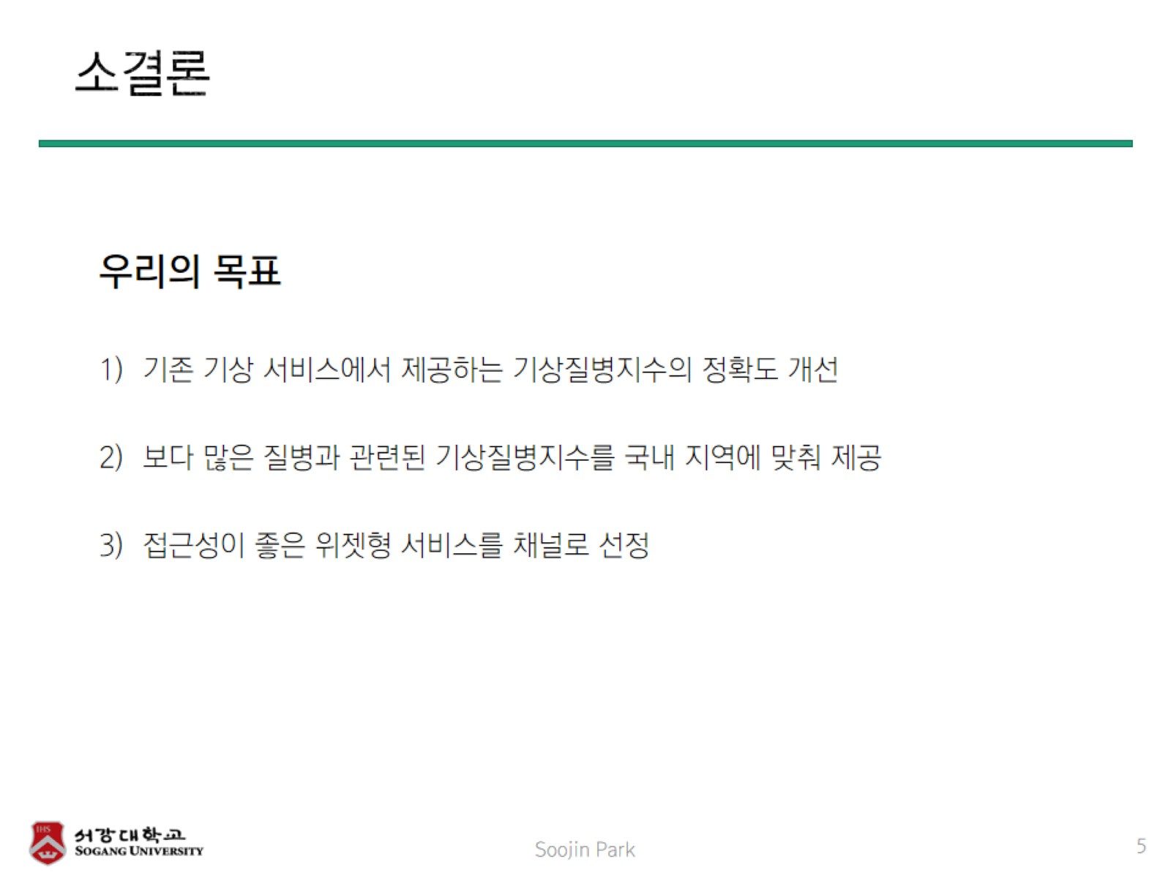
소결론

Slide 6
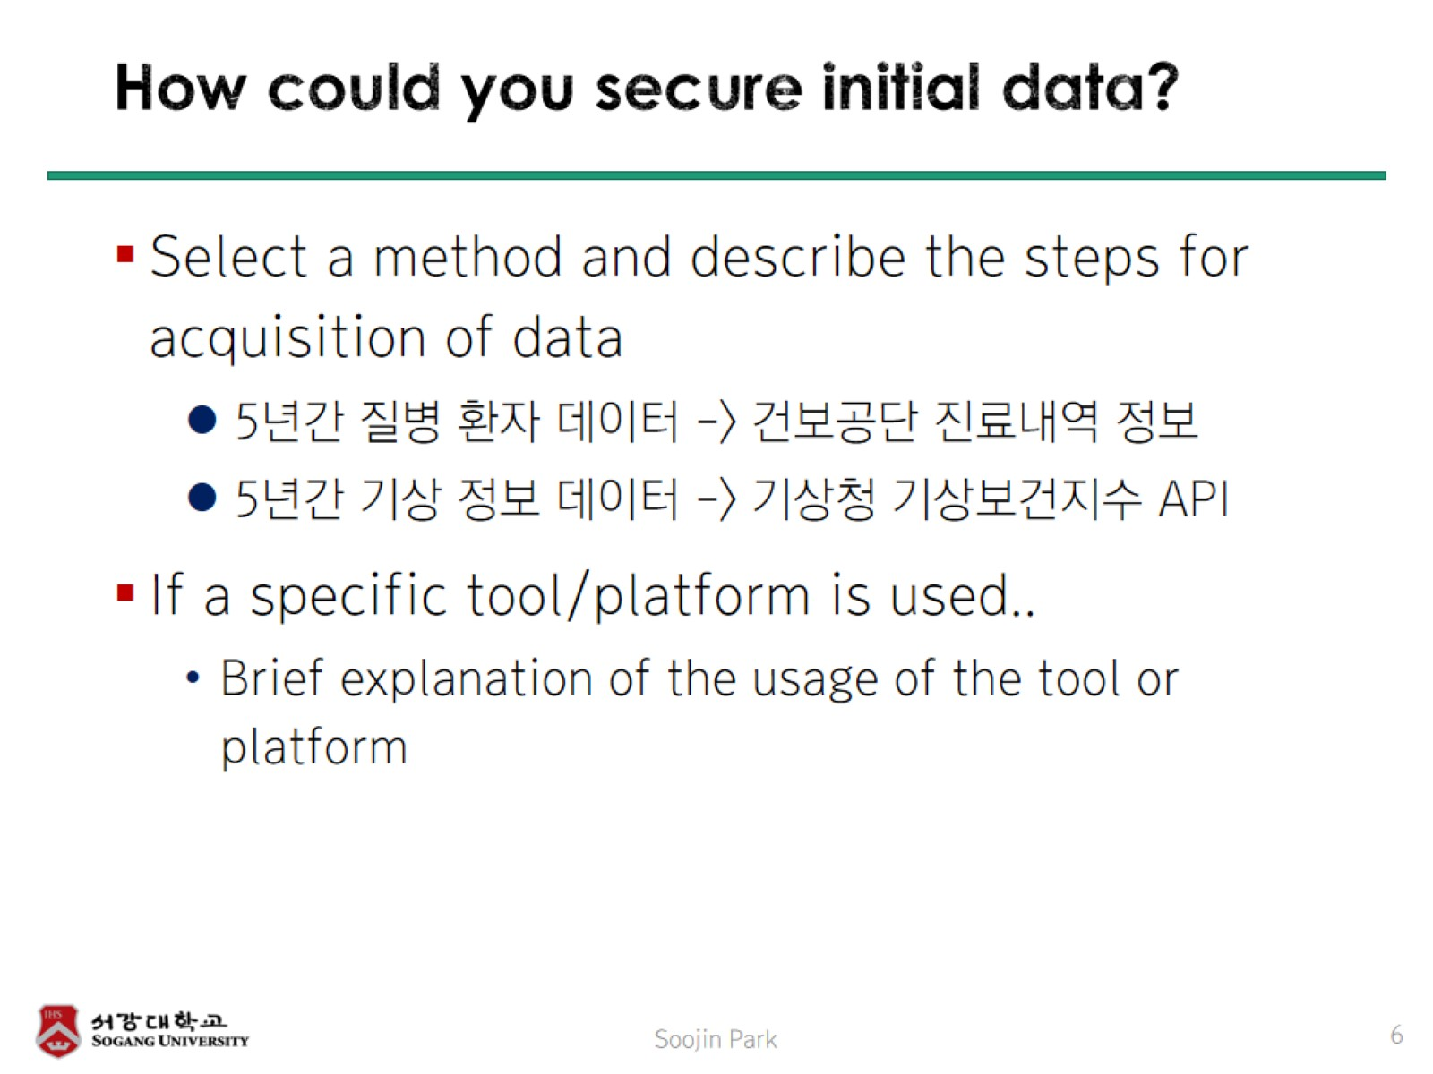
How could you secure initial data?

