Slide 1
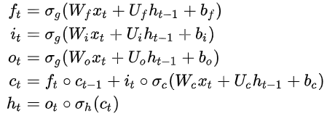
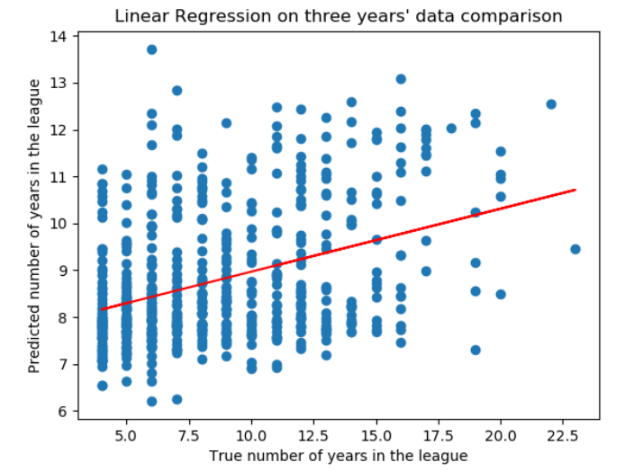
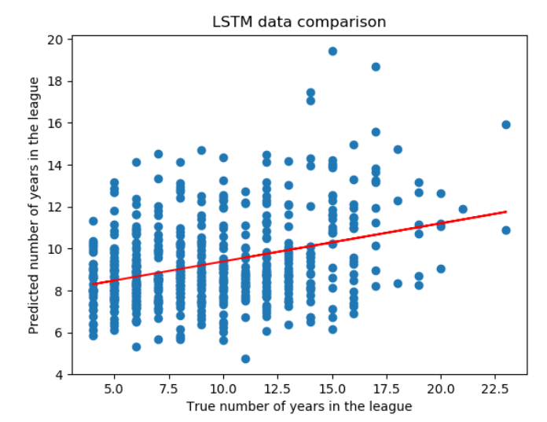
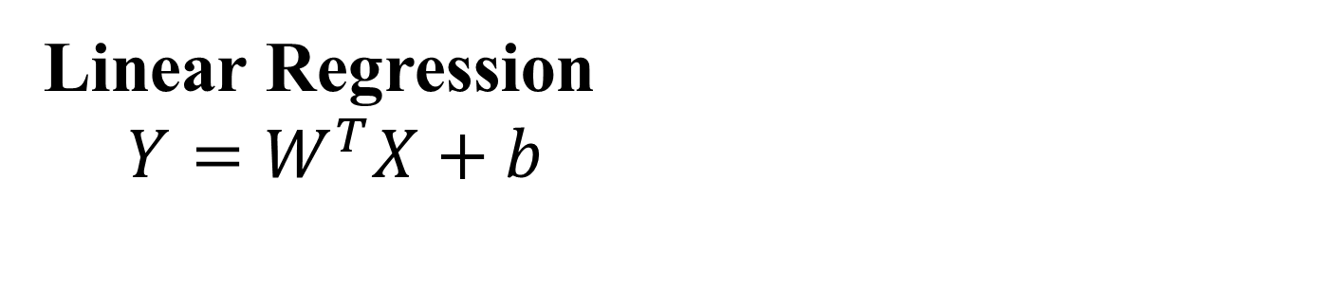
Peak Baseball Career Performance from Early Career Indicators
Paavani Dua¹, Liam Kelly², and Matthew Lee³
{¹paavanid, ²kellylj, ³mattskl}@stanford.edu
Department Name
Motivation
Models
Discussion
Baseball is a multi-billion dollar industry with numerous games played per season and it would valuable for teams to know when players are at their peak performance. While previous research has only taken aging patterns and WAR statistics into consideration to predict players future performances^{[1]}, our goal for this project was to use a LSTM model to predict a player’s career trajectory based on his first 3 seasons, quantified by career length and peak performance year.
Linear Regression
$$Y=W^{T}X+b$$
By using LSTM, we hoped to find patterns in a player’s performance over his career, including his peak performing year. Training the model against peak year and career length simultaneously was supposed to reveal the pattern. Unfortunately, the model performance was poor. We attempted training the LSTM model against peak years and career lengths separately, but achieved even worse results. These results seem to indicate that there may be no real pattern in player performances, especially in his early years. This result was rather unexpected, as it also means that the peak year for a player has little relation to his career length.
Long Short-term Memory
One LSTM layer; one FC layer
64 hidden states, 2 outputs
Outputs: 1. Peak performance year
2. Career length
Results
Data & Features
Kaggle Baseball Dataset^{[2]} is used which has Major League Baseball batting and pitching statistics from 1871-2016. Data is pruned to only include statistics from 1960-2016 and players who played at least 4 seasons.
12 important performance indicators^{[3]} were extracted. They are normalized by the number of games played. Career length is extracted from the raw data and total responsible runs are used to determine the peak year.
Features
Game(G) Doubles (2B)
Triples (3B) Bases on Balls (BB)
Runs (R) Home Runs (HR)
Hits (H) Caught Stealing in (CS)
Runs Batted in (RBI) At Bat (AB)
Stolen Bases(SB) Strikeout (SO)
Future Work
Better data cleaning Linear regression is sensitive to anomalies. We looked into anomaly elimination but with little success. Method of elimination can be improved since there are many players with no useful stats (no runs, hits, etc.)
GRU implantation Consider using GRU, which has shown better performance on smaller datasets. This may be useful since time series are short
Model | Average career length training error (in years) | Average career length test error (in years)
Linear Regression | 3.1417 | 3.0246
LSTM | 2.9873 | 3.0744
Model | Average peak year training error (in years) | Average peak year test error (in years)
Linear Regression | 2.2185 | 2.1728
LSTM | 2.2539 | 2.2919
References
[1] T. Tiger, “Determining aging patterns, and explaining analysis techniques,” 2007
[2] Mobius, “Baseball data: The sabermetrics revolution, kaggle baseball dataset”, 2017.
[3] P. Birnbaum, “A guide to sabermetric research,” 2018.
Model | Training set size | Test set size
Linear Regression | 15228 | 1692
LSTM | 5076 | 564

