Slide 2
CONTENT
SUBJECT 1
SUBJECT 2
SUBJECT 3
SUBJECT 4

Slide 3
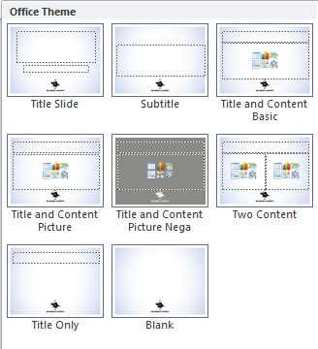
Creating a new page
When creating a new page, select from the menu “Home / New slide...” and you will see a list of templates.
You can also change the content of an existing page by selecting “Home / Layout”, so that you can change the content of the page.

Slide 4

USING PICTURE BACKGROUND
1. Click on the slide where you want to place your image and choose Layout as “Title and Content Picture” or “Title and Content Picture Nega”
2. From the “Design" tab choose “Background" and “Background Styles" and finally select “Format Background"
3. Select “Fill" and then choose “Picture or texture fill"
4. Choose “File", then navigate to the picture you want to use and double click it.

Slide 5


