Slide 1
Introduction to Database （ Chapter 1）
李龙杰
兰州大学 信息科学与工程学院
ljli@lzu.edu.cn
https://ljlilzu.github.io/

Slide 2
What Is a DB?
Database (DB) :
In general, very large, integrated collection of data.
Models a real-world enterprise
Entities (e.g., teams, games)
Relationships
(e.g., The Forty-Niners are playing in The Superbowl)
Database today are essential to every business.

Slide 3
Database
数据库定义
数据库(Database, DB)是长期储存在计算机内、有组织的、可共享的大量数据集合
数据库特点
数据按一定的数据模型组织、描述和储存
可为各种用户共享
冗余度较小
数据独立性较高
易扩展

Slide 4
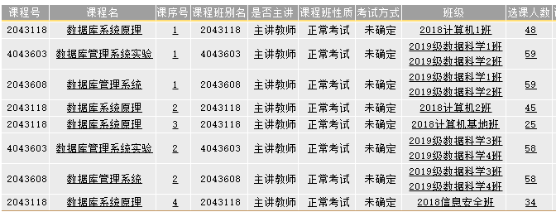
What Is a DB? (cont.)
A database is basically a container that holds several types of objects and data in an organized fashion.
Generally, one database is used for a particular application or purpose, though this is not a hard and fast rule.
For example, some systems have one database for all the enterprise applications required to run a business.
On the other hand, one application could access more than one database.
Notes:
Hard and fast rule 精确的标准；固定规则

Slide 5
什么是数据
数据(Data)是数据库中存储的基本对象
数据的定义：描述事物的符号记录
数据的种类：文字、图形、图象、声音
数据的特点：数据与其语义是不可分的
数据实例
（李明，5，92， 26）
数据的形式不能完全表达其内容
数据的解释
语义：学生姓名、名次、平均成绩、总人数）
解释：李明班级排名第5，平均成绩92，全班共26人

Slide 6
What Is a DBMS?
Database Management System (DBMS)
A DBMS is a system software designed to store, manage, and facilitate access to databases.
DBMS is expected to:
Allow users to create new databases.
Give users the ability to query the data and modify the data.
Support the storage of very large amounts of data.
Enable the recovery of the database in the face of failures, errors of many kinds, etc.
Control access to data from many users at once.

Slide 7
What Is a DBS?
Database System (DBS)
A computer system running one or more database services, contains database, DBMS (and development tools), application system, and DBA.
DBA: database administrator
用户
用户
用户
应用系统
应用开发工具
数据库管理系统
数据库管理员
操作系统
数据库

Slide 8
Levels of Abstraction
Users
Views describe how users see the data.
Conceptual schema defines logical structure
Physical schema describes the files and indexes used.
View 1
View 2
View 3
Conceptual Schema
Physical Schema
DB

Slide 9
Data Independence
Applications insulated from how data is structured and stored.
Logical data independence: Protection from changes in logical structure of data.
Physical data independence: Protection from changes in physical structure of data.
Q: Why are these particularly important for DBMS?
View 1
View 2
View 3
Conceptual Schema
Physical Schema
DB
Notes:
Insulated 隔绝

Slide 10
Data Independence
Logical data independence:
It is a form of database management that keeps data separated from all programs that make use of it.
As a cornerstone for the idea of a DBMS, this independence ensures that the data cannot be redefined or reorganized by any of the programs that make use of it.
Physical data independence:
In this manner, the data remains accessible, but it is also stable and cannot be corrupted by the applications.

Slide 11
Interesting Stuff About Databases
It used to be about boring stuff: employee records, bank records, etc.
Today, the field covers all the largest sources of data, with many new ideas.
Web search.
Data mining.
Scientific and medical databases.
Integrating information.
Big Data

Slide 12








More about database
You may not notice it, but there are databases behind the scenes serving up the information you request.

Slide 13
Current DBMS
A major part of the software industry:
Oracle: Oracle databse, MySQL
IBM: DB2
MicroSoft: SQL Server, Access
华为GaussDB，阿里OceanBase、PolarDB，人大金仓，达梦，神州通用
Open Source coming on strong
PostgreSQL, BerkeleyDB, MariaDB, ...
NoSQL (Not Only SQL)
MongoDB, CouchDB, HBase, Cassandra, Hypertable, ...

Slide 14
Why Study Databases?
Need for DBMS has exploded in the last years
Corporate: “customer relationship mgmt”, “supply chain mgmt”, "data warehouses", etc.
Scientific: digital libraries, Human Genome project, physical sensors, grid physics network
Database administrators are paid well
Databases are everywhere (i.e. lots of job opportunities)
Notes:
“mgmt.” short for management

Slide 15
What’s the intellectual content of DBMS?
representing information
data modeling
languages and systems for querying data
complex queries with real semantics over massive data sets
concurrency control for data manipulation
controlling concurrent access
ensuring transactional semantics
reliable data storage
maintain data semantics even if you pull the plug

Slide 16
Structure of a DBMS
These layers must consider concurrency
control and recovery
A typical DBMS has a layered architecture.
The figure does not show the concurrency control and recovery components.
Each database system has its own variations
Query Optimization
and Execution
Relational Operators
Files and Access Methods
Buffer Management
Disk Space Management
DB

Slide 17
Advantages of a DBMS
Data independence
Efficient data access
Data integrity & security
Data administration
Concurrent access, crash recovery
Reduced application development time

Slide 18
Any Questions?
Homework: review Chapter 1
2020年9月7日

