Slide 1
Relational Model SQL Data Definition，Constraint （ Section 2.1--2.3）
李龙杰
兰州大学 信息科学与工程学院
ljli@lzu.edu.cn
https://ljlilzu.github.io/

Slide 2
What is a Data Model?
A data model is a collection of concepts for describing data.
1. Data Structure
relational model: tables;
semistructured model: trees/graphs.
2. Data Operations
3. Constraints
see P.17

Slide 3
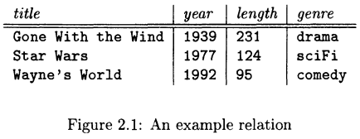

Relational model
The relational model of data is the most widely used model today.
Main concept: relation, basically a table with rows and columns.
Every relation has a schema, which describes the columns, or fields.
(schema = data structure )

Slide 4
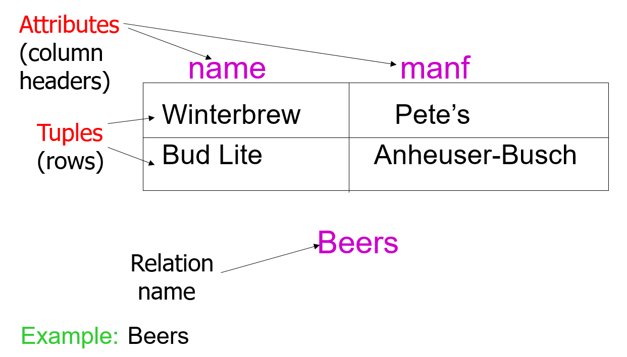
A Relation is a Table

Slide 5
Schemas
A schema is a way to organize the tables and objects within the database.
Relation schema =relation name and attribute's name list
Example:
Beers(name, manf) Movies(title, year, length, genre)
or
Movies(title: string, year: integer, length: integer, genre: string)
Note: attributes in a relation schema are a set.
Database = collection of relations.
Database schema = set of all relation schemas in the database.

Slide 6
Why Relations?
Very simple model.
Often matches how we think about data.
Abstract model that underlies SQL, the most important database language today.

Slide 7
Our Running Example
Beers(name, manf)
Bars(name, addr, license)
Drinkers(name, addr, phone)
Likes(drinker, beer)
Sells(bar, beer, price)
Frequents(drinker, bar)
Underline = key (tuples cannot have the same value in all key attributes).
Excellent example of a constraint.

Slide 8
SQL
SQL: Structured Query Language
SQL is primarily a query language, for getting information from a database.
But SQL also includes a data-definition component for describing database schemas.
Most commercial database management systems implement something similar, but not identical to, the standard.

Slide 9
SQL
SQL statements have three categories:
Data Definition Language (DDL) statements
Data Manipulation Language (DML) statements
Data Control Language (DCL) statements
Most commercial database management systems implement something similar, but not identical to, the standard.

Slide 10
Creating (Declaring) a Database
Simplest form is:
CREATE DATABASE <db_name>;
To delete a relation:
DROP DATABASE <db_name>;

Slide 11
Creating (Declaring) a Relation
Simplest form is:
CREATE TABLE <table_name>
(
<list of elements>
);
To delete a relation:
DROP TABLE <table_name>;

Slide 12
Elements of Table Declarations
Most basic element: an attribute and its type.
The most common types are:
INT or INTEGER (synonyms).
REAL or FLOAT (synonyms).
CHAR(n) = fixed-length string of n characters.
VARCHAR(n) = variable-length string of up to n characters.

Slide 13
Example: Create Table
CREATE TABLE Book_Info
(
Book_ID SMALLINT ,
Book_Name VARCHAR(20) ,
Description VARCHAR(30) ,
Price FLOAT,
Author_ID INT
)
CREATE TABLE Sells
( bar CHAR(20),
beer VARCHAR(20),
price REAL
);
SQL is case insensitive

Slide 14
SQL Values
Integers and reals are represented as you would expect.
Strings are too, except they require single quotes.
Two single quotes = real quote, e.g., 'Joe''s Bar'.
Any value can be NULL.

Slide 15
Dates and Times
DATE and TIME are types in SQL.
The form of a date value is: DATE ‘yyyy-mm-dd’
Example: DATE '2007-09-30' for Sept. 30, 2007.
The form of a time value is: TIME ‘hh:mm:ss’
with an optional decimal point and fractions of a second following.
Example: TIME '15:30:02.5' = two and a half seconds after 3:30PM.

Slide 16
Declaring Keys
An attribute or list of attributes may be declared PRIMARY KEY or UNIQUE.
Either says that no two tuples of the relation may agree in all the attribute(s) on the list.
There are a few distinctions to be mentioned later.

Slide 17
Declaring Single-Attribute Keys
Place PRIMARY KEY or UNIQUE after the type in the declaration of the attribute.
Example:
CREATE TABLE Beers
(
name CHAR(20) UNIQUE,
manf CHAR(20)
);

Slide 18
Declaring Multi-attribute Keys
A key declaration can also be another element in the list of elements of a CREATE TABLE statement.
This form is essential if the key consists of more than one attribute.
May be used even for one-attribute keys.

Slide 19
Example: Multi-attribute Key
The bar and beer together are the key for Sells:
CREATE TABLE Sells (
bar CHAR(20),
beer VARCHAR(20),
price REAL,
PRIMARY KEY (bar, beer)
);

Slide 20
PRIMARY KEY vs. UNIQUE
There can be only one PRIMARY KEY for a relation, but several UNIQUE attributes.
No attribute of a PRIMARY KEY can ever be NULL in any tuple. But attributes declared UNIQUE may have NULL’s, and there may be several tuples with NULL.

Slide 21
Modifying Relation Scheme
Delete relation R:
DROP TABLE R;
e.g
DROP TABLE Book_Info_MO;
Modify an existing relation
ALTER TABLE tablename ...

Slide 22
Modifying Relation Scheme
Example: Add an attribute discount to relation Sells
ALTER TABLE Sells ADD discount float;
Drop the discount attribute from Sells
ALTER TABLE Sells DROP discount;

Slide 23
Default Values
Example:
Add an attribute discount to relation Sells:
ALTER TABLE Sells
ADD discout float DEFAULT 0.0;

Slide 24
Any Questions?
Homework:
Sec. 2.2, 2.3 (阅读)
Exercise 2.3.1, 2.3.2 @ P.36-37
2020年9月6日

Slide 25
Semistructured Data
Another data model, based on trees.
Motivation: flexible representation of data.
Motivation: sharing of documents among systems and databases.

Slide 26
XML
XML = eXtensible Markup Language.
While HTML uses tags for formatting (e.g., “italic”), XML uses tags for semantics (e.g., “this is an address”).
Key idea: create tag sets for a domain (e.g., movies), and translate all data into properly tagged XML documents.

Slide 27
XML Documents
Start the document with a declaration, surrounded by <?xml … ?> .
Typical:
<?xml version = “1.0” encoding = “utf-8” ?>
Balance of document is a root tag surrounding nested tags.

Slide 28
Tags
Tags, as in HTML, are normally matched pairs, as <FOO> … </FOO>.
Optional single tag <FOO/>.
Tags may be nested arbitrarily.
XML tags are case sensitive.

Slide 29
Example: an XML Document
A NAME
subobject
<?xml version = “1.0” encoding = “utf-8” ?>
<BARS>
<BAR><NAME>Joe’s Bar</NAME>
<BEER><NAME>Bud</NAME>
<PRICE>2.50</PRICE></BEER>
<BEER><NAME>Miller</NAME>
<PRICE>3.00</PRICE></BEER>
</BAR>
<BAR> …
</BARS>
A BEER
subobject
29

Slide 30
Attributes
Like HTML, the opening tag in XML can have atttribute = value pairs.
Attributes also allow linking among elements (discussed later).

Slide 31
Bars, Using Attributes
<?xml version = “1.0” encoding = “utf-8” ?>
<BARS>
<BAR name = “Joe’s Bar”>
<BEER name = “Bud” price = 2.50 />
<BEER name = “Miller” price = 3.00 />
</BAR>
<BAR> …
</BARS>
name and
price are
attributes
Notice Beer elements
have only opening tags
with attributes.

