Slide 1
Outline
Queries Optimizing

Slide 2

RDBMS Architecture
How does a SQL engine work ?
SQL Query
Relational Algebra (RA) Plan
Optimized RA Plan
Execution
Declarative query (from user)
Translate to relational algebra expression
Find logically equivalent- but more cost-efficient- RA expression
Execute each operator of the optimized plan!

Slide 3
RDBMS Architecture
How does a SQL engine work ?
SQL Query
Relational Algebra (RA) Plan
Optimized RA Plan
Execution
Relational Algebra allows us to translate declarative (SQL) queries into precise and optimizable expressions!

Slide 4
Relational Algebra (RA)
Five basic operators:
Selection: σ
Projection: π
Cartesian Product: ×
Union: ∪
Difference: -
Derived or auxiliary operators:
Intersection
Joins:
Renaming: ρ

Slide 5

Converting SFW Query to RA
Students(sid,sname,gpa)
People(ssn,sname,address)
SELECT DISTINCT gpa, address
FROM Students S, People P
WHERE gpa > 3.5
AND sname = sname;
How do we represent this query in RA?

Slide 6
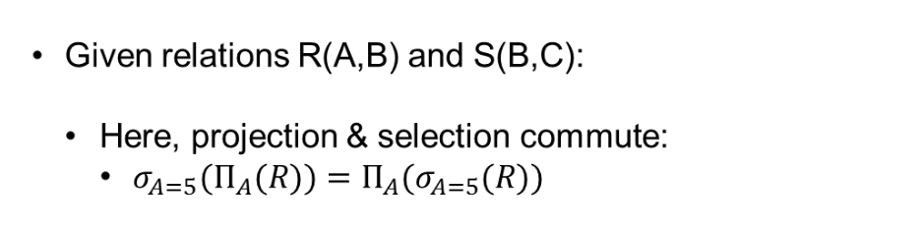

Logical Equivalence of RA Plans

Slide 7
RDBMS Architecture
How does a SQL engine work ?
SQL Query
Relational Algebra (RA) Plan
Optimized RA Plan
Execution
We’ll look at how to then optimize these plans now

Slide 8


Visualize the plan as a tree
R(A,B)
S(B,C)
Bottom-up tree traversal = order of operation execution!

Slide 9

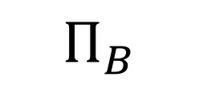
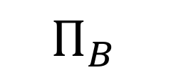
One simple plan -- “Push down” projection
R(A,B)
S(B,C)
R(A,B)
S(B,C)
What SQL query does this correspond to?
Why might we prefer this plan?
Are there any logically equivalent RA expressions?

Slide 10
Logical Optimization
Heuristically, we want selections and projections to occur as early as possible in the plan
Terminology: “push down selections and projections”
Intuition: We will usually have fewer tuples in a plan.

Slide 11


Translating to RA
R(A,B) S(B,C) T(C,D)
SELECT R.A,S.D
FROM R,S,T
WHERE R.B = S.B
AND S.C = T.C
AND R.A < 10;
σ_{Α< 10}
T(C,D)
R(A,B)
S(B,C)

Slide 12

Optimizing RA Plan
Push down selection on A so it occurs earlier
R(A,B) S(B,C) T(C,D)
SELECT R.A,S.D
FROM R,S,T
WHERE R.B = S.B
AND S.C = T.C
AND R.A < 10;
σ_{Α< 10}
T(C,D)
R(A,B)
S(B,C)

Slide 13

Optimizing RA Plan
R(A,B) S(B,C) T(C,D)
Push down selection on A so it occurs earlier
SELECT R.A,S.D
FROM R,S,T
WHERE R.B = S.B
AND S.C = T.C
AND R.A < 10;
T(C,D)
σ_{Α< 10}
S(B,C)
R(A,B)

Slide 14

Optimizing RA Plan
Push down projection so it occurs earlier
R(A,B) S(B,C) T(C,D)
SELECT R.A,S.D
FROM R,S,T
WHERE R.B = S.B
AND S.C = T.C
AND R.A < 10;
T(C,D)
σ_{Α < 10}
S(B,C)
R(A,B)

Slide 15


Optimizing RA Plan
R(A,B) S(B,C) T(C,D)
We eliminate B earlier!
SELECT R.A,S.D
FROM R,S,T
WHERE R.B = S.B
AND S.C = T.C
AND R.A < 10;
In general, when is an attribute not needed…?
T(C,D)
σ_{Α < 10}
S(B,C)
R(A,B)

Slide 16
Basic RA strategies
Push projection through (1) selection, (2) join
Push selection through (3) selection, (4) projection, (5) join
Also: Joins can be re-ordered!
⇒ Note that this is not an exhaustive set of operations
This covers local re-writes; global re-writes possible but much harder
This simple set of tools allows us to greatly improve the execution time of queries by optimizing RA plans!

Slide 17
Takeaways
This process is called logical optimization
Many equivalent plans used to search for “good plans”
Relational algebra is a simple and elegant abstraction

