Slide 1
事务（Transaction） （ Sec. 6.6 ）
李龙杰
兰州大学 信息科学与工程学院
ljli@lzu.edu.cn
https://ljlilzu.github.io/

Slide 2
例子1
考虑银行应用中的一个转账业务，从A账户向B账户转1000元。
SELECT amount FROM A; UPDATE A SET amount = amount - 1000； UPDATE B SET amount = amount + 1000；
三条语句顺序执行，在执行的过程中系统可能发生故障（崩溃、停电），会出现A账户少了1000元，而B账户的余额不变。
Notes:
这个业务至少有三条SQL语句
如果一个银行经常出现这样的事情，这个银行肯定要倒闭了

Slide 3
例子2
数据库的一个重要特征就是可共享，也可能会造成问题
例如车票预订系统。
A用户要订1张“十一”从兰州到西安的G1876次车的车票。首先查询车票，发现还有1张票，然后进行预订。与此同时，B用户也要预订同一天、同一车次的车票。可能发生一张票卖给了两个人的事情。
DBMS是非常“靠谱”的，有一种机制能够保证此类事件不会发生。用户可以放心的将业务交给DBMS。
Notes:
Database systems are normally being accessed by many users or processes at the same time.
Both queries and modifications.

Slide 4
事务（Transaction）
事务是用户定义的一个数据库操作序列，这些操作要么全做要么全不做，是一个不可分割的工作单位。
事务的显式定义
BEGIN TRANSACTION
SELECT amount FROM A; UPDATE A SET amount = amount - 1000； UPDATE B SET amount = amount + 1000；
COMMIT
事务的隐式定义
Notes:
DBMS的这种机制是 事务

Slide 5
事务的原子性
事务有四个性质：原子性（Atomicity）、一致性（Consistency）、隔离性（Isolation）和持久性（Durability），简称ACID性质
原子性：
事务包含的所有操作是一个整体，包含在其中的对数据库的操作要么都被执行，要么都不执行。
不能只执行部分操作
做事情要有始有终，不能半途而废

Slide 6
事务的一致性
一致性：
一致指的是数据符合数据库本身的定义和要求，没有包含非法或无效的错误数据。
一致性是指事务必须使数据库从一个一致的状态变到另外一个一致的状态，也就是执行事务之前和之后的状态都必须处于一致的状态。
如，转账事务执行前后，A、B账户的余额之和不变；一张车票只卖给一个乘客
一致性是用户自己定义的
取钱操作的一致性又不一样
一致性也可以理解为：事务的执行要遵守规则、约束
一致也可以理解为一种“和谐”，事务的一致性就是不破坏这种和谐
Notes:
事务的原子性保证了，一致性也就保证了
和谐 是中国传统文化的基本理念，是经济社会和谐稳定，持续健康发展的重要保证。

Slide 7
事务的隔离性
隔离性
事务的隔离性指的是，即使数据库中有多个事务并发地执行，各个事务之间不应互相影响，并且在并发状态下执行的事务和串行执行的事务产生的结果完全相同。
在多个事务并发执行时，系统应保证与这些事务先后单独执行时的结果一样
车票预订的例子
隔离性也可以理解为事务之间相互不干扰，体现了一种“自由”和“平等”
自由与规则相辅相成，没有规则约束的自由，犹如无源之水、无本之木。
平等是兼顾效率与公平的平等
Notes:
Database systems are normally being accessed by many users or processes at the same time.

Slide 8
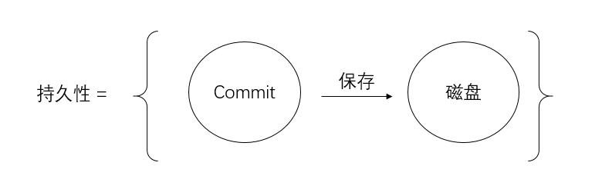
事务的持久性
持久性：
当一个事务执行完毕时，执行这个事务的结果已经被保存在永久性存储介质中了，即使服务器在事务执行完毕后停机，执行事务所得的结果也不会丢失。
例子
BEGIN TRANSACTION
SELECT amount FROM A; UPDATE A SET amount = amount - 1000； UPDATE B SET amount = amount + 1000；
COMMIT
爱岗敬业，科学严谨

Slide 9
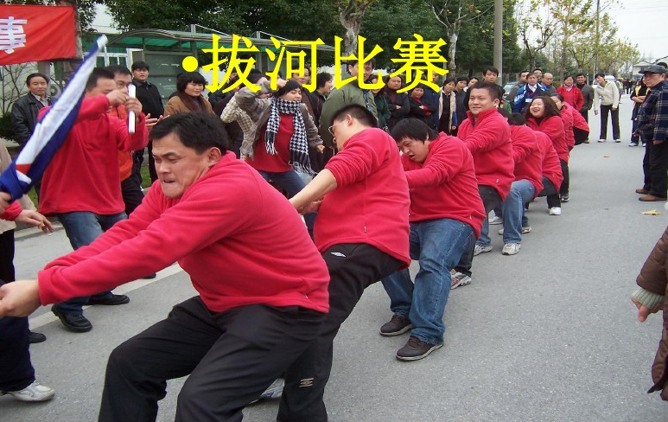
事务性质的保证
数据库的数据恢复技术可以保证事务的原子性、一致性和持久性
数据库的并发控制技术可以保证事务的隔离性
DBMS由许多不同的功能模块组成，它们之间明确分工、各司其职、相互合作形成了安全可靠的数据库系统。
将DBMS看成一个团队，各功能模块就是团队成员，数据库系统是团队合作的结果。
团队精神包含协作、奉献、实干
要心往一处想、劲往一处使

Slide 10



Example: Interacting Processes
Assume the usual Sells(bar,beer,price) relation, and suppose that Joe’s Bar sells only Bud for $2.50 and Miller for $3.00.
Sally is querying Sells for the highest and lowest price Joe charges.
Joe decides to stop selling Bud and Miller, but to sell only Heineken at $3.50.

Slide 11
Sally’s Program
Sally executes the following two SQL statements called (min) and (max) to help us remember what they do.
(max) SELECT MAX(price) FROM Sells
WHERE bar = 'Joe''s Bar';
(min) SELECT MIN(price) FROM Sells
WHERE bar = 'Joe''s Bar';

Slide 12
Joe’s Program
At about the same time, Joe executes the following steps: (del) and (ins).
(del) DELETE FROM Sells
WHERE bar ='Joe''s Bar‘;
(ins) INSERT INTO Sells
VALUES('Joe''s Bar', 'Heineken', 3.50);

Slide 13
Interleaving of Statements
Although (max) must come before (min), and (del) must come before (ins), there are no other constraints on the order of these statements, unless we group Sally’s and/or Joe’s statements into transactions.

Slide 14
Example: Strange Interleaving
Suppose the steps execute in the order (max)(del)(ins)(min).
Joe’s Prices:
Statement:
Result:
Sally sees MAX < MIN!
{2.50,3.00}
{2.50,3.00}
{3.50}
(max)
(del)
(ins)
(min)
3.00
3.50

Slide 15
Transactions
Transaction = process involving database queries and/or modification.
A transaction is a collection of one or more operations on the database that must be executed atomically.
Normally with some strong properties regarding concurrency.
Formed in SQL from single statements or explicit programmer control.

Slide 16
COMMIT
The SQL statement COMMIT causes a transaction to complete.
It’s database modifications are now permanent in the database.
Start a transaction by
BEGIN TRANSACTION
START TRANSACTION # MySQL

Slide 17
ROLLBACK
The SQL statement ROLLBACK also causes the transaction to end, but by aborting.
No effects on the database.
Failures like division by 0 or a constraint violation can also cause rollback, even if the programmer does not request it.

Slide 18
Fixing the Problem by Using Transactions
If we group Sally’s statements (max)(min) into one transaction, then she cannot see this inconsistency.
She sees Joe’s prices at some fixed time.
Either before or after he changes prices, or in the middle, but the MAX and MIN are computed from the same prices.

Slide 19
Another Problem: Rollback
Suppose Joe executes (del)(ins), not as a transaction, but after executing these statements, thinks better of it and issues a ROLLBACK statement.
If Sally executes her statements after (ins) but before the rollback, she sees a value, 3.50, that never existed in the database.

Slide 20
Solution
If Joe executes (del)(ins) as a transaction, its effect cannot be seen by others until the transaction executes COMMIT.
If the transaction executes ROLLBACK instead, then its effects can never be seen.

Slide 21
事务的隔离级别
自然辩证法告诉我们事物是相互联系、充满着矛盾的统一整体
数据库系统也存在这样的对立统一
一方面希望保证事务之间的隔离，另一方面又希望提高并发访问
为了解决这一矛盾，DBMS定义了事务的隔离级别
SERIALIZABLE（可串行化）
REPEATABLE READ（可重复读）
READ COMMITTED（读提交数据）
READ UNCOMMITTED（可以读未提交数据）
用户可以根据业务的需求，设置相应的隔离级别，在事务的隔离与并发访问之间进行权衡

Slide 22
事务的隔离级别
SERIALIZABLE：允许事务并发执行，但须保证并发调度可串行化。
REPEATABLE READ：只许事务读已提交的数据，且两次读之间不许其他事务修改此数据。事务可以不可串行化。
READ COMMITTED：允许事务读已提交的数据，但不要求“可重复读”。
READ UNCOMMITTED：允许事务读已提交或未提交的数据。
上述四种级别可以用下列SQL语句定义：
SET TRANSACTION ISOLATION LEVEL SERIALIZABLE
SET TRANSACTION ISOLATION LEVEL REPEATABLE READ
SET TRANSACTION ISOLATION LEVEL READ COMMITTED
SET TRANSACTION ISOLATION LEVEL READ UNCOMMITTED

Slide 23
Isolation Levels
SQL defines four isolation levels = choices about what interactions are allowed by transactions that execute at about the same time.
Only one level (“serializable”) = ACID transactions.
Each DBMS implements transactions in its own way.

Slide 24
Choosing the Isolation Level
Within a transaction, we can say:
SET TRANSACTION ISOLATION LEVEL X
where X =
SERIALIZABLE
REPEATABLE READ
READ COMMITTED
READ UNCOMMITTED

Slide 25
Serializable Transactions
If Sally = (max)(min) and Joe = (del)(ins) are each transactions, and Sally runs with isolation level SERIALIZABLE, then she will see the database either before or after Joe runs, but not in the middle.

Slide 26
Isolation Level Is Personal Choice
Your choice, e.g., run serializable, affects only how you see the database, not how others see it.
Example: If Joe Runs serializable, but Sally doesn’t, then Sally might see no prices for Joe’s Bar.
i.e., it looks to Sally as if she ran in the middle of Joe’s transaction.

Slide 27
Read-Commited Transactions
If Sally runs with isolation level READ COMMITTED, then she can see only committed data, but not necessarily the same data each time.
Example: Under READ COMMITTED, the interleaving (max)(del)(ins)(min) is allowed, as long as Joe commits.
Sally sees MAX < MIN.

Slide 28
Repeatable-Read Transactions
Requirement is like read-committed, plus: if data is read again, then everything seen the first time will be seen the second time.
But the second and subsequent reads may see more tuples as well.

Slide 29
Example: Repeatable Read
Suppose Sally runs under REPEATABLE READ, and the order of execution is (max)(del)(ins)(min).
(max) sees prices 2.50 and 3.00.
(min) can see 3.50, but must also see 2.50 and 3.00, because they were seen on the earlier read by (max).

Slide 30
Read Uncommitted
A transaction running under READ UNCOMMITTED can see data in the database, even if it was written by a transaction that has not committed (and may never).
Example: If Sally runs under READ UNCOMMITTED, she could see a price 3.50 even if Joe later aborts.

Slide 31
隔离级别的控制
事务隔离级别是通过数据库的锁机制来控制的，在不同的应用场景需要应用不同的事务隔离级别，大部分默认的事务隔离级别是READ COMMITTED，默认的隔离级别，已经可以满足我们大部分应用的需求。
通常来说，事务隔离级别越低，所需持有锁的时间也就越短，并发性能也就越好。

Slide 32
读写锁
读写锁的概念很平常，在读取数据的时候，应该先加读锁，读取完之后的某个时间再解开读锁。
加了读锁的数据，只能读，不能写，因为加了读锁，说明有事务准备读取这个数据，如果被别的事务重写这个数据，那数据就不准确了。所以一个事务给这个数据加了读锁，别的事务也可以对这个数据加读锁，因为大家都是只读不写。
写锁则具有排他性（exclusive lock），当一个事务准备对一个数据进行写操作的时候，先要对数据加写锁，那么数据就是可变的，这时候，其他事务就无法对这个数据加读锁了，除非这个写锁释放。

Slide 33
两段锁协议
两段锁协议：两段锁协议要求所有事务必须分两个阶段对数据项加锁和解锁：
（1）在对任何数据进行读、写操作之前，先要申请并获得对该数据的封锁；
（2）在释放一个封锁之后，事务不再申请和获得任何其他封锁。

Slide 34
2020年11月15日

