Slide 1
Design Theory for Relational Databases Functional Dependencies （ Sec 3.1, 3.2）
李龙杰
兰州大学 信息科学与工程学院
ljli@lzu.edu.cn
https://ljlilzu.github.io/

Slide 2
Functional Dependencies（函数依赖）
X ->Y is an assertion about a relation R that whenever two tuples of R agree on all the attributes of X, then they must also agree on all attributes in set Y.
Say “X ->Y holds in R.”
Convention: …, X, Y, Z represent sets of attributes; A, B, C,… represent single attributes.
Convention: for sets of attributes, just ABC, rather than {A,B,C }.

Slide 3
Splitting Right Sides of FD’s
X->A₁A₂…A_{n} holds for R exactly when each of X->A₁, X->A₂,…, X->A_{n} hold for R.
Example: A->BC is equivalent to A->B and A->C.
There is no splitting rule for left sides.
We’ll generally express FD’s with singleton right sides.

Slide 4
Example: FD’s
Drinkers(name, addr, beersLiked, manf, favBeer)
Reasonable FD’s to assert:
name -> addr favBeer
Note this FD is the same as name -> addr and name -> favBeer.
beersLiked -> manf

Slide 5
Example: Possible Data
name addr beersLiked manf favBeer
Janeway Voyager Bud A.B. WickedAle
Janeway Voyager WickedAle Pete’s WickedAle
Spock Enterprise Bud A.B. Bud
Because name -> addr
Because name -> favBeer
Because beersLiked -> manf

Slide 6
Key of Relations
A₁A₂…A_{n} is a key for relation R if:
A₁A₂…A_{n} functionally determines all other attributes of R.
No proper subset of A₁A₂…A_{n} functionally determines all other attributes of R.
A key must be minimal.

Slide 7
Superkey of Relations
A set of attributes that contains a key is called a superkey.
superkey: superset of a key
every key is a superkey
some superkeys are not (minimal) key

Slide 8
Example: Superkey
Drinkers(name, addr, beersLiked, manf, favBeer)
{name, beersLiked} is a superkey because together these attributes determine all the other attributes.
name -> addr favBeer
beersLiked -> manf

Slide 9
Example: Key
{name, beersLiked} is a key because neither {name} nor {beersLiked} is a superkey.
name doesn’t -> manf; beersLiked doesn’t -> addr.
There are no other keys, but lots of superkeys.
Any superset of {name, beersLiked}.

Slide 10
Where Do Keys Come From?
Just assert a key K.
The only FD’s are K -> A for all attributes A.
Assert FD’s and deduce the keys by systematic exploration.

Slide 11
More FD’s From “Physics”
Example: “no two courses can meet in the same room at the same time” tells us: hour room -> course.

Slide 12
Inferring FD’s
We are given FD’s X₁ -> A₁, X₂ -> A₂,…, X_{n} -> A_{n} , and we want to know whether an FD Y -> B must hold in any relation that satisfies the given FD’s.
Example: If A -> B and B -> C hold, surely A -> C holds, even if we don’t say so.
Important for design of good relation schemas.
We can use Armstrong’s axiom to deduce all of the FD implied in FD’s, that is denoted F⁺.

Slide 13
Inference Test
To test if Y -> B, start by assuming two tuples agree in all attributes of Y.
Y
0000000. . . 0
00000?? . . . ?

Slide 14
Inference Test – (2)
Use the given FD’s to infer that these tuples must also agree in certain other attributes.
If B is one of these attributes, then Y -> B is true.
Otherwise, the two tuples, with any forced equalities, form a two-tuple relation that proves Y -> B does not follow from the given FD’s.

Slide 15
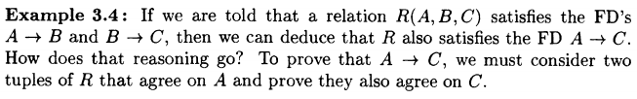
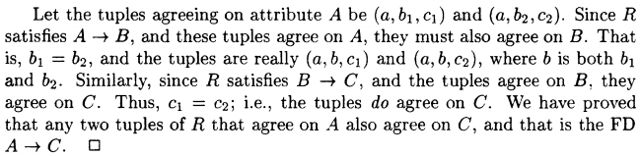
Example

Slide 16
Equivalent of FD’s
Two sets of FD’s S and T are equivalent if the set of relation instances satisfying S is exactly the same as the set of relation instances satisfying T.
A set of FD's S follows from a set of FD's T if every relation instance that satisfies all the FD's in T also satisfies all the FD's in S.
Two sets of FD's S and T are equivalent iff S follows from T , and T follows from S.

Slide 17
Rules about FD’s
Splitting rule:
X->A₁A₂…A_{n} , then X->A₁, X->A₂,…, X->A_{n}
Combining rule:
X->A₁, X->A₂,…, X->A_{n} , then X->A₁A₂…A_{n}

Slide 18
Armstrong’s axiom
Reflexivity rule (自反规则/自反律)
If Y⊆X, then X->Y
Augmentation rule (增广规则)
If X->Y, then XZ->YZ
Transitive rule (传递规则)
If X -> Y and Y -> Z, then X -> Z

Slide 19
Additional rules
Union rule (合并规则)
If X->Y, X->Z , then X->YZ
Pseudo transitivity rule (伪传递规则)
If X->Y, WY->Z , then XW->Z
Decomposition rule (分解规则)
If X→Y, Z⊆Y, then X→Z
Composition rule (复合规则)
If X→Y, W→Z, then XW→YZ

Slide 20
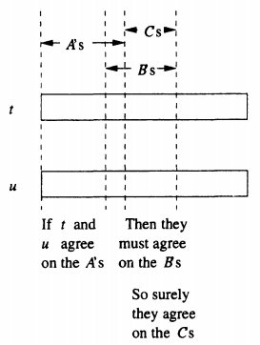
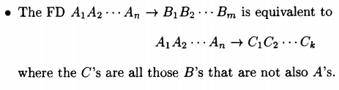
Trivial FD’s (平凡函数依赖)
Y⊆X, then X->Y is a trivial FD.
The right side of a trivial FD is a subset of its left side.
trivial-dependency rule

Slide 21
Closure (闭包) of Attributes
{A₁, A₂, …, A_{n}}: a set of attributes, S: a set of FD’s
Closure of {A₁, A₂, …, A_{n}} under S is the set of attributes B that satisfies A₁, A₂, …, A_{n}->B.
Marked as {A₁, A₂, …, A_{n}}⁺
A₁, A₂, …, A_{n} in {A₁, A₂, …, A_{n}}⁺？
Yes.

Slide 22
X
A
Y⁺
new Y⁺
Process of computing the closure of Y

Slide 23
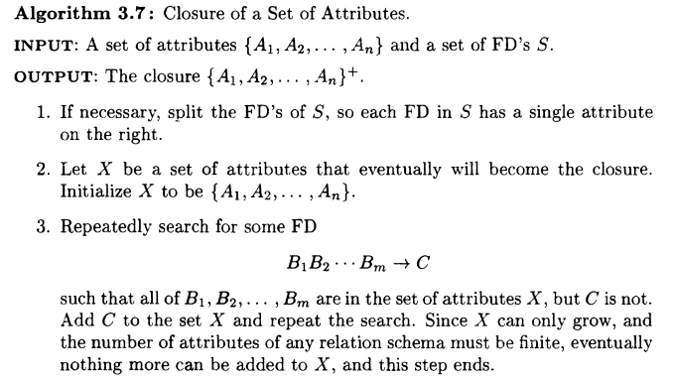

Slide 24


Example
{B, C}⁺?
Does D->A follows from the FD’s?
Another Example: Consider R(A, B, C, D, E, I) and FD’s A->D, AB->E, BI->E, CD->I, and E->C, what is AE⁺?

Slide 25
Closing set of FD’s
Given a set of FD’s F, there are certain other FD’s that are logically implied by F.
e.g.: If A → B and B → C, then we can infer that A → C
The set of all FD’s logically implied by F is the closure of F.
We denote the closure of F by F⁺.

Slide 26
Example
R = (A, B, C, G, H, I) F = {A → B, A → C, CG → H, CG → I, B → H}
some members of F⁺
A → H
by transitivity from A → B and B → H
AG → I
by augmenting A → C with G, to get AG → CG and then transitivity with CG → I
CG → HI
by union CG → H and CG → I

Slide 27
Basis
Generally, F⁺ contains plenty of FD’s.
F⁺ is equivalent to F.
Formally, if F⁺ = G⁺, the F is equivalent to G.
Any set of FD 's equivalent to F is said to be a basis for F.

Slide 28
minimal basis
A minimal basis for a relation is a basis B that satisfies three conditions: 1. All the FD's in B have singleton right sides. 2. If any FD is removed from B, the result is no longer a basis. 3. If for any FD in B we remove one or more attributes from the left side of F , the result is no longer a basis.

Slide 29
Example
Consider R(A, B, C), and FD’s A→B, B→A, B→C, A→C, C→A. List the minimal basis.
{A→B, B→C, C→A}

Slide 30

Projecting FD’s
Example: R(A, B, C, D) with FD’s AB->C, C->D, and D->A.
R1 = $π_{ABC}\left(R\right),$ What FD’s holds in R1?
Not only AB->C, but also C->A!

Slide 31
Why?
ABCD
a₁b₁cd₁
a₂b₂cd₂
d₁=d₂ because
C -> D
comes
from
a₁=a₂ because
D -> A
ABC
a₁b₁c
a₂b₂c
Thus, tuples in the projection
with equal C’s have equal A’s;
C -> A.

Slide 32
Basic Idea
Start with given FD’s and find all nontrivial FD’s that follow from the given FD’s.
Nontrivial = right side not contained in the left.
Restrict to those FD’s that involve only attributes of the projected schema.

Slide 33
Simple, Exponential Algorithm
For each set of attributes X, compute X ⁺.
Add X ->A for all A in X ⁺ - X.
However, drop XY ->A whenever we discover X ->A.
Because XY ->A follows from X ->A in any projection.
Finally, use only FD’s involving projected attributes.

Slide 34
A Few Tricks
No need to compute the closure of the empty set or of the set of all attributes.
If we find X ⁺ = all attributes, so is the closure of any superset of X.

Slide 35
Projecting FD’s
Example:
R(ABC) with FD’s A ->B and B ->C. Project onto AC.
A ⁺=ABC ; yields A ->B, A ->C.
We do not need to compute AB ⁺ or AC ⁺.
B ⁺=BC ; yields B ->C.
C ⁺=C ; yields nothing.
BC ⁺=BC ; yields nothing.

Slide 36
Example -- Continued
Resulting FD’s: A ->B, A ->C, and B ->C.
Projection onto AC : A ->C.
Only FD that involves a subset of {A, C}.

Slide 37
Any Questions?
Exercises 3.2.1, 3.2.2, 3.2.10 @ P.83
2020年12月6日

