Slide 1
Design Theory for Relational Databases Decomposition and Normal Form （ Sec. 3.3, 3.4, 3.5）
李龙杰
兰州大学 信息科学与工程学院
ljli@lzu.edu.cn
https://ljlilzu.github.io/

Slide 2
Anomalies
A bad design of relation schema can lead to anomalies and redundancy.
Update anomaly : one occurrence of a fact is changed, but not all occurrences.
Deletion anomaly : valid fact is lost when a tuple is deleted.
Redundancy: Information is repeated unnecessarily in several tuples.

Slide 3
Example of Bad Design
Drinkers(name, addr, beersLiked, manf, favBeer)
name addr beersLiked manf favBeer
Janeway Voyager Bud A.B. WickedAle
Janeway ??? WickedAle Pete’s ???
Spock Enterprise Bud ??? Bud
Data is redundant, because each of the ???’s can be figured
out by using the FD’s name -> addr favBeer and
beersLiked -> manf.

Slide 4
This Bad Design Also Exhibits Anomalies
name addr beersLiked manf favBeer
Janeway Voyager Bud A.B. WickedAle
Janeway Voyager WickedAle Pete’s WickedAle
Spock Enterprise Bud A.B. Bud
Update anomaly: if Janeway is transferred to Intrepid,
will we remember to change each of her tuples?
Deletion anomaly: If nobody likes Bud, we lose track
of the fact that Anheuser-Busch manufactures Bud.

Slide 5
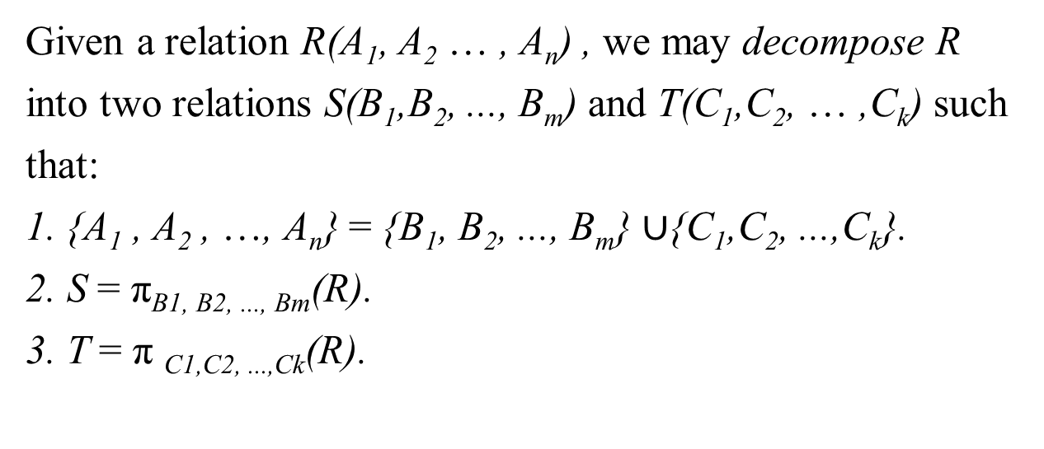
Solution
Decomposition is an accepted way.

Slide 6
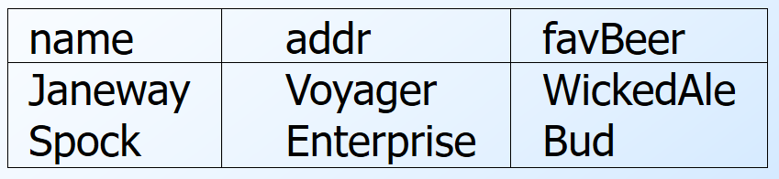
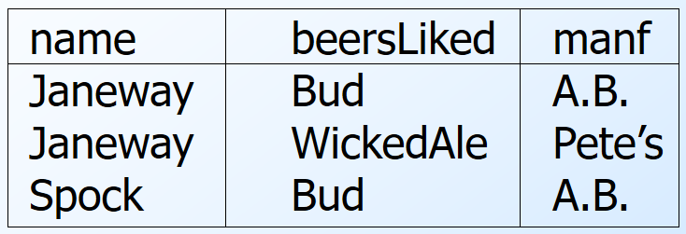
Decomposition Example
Drinkers1(name, addr, favBeer)
Drinkers2(name, beersLiked, manf)

Slide 7
Boyce-Codd Normal Form
We say a relation R is in BCNF if whenever X ->Y is a nontrivial FD that holds in R, X is a superkey.
Remember: nontrivial means Y is not contained in X.
Remember: a superkey is any superset of a key (not necessarily a proper superset).
That is, the left side of every nontrivial FD must contain a key.

Slide 8
Example
Drinkers(name, addr, beersLiked, manf, favBeer)
FD’s: name->addr favBeer, beersLiked->manf
Only key is {name, beersLiked}.
In each FD, the left side is not a superkey.
Any one of these FD’s shows Drinkers is not in BCNF

Slide 9
Another Example
Beers(name, manf, manfAddr)
FD’s: name->manf, manf->manfAddr
Only key is {name} .
name->manf does not violate BCNF, but manf->manfAddr does.

Slide 10
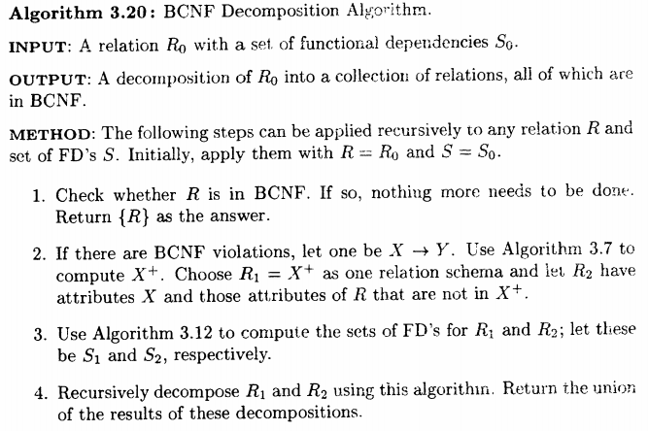
Decomposition into BCNF

Slide 11
Decompose R Using X -> Y
Replace R by relations with schemas:
R₁ = X⁺.
R₂ = R – (X⁺ – X ).
Project given FD’s F onto the two new relations.

Slide 12
Decomposition Picture
R₁
R-X ⁺
X
X ⁺-X
R₂
R

Slide 13
Example: BCNF Decomposition
Drinkers(name, addr, beersLiked, manf, favBeer)
F = name->addr, name -> favBeer, beersLiked->manf
Pick BCNF violation name->addr.
Close the left side: {name}⁺ = {name, addr, favBeer}.
Decomposed relations:
Drinkers1(name, addr, favBeer)
Drinkers2(name, beersLiked, manf)

Slide 14
Example -- Continued
We are not done; we need to check Drinkers1 and Drinkers2 for BCNF.
Projecting FD’s is easy here.
For Drinkers1(name, addr, favBeer), relevant FD’s are name->addr and name->favBeer.
Thus, {name} is the only key and Drinkers1 is in BCNF.

Slide 15
Example -- Continued
For Drinkers2(name, beersLiked, manf), the only FD is beersLiked->manf, and the only key is {name, beersLiked}.
Violation of BCNF.
beersLiked⁺ = {beersLiked, manf}, so we decompose Drinkers2 into:
Drinkers3(beersLiked, manf)
Drinkers4(name, beersLiked)
Any two-attribute relations is in BCNF.
Example 3.17, P.89

Slide 16
Example -- Concluded
The resulting decomposition of Drinkers :
Drinkers1(name, addr, favBeer)
Drinkers3(beersLiked, manf)
Drinkers4(name, beersLiked)
Notice: Drinkers1 tells us about drinkers, Drinkers3 tells us about beers, and Drinkers4 tells us the relationship between drinkers and the beers they like.

Slide 17
Any Questions?
Exercises 3.3.1, 3.3.2, 3.3.4 @ P.92
2020年12月7日

Slide 18
Third Normal Form -- Motivation
There is one structure of FD’s that causes trouble when we decompose.
AB ->C and C ->B.
Example: A = street address, B = city, C = zip code.
There are two keys, {A,B } and {A,C }.
C ->B is a BCNF violation, so we must decompose into AC, BC.

Slide 19
We Cannot Enforce FD’s
The problem is that if we use AC and BC as our database schema, we cannot enforce the FD AB ->C by checking FD’s in these decomposed relations.
Example with A = street, B = city, and C = zip on the next slide.

Slide 20
An Unenforceable FD
street zip
545 Tech Sq. 02138
545 Tech Sq. 02139
city zip
Cambridge 02138
Cambridge 02139
Join tuples with equal zip codes.
street city zip
545 Tech Sq. Cambridge 02138
545 Tech Sq. Cambridge 02139
Although no FD’s were violated in the decomposed relations,
FD street city -> zip is violated by the database as a whole.

Slide 21
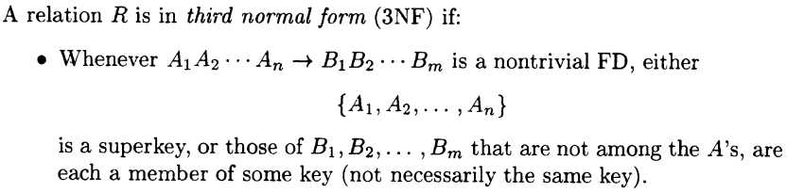
3NF Let’s Us Avoid This Problem
3rd Normal Form (3NF) modifies the BCNF condition so we do not have to decompose in this problem situation.
An attribute is prime if it is a member of any key.
X ->A violates 3NF if and only if X is not a superkey, and also A is not prime.

Slide 22
Example: 3NF
In our problem situation with FD’s AB ->C and C ->B, we have keys AB and AC.
Thus A, B, and C are each prime.
Although C ->B violates BCNF, it does not violate 3NF.

Slide 23
What 3NF and BCNF Give You
There are two important properties of a decomposition:
Lossless Join : it should be possible to project the original relations onto the decomposed schema, and then reconstruct the original.
Dependency Preservation : it should be possible to check in the projected relations whether all the given FD’s are satisfied.

Slide 24
3NF and BCNF -- Continued
We can get (1) with a BCNF decomposition.
We can get both (1) and (2) with a 3NF decomposition.
But we can’t always get (1) and (2) with a BCNF decomposition.
street-city-zip is an example.

Slide 25
Testing for a Lossless Join
If we project R onto R₁, R₂,…, R_{k} , can we recover R by rejoining?
Any tuple in R can be recovered from its projected fragments.
So the only question is: when we rejoin, do we ever get back something we didn’t have originally?

Slide 26
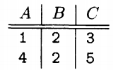
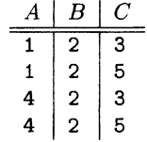
Example 3.21
R(A, B, C), no FD holds. Suppose R consist of two tuples
R₁= π_{AB}(R): (1, 2), (4, 2)
R₂= π_{BC}(R): (2, 3), (2, 5)
R₃=R₁⋈ R₂
We get “too much”.
(1, 2, 5) and (4, 2, 3) are two bogus tuples.
This decomposition does not have a lossless join.

Slide 27
The Chase Test
Suppose tuple t comes back in the join.
Then t is the join of projections of some tuples of R, one for each R_{i} of the decomposition.
Can we use the given FD’s to show that one of these tuples must be t ?

Slide 28
The Chase – (2)
Start by assuming t = abc… .
For each i, there is a tuple s_{i} of R that has a, b, c,… in the attributes of R_{i}.
s_{i} can have any values in other attributes.
We’ll use the same letter as in t, but with a subscript, for these components.

Slide 29
Example: The Chase
Let R = ABCD, and the decomposition be AB, BC, and CD.
Let the given FD’s be C->D and B ->A.
Suppose the tuple t = abcd is the join of tuples projected onto AB, BC, CD.

Slide 30
The Tableau
The tuples
of R projected onto
AB, BC, CD.
A B C D
a b c₁ d₁
a₂ b c d₂
a₃ b₃ c d
a
d
Use B ->A
Use C->D
We’ve proved the
second tuple must be t.

Slide 31
Summary of the Chase
If two rows agree in the left side of a FD, make their right sides agree too.
Always replace a subscripted symbol by the corresponding unsubscripted one, if possible.
If we ever get an unsubscripted row, we know any tuple in the project-join is in the original (the join is lossless).
Otherwise, the final tableau is a counterexample.

Slide 32
Example: Lossy Join
Same relation R = ABCD and same decomposition.
But with only the FD C->D.

Slide 33
The Tableau
These projections
rejoin to form
abcd.
A B C D
a b c₁ d₁
a₂ b c d₂
a₃ b₃ c d
d
These three tuples are an example
R that shows the join lossy. abcd
is not in R, but we can project and
rejoin to get abcd.
Use C->D

Slide 34
3NF Synthesis Algorithm
We can always construct a decomposition into 3NF relations with a lossless join and dependency preservation.
Need minimal basis for the FD’s:
Right sides are single attributes.
No FD can be removed.
No attribute can be removed from a left side.

Slide 35
Constructing a Minimal Basis
Split right sides.
Repeatedly try to remove an FD and see if the remaining FD’s are equivalent to the original.
Repeatedly try to remove an attribute from a left side and see if the resulting FD’s are equivalent to the original.

Slide 36
3NF Synthesis – (2)
One relation for each FD in the minimal basis.
Schema is the union of the left and right sides.
If no key is contained in an FD, then add one relation whose schema is some key.

Slide 37
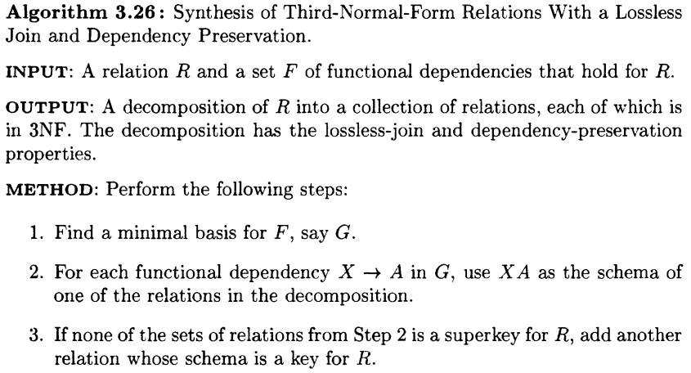
3NF Synthesis algorithm

Slide 38
Example: 3NF Synthesis
Relation R = ABCD.
FD’s A->B and A->C.
Decomposition: AB and AC from the FD’s, plus AD for a key.

Slide 39
Why It Works
Preserves dependencies: each FD from a minimal basis is contained in a relation, thus preserved.
Lossless Join: use the chase to show that the row for the relation that contains a key can be made all-unsubscripted variables.
3NF: hard part – a property of minimal bases.

Slide 40
Any Questions?
Exercises 3.4.1, 3.4.2 @ P.102
Exercises 3.5.1, 3.5.2, 3.5.3, 3.5.4 @ P.105
2020年12月7日

