Slide 1
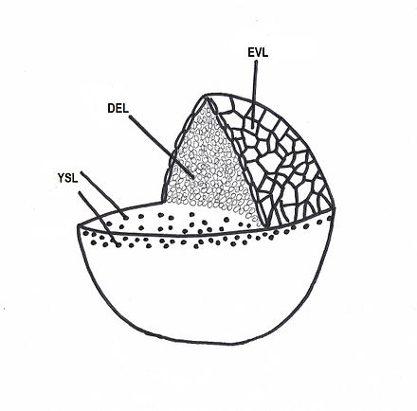
Project 4
The 50% epiboly embryo contains three portions
The enveloping layer (EVL)
  an outer epithelial monolayer that protects the embryo from trauma and helps establish intra-embryonic conditions distinct from the surrounding environment.
2. The deep cells (DEL)
  eventually form the embryo's three germ layers.
3. The yolk syncytial layer (YSL)
  a group of nuclei that lie on top of the yolk cell. YSL is necessary for the hydrolysis of yolk material and for the transfer of nutrients from the yolk cell to the embryonic blastoderm and larval tissues.
Yolk cell
The goal of this work is identifying which metabolically related genes are shared or unique between EVL and YSL. More specifically:
  1. Identify different cell types.
2. Compare the expression of metabolically related genes between EVL and YSL.
3. Are there some metabolically related genes with higher expression in EVL than in YSL?

Slide 2
Some hints for data analysis

