Slide 1

CliniConnect
Advanced Software Engineering(CS5551)
Guided By-Professor Lee
Project Team -1
Shweta Parihar(42)
Luke McDuff (27)
Benjamin Chrysler (8)
Sri Chaitanya Patluri (44)

Slide 2
ClinicConnect
Motivation:
There are many patient to clinic application exist, which are typically patient portal containing overwhelming large amount of data and features. A simple application with few key important features which can help patient to monitor regular health and share the details with doctors easily and timely manner.
Significance:
CliniConnect is a communication application to help Patients connect easier with their clinic and doctors connect easier with there patient.
The application targets at-risk patients typically in low income areas who face challenges connecting with their Clinic.

Slide 3
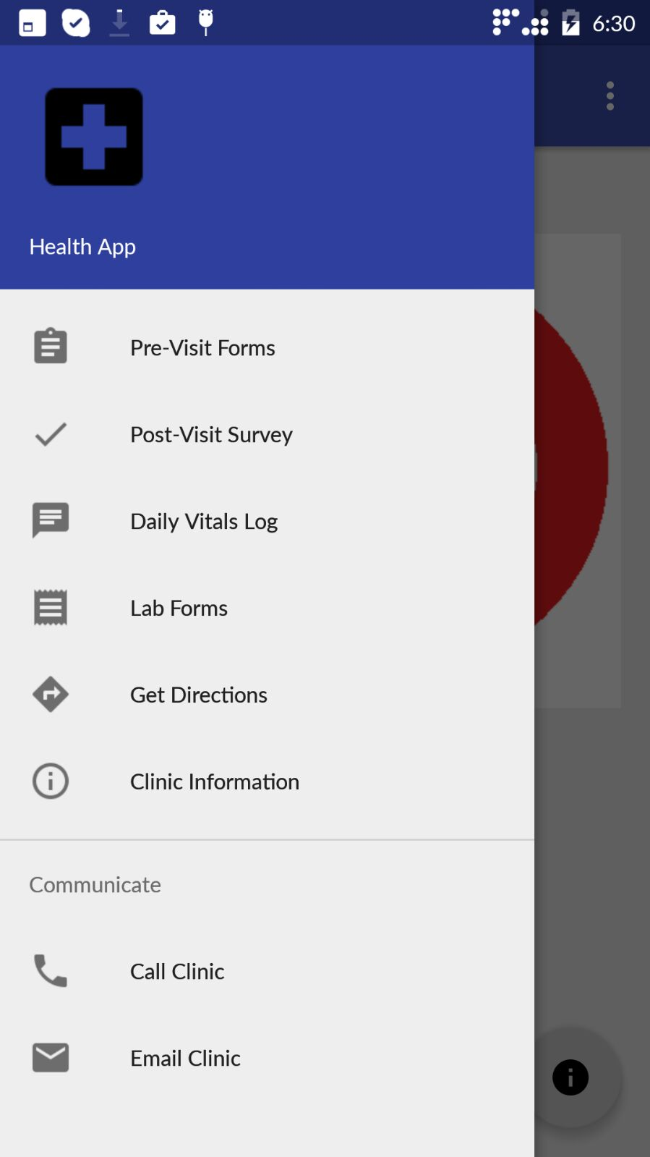
ClinicConnect Android application
Patients can use the CliniConnect Android application to:
Fill out Pre-Visit paperwork before clinic visit and save waiting time.
Complete Post-Visit surveys.
Send vital information
Blood pressure
Blood sugar
Temperature
Description of current state of wellness
Receive lab work orders with QR code
Receive turn-by turn directions to the clinic in a single click.
Call/email the clinic without having to enter an email or dial a number.
Receive appointment reminder push notifications on phone.

Slide 4
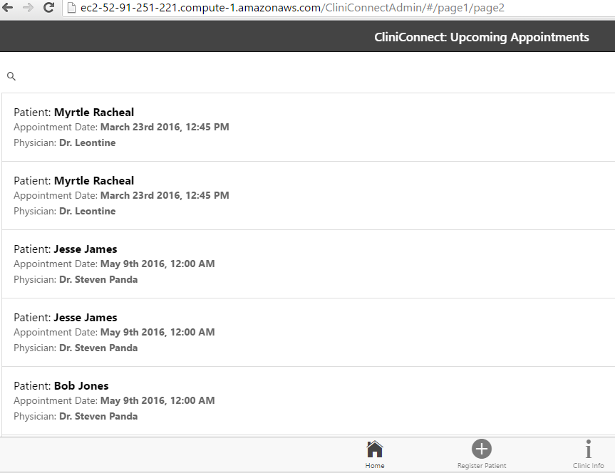
CliniConnect web application
Clinic administrators(Doctor/Nurses) can use the CliniConnect web application to :
Register a new patient into the system
View all registered patients using android application
View all daily vitals log entered by any patient.
View the submitted Pre-Visit and Post-Visit Paperwork for any patient.
Send a patient a push notification appointment reminder which will pop up on patient smart phone.
Send a patient a new lab order with scanable QR code
Update new information about the clinic that controls android application features like: navigation & call/email.

Slide 5
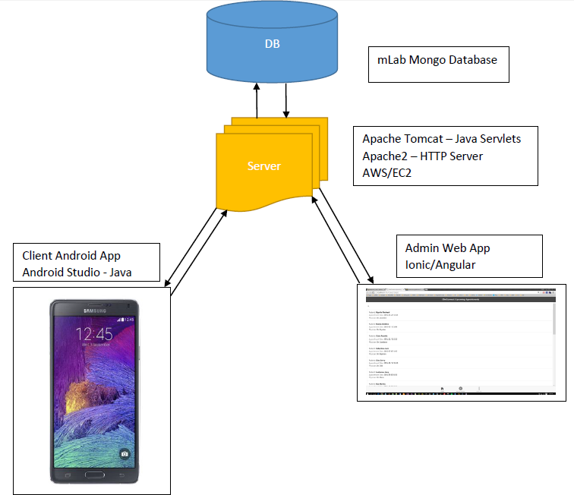
Architecture

Slide 6
Live Demo
CliniConnect

