Slide 1
WTF is… Linux? And also Kali
An introduction (of sorts)

Slide 2

The Logo is a Penguin!
It is also a popular open source operating system used by millions of people worldwide

Slide 3

Linux was first released in 1991
It is based on the GNU Project
The chief “architect” of Linux is this dude →
His name is Linus Torvalds.
He is not a known giver of f**ks
He is a very vocal proponent of well written code
Googling “Linux” or “Linux History” will give you far more information if you are interested

Slide 4

Linux uses Low Level API’s
-This means it has better access to interface directly with the PC hardware
-In contrast to Windows which always has a middle man between the user and the hardware
Linux isn’t as much of a resource hog as Windows (when did this turn into a bash on Windows thing?)
It is however totally possible to completely and totally bork your PC while using Linux due to the lower level access
It’s open source which means if you find a bug and you can fix it, go ahead! (just make sure your code is perfect or Linus will be mad)
It also means it isn’t perfect, though it is getting better and better with community input
This could be you!

Slide 5


Where does Kali fit into this?
Kali is what is known as a “distro” or distribution
It is a customised version of Linux that comes with a whole heap of built in security tools
It is derived from another “distro” called Debian
Why not just use this “Debian” distro then? (did you not read the second bullet point?)
Kali contains things that can get you into trouble. The organisation that maintains it is called Offensive Security which should give you a hint.

Slide 6
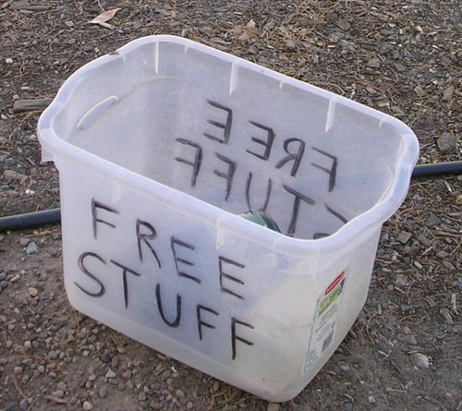
Things to Know About Kali:
Kali is generally ran as a Virtual Machine (using VMware or VBox)
It is commonly ran in “Live” mode rather than being installed
In Kali “root” is NOT hallowed ground (it is generally ran AS “root”)
Some tools run in a GUI, most run through the command line interface
It’s FREE!
Did I mention it’s free?

Slide 7
What can I do with Kali?
Penetration Testing or Pen Testing
How would I go about doing that??
Set up a little network of Virtual Machines! :D
If you’ve downloaded VBox or VMware (links on the last slide) then you already have most of what you need.
Download some server image files (remember Linux is free) from the internet and install them as Virtual Machines
Once you have them installed as Virtual Machines you can look into installing some services on them (maybe a small MySQL server?)
Remember each Virtual Machine needs RAM and CPU so don’t go mental unless your PC can handle it

Slide 8

(Possibly?) Legal Stuff
Kali contains a lot of powerful tools that can get you into a LOT of trouble if you use it maliciously, so make sure you have EXPLICIT permission to do whatever it is that you are trying to do
There is probably a lot more that should be written here. Just don’t be stupid and you’ll be fine. There are environments provided for you (and that you can create yourself as mentioned) to do the work in safety where you can’t get yourself into trouble or mess up someone’s stuff
Nobody wants to read this book, don’t make them by doing anything daft.

Slide 9
Links!
https://www.kali.org/ (Remember to pick the right one for your system)
http://docs.kali.org/ (Kali documentation)
https://my.vmware.com/web/vmware/downloads (VMware Player)
https://www.virtualbox.org/ (My preferred VM)
http://www.owasp.org (Vulnerabilities, lots of em!)
http://en.wikipedia.org/wiki/Linux_kernel (The wiki is actually pretty good for this)

