Slide 1

The Islamic University of Gaza
Faculty of Engineering
Civil Engineering Department
Numerical Analysis
ECIV 3306
Chapter 22
Integration of Equations

Slide 2
Gauss Quadrature
Gauss quadrature implements a strategy of positioning any two points on a curve to define a straight line that would balance the positive and negative errors.
Hence, the area evaluated under this straight line provides an improved estimate of the integral.

Slide 3
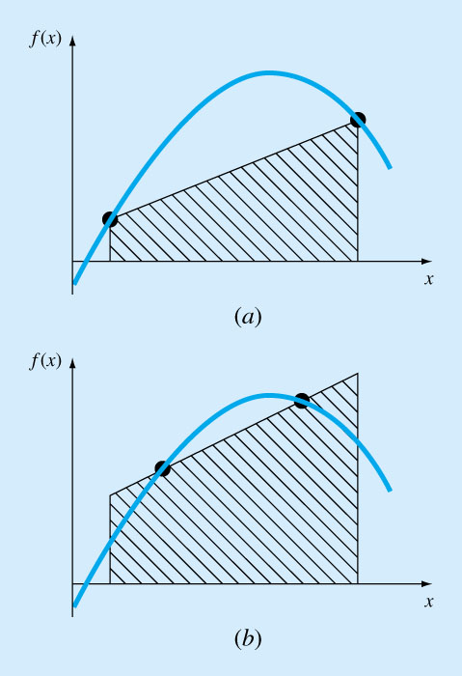

Slide 4
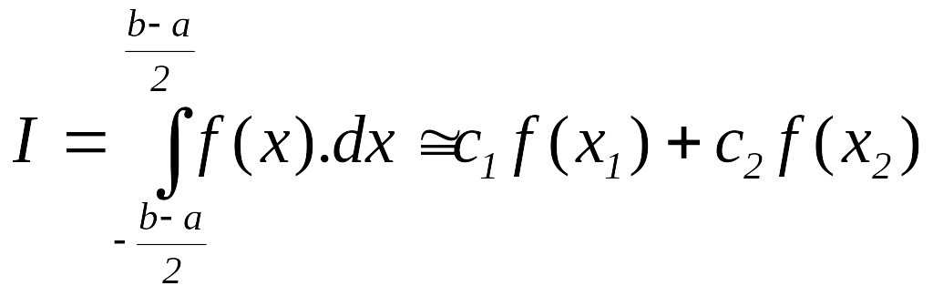
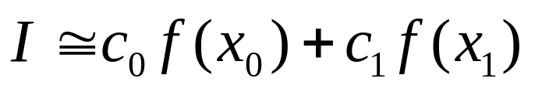
Two points Gauss-Legendre Formula
Assume that the two Integration points are x_{o} and x₁ such that:
The object of Gauss quadrature is to determine the equations of the form:
c₀ and c₁ are constants, the function arguments x₀ and x₁ are unknowns…….(4 unknowns)

Slide 5
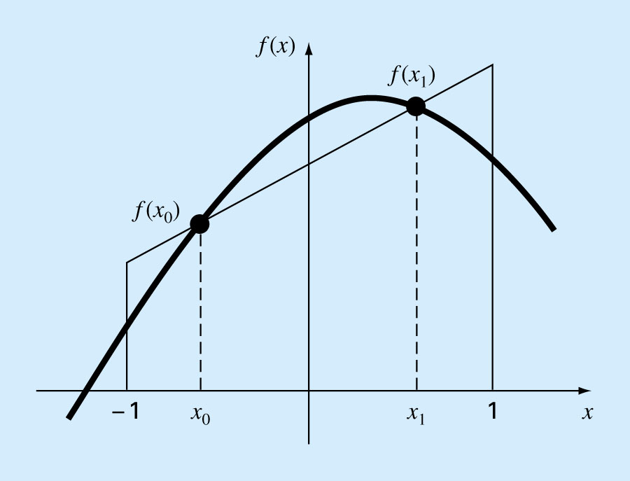

Slide 6
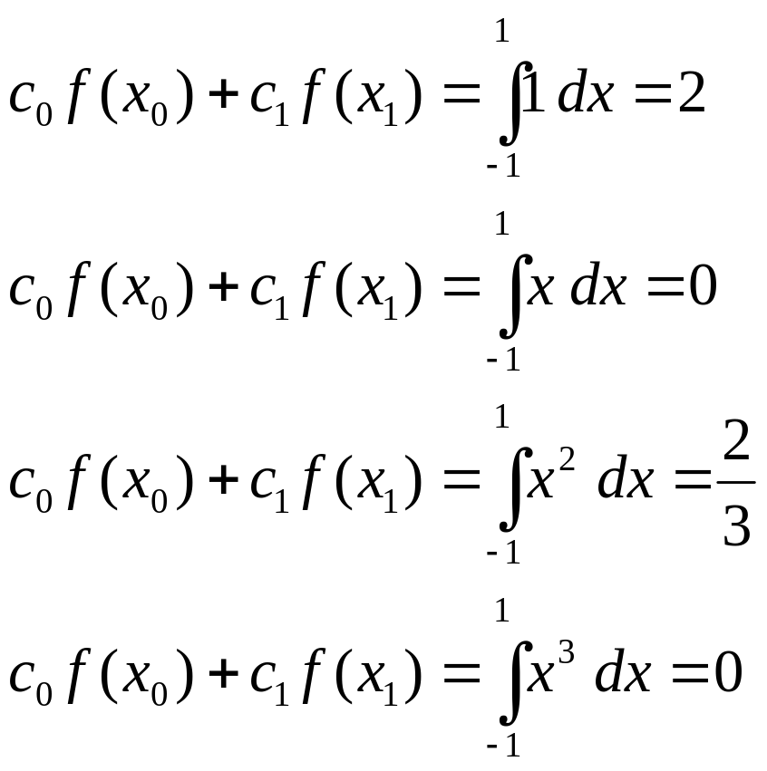
Two points Gauss-Legendre Formula
Thus, four unknowns to be evaluated require four conditions.
If this integration is exact for a constant, 1st order, 2nd order, and 3rd order functions:

Slide 7
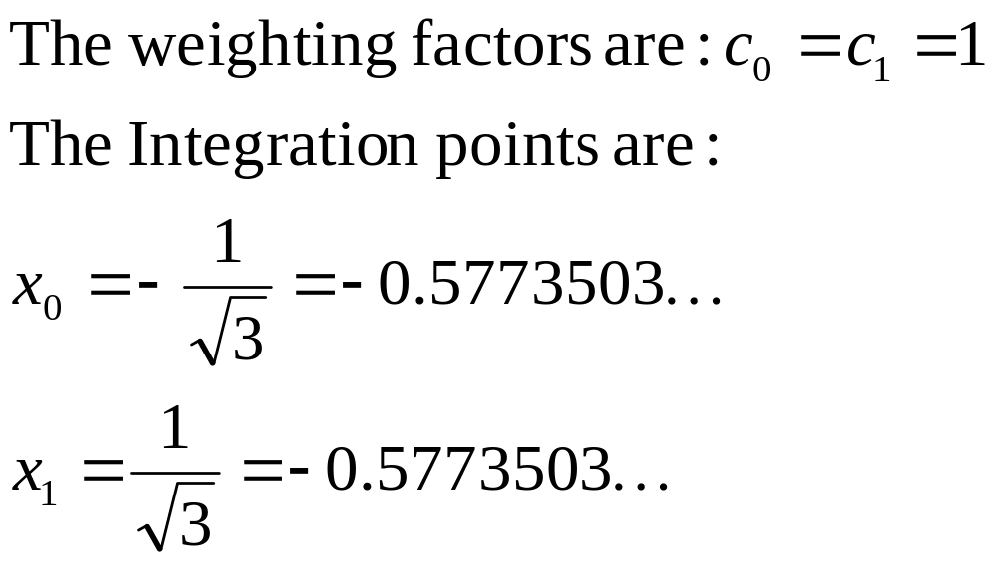
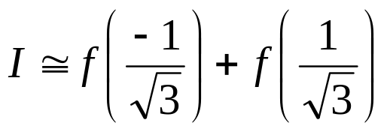
Two points Gauss-Legendre Formula
Solving these 4 equations, we can determine c₁, c₂, x₁ and x₂.

Slide 8
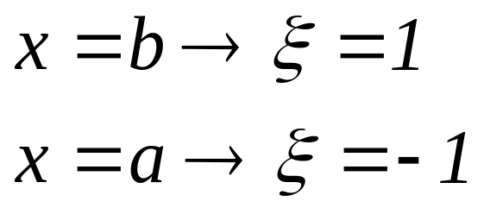
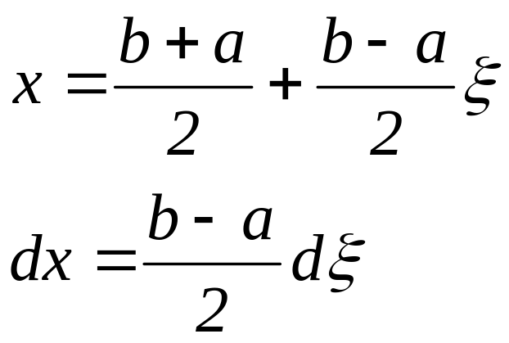
Two points Gauss-Legendre Formula
Since we used limits for the previous integration from –1 to 1 and the actual limits are usually from a to b, then we need first to transform both the function and the integration from the x-system to the x_{d}-system
f(x)
f(ξ)
f(x₁)
f(x_{o})
x
a
x_{o}
x₁
b
ξ
-1
1

Slide 9
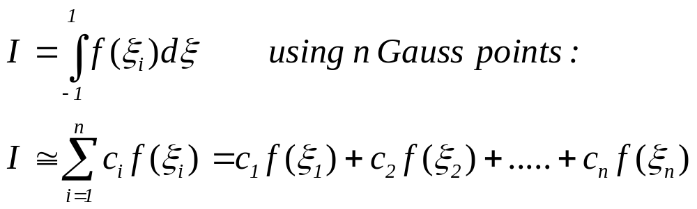
Higher-Points Gauss-Legendre Formula

Slide 10
Multiple Points Gauss-Legendre
Points Weighting factor Function argument Exact for
2 1.0 -0.577350269 up to 3rd
1.0 0.577350269 degree
3 0.5555556 -0.774596669 up to 5th
0.8888889 0.0 degree
0.5555556 0.774596669
4 0.3478548 -0.861136312 up to 7th
0.6521452 -0.339981044 degree
0.6521452 0.339981044
0.3478548 0.861136312
6 0.1713245 -0.932469514 up to 11th
0.3607616 -0.661209386 degree
0.4679139 -0.238619186
0.4679139 0.238619186
0.3607616 0.661209386
0.1713245 0.932469514

Slide 11
Gauss Quadrature - Example
Find the integral of:
f(x) = 0.2 + 25 x – 200 x² + 675 x³ – 900 x⁴ + 400 x⁵
  Between the limits 0 to 0.8 using:
  2 points integration points (ans. 1.822578)
  3 points integration points (ans. 1.640533)

Slide 12
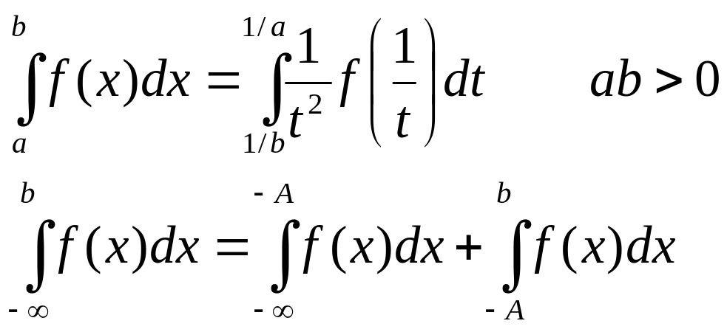
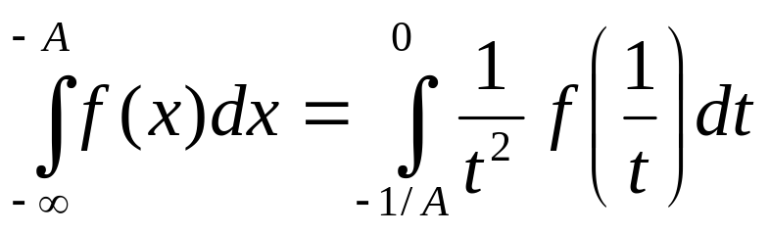
Improper Integral
Improper integrals can be evaluated by making a change of variable that transforms the infinite range to one that is finite,
Can be evaluated by Newton-Cotes closed formula

Slide 13
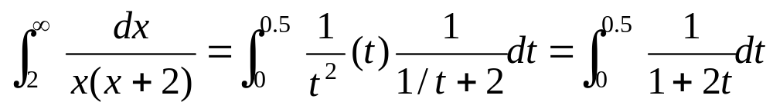
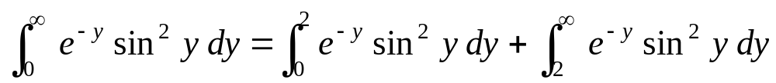
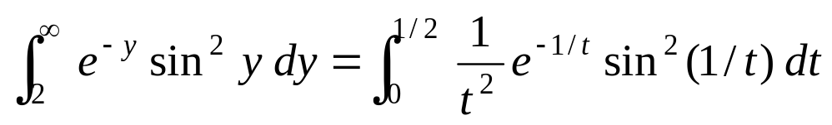
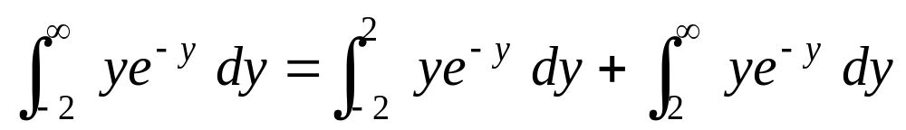
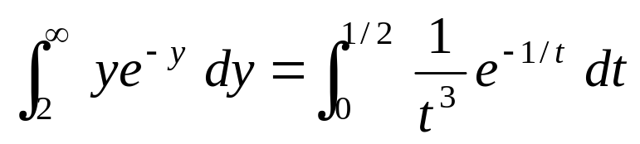
Improper Integral - Examples
.
.
.

Slide 14
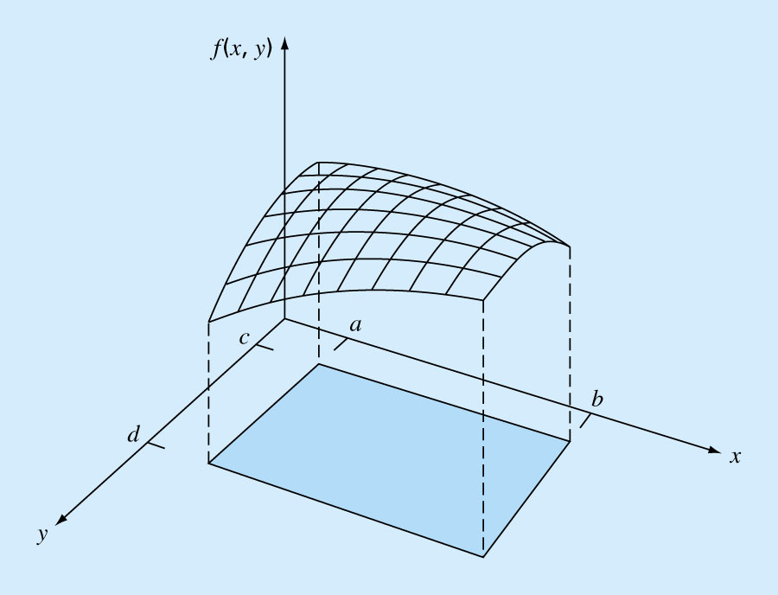
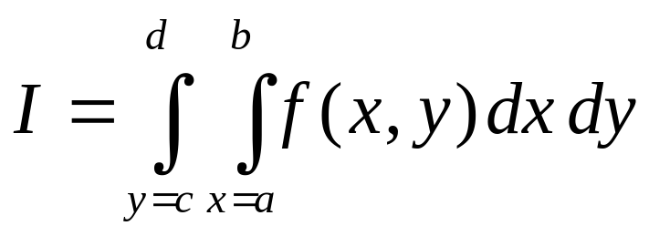
Multiple Integration
Double integral:

Slide 15
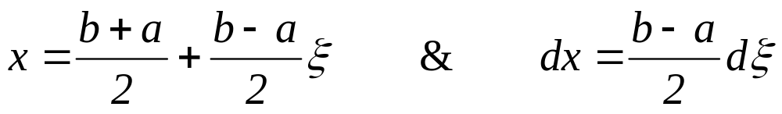
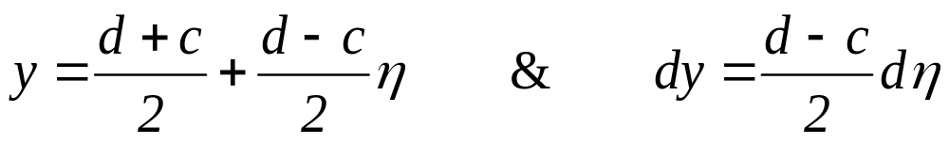
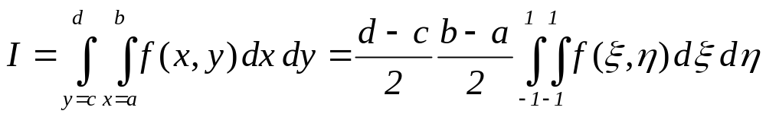
Multiple Integration using Gauss Quadrature Technique
.
.
.

Slide 16
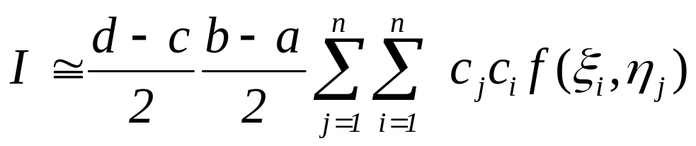
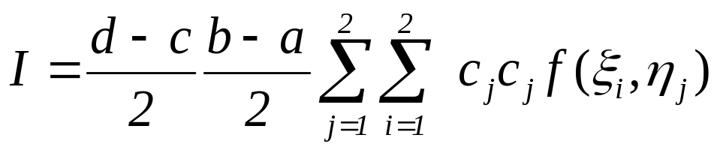
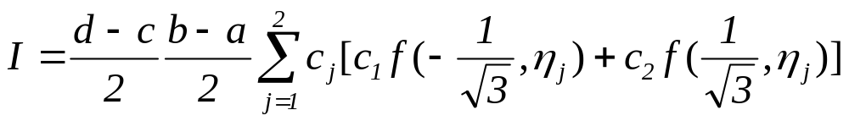
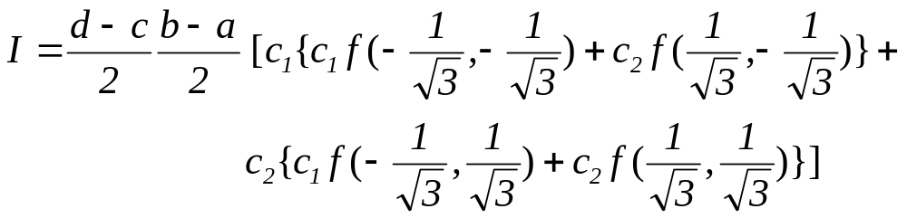
Multiple Integration using Gauss Quadrature Technique
Now we can use the Gauss Quadrature technique:
If we use two points Gauss Formula:

Slide 17
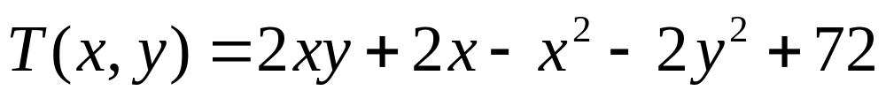
Double integral - Example
Compute the average temperature of a rectangular heated plate which is 8m long in the x direction and 6 m wide in the y direction. The temperature is given as:
(Use 2 segment applications of the trapezoidal rule in each dimension)

Slide 18
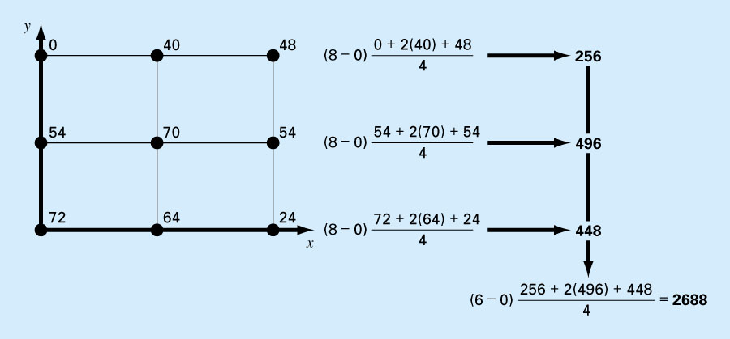
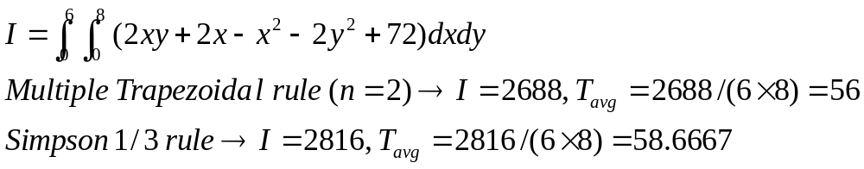
Double integral - Example
HW: Use two points Gauss formula to solve the problem

