Slide 1
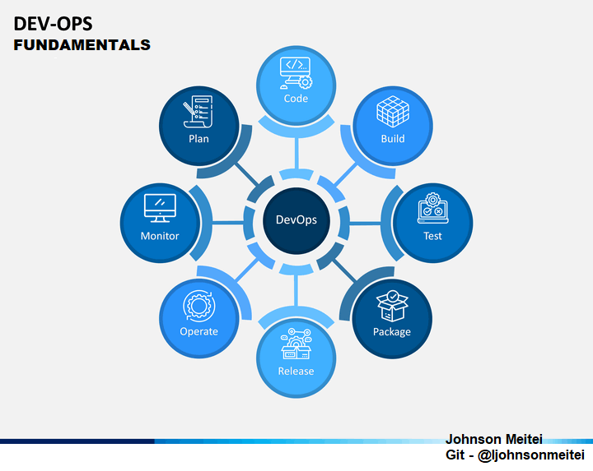

Slide 2
Will continue in the next session …..

