Slide 1
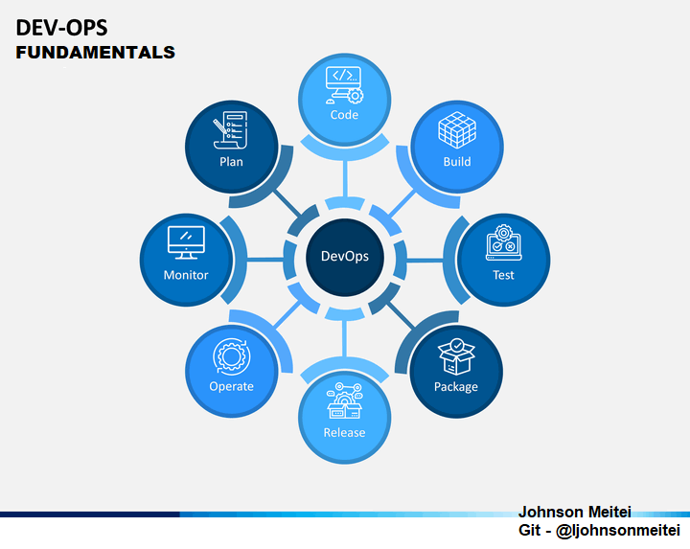

Slide 2


Slide 3
Will continue in the next session …..

