Slide 1
Getting Started with Git in RStudio
Version Control for Reproducible Research

Slide 2
What is Git?
Git is a version control system. • Tracks changes in your code. • Helps you collaborate and revert mistakes. • Works with GitHub and GitLab.

Slide 3
Why Use Git with R?
Organize R scripts and data. • Revert to older versions. • Collaborate safely. • Fully integrated with RStudio.

Slide 4
Setting Up Git in RStudio
Install Git and configure identity. • use_git_config() in R. • Enable Git under Tools → Global Options → Git/SVN.

Slide 5
Basic Workflow
Modify files → Stage → Commit → Push. • Track progress with the Git pane.

Slide 6
Push to GitHub
Use usethis::use_github(). • Creates remote repo and pushes first commit.

Slide 7
Summary
Set up Git. • Track changes. • Collaborate with GitHub.

Slide 8
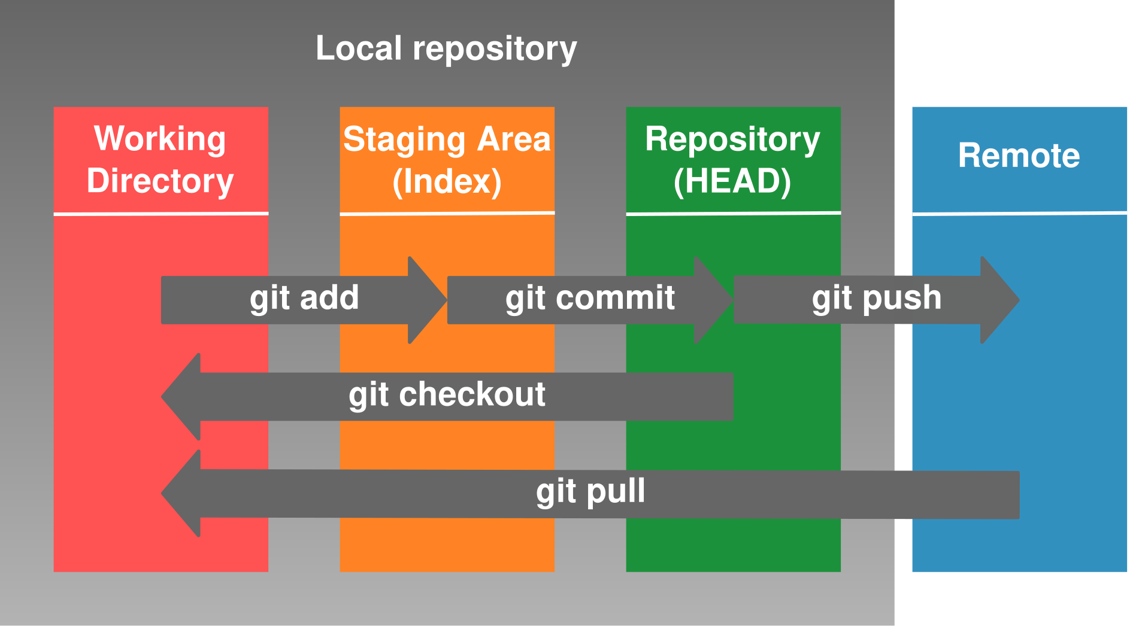
Git Workflow Overview

Slide 9
What is Git?
Git is a version control system. • Tracks changes in your code. • Helps you collaborate and revert mistakes. • Works with GitHub and GitLab.

Slide 10
Why Use Git with R?
Organize R scripts and data. • Revert to older versions. • Collaborate safely. • Fully integrated with RStudio.

Slide 11
Setting Up Git in RStudio
Install Git and configure identity. • use_git_config() in R. • Enable Git under Tools → Global Options → Git/SVN.

Slide 12
Basic Workflow
Modify files → Stage → Commit → Push. • Track progress with the Git pane.

Slide 13
Push to GitHub
Use usethis::use_github(). • Creates remote repo and pushes first commit.

Slide 14
Summary
Set up Git. • Track changes. • Collaborate with GitHub.

