Slide 1

Puppy Classroom App Studio
22 Minutes
Business Keynote
From Idea To Live
App, Every Day
How A Factory Builds Safe, Branded Apps For Your
Business
23 Oct 2026
Track B · Business Keynote · v1 · Slide 1
Puppy Classroom App Studio
Source: AF-UNDERSTANDING-2026-10-22.md · AF-CARD-TEMPLATE.md · BRICK-KITS.csv · glossary.json
Notes:
Welcome, and thank you for being here. In the next twenty minutes or so, I'm going to show you how an app gets made in a factory rather than in a back bedroom. You'll see the road every idea travels, the gates where a real person checks the work, the walls that keep your customers' data apart, and how your business can start with one short form. One thing before we begin: every business, person and number you'll see today is invented. Some of the screens show where the factory is heading by 2029, and those are clearly labelled as a vision, not today's figures. Nothing here is anyone's private data. So sit back, and let's walk through the factory together, from the front door to the radar that watches every live app.
Framework beat: Title Hook

Slide 2

The Promise
What You Leave With Today
One Clear Path From Your Idea To An
App Your Customers Use
No Code. No Guesswork. Every Step Checked.
23 Oct 2026
Track B · Business Keynote · v1 · Slide 2
Puppy Classroom App Studio
Source: AF-UNDERSTANDING-2026-10-22.md · AF-CARD-TEMPLATE.md · BRICK-KITS.csv · glossary.json
Notes:
Here's my promise to you. By the end of this talk, you'll know the nine stages an app goes through, from a one-line idea to a live app with paying customers. You'll know the gates where a person says yes or no, and why those gates save you money. You'll know what the factory needs from you, and it isn't code. And you'll know exactly what you could do on Monday morning to start. You don't need to be technical. You don't need to know what a database is. What you need is to know your customers: who they are, what they pay for, and what keeps them up at night. That part only you can bring, and the factory is built to turn that knowledge into a working app.
Framework beat: Promise

Slide 3




Who This Is For
And Who It Isn't
For You If
For You If
For You If
Not For You If
You Run A Service
Business With Repeat
Customers
Rules Or Licences Shape
Your Work
You Want Your Own
Brand On The App
You Want A One-Off Toy
Nobody Returns To
Key
A Kill Answer: The Factory Stops These Early
23 Oct 2026
Track B · Business Keynote · v1 · Slide 3
Puppy Classroom App Studio
Source: AF-UNDERSTANDING-2026-10-22.md · AF-CARD-TEMPLATE.md · BRICK-KITS.csv · glossary.json
Notes:
So who is this for? It's for owners of service businesses with repeat customers: people who come back every month, every season or every litter. It's especially for businesses where a licence or a rulebook shapes the work, like breeders, boarding kennels, groomers and clinics, because rules are exactly where a well-built app earns its keep. It's for anyone who wants their own name and colours on the screen rather than someone else's logo. And it's honestly not for everyone. If you want a novelty app that people open once and forget, the factory will stop it at the very first gate. That isn't harsh. It's the factory protecting your money before a single credit is spent.
Framework beat: Who It's For / Not For

Slide 4

Where This Started
Lisa's Story
The Backstory
I Kept Paying For Apps That Were Built
Once And Then Left To Break
Each One Started From Scratch. None Of Them Learned From The Last.
23 Oct 2026
Track B · Business Keynote · v1 · Slide 4
Puppy Classroom App Studio
Source: AF-UNDERSTANDING-2026-10-22.md · AF-CARD-TEMPLATE.md · BRICK-KITS.csv · glossary.json
Notes:
Let me tell you where this started. And a note for whoever presents this: this story is to be checked with Lisa before use. I run animal businesses, and I trained as a solicitor, so rules and records are part of my everyday life. I wanted simple tools for my own clients. Every app I paid for was hand-made from nothing. Each one had different gaps. When I asked a simple question, 'can one customer ever see another customer's records?', nobody could give me a straight answer with proof. And none of those apps learned anything from the one before. That was my wall. I had good ideas, and I had customers who wanted them, but I had fragile apps and no way to trust them.
Framework beat: Origin Story · Epiphany Bridge: Backstory, Desire, Wall

Slide 5

The Moment It Changed
The Epiphany
Stop Building Apps. Build The Factory
That Builds Them.
Same Road, Same Checks, Same Parts, Every Time
23 Oct 2026
Track B · Business Keynote · v1 · Slide 5
Puppy Classroom App Studio
Source: AF-UNDERSTANDING-2026-10-22.md · AF-CARD-TEMPLATE.md · BRICK-KITS.csv · glossary.json
Notes:
Then it clicked. Car makers don't hand-carve every car. They have a production line, standard parts and an inspection at every station, and every car that rolls off the line is better because of the ones before it. So I stopped trying to build apps, and I built the factory that builds them. One road with nine stages. A shelf of proven parts that we call bricks. And a gate between every stage, where the work is checked before it's allowed to move on. Each new app reuses what the last one proved. When something goes wrong, the fix becomes a new line on the checklist, so it can't happen again. That's the plan you're about to see.
Framework beat: Origin Story · Epiphany Bridge: Epiphany, Plan

Slide 6

The One Thing
If You Remember One Slide
A Factory With Gates Is What Makes A
Custom App Safe, Fast And Affordable
Gates Catch Problems While They Are Still Cheap
23 Oct 2026
Track B · Business Keynote · v1 · Slide 6
Puppy Classroom App Studio
Source: AF-UNDERSTANDING-2026-10-22.md · AF-CARD-TEMPLATE.md · BRICK-KITS.csv · glossary.json
Notes:
If you remember one slide from today, make it this one. A factory with gates is what makes a custom app safe, fast and affordable. Here's why. A problem caught at the idea stage costs a short conversation. The same problem caught while building costs credits and time. Caught after launch, it costs customers, money and trust, and sometimes a call from a regulator. So the factory refuses to move an app forward until the evidence for that stage is there. Every stage has a finished-when line, and every gate checks it. That discipline is what lets one small team ship many apps without cutting corners, and it's what lets you trust the app with your customers.
Framework beat: The One Thing

Slide 7
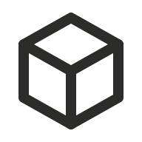


Three Things Most People Get Wrong
Three Secrets
Secret 1 · The Vehicle
Secret 2 · You
Secret 3 · The World
Apps Are Assembled From Proven
Parts, Not Invented
You Don't Need To Be Technical,
Just Clear
Safe And Legal Is Built In, Not
Bolted On
23 Oct 2026
Track B · Business Keynote · v1 · Slide 7
Puppy Classroom App Studio
Source: AF-UNDERSTANDING-2026-10-22.md · AF-CARD-TEMPLATE.md · BRICK-KITS.csv · glossary.json
Notes:
Now, there are three beliefs that stop business owners from getting the app they need, and I want to break each one. The first is about the vehicle: the belief that every app has to be invented from nothing, so it must be slow and expensive. The second is about you: the belief that you need to be technical, or hire someone technical, to get an app made. The third is about the world outside: the belief that safety, privacy and the law are someone else's problem, to be sorted out later. Each of the next sections takes one of those beliefs and shows you what the factory does instead. Let's start with the vehicle.
Framework beat: 3 Secrets Overview

Slide 8






Secret 1 · Eight Shelves Of Bricks
Every App Is Assembled From The Same Shelves
BASICS
Boundaries
Bucks
Body
Always: Sign-In, Menus
Allowed: Walls, Roles
Money: Plans, Payments
The Rest: Screens,
Records
Brand
Boost
Brains
Bots
Swaps: Name, Colours
Found: Pages, Reviews
Works It Out: Scoring
Alone: Reminders,
Imports
Key
Top Band = Shelf Colour
Each Shelf Has Its Own Icon
23 Oct 2026
Track B · Business Keynote · v1 · Slide 8
Puppy Classroom App Studio
Source: BRICK-LAYERS-AND-COLOUR-SPINE-2026-09-19.md · BRICK-REGISTRY.csv v0.16 (101 bricks)
Notes:
Secret one. Apps are assembled, not invented. Every app is built from bricks: small, proven parts, each one already tested in other apps. There are one hundred and one bricks in the register today, and they sit on eight shelves. BASICS is the floor that every app gets: sign-in and menus. Boundaries holds the walls between businesses, customers and the public. Bucks handles plans and payments. Body is everything your customers actually see, like bookings and records. Brand swaps the name, colours and logo. Boost gets you found, with public pages and reviews. Brains works things out, like scores and reports. And Bots run on their own, sending reminders and doing imports. Bricks then group into kits, numbered K00 to K08: a booking kit, a client portal kit, a breeding records kit.
Framework beat: Secret 1 · Vehicle: Teach

Slide 9
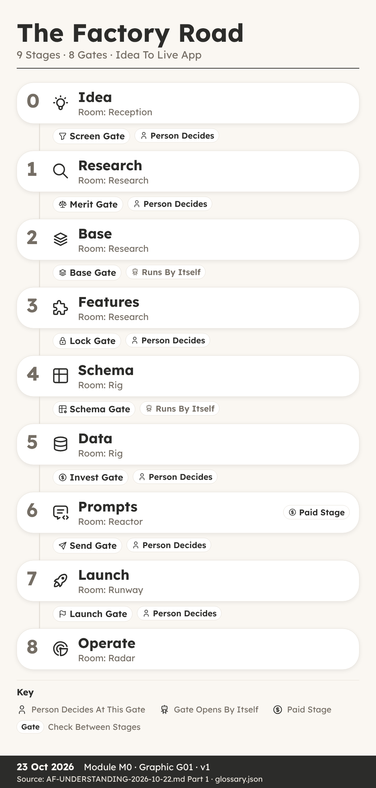
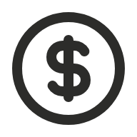

Secret 1 · One Road, Nine Stages
Every Idea Travels The Same Road
Starts As A Short Form
A Person Decides At Six Gates
Only Stage 6 Spends Build Credits
Watched Every Day After Launch
Key
Person Decides
Runs By Itself
23 Oct 2026
Track B · Business Keynote · v1 · Slide 9
Puppy Classroom App Studio
Source: AF-UNDERSTANDING-2026-10-22.md · AF-CARD-TEMPLATE.md · BRICK-KITS.csv · glossary.json
Notes:
And every app travels the same road. Stage zero is your idea, sitting in reception. Stage one is research: competitors, customer words, market size and any rules that apply. Stage two picks a base to start from. Stage three chooses the features, and who sees what. Stage four builds the tables, the structure that holds the data. Stage five sets up test businesses and test people. Stage six writes the build prompts, and this is the only stage that spends paid build credits. Stage seven is launch, with a sales page and your domain. Stage eight is operate, where the app is watched every single day. Between stages sit the gates, and six of them need a person's yes. Notice that nothing is spent until the plan is locked.
Framework beat: Secret 1 · Vehicle: Proof

Slide 10
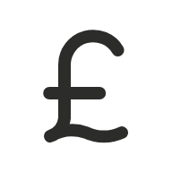




Secret 2 · You Just Fill In A Form
The Idea Form Asks What Only You Know
Your Vision
Who Pays
The Pain
20 Code
Questions
3 Kill
Questions
Verdict And
Data Role
Plain Questions. Six Must Be Answered; The Rest Can Say Not Yet Known.
23 Oct 2026
Track B · Business Keynote · v1 · Slide 10
Puppy Classroom App Studio
Source: AF-CARD-TEMPLATE.md (frozen 19 Oct 2026) · AF-UNDERSTANDING-2026-10-22.md
Notes:
Secret two. You don't need to be technical; you need to be clear. Your part starts with one form. It asks for your vision in a sentence, who pays, and the pain you solve for them. Then it asks twenty short code questions, in plain words. For example: can a stranger read anything without signing in? Can one person belong to two businesses? Six of those questions must be answered. The rest are allowed to say 'not yet known', and the factory will find out. Then come three kill questions: could it give wrong answers that look right, would people use it once and stop, and is there no reason to come back. Finally the factory suggests a verdict, pass, hold or kill, and the data role: who is responsible for the personal data.
Framework beat: Secret 2 · Internal: Teach

Slide 11



Secret 2 · 20 Codes In 4 Groups
Each Answer Is A Word Plus A Number
1 · Businesses
2 · Who Signs In
3 · Customers
4 · Public
TEN (0-6) · PARENTS ·
DOWN · MEET · POOL ·
EXIT
ROLE · BELONG · GUEST
· HELP · JOIN
CUST (0-5) · PRICE ·
SHARE · SEN (0-3)
VIEW · POST · BRAND ·
SEND · PAY
Key
Ring 1 Inside
Ring 4 Public
Group Icon
23 Oct 2026
Track B · Business Keynote · v1 · Slide 11
Puppy Classroom App Studio
Source: AF-CARD-TEMPLATE.md · codes-catalogue.json · LC-VISUAL-STANDARD.md (rings)
Notes:
Those twenty answers become a code: a word plus a number for each part. They sit in four groups, from the inside out. Businesses: how many businesses use the app and who sits above them, from TEN zero, no data stored, up to TEN six, several governing bodies. Who signs in: whether staff have different roles, whether guests can be let in, how people join. Customers: how deep the app goes into your customers, from staff-only records up to customers selling to each other, and how sensitive the data is, from ordinary to children's data. And public: what a stranger can see or send without signing in. Together these numbers tell the factory exactly which walls your app needs, before anyone builds a thing.
Framework beat: Secret 2 · Internal: Proof

Slide 12

Secret 3 · Walls Keep Data Apart
Every App Gets The Walls Its Codes Call For
W1 Brand Wall
W2 Member Wall
W6 Public Wall
W8 Sensitivity Hold
One Business Never Sees
Another
One Customer Never
Sees Another
Strangers See Only What
Is Meant
Health Or Children's
Data Waits For A Check
Key
Wall (W1-W8)
Boundaries Shelf
23 Oct 2026
Track B · Business Keynote · v1 · Slide 12
Puppy Classroom App Studio
Source: codes-catalogue.json (walls W1-W8) · TENANCY-CLASSIFICATION-AND-ISOLATION-RULES.md
Notes:
Secret three. Safety and the law are built in, not bolted on at the end. The factory has eight walls, and each app gets the ones its codes call for. The brand wall means one business can never see another business's data, even inside the same app. The member wall means one customer can never see another customer's records. The public wall controls exactly what a signed-out stranger can read or submit. And the sensitivity hold stops any app that handles health or children's data until a proper data protection impact check has been done and signed. These walls aren't promises in a brochure. As you're about to see, they're tested, again and again, from outside the app.
Framework beat: Secret 3 · External: Teach

Slide 13




Secret 3 · Tested After Every Paid Step
Six Checks, In This Order, Every Time
1
2
3
4
5
6
Record It
Check The
Spend
Publish
Re-Probe
Every Table
Test As Real
Members
Mark It Done
Test Members From Two Different Brands Try To See Each Other's Data. It Must Fail.
23 Oct 2026
Track B · Business Keynote · v1 · Slide 13
Puppy Classroom App Studio
Source: TEMPLATE-MIRROR.md (6j, 6l) · THE-STAGE-TRANSITIONS.md
Notes:
Here's how they're tested. Every time the builder does paid work, six things happen, in this order, every single time. First we record what was done. Second we check what it cost, and whether anything should be refunded. Third we publish. Fourth we re-probe every table, to make sure nothing has opened up. Fifth we test as real members: an existing member and a brand-new member of each brand do the app's main job from start to finish. Then a member of brand A deliberately tries to read brand B's records, and that test must fail. Sixth, and only then, the step is marked done. If anything leaks at any point, the build stops until it's fixed and proved.
Framework beat: Secret 3 · External: Proof

Slide 14

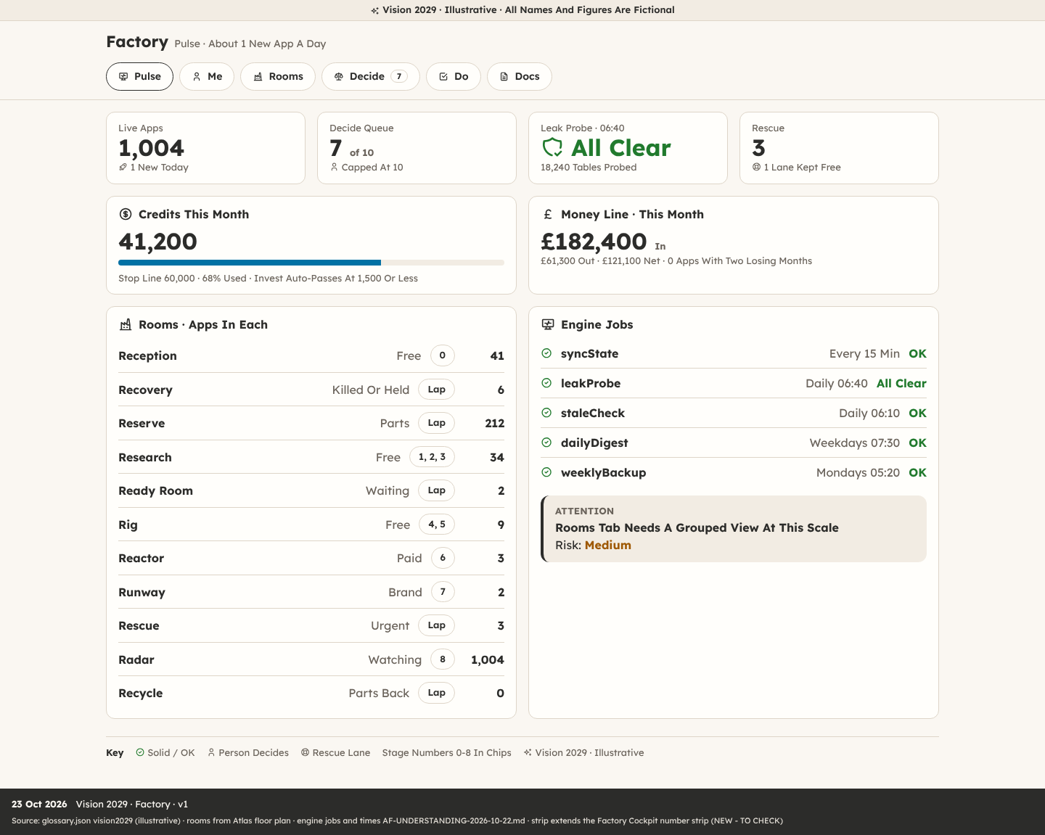

The Factory In 2029
Vision 2029 · Illustrative
About One New App A Day
1,004 Live Apps
1 New App A Day
Leak Probe All Clear At 06:40
Decide Queue 7 Of 10
Key
Vision 2029 · Illustrative: Not Today's Figures
23 Oct 2026
Track B · Business Keynote · v1 · Slide 14
Puppy Classroom App Studio
Source: glossary.json vision2029 (illustrative) · AF-UNDERSTANDING-2026-10-22.md (APPFACT target: 1 app a day for 3 years)
Notes:
Now let me show you where this is heading. These are vision figures for 2029, clearly illustrative, not today's numbers. The target set for the factory is one new app a day, for three years. That adds up to roughly a thousand live apps. Every one of them is probed for leaks every morning at twenty to seven, on every table. Every one is watched on the radar for problems and for money: is it earning more than it costs? And the person running the factory only sees real decisions. The decide queue is capped at ten, so nothing important gets buried under noise. That's what a factory buys you: scale without losing care.
Framework beat: Future Pacing

Slide 15

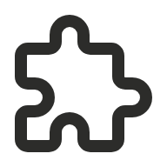

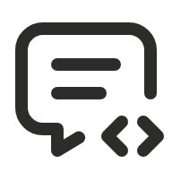
Fully Automated, Except The Gates
Vision 2029 · Illustrative
A Person Is Only Needed Where Judgement Matters
Form
Research
Features
Tables And
Tests
Build Prompts
Launch
Screen
Merit
Lock
Invest
Send
Launch
Key
Person Decides At This Gate
Vision 2029 · Illustrative
23 Oct 2026
Track B · Business Keynote · v1 · Slide 15
Puppy Classroom App Studio
Source: AF-UNDERSTANDING-2026-10-22.md · AF-CARD-TEMPLATE.md · BRICK-KITS.csv · glossary.json
Notes:
And this is the 2029 picture of automation. Every step you see runs by itself: the research sweep, the tables, the test data, the build prompts and the launch pages. The only human touch points are the gates. Screen, where the idea is first judged. Merit, where research says it's worth building. Lock, where the feature list is frozen. Invest, where credits are committed. Send, where the build is proved live. And Launch, where real customers are let in. Those are the moments where judgement, law and money decisions live. A machine can prepare everything for them, but a person should still say yes. That balance is deliberate, and it's what keeps the factory trustworthy.
Framework beat: Future Pacing · Proof

Slide 16
One App, Many Brands
White-Label: Same App, Your Name On It
Litterline
Puppy Classroom
Edition
Your Brand Here
Licence And Records Hub For
Breeders · LJR7
Your Name, Colours And Domain
Same App, Reseller Jacket, Join
Link /join/ppp
Key
Brand Shelf: What A Reseller Swaps
23 Oct 2026
Track B · Business Keynote · v1 · Slide 16
Puppy Classroom App Studio
Source: glossary.json brands · SLIP-2026-10-04-0630 reseller-never-free · invented app Litterline
Notes:
Here's an invented example of one app in many brands. Litterline is a licence and records hub for dog breeders: litters, health records, kennel logs and the evidence a council inspector asks for. Under the LJR7 brand, it's sold directly. Under the Puppy Classroom jacket, it's exactly the same app with a different name, colours and join link, sold to Puppy Classroom's own audience. And under your brand, it's yours: your name, your colours, your domain. Nothing is rebuilt for each brand. The Brand shelf swaps the jacket, and the walls keep every brand's members completely apart. That's what white-label means in the factory: one app, built once, worn by many brands.
Framework beat: Case Study

Slide 17


Reseller Rule: Never Free
The Plan Is Chosen On Your Landing Page And Carried Through
1
2
3
4
5
Landing Page
Button
Link Carries
Brand And Plan
Sign In First
Pay Second
Into The App
Worked Example: /join/ppp?plan=plus-yearly. A Reseller Brand Has No Free Plan; The Server Refuses
One.
23 Oct 2026
Track B · Business Keynote · v1 · Slide 17
Puppy Classroom App Studio
Source: SLIP-2026-10-04-0630-DECISION-plan-carried-from-landing-page-reseller-never-free.md
Notes:
One rule matters a lot for resellers. A reseller brand never offers a free plan. Your landing page button carries both your brand and the plan, for example join, slash, ppp, with plan equals plus-yearly. The member signs in first and pays second, so nobody pays without an account. When they come back from sign-in, the server checks that the plan really belongs to your brand, and it refuses a free plan on a reseller brand. It records the chosen plan against the member, even if they abandon checkout, so you can follow up. And the price is never read from the web address, so nobody can edit a link to pay less. Each payment is stamped with the brand that made the sale.
Framework beat: Case Study · Rule

Slide 18
What You Get
The Stack
Part
What It Does
Replaces
Idea Review
Screen And Merit Gates On Your Idea
Guesswork
Research Pack
Competitors, Market, Rules Flag
Weeks Of Searching
Your App
Built From Proven Bricks And Kits
A Hand-Made Build
Walls And Tests
Leak Tests Before Launch
Hoping It's Safe
Launch Kit
Sales Page, Domain, Funnels
A Separate Agency
Daily Watch
Leak Probe, Monitoring, Rescue
Finding Out From Customers
23 Oct 2026
Track B · Business Keynote · v1 · Slide 18
Puppy Classroom App Studio
Source: AF-UNDERSTANDING-2026-10-22.md Part 1 · prices TO CONFIRM
Notes:
So what do you actually get? First, a real review of your idea at the Screen and Merit gates, instead of guesswork. Second, a research pack: competitors, the market and any rules that apply, instead of weeks of searching. Third, your app itself, assembled from proven bricks and kits instead of a hand-made build. Fourth, walls and leak tests before any customer arrives, instead of hoping it's safe. Fifth, a launch kit: a sales page, your domain and your funnels, instead of hiring a separate agency. And sixth, a daily watch: leak probes, monitoring and a rescue lane if anything breaks, instead of finding out from an angry customer. Prices are set separately, so they're not shown here.
Framework beat: The Stack

Slide 19

Where This Leads
Pick The Step That Fits You
1
2
3
4
5
This Course
Idea Form
Your App Built
Reseller Plan
Partner Link
Start Small: The Idea Form Is Free To Fill In
23 Oct 2026
Track B · Business Keynote · v1 · Slide 19
Puppy Classroom App Studio
Source: D9 value ladder · reseller rule SLIP-2026-10-04-0630
Notes:
There are several ways in, and you can start wherever fits. You can learn how it all works with this course. You can send one idea through the idea form and get an honest verdict. You can have your app built through the factory. If you have an audience of your own, like members, clients or a club, you can put your brand on apps for them with a reseller plan. And if you simply know businesses that need this, you can share a partner link. Each step leads naturally to the next, but none of them forces it. The best place for most people to start is the idea form, because it costs nothing to fill in.
Framework beat: Value Ladder

Slide 20


Two Choices
What Happens Next Is Up To You
Keep Going As You Are
Send One Idea
Paper, Spreadsheets, Apps That Don't Talk
Ten Minutes On The Form, The Factory Does The Rest
23 Oct 2026
Track B · Business Keynote · v1 · Slide 20
Puppy Classroom App Studio
Source: AF-UNDERSTANDING-2026-10-22.md · AF-CARD-TEMPLATE.md · BRICK-KITS.csv · glossary.json
Notes:
So you have two choices. The first is to carry on as you are: paper forms, spreadsheets, and apps that don't talk to each other, with records scattered everywhere when the inspector calls. That choice costs nothing today, but it keeps costing you time every week. The second choice is to take ten minutes, send one idea through the form, and let the factory tell you honestly whether it's worth building. If it isn't, you'll know why, and you'll have saved money. If it is, you'll see exactly what it would take. Either way, you'll leave knowing more than you did this morning, and the decision stays yours.
Framework beat: Two Choices

Slide 21
Start Here
Three Ways To Take The Next Step
1
Fill In The Idea Form
Idea Form
2
Ask About A Reseller Plan For Your Brand
Link: TO CONFIRM
3
Share Your Partner Link With A Business You Know
Reseller Plan
/join/ppp
Partner Link
TO CONFIRM
No Income Promises. Any Results Depend On Your Own Business And Effort.
23 Oct 2026
Track B · Business Keynote · v1 · Slide 21
Puppy Classroom App Studio
Source: AF-UNDERSTANDING-2026-10-22.md · AF-CARD-TEMPLATE.md · BRICK-KITS.csv · glossary.json
Notes:
Here's how to take the next step. One: fill in the idea form. The link is on screen, and it takes about ten minutes. Two: if you'd like your own brand on these apps for your members or clients, ask about a reseller plan. Three: if you know another business that's struggling with paper and rules, share your partner link with them. I want to be clear about one thing. I make no income promises, to you or to anyone. What you get out of an app, a reseller plan or a partner link depends on your own business and your own effort. What I can promise is that the factory will treat your idea with care.
Framework beat: Call To Action

Slide 22

Recap
Questions Welcome
Apps Are Assembled From 101 Proven Bricks On 8 Shelves
You Answer A Form; The Factory Does The Building
Walls And Leak Tests Are Built In, At Every Paid Step
A Person Decides At The Gates That Matter
WHY IT MATTERS
Gates Catch Problems While They Are Still Cheap, So Your Customers Never Meet Them
23 Oct 2026
Track B · Business Keynote · v1 · Slide 22
Puppy Classroom App Studio
Source: AF-UNDERSTANDING-2026-10-22.md · AF-CARD-TEMPLATE.md · BRICK-KITS.csv · glossary.json
Notes:
Let's recap. Apps are assembled from one hundred and one proven bricks on eight shelves, not invented from nothing. Your part is a form: your vision, who pays, the pain, and twenty plain questions. Walls and leak tests are built in, and they run after every paid step, from outside the app. And a person decides at the gates that matter, where judgement, law and money meet. Why does it matter? Because gates catch problems while they're still cheap, so your customers never meet them. Thank you so much for your time today. I'd love to hear your questions, and if you have an idea already, the form is waiting for you.
Framework beat: Recap · Q&A

