Slide 1

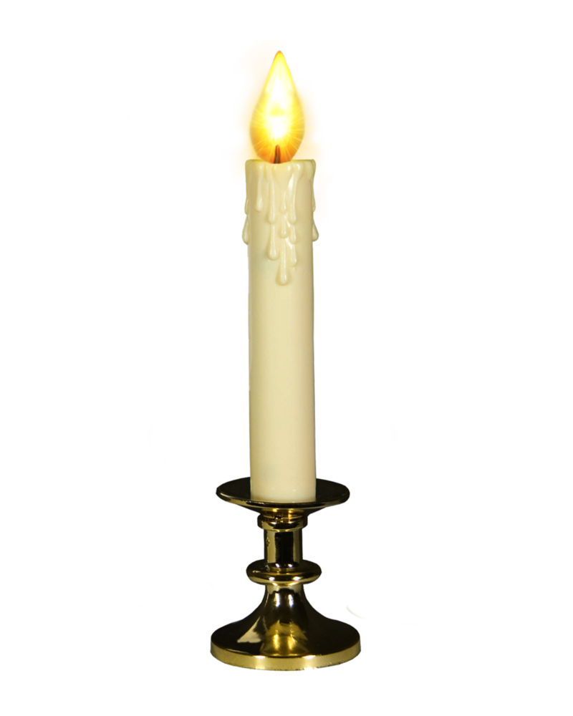
Dear Brother Liqun力群 and My Only Brother,
On this special date of your life on July 3rd, I have seen how a brother like you to achieve your goals step by step and as your plan in the last 57 years.
Happy Birthday to you!
        Lovingly yours
Lijun
July 3rd, 2017

Slide 2

