Slide 1
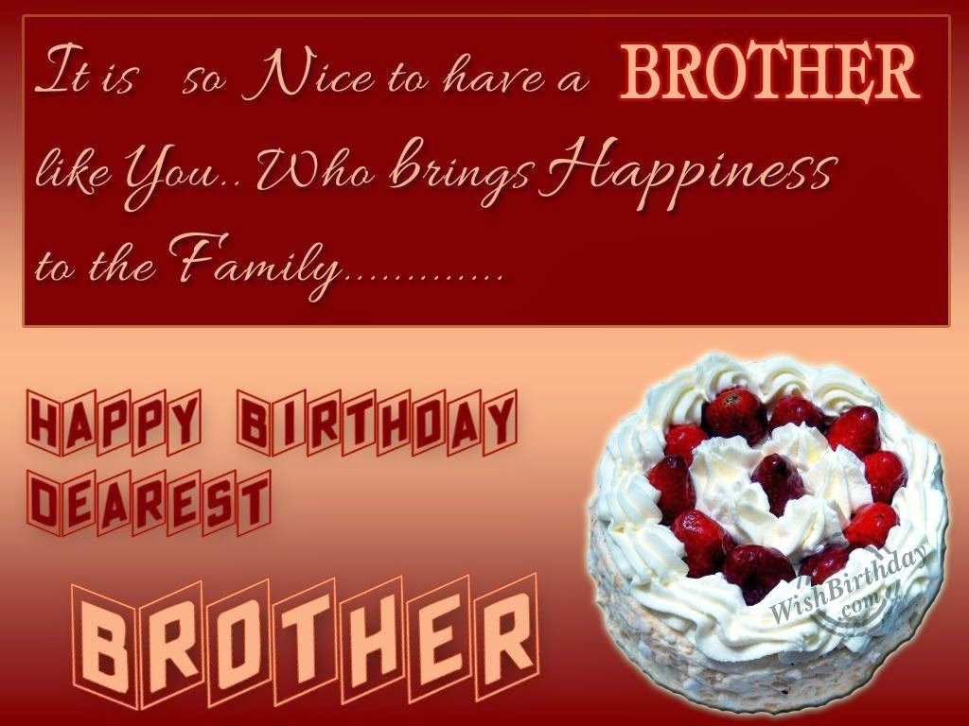
Dear Brother Liqun and my only brother,
On this special day of July 3rd, I wish you a very happy 57th birthday !
Lovingly yours,
Lijun
July 3rd, 2017

