Slide 1
Higher Concept: Default Create
Creation of objects is a concept higher than any language implementation of the concept.

Slide 2
Universal Default Creation
Default creation is REQUIRED
Non-default creation overrides default
Non-default creation must be specified
Otherwise—default is used
Default creation is code—NOT compiler!
  Why?

Slide 3

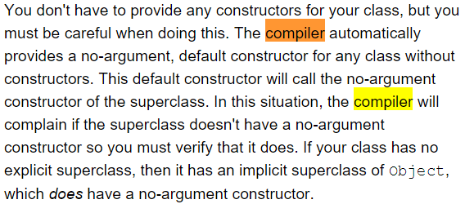
Example: Java no-arg constructor
“compiler automatically provides ...”
  The “code” in the compiler is unreachable by you!
  You (programmer) CANNOT override this code!
Poor design
  Removes your capacity to create universal default
Complains = BUG

Slide 4
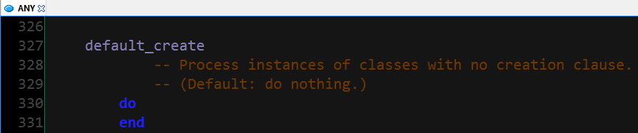
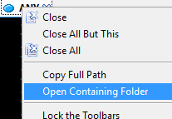
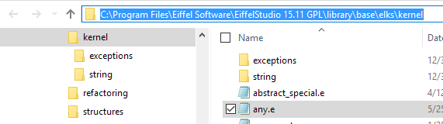
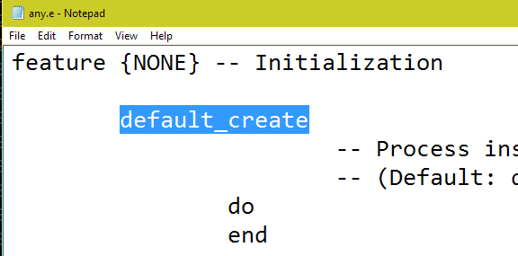
Example: Eiffel Default Create
ANY = file → You can “override” as you need!
NOT “compiler generated”
  (where you cannot see it)

