Slide 1
Real v. Not
Language notation RULES shaped by:
  Reality (observed RULES implemented in notation)
  Contrivance (artificial or invented “rules”)
Example: Math notation RULES → Observed
Observed RULES → Useful Math (v. Useless)
Math RULES are not:
  Invented → You could make this stuff up, but ...
  Artificial → To what purpose (useful semantic)?
  Contrived → The results would be disastrous!

Slide 2
RULES: Good, Bad, Ugly
if [language] = contrived then [result]
Where:
  Good = Based on observed rules of reality
  Bad = Somewhat good
  Ugly = Utterly invented or made up
Results?
  Good: Elegant, highly useful, LESS bugs!
  Bad/Ugly: Difficult, questionably useful, BUGS!

Slide 3
All languages “Create”
How?
  By special “Creation Procedures”
    (In Java = “Constructors”)
  Following special RULES
What are they?
  “Creation instructions” → makes object & sets fields
  Language notation to ID “creation instructions”

Slide 4
PANCAKE Creation RULES
Q: How does one make pancakes?
  A: Recipe (written or remembered)
Q: Is there only one recipe for pancakes?
  A: NO! There are many!
Q: If we make “Class PANCAKE” and the constructors are “recipes”, do we expect many creation procedures?
  A: YES, WE DO!
  THEN: Why does Java have only ONE?

Slide 5
Java Constructor “rules”
Constructor name MUST = Class name (why?)
Dif constructors = same name/dif args (why?)*
“super” must be in first line (why?)*
Many other irrational “rules”!
Java is NOT the only one!
* NO logical or rational reason!

Slide 6
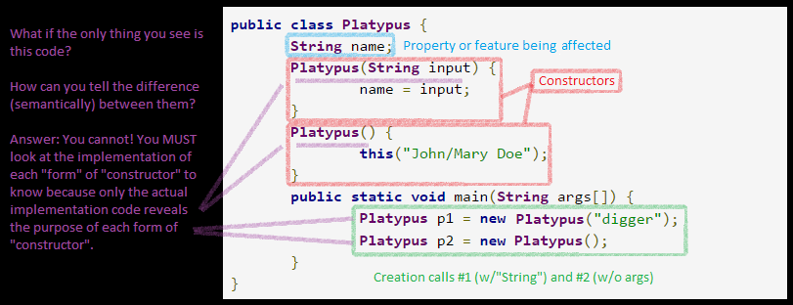
Consequences: Java
Multiple “constructors” / same name
  Severe lack of semantics
  Small semantics → Big Confusion → Big Bugs
  “Platypus” alone tells no story about creation!!!
  Okay, I pass a String; so what? That means what?

Slide 7
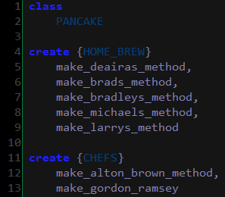
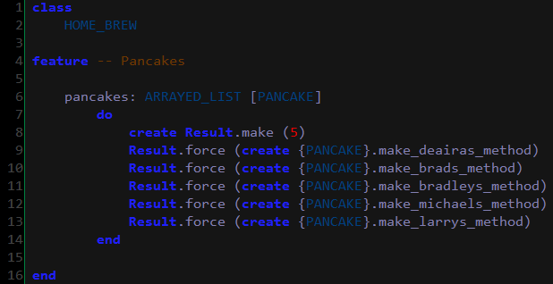
PANCAKE CLASS
NOTE:
  One class: PANCAKE
  Many recipes (creations)
  Constrained access:
    HOME_BREW
    CHEFS
  Clear!
  Elegant!

