Slide 1
Software Projects
The High-level notion of PROJECT

Slide 2
What is a project?
A collection of files for a software product
  Local files (code, specifications, resources)
  Libraries (code, specifications, resources)
Every project has a starting point (root)
  OO → {OBJECT}.feature
  Process-oriented → {Program} line #1
  Function-oriented → {Function} line #1
  Web → “Home” page (index.html)
  Etc. ...

Slide 3
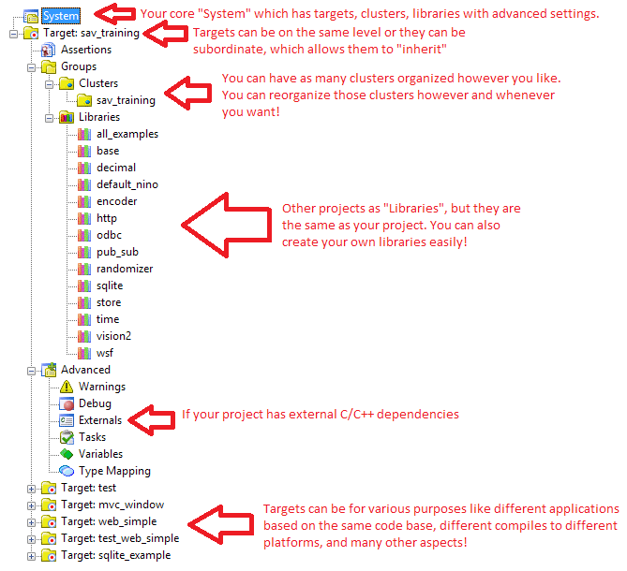
System with Libraries

