Slide 1
Abstract factories

Slide 2









Slide 3
Creational Design Patterns
deal with object creation mechanisms
provide solutions for creating objects to enhance:
Flexibility
Reusability
management of object creation processes
Maintainability
Scalability
help in abstracting the instantiation process and make the system more adaptable to changes in the future.

Slide 4
Who are we?
ComputerGo GmbH
Sells computer parts
Has a very old IT system to handle their logistics
Is preparing to expand
Needs a new, improved system that can be easily adjusted
Language is Java
If you have an IDE you can use it, otherwise you can use replit

Slide 5

Start implementing
We focus on CPUs first
There are different kinds of CPUs, create one class for IntelCPUs and one for AMDCPUs
Both classes should implement a shared Interface, the CPU Interface

Slide 6
Start implementing
What do our CPUs need?
What can we put inside the CPU interface?
At what point do we have a factory?

Slide 7
Factories?
What we have implented now can be called a factory method
Methods are defined in base class
They can be altered in the subclasses
In a less complex system this is sufficient

Slide 8
IMplementation
We now also have GPUs and Monitors
They both can be either Intel or AMD
There should also be an interface that they each implement

Slide 9
Abstract factories
provides an interface for creating families of related or dependent objects
without specifying their concrete
to create multiple related objects that are part of a larger system.
defines methods for creating these objects
→ concrete implementations of the factory produce instances of different concrete classes that belong to the same family.

Slide 10
Abstract factories
What we built now are
Abstract Products & Concrete Products
What we need in order to implement the abstract factory design pattern are
Abstract Factory & Concrete Factories

Slide 11
Abstract factories
AbstractFactory
interface that declares the methods for creating the various types of related objects
ConcreteFactory:
classes that implement the AbstractFactory interface
responsible for creating instances of the concrete products that belong to the same family.

Slide 12
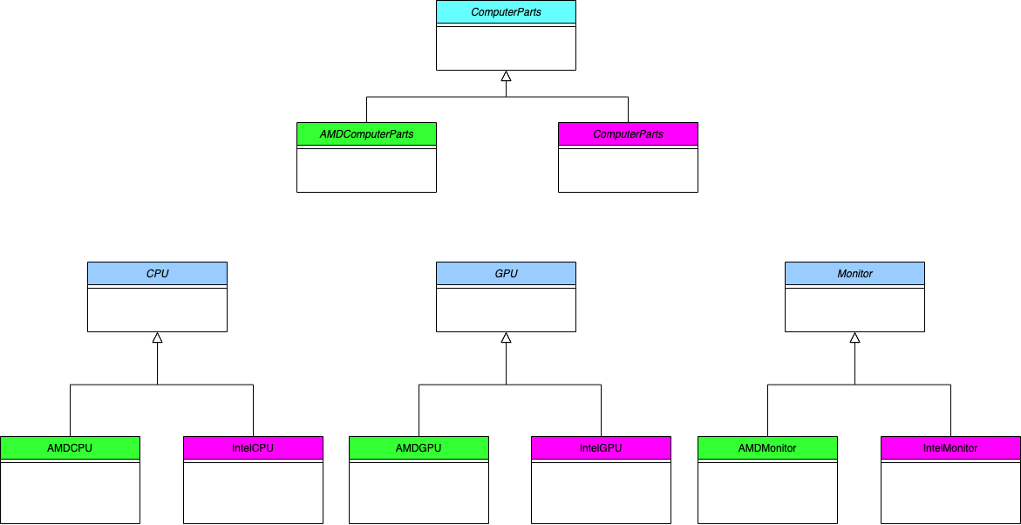
Class diagram

Slide 13
Final implementation
Create abstract and concrete factories!

Slide 14
Final discussion
What are your thoughts?
Is this a useful pattern?
What are possible pros and cons?

