Slide 1
Hardness of Explicit Constructions via Cryptography
Jiatu Li
MIT
Range avoidance, indistinguishability obfuscation, and bounded arithmetic.
STOC 2023, Rahul Ilango, Jiatu Li, Ryan Williams
Hardness of Range Avoidance and Remote Point for Restricted Circuits via Cryptography
STOC 2024, Jiatu Li, Yilei Chen
(partially based on Rahul Ilango’s slides on STOC 2023 ☺)

Slide 2
Overview
1. Background: Explicit Constructions
2. [ILW23]: Hardness for Explicit Constructions from Witness Encryption
3. [CL24]: Stronger Hardness from Lattice-Based Cryptography
4. Open Problems

Slide 3
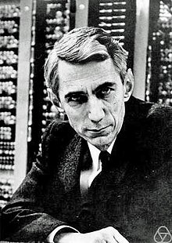
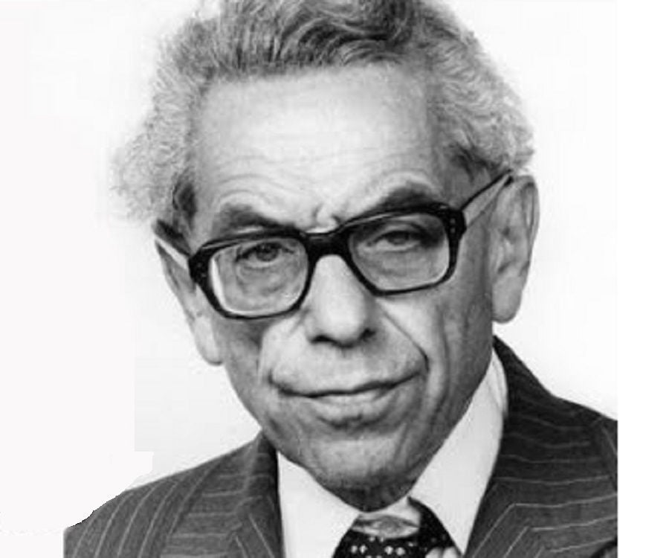
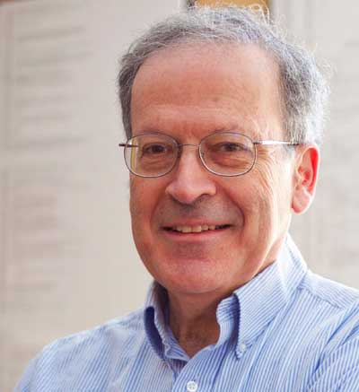
Explicit Construction Problems
A random truth table has large circuit complexity
“Ramsey Graph”
A random graph has neither large clique nor large independent set
“Rigid Matrix”
A random matrix is far from being low-rank
Shannon
Erdős
Valiant

Slide 4


Explicit Constructions
Water is almost everywhere...
But where can I find water?
“You might wonder why should coming up with explicit construction be so difficult. After all, a proof of existence via the probabilistic method shows not only that an object with the desired property exists but in fact the vast majority of objects have the property.”
Sanjeev Arora and Boaz Barak [AB09]

Slide 5
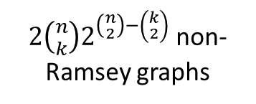






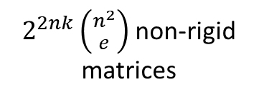

(Empty) Pigeonhole Principle
N pigeons fly into M holes, N < M
Then: there is an empty pigeonhole!
Plant a clique or independent set of size k
$$n×k$$
$e$-sparse
$$k×n$$
A
E
B
+
🕊
$2^{2^{n}}$ truth tables
$2^{\left({n \atop 2}\right) }$ graphs
$2^{n^{2} }$ GF(2)-matrics
🏠
$2\left({n \atop k}\right)2^{\left({n \atop 2}\right)−\left({k \atop 2}\right)}$ non-Ramsey graphs
$2^{2nk}\left({n^{2} \atop e}\right)$ non-rigid matrices
$2^{O(s\log{s)}}$ small circuits

Slide 6
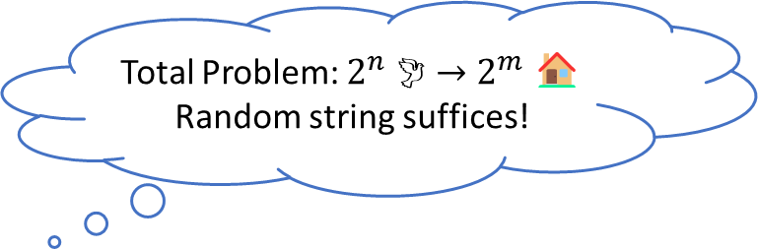
Range Avoidance Problem
Total Problem: $2^{n}$ 🕊 $→$ $2^{m}$ 🏠
Random string suffices!
Definition (Avoid)
Given a circuit $C:{\left\{0,1\right\}}^{n}→{\left\{0,1\right\}}^{m}$, $m>n$, output any $y∈{\left\{0,1\right\}}^{m}$ such that $C^{−1}\left(y\right)=∅$.
Theorem ([Korten21], informal)
Deterministic algorithm for the range avoidance problem is enough to resolve interesting explicit construction problems including Circuit lower bounds; Ramsey graphs and strong extractors (matching random construction); Rigid matrices; ……
Ideally: FP (poly-time);
FP^{NP} algorithm also implies breakthrough results

Slide 7
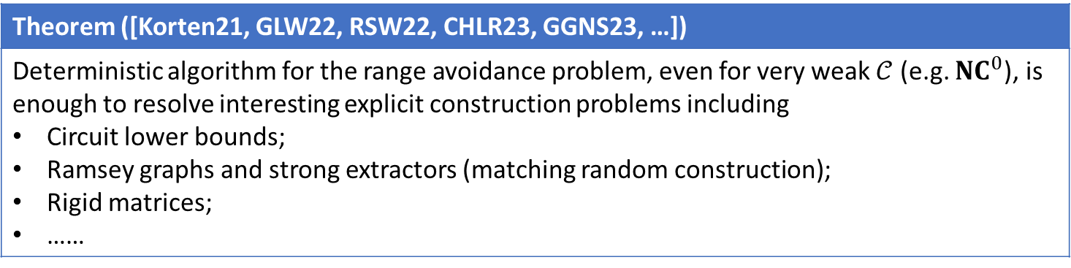
Range Avoidance Problem
Definition (Avoid)
Given a circuit $C:{\left\{0,1\right\}}^{n}→{\left\{0,1\right\}}^{m}$, $m>n$, output any $y∈{\left\{0,1\right\}}^{m}$ such that $C^{−1}\left(y\right)=∅$.
Definition ($𝒞$-Avoid)
Given a $𝒞$-circuit $C:{\left\{0,1\right\}}^{n}→{\left\{0,1\right\}}^{m}$, $m>n$, output any $y∈{\left\{0,1\right\}}^{m}$ such that $C^{−1}\left(y\right)=∅$.
Theorem ([Korten21, GLW22, RSW22, CHLR23, GGNS23, …])
Deterministic algorithm for the range avoidance problem, even for very weak $𝒞$ (e.g. ${NC}^{0}$), is enough to resolve interesting explicit construction problems including Circuit lower bounds; Ramsey graphs and strong extractors (matching random construction); Rigid matrices; ……

Slide 8


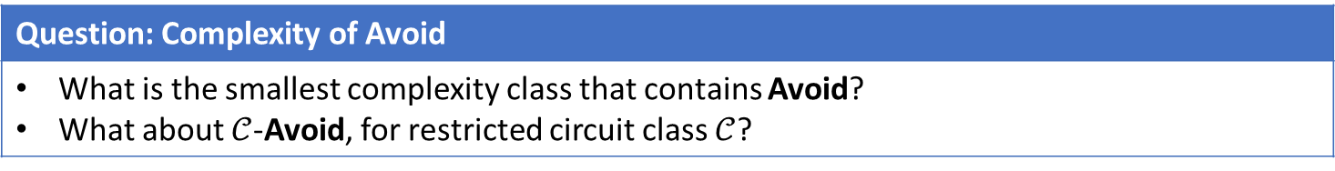
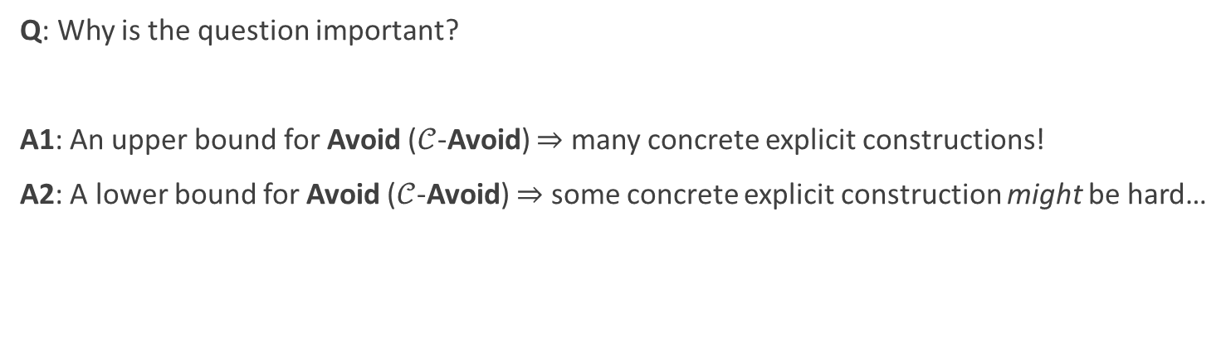


Complexity of Avoid
Question: Complexity of Avoid
What is the smallest complexity class that contains Avoid? What about $𝒞$-Avoid, for restricted circuit class $𝒞$?
Q: Why is the question important?
A1: An upper bound for Avoid ($𝒞$-Avoid) $⇒$ many concrete explicit constructions!
A2: A lower bound for Avoid ($𝒞$-Avoid) $⇒$ some concrete explicit construction might be hard…
$𝒞$-Avoid $⇒$ A/B/C
$𝒞$-Avoid is similar to A/B/C
Hardness of $𝒞$-Avoid
Hardness of $𝒞$-Avoid
Hardness of A/B/C
Barrier of solving A/B/C

Slide 9

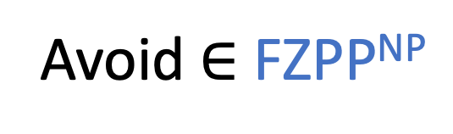

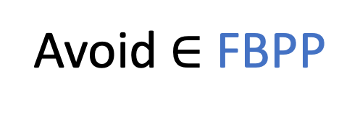
Trivial Algorithms for Avoid
[Kleingberg-Korten-Mitropolsky-Papadimitrou ‘21]
“Output a random string”
“Pick random string; check it’s not in range”
Avoid $∈$ FBPP
Avoid $∈$ FZPP^{NP}
(Works except with probability $2^{n−m}$)
Derandomize algos above?
Is Avoid in FP?
Is Avoid in FP^{NP}?

Slide 10
Non-trivial Algorithms for Avoid
Theorem ([Korten21])
E^{NP} requires $2^{εn}$ size circuits $⇔$ Avoid $∈$ FP^{NP}
Theorem ([RSW22], informal)
NC¹-Avoid reduces to NC⁰-Avoid
Theorem ([RSW22,CHLR23], informal)
ACC⁰-Avoid with weak parameters (i.e. large stretch, small circuit size) $∈$ FP^{NP}
Theorem ([GLW22, GGNS23], informal)
NC⁰-Avoid with very weak parameters $∈$ FP

Slide 11
Today’s Question
“Output a random string”
“Pick random string; check it’s not in range”
Avoid $∈$ FBPP
Avoid $∈$ FZPP^{NP}
(Works except with probability $2^{n−m}$)
We expect most concrete explicit construction problems are solvable in FP ☺
Derandomize algos above?
Ground truth was unclear!!!
Existing algorithms heavily reply on the power of an NP oracle ☹
Is Avoid in FP?
Is Avoid in FP^{NP}?
✔

Slide 12
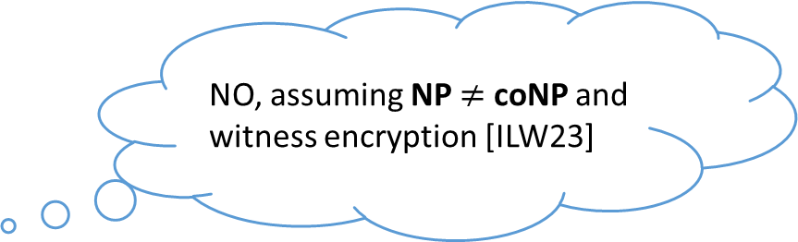
Today’s Result 1
“Output a random string”
“Pick random string; check it’s not in range”
Avoid $∈$ FBPP
Avoid $∈$ FZPP^{NP}
(Works except with probability $2^{n−m}$)
Derandomize algos above?
NO, assuming NP $≠$ coNP and witness encryption [ILW23]
Is Avoid in FP?
Is Avoid in FP^{NP}?
✔

Slide 13
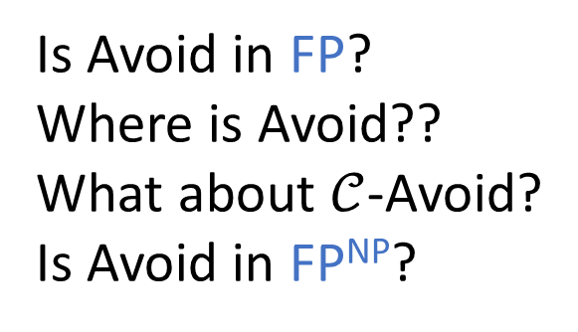

Today’s Result 2
“Output a random string”
“Pick random string; check it’s not in range”
Avoid $∈$ FBPP
Avoid $∈$ FZPP^{NP}
(Works except with probability $2^{n−m}$)
Derandomize algos above?
Under non-standard but plausible assumptions, $𝒞$-Avoid does not have “non-deterministic search algorithms” for weak $𝒞$ [CL24]
Is Avoid in FP?
Where is Avoid??
What about $𝒞$-Avoid?
Is Avoid in FP^{NP}?
❌
✔

Slide 14
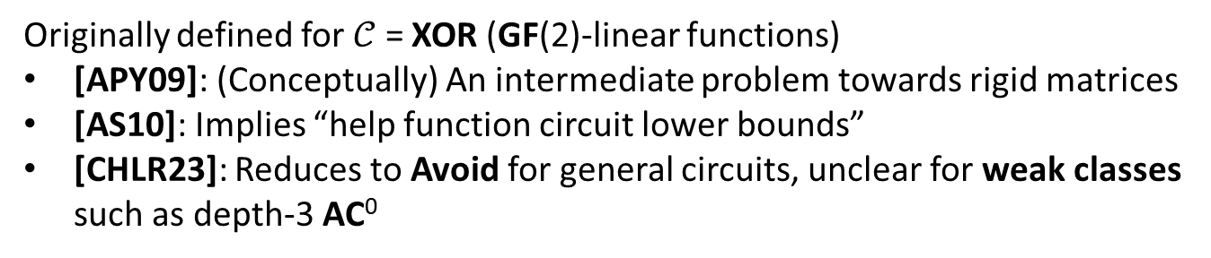
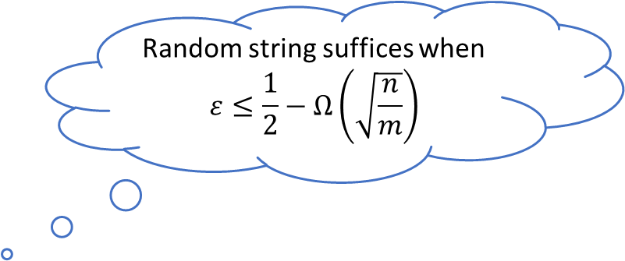
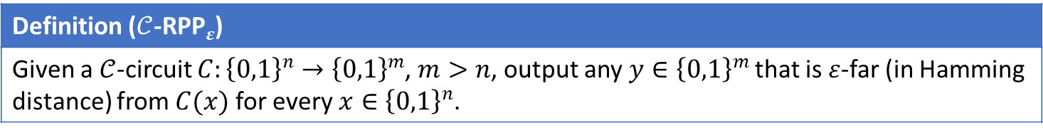
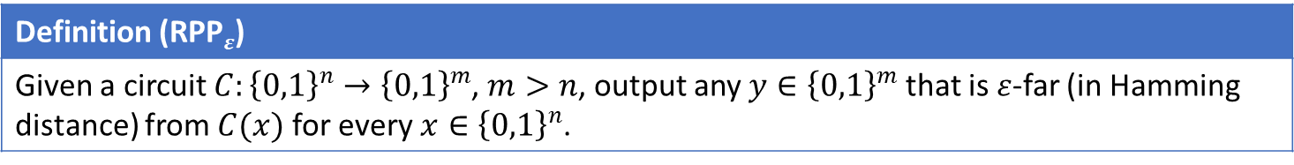
Remote Point Problem
Random string suffices when
$$ε≤\frac{1}{2}−Ω\left(\sqrt{\frac{n}{m}}\right)$$
Definition (RPP$ε$)
Given a circuit $C:{\left\{0,1\right\}}^{n}→{\left\{0,1\right\}}^{m}$, $m>n$, output any $y∈{\left\{0,1\right\}}^{m}$ that is $ε$-far (in Hamming distance) from $C(x)$ for every $x∈{\left\{0,1\right\}}^{n}$.
Definition ($𝒞$-RPP$ε$)
Given a $𝒞$-circuit $C:{\left\{0,1\right\}}^{n}→{\left\{0,1\right\}}^{m}$, $m>n$, output any $y∈{\left\{0,1\right\}}^{m}$ that is $ε$-far (in Hamming distance) from $C(x)$ for every $x∈{\left\{0,1\right\}}^{n}$.
Originally defined for $𝒞$ = XOR (GF(2)-linear functions)
[APY09]: (Conceptually) An intermediate problem towards rigid matrices
[AS10]: Implies “help function circuit lower bounds”
[CHLR23]: Reduces to Avoid for general circuits, unclear for weak classes such as depth-3 AC⁰

Slide 15
Overview
1. Background: Explicit Constructions
2. [ILW23]: Hardness for Explicit Constructions from Witness Encryption
3. [CL24]: Stronger Hardness from Lattice-Based Cryptography
4. Open Problems

Slide 16

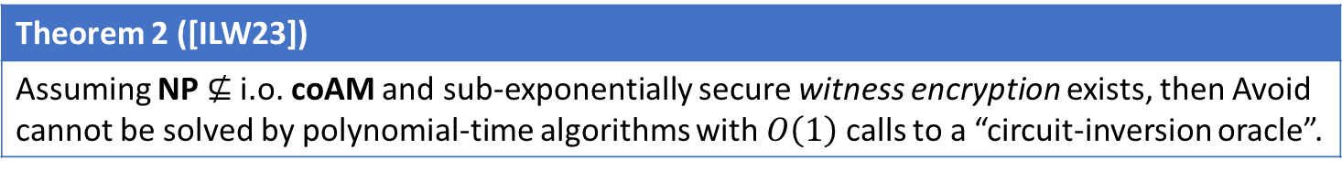
Our Results
Theorem 1 ([ILW23])
Assuming NP $≠$ coNP and sub-exponentially secure witness encryption exists, then Avoid $∉$ FP.
Theorem 2 ([ILW23])
Assuming NP $⊈$ i.o. coAM and sub-exponentially secure witness encryption exists, then Avoid cannot be solved by polynomial-time algorithms with $O\left(1\right)$ calls to a “circuit-inversion oracle”.
Theorem 2 implies the unprovability of “dual weak PHP” in bounded arithmetic (fragments of Peano that corresponds to complexity classes).

Slide 17


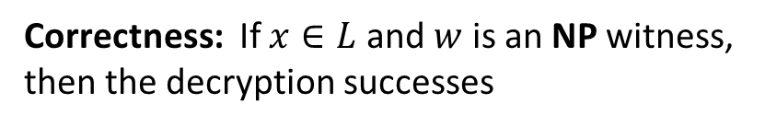
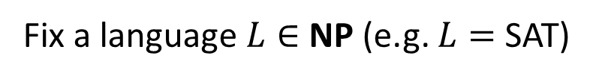
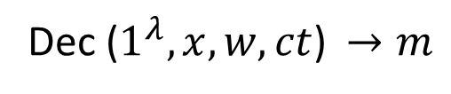
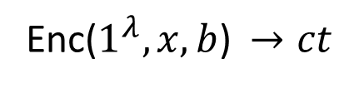
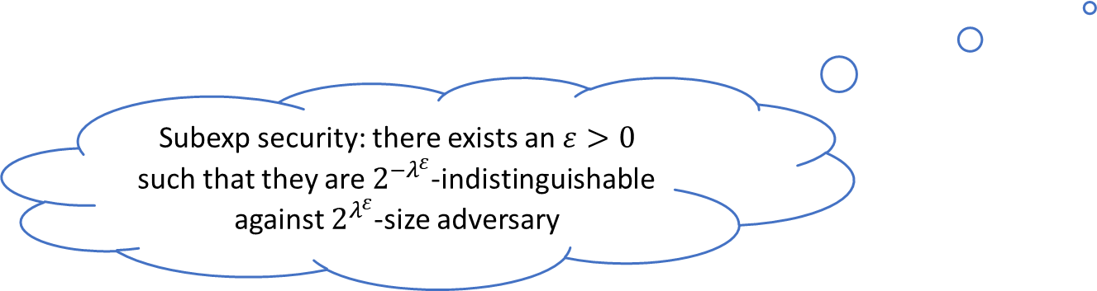

Witness Encryption
[GGSW ‘13]
Fix a language $L∈$ NP (e.g. $L=$ SAT)
Enc($1^{λ},x,b$)$→ct$
Correctness: If $x∈L$ and $w$ is an NP witness,
then the decryption successes
Dec ($1^{λ},x,w,ct$)$→m$
Security: If $x∉L$, then Enc($x,0$) $≈$ Enc($x,1$)
Subexp security: there exists an $ε>0$ such that they are $2^{{−λ}^{ε}}$-indistinguishable against $2^{λ^{ε}}$-size adversary
From well-founded iO [JLS21,JLS22]
Lattice-based constructions [CVW18,VWW22,Tsa22]
Generic-group model [BIOW20]

Slide 18
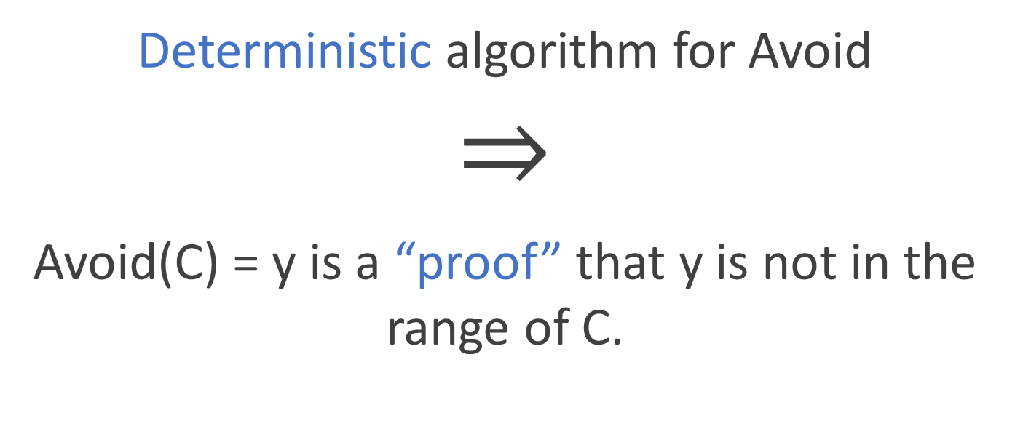
An Idea
Deterministic algorithm for Avoid
$$⇒$$
Avoid(C) = y is a “proof” that y is not in the range of C.
Should this have a short proof?

Slide 19

Intuition of Theorem 1
Subexp-secure WE
$$⇒$$
+
NP = coNP
Deterministic algo
for Avoid
Specifically:
A non-deterministic poly-time algorithm that checks if a formula is unsatisfiable

Slide 20
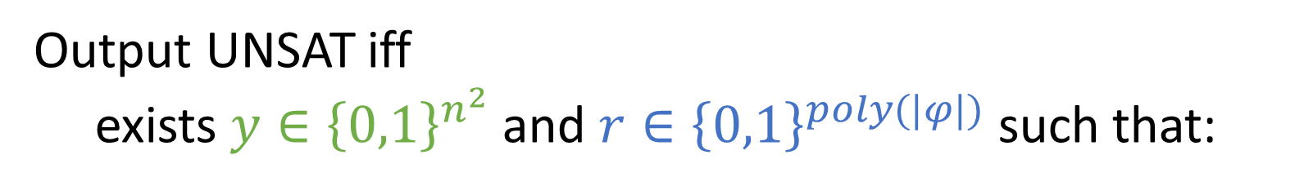
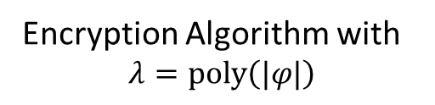
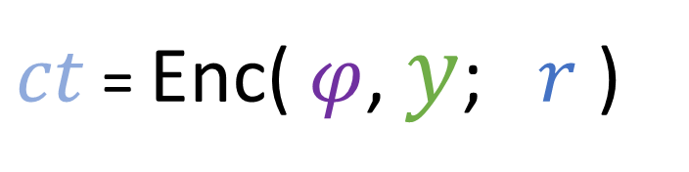
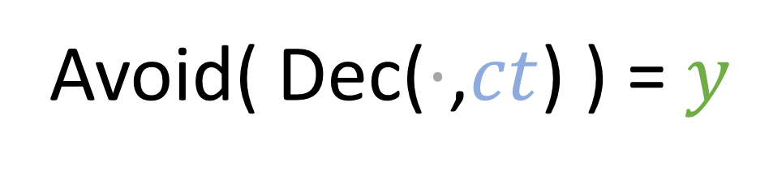
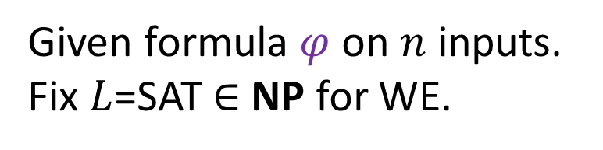
Reduction:
Given formula $φ$ on $n$ inputs.
Fix $L$=SAT$∈$NP for WE.
Output UNSAT iff
exists $y∈{\left\{0,1\right\}}^{n^{2}}$ and $r∈{\left\{0,1\right\}}^{poly(|φ|)}$ such that:
Avoid( Dec($⋅$,$ct$) ) = $y$
Non-deterministic poly-time
Deterministic Avoid algo
Decryption Algorithm
Cipher text
obtained by:
$ct$ = Enc( $φ$, $y$; $r$ )
Encryption Algorithm with
$$λ=poly\left(|φ|\right)$$
Internal
randomness

Slide 21

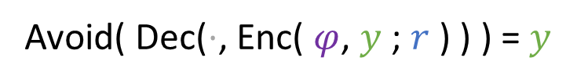
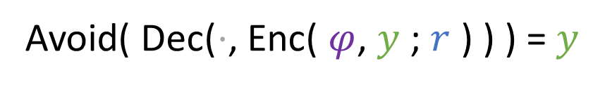


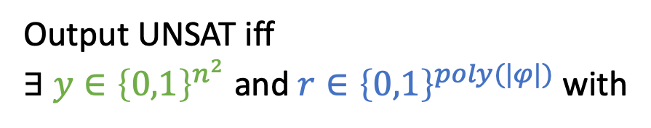
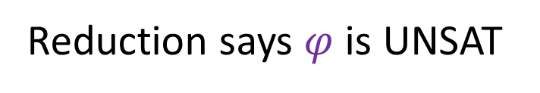


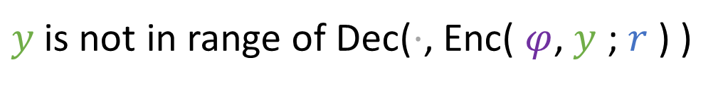
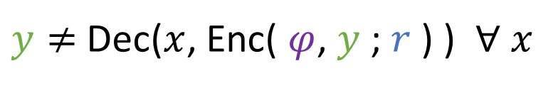
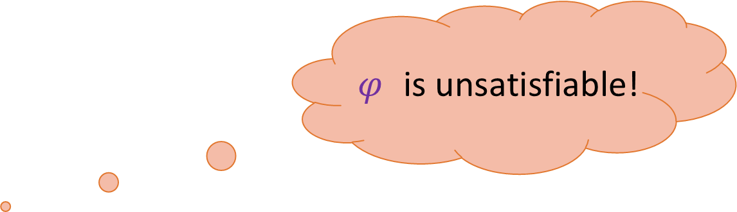
Soundness
(If reduction says UNSAT, then $φ$is UNSAT)
Reduction
Reduction says $φ$is UNSAT
Output UNSAT iff
$∃$ $y∈{\left\{0,1\right\}}^{n^{2}}$ and $r∈{\left\{0,1\right\}}^{poly(|φ|)}$ with
$$⇒$$
Construction of reduction
Avoid( Dec($⋅$, Enc( $φ$, $y$ ; $r$ ) ) ) = $y$
Avoid( Dec($⋅$, Enc( $φ$, $y$ ; $r$ ) ) ) = $y$
$$⇒$$
Avoid correctness
$y$is not in range of Dec($⋅$, Enc( $φ$, $y$ ; $r$ ) )
$$⇒$$
$φ$ is unsatisfiable!
Definition
$y≠$Dec($x$, Enc( $φ$, $y$ ; $r$ ) ) $∀ x$
$$⇒$$
Correctness of WE
$$φ\left(x\right)≠1 ∀x$$

Slide 22





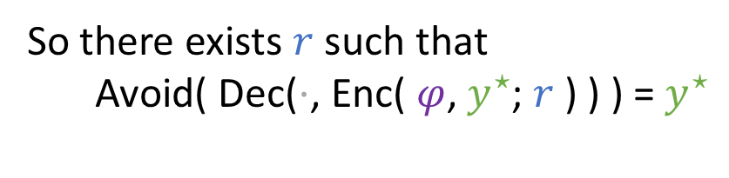
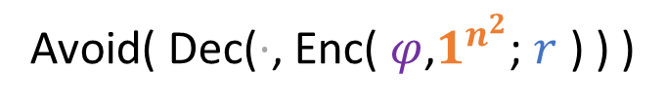
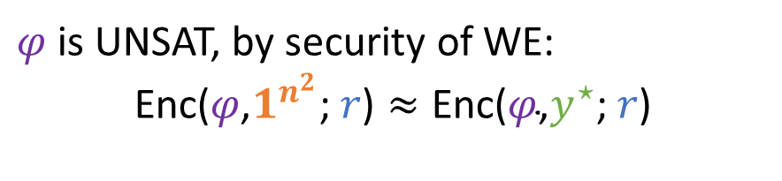


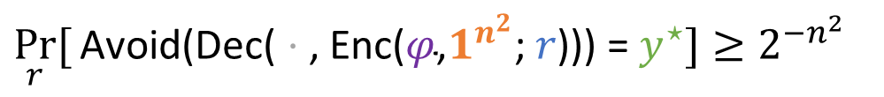
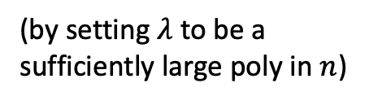
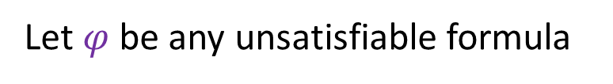


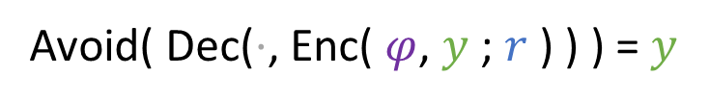
Completeness
Reduction
Output UNSAT iff
$∃$ $y∈{\left\{0,1\right\}}^{n^{2}}$ and $r∈{\left\{0,1\right\}}^{poly(|φ|)}$ with
(If $φ$is UNSAT, then reduction says UNSAT)
Avoid( Dec($⋅$, Enc( $φ$, $y$ ; $r$ ) ) ) = $y$
Let $φ$ be any unsatisfiable formula
Therefore:
$\underset{r}{Pr}{[}$Avoid($\text{Dec}\text{(}⋅\text{, }\text{Enc}\text{(}φ\text{,}y^{⋆}\text{; }r\text{))}$) = $y^{⋆}]$
Uniformly random
Look at the distribution of:
$$≥$$
$\underset{r}{Pr}{[}$Avoid($\text{Dec}\text{(}⋅\text{, }\text{Enc}\text{(}φ\text{,}1^{n^{2}}\text{; }r\text{))}$) = $y^{⋆}] −2^{{−λ}^{ε}}$
Avoid( Dec($⋅$, Enc( $φ$,$1^{n^{2}}$; $r$ ) ) )
$$≥$$
$$2^{−n^{2}}−2^{{−λ}^{ε}}$$
Must be some $y^{⋆}∈{\left\{0,1\right\}}^{n^{2}}$such that:
(by setting $λ$ to be a sufficiently large poly in $n$)
$\underset{r}{Pr}{[}\text{Avoid}\text{(}\text{Dec}\text{(}⋅\text{, }\text{Enc}\text{(}φ\text{,}1^{n^{2}}\text{; }r\text{)))}$= $y^{⋆}]≥2^{−n^{2}}$
$$>$$
$$0$$
So there exists $r$ such that
Avoid( Dec($⋅$, Enc( $φ$, $y^{⋆}$; $r$ ) ) ) =$y^{⋆}$
$φ$ is UNSAT, by security of WE:
$$\text{Enc}\text{(}φ\text{,}1^{n^{2}}\text{; }r\text{)}≈\text{Enc}\text{(}φ\text{,}y^{⋆}\text{; }r\text{)}$$
So reduction outputs UNSAT

Slide 23
Overview
1. Background: Explicit Constructions
2. [ILW23]: Hardness for Explicit Constructions from Witness Encryption
3. [CL24]: Stronger Hardness from Lattice-Based Cryptography
4. Open Problems

Slide 24
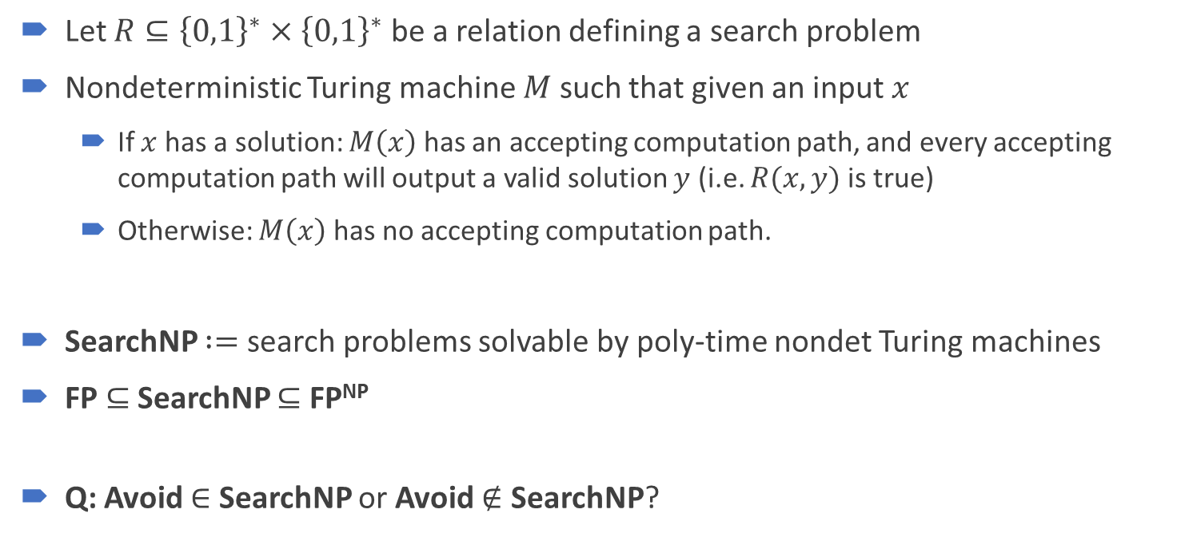
Nondeterministic Search Algorithm
Let $R⊆{\left\{0,1\right\}}^{∗}×{\left\{0,1\right\}}^{∗}$ be a relation defining a search problem
Nondeterministic Turing machine $M$ such that given an input $x$
If $x$ has a solution: $M\left(x\right)$ has an accepting computation path, and every accepting computation path will output a valid solution $y$ (i.e. $R(x,y)$ is true)
Otherwise: $M\left(x\right)$ has no accepting computation path.
SearchNP $:=$ search problems solvable by poly-time nondet Turing machines
FP $⊆$ SearchNP $⊆$ FP^{NP}
Q: Avoid $∈$ SearchNP or Avoid $∉$ SearchNP?
Related to proof complexity generators [RSW22, Kra19, Kra22]
Ground truth is unclear!

Slide 25

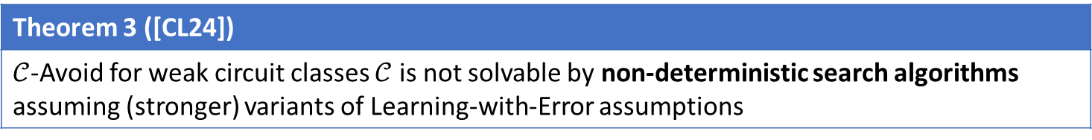
Our Result (Informal)
Let $R⊆{\left\{0,1\right\}}^{∗}×{\left\{0,1\right\}}^{∗}$ be a relation defining a search problem
Nondeterministic Turing machine $M$ such that given an input $x$
If $x$ has a solution: $M\left(x\right)$ has an accepting computation path, and every accepting computation path will output a valid solution $y$ (i.e. $R(x,y)$ is true)
Otherwise: $M\left(x\right)$ has no accepting computation path.
Theorem 3 ([CL24])
$𝒞$-Avoid for weak circuit classes $𝒞$ is not solvable by non-deterministic search algorithms assuming (stronger) variants of Learning-with-Error assumptions

Slide 26
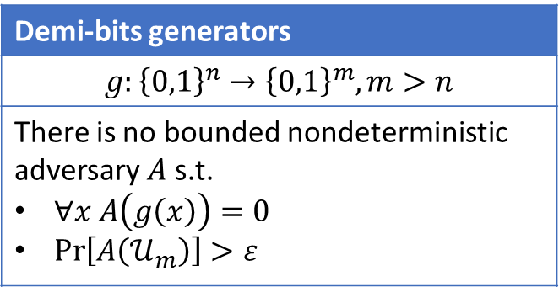
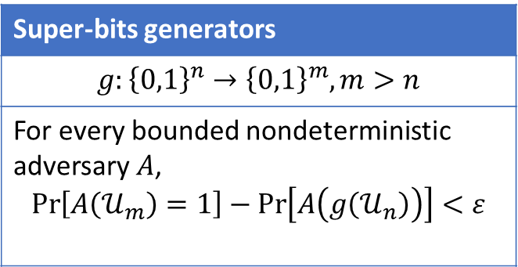
Cryptography against NP
In a pioneer work of Rudich (1997), two basic primitives are defined as analogues of pseudorandom generators
Super-bits generators
$$g:{\left\{0,1\right\}}^{n}→{\left\{0,1\right\}}^{m}, m>n$$
For every bounded nondeterministic adversary $A$, $$\operatorname{Pr}\left[A\left(𝒰_{m}\right)=1\right]−\operatorname{Pr}\left[A\left(g\left(𝒰_{n}\right)\right)\right]<ε$$
Demi-bits generators
$$g:{\left\{0,1\right\}}^{n}→{\left\{0,1\right\}}^{m}, m>n$$
There is no bounded nondeterministic adversary $A$ s.t. $∀x A\left(g\left(x\right)\right)=0$ $\operatorname{Pr}\left[A\left(𝒰_{m}\right)\right]>ε$
Need to accept uniform distribution with higher probability!

Slide 27
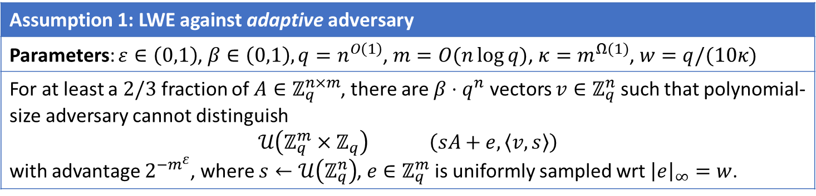
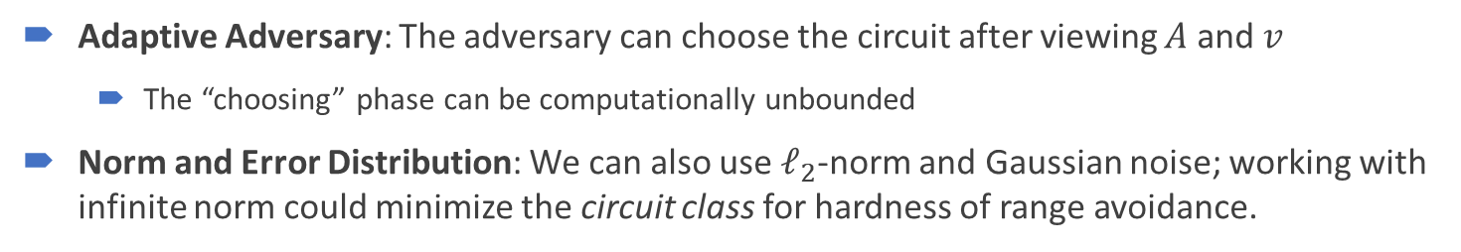
Our Assumption (for Avoid)
Learning-with-Error
Assumption 1: LWE against adaptive adversary
Parameters: $ε∈\left(0,1\right)$, $β∈\left(0,1\right),q=n^{O\left(1\right)}$, $m=O(n\log{q})$, $κ=m^{Ω(1)}$, $w=q/(10κ)$
For at least a $2/3$ fraction of $A∈ℤ_{q}^{n×m}$, there are $β⋅q^{n}$ vectors $v∈ℤ_{q}^{n}$ such that polynomial-size adversary cannot distinguish $$𝒰\left(ℤ_{q}^{m}×ℤ_{q}\right) \left(sA+e, \left\langle v,s\right\rangle \right)$$ with advantage $2^{−m^{ε}}$, where $s←𝒰\left(ℤ_{q}^{n}\right)$, $e∈ℤ_{q}^{m}$ is uniformly sampled wrt ${\left|e\right|}_{∞}=w$.
Adaptive Adversary: The adversary can choose the circuit after viewing $A$ and $v$
The “choosing” phase can be computationally unbounded
Norm and Error Distribution: We can also use $ℓ_{2}$-norm and Gaussian noise; working with infinite norm could minimize the circuit class for hardness of range avoidance.

Slide 28


Our Assumption, Strengthened
Learning-with-Error
Assumption 1’: LWE against adaptive nondeterministic adversary
Parameters: $ε∈\left(0,1\right)$, $β∈\left(0,1\right),q=n^{O\left(1\right)}$, $m=O(n\log{q})$, $κ=m^{Ω(1)}$, $w=q/(10κ)$
For at least a $2/3$ fraction of $A∈ℤ_{q}^{n×m}$, there are $β⋅q^{n}$ vectors $v∈ℤ_{q}^{n}$ such that no polynomial-sized nondeterministic algorithm $Adv$ will have $$\operatorname{Pr}\left[Adv\left(𝒰\left(ℤ_{q}^{m}×ℤ_{q}\right)=1\right)\right]−\operatorname{Pr}\left[Adv\left(\left(sA+e, \left\langle v,s\right\rangle \right)\right)=1\right]≥2^{−m^{ε}},$$ where $s←𝒰\left(ℤ_{q}^{n}\right)$, $e∈ℤ_{q}^{m}$ is uniformly sampled wrt ${\left|e\right|}_{∞}=w$.
The adversary is nondeterministic, but it is required to accept the uniform distribution with higher probability.
Equivalent formulation: $f\left(s,e\right)≔\left(sA+e,\left\langle v,s\right\rangle \right)$ is a super-bits generator (Rudich 1997)

Slide 29


Our Assumption (for Avoid)
Can be implemented by a layer of AND gates
Inhomogeneous Short Integer Solution
Assumption 2: ISIS against nondeterministic adversary
Parameters: $ε∈\left(0,1\right)$, $β∈\left(0,1\right),q=n^{O\left(1\right)}$, $m=O(n\log{q})$, $κ=m^{Ω(1)}$, $w=q/(10κ)$
Function: Ext $:{\left\{0,1\right\}}^{O(κ\log{(n/k)})}→{\left\{0,1\right\}}^{m}$ be an encoding of $κ$-sparse strings
For at least a $2/3$ fraction of $A∈ℤ_{q}^{n×m}$, there is no nondeterministic algorithms $P$such that $P$ accepts at least $β⋅q^{n}$ vectors in $ℤ_{q}^{n}$ $P$ rejects every vector of form $y≔A⋅Ext\left(u\right) mod q$
Average-case hardness against nondeterministic algorithms
Equivalent formulation: $g\left(u\right)≔A⋅Ext(u)$ is a demi-bits generator (Rudich 1997)

Slide 30



Our Hardness Results (for Avoid)
Output
DOR
EMAJ gates
AND gates
DOR $∘$ EMAJ $∘$ AND circuits:
DOR: unbounded fan-in OR gate, with a semantic promise that at most one of its input wires is 1
EMAJ: exact majority gate, which outputs 1 iff exactly ½ of its input wires are 1
AND: unbounded fan-in AND gate
Input
Theorem 3 (slightly more formal)
Under Assumption 1’ and Assumption 2, range avoidance for DOR $∘$ EMAJ $∘$ AND circuits cannot be solved by (non-uniform) polynomial-time nondeterministic search algorithms.
Theorem 3$−$
Under Assumption 1 and Assumption 2, range avoidance for DOR $∘$ EMAJ $∘$ AND circuits cannot be solved by deterministic polynomial-sized circuits.

Slide 31


Comparison to Standard Lattice Assumptions
Best known attack: $(n/\log{n})$-approximate GapCVP (in $ℓ_{∞}$-norm) is in NP $∩$ coNP [GG98, AR05]
Stronger as…
We need two assumptions (LWE and ISIS) instead of only one assumption (e.g. Regev’s PKE).
Security against nondeterministic adversaries
Weaker as…
The noise is much higher compared to standard assumptions.
Security against adaptive adversary: an unbounded choosing phase after seeing the query matrix $(A;v)$
Security against adaptive adversary: an unbounded choosing phase after seeing the query matrix (𝐴;𝑣)
Our assumption is secure even if GapCVP ($ℓ_{∞}$-norm) with $n^{0.1}$-approximation ratio is in poly-time
Our assumption is secure even if GapCVP (ℓ_∞-norm) with 𝑛^0.1-approximation ratio is in poly-time
Lattice-based PKEs are insecure if GapCVP with $n^{2}$-approximation ratio is in poly-time
Lattice-based PKEs are insecure if GapCVP with 𝑛^2-approximation ratio is in poly-time
Most (if not all) lattice-based PKEs are provably insecure against nondeterministic adversaries using the NP $∩$ coNP algorithm in [GG98, AR05] (also see [Barak17])

Slide 32
Our Technique: A Bird’s Eye View
Step 1: Hardness from Witness Encryption
[ILW23]: Hardness of Avoid from witness encryption for NP
Step 2: WE from $\tilde{PK}E$ (PKE with pseudorandom public key)
Step 2: WE from (𝐏𝐊) ̃𝐄 (PKE with pseudorandom public key)
Obs1: witness encryption for hard languages (instead of NP) suffices!
Step 3: Instantiation of $\tilde{PK}E$
Step 3: Instantiation of (𝐏𝐊) ̃𝐄
Construction of $\tilde{PK}E$ with very hard “PKE problem” and is secure against nondeterministic algorithms
Construction of (𝐏𝐊) ̃𝐄 with very hard “PKE problem” and is secure against nondeterministic algorithms
Generalizations: RPP, restricted circuits, hardness against nondeterministic algorithms, etc.
Obs2: most PKE schemes have certain good properties (we call it $\tilde{PK}E$)
Obs2: most PKE schemes have certain good properties (we call it (𝐏𝐊) ̃𝐄)
Obs3: $\tilde{PK}E$ (+ some property) $⇒$ WE for its “PKE problem”
Obs3: (𝐏𝐊) ̃𝐄 (+ some property) ⇒ WE for its “PKE problem”
Modified from standard LWE/LPN based schemes [AD97, Regev09, Ale11]

Slide 33

Step 1: Hardness from WE
Idea of [ILW23]: Solving Avoid deterministic + witness encryption for $L∈$ NP $⇒$ an efficient proof system for $\overline{L}$.
Witness encryption for NP + NP $≠$ coNP $⇒$ Avoid $∉$ FP
Generalizations:
If decoding of witness encryption can be implemented by $𝒞$-circuits, $𝒞$-Avoid algorithms suffice.
Witness encryption “secure against nondeterministic adversaries” + solving Avoid nondeterministic $⇒$ efficient proof systems.

Slide 34

Step 1: Hardness from WE
What is “security against nondeterministic adversaries”?
Definition (Witness Encryption against Nondeterminism)
Let (Enc, Dec) be a witness encryption scheme for language $L∈$ NP Enc($x,b$) $→$ ct Dec($x,w,ct$) $→$ $b$ It is said to be $ε$-secure if there is a p.p.t. simulator $S$ such that for every $x∉L$, every message $b∈\{0,1\}$, and any poly-size nondeterministic $Adv$: $$\operatorname{Pr}\left[Adv\left(S\left(1^{n},x\right)\right)=1\right]−\operatorname{Pr}\left[Adv\left(Enc\left(x,b\right)\right)=1\right]<ε$$
The adversary cannot accept the simulated distribution more often compared to the actual cipher text!

Slide 35


Step 2: WE from $\tilde{PK}E$
It works if the witness encryption scheme has flexible security parameter, i.e., Enc($1^{λ}$, …) will be $2^{−λ^{Ω\left(1\right)}}$-secure
Three main challenges (from the [ILW23] framework)
Hard Language
Strong Security
Easy Decoding
[ILW23] requires witness encryption for a language not in coNP
[ILW23] requires that the advantage of the adversary cannot be larger than $2^{−k}$, where $k$ is the proof length
[ILW23] requires that the advantage of the adversary cannot be larger than 2^(−𝑘), where 𝑘 is the proof length
The circuit class for the hardness results depends on the decoding complexity.
iO-based candidates are unlikely to be very efficient

Slide 36


Step 2: WE from $\tilde{PK}E$
Many well-studied PKEs are $\tilde{PK}E$, e.g., Goldwasser-Micali and Regev’s PKE.
Definition (PKE with pseudorandom public-key, informal)
Let (Gen, Enc, Dec) be a PKE scheme: Gen$→$ ($pk, sk$) Enc($pk,b$) $→$ ct Dec($sk,ct$) $→$ $b$
It is said to be a PKE with pseudorandom public-key ($\tilde{PK}E$) if it satisfies: (Ideal World). There is an “ideal” distribution $𝒟$ for public keys. (Hard PKE Problem). The problem of distinguishing “real public keys” and “ideal public keys” is hard. Namely, the following two distributions are indistinguishable: $$rpk←Gen ipk←𝒟$$ (Security in Ideal World). Encryption is semantically secure using ideal public keys $pk←𝒟$
Called “dual-mode PKE” [PVW08] or “meaningful/meaningless PKE” [KN08] if it has statistical security in ideal world
Encryption using ideal public keys may not be decryptable, even statistically

Slide 37


Step 2: WE from $\tilde{PK}E$
Definition (PKE with pseudorandom public-key, informal)
Let (Gen, Enc, Dec) be a PKE scheme: Gen$→$ ($pk, sk$) Enc($pk,b$) $→$ ct Dec($sk,ct$) $→$ $b$
It is said to be a PKE with pseudorandom public-key ($\tilde{PK}E$) if it satisfies: (Ideal World). There is an “ideal” distribution $𝒟$ for public keys. (Hard PKE Problem). The problem of distinguishing “real public keys” and “ideal public keys” is hard. Namely, the following two distributions are indistinguishable: $$rpk←Gen ipk←𝒟$$ (Security in Ideal World). Encryption is secure using ideal public keys $ipk←𝒟$
After viewing the ideal public key $ipk←𝒟$, the “choosing phase” can be computationally unbounded!
Definition (Adaptive Security in Ideal World, informal)
(Adaptive Security in Ideal World). Encryption is secure using ideal public keys, even if the adversary is allowed to view the ideal public key before proposing its attack algorithm.

Slide 38


Step 2: WE from $\tilde{PK}E$
Definition ($\tilde{PK}E$ with adaptive security, informal)
It is said to be a PKE with pseudorandom public-key ($\tilde{PK}E$) if it satisfies: (Ideal World). There is an “ideal” distribution $𝒟$ for public keys. (Hard PKE Problem). The problem of distinguishing “real public keys” and “ideal public keys” is hard. Namely, the following two distributions are indistinguishable: $$rpk←Gen ipk←𝒟$$ (Adaptive Security in Ideal World). Encryption is secure using ideal public keys, even if the adversary is allowed to view the ideal public key before proposing its attack algorithm.
Adaptive security against nondeterministic adversaries can be defined in the spirit of Rudich’s super-bits using simulation paradigm.
Theorem (informal)
Let (Gen, Enc, Dec) be a $\tilde{PK}E$ scheme with adaptive security in ideal world, then the PKE problem admits a secure witness encryption scheme. Moreover: The decryption algorithm of the witness encryption scheme is just Dec. The security parameter of the witness encryption scheme is the same as the security parameter for the adaptive security of the original $\tilde{PK}E$ scheme. If the adaptive security works against nondeterministic algorithms, so does the witness encryption scheme.

Slide 39



Step 3: Instantiation
Theorem (informal)
Let (Gen, Enc, Dec) be a $\tilde{PK}E$ scheme with adaptive security in ideal world, then the PKE problem admits a secure witness encryption scheme. Moreover: The decryption algorithm of the witness encryption scheme is just Dec. The security parameter of the witness encryption scheme is the same as the security parameter for the adaptive security in ideal world of the original $\tilde{PK}E$ scheme. If the adaptive security works against nondeterministic algorithms, so does the witness encryption scheme.
Recall that “[ILW23] requires that the advantage of the adversary cannot be larger than $2^{−k}$, where $k$ is the proof length”.
The goal is to construct a $\tilde{PK}E$ scheme with:
adaptive security (against nondeterministic algorithms),
efficient decryption algorithm,
strong security in ideal world (compared to length of the secret key),
hard PKE problem (not in coNP).
Here, “proof” in the PKE problem is just the secret key

Slide 40



Step 3: Instantiation
Bug 1: NOT secure against adaptive adversary! Almost all ideal keys are real keys $⇒$ can be broken by a key-guessing adversary
(Dual) Regev’s PKE as a $\tilde{PK}E$
Let (Gen, Enc, Dec) be a PKE scheme: Gen: $A←𝒰\left(ℤ_{q}^{n×m}\right),x←𝒰\left({\left\{0,1\right\}}^{m}\right), v=Ax mod q;pk=\left(A,v\right), sk=x$ Enc($pk=(A,v),b$): $\left(p=sA+e, c=\left\langle v,s\right\rangle +b⋅\left\lfloor \frac{q}{2}\right\rfloor \right) mod q$, $e$ is a small error Dec($sk=x,ct=(p,c)$): output 1 iff $c−\left\langle p,x\right\rangle$ is closer to $q/2$ then to $0$
(Ideal world). $𝒟=𝒰\left(ℤ_{q}^{n×m}×ℤ_{q}^{n}\right)$ (Hardness of PKE problem). Distinguishing $𝒰\left(ℤ_{q}^{n×m}×ℤ_{q}^{n}\right)$ and $(A,Ax)$ for $x∈{\left\{0,1\right\}}^{n}$. Indeed, they are statistically close by the leftover hash lemma. (Security in ideal world). Exactly the LWE assumption!
Bug 2: NOT secure against nondet. adversary! LWE in standard parameter is known to be in NP $∩$ coNP [GG98,AR05]
Bug 3: Security parameter (in ideal world) is not large enough compared to secret-key length!
(required by [ILW23] framework)

Slide 41


Step 3: Instantiation – One Simple Trick
Sparse $\left\{0,1\right\}$-vector
Modified (Dual) Regev’s PKE as a $\tilde{PK}E$
Let (Gen, Enc, Dec) be a PKE scheme: Gen: $A←𝒰\left(ℤ_{q}^{n×m}\right),x←𝒰\left({\left\{0,1\right\}}^{m}\right), v=Ax mod q;pk=\left(A,v\right), sk=x$ Enc($pk=(A,v),b$): $\left(p=sA+e, c=\left\langle v,s\right\rangle +b⋅\left\lfloor \frac{q}{2}\right\rfloor \right) mod q$, $e$ is a small error Dec($sk=x,ct=(p,c)$): output 1 iff $c−\left\langle p,x\right\rangle$ is closer to $q/2$ then to $0$
(Ideal world). $𝒟=𝒰\left(ℤ_{q}^{n×m}×ℤ_{q}^{n}\right)$ (Hardness of PKE problem). Distinguishing $𝒰\left(ℤ_{q}^{n×m}×ℤ_{q}^{n}\right)$ and $(A,Ax)$ for $x∈{\left\{0,1\right\}}^{n}$. Indeed, they are statistically close by the leftover hash lemma. (Adaptively security in ideal world). Exactly the LWE assumption!
Still small, but much larger than the standard setting!
ISIS: Plausibly secure against nondet. adv
LWE: Plausibly secure against adaptive nondet. adv

Slide 42
Overview
1. Background: Explicit Constructions
2. [ILW23]: Hardness for Explicit Constructions from Witness Encryption
3. [CL24]: Stronger Hardness from Lattice-Based Cryptography
4. Open Problems

Slide 43




Four Worlds of Explicit Construction
[ILW23]: We are not in Avoidtopia $∩$ Obfustopia
Avoidtopia
Uniformia
Infinia
Surjectivia
Some unary explicit
constructions are hard
against FP algorithms
Avoid $∈$ FP
Avoid $∉$ FP
Certain unary explicit
construction is hard
against FP algorithms
almost everywhere
($∃$ a fixed family of uniform
circuit such that no poly-time
algorithm solves Avoid of this
circuit family even on infinitely
many input lengths)
Imply FP explicit
construction for
many concrete
problems!
Every unary explicit
construction admits
an FP algorithm
(Avoid is easy when the
input circuit is a fixed
family of uniform circuit)
Every unary explicit
constructions are
in i.o.-FP
(Avoid is easy infinitely
often when the input circuit is a fixed family of uniform circuit)

Slide 44

Other Open Problems
Hardness of remote point for XOR circuits -- the initial question in [APY09]; we can only rule out algorithms for (XOR $∘$ AND)-RPP.
Meta-mathematical implication: Can we view our results as a barrier towards proving circuit lower bounds against constant-depth circuits?
Assumptions independent of concrete structures: If we only care about whether Avoid (for general circuits) is hard against nondeterministic algorithms, can we get rid of concrete structures (e.g., lattice or number theory) in the assumption?
Cryptographic application of our PKE and witness encryption schemes.

