Slide 1



Distinguishing Predicting Certifying
Yao’s Lemma
Reconstruction Paradigm
Ted
Jiatu Li (MIT) Edward Pyne (MIT) Roei Tell (U Toronto)
Paper Title: Distinguishing, Predicting, and Certifying: On the Long Reach of Partial Notions of Pseudorandomness
Notes:
In this talk, I will explain our recent work on three fundamental concepts in the theory of pseudorandomness
Distinguishing, predicting, and certifying
This is a joint work with Ted Pyne and Roei Tell
Concretely, we are interesting two basic tools,
[Click]
Yao’s lemma transforming a distinguisher to a predictor of a pseudorandom distribution
[Click]
And more generally the reconstruction paradigm, which we will explain later

Slide 2

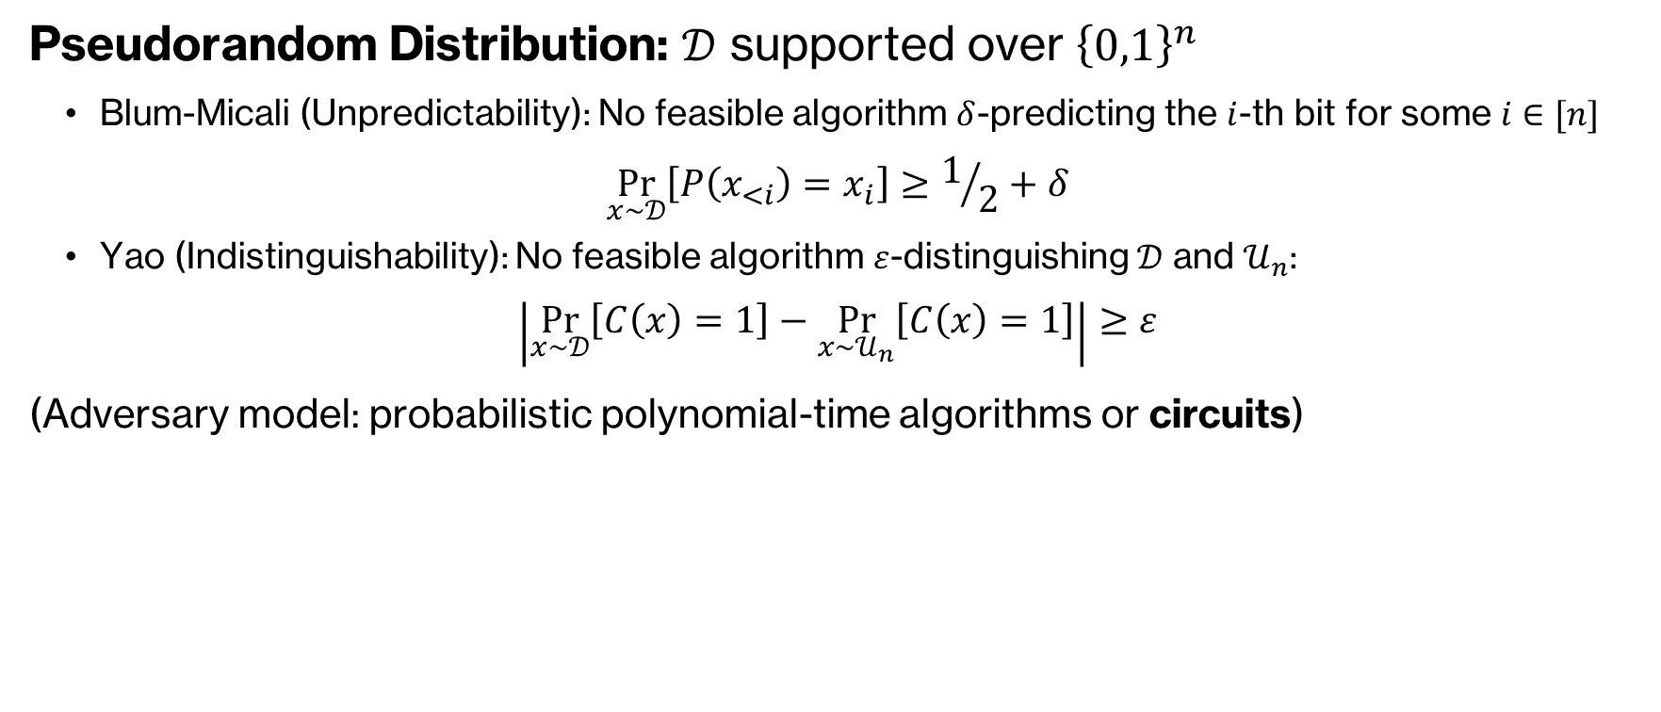
Yao's Lemma
Pseudorandom Distribution: $𝒟$ supported over ${\left\{0,1\right\}}^{n}$
Blum-Micali (Unpredictability): No feasible algorithm $δ$-predicting the $i$-th bit for some $i∈[n]$
$$\underset{x∼𝒟}{Pr}\left[P\left(x_{<i}\right)=x_{i}\right]≥1/2+δ$$
Yao (Indistinguishability): No feasible algorithm $ε$-distinguishing $𝒟$ and $𝒰_{n}$:
$$\left|\underset{x∼𝒟}{Pr}\left[C\left(x\right)=1\right]−\underset{x∼𝒰_{n}}{Pr}\left[C\left(x\right)=1\right]\right|≥ε$$
(Adversary model: probabilistic polynomial-time algorithms or circuits)
Yao’s Lemma
A distribution is indistinguishable if and only if it is unpredictable.
Notes:
We first recall Yao’s lemma.
For a distribution D support over n-bit strings, there are two standard definitions of its pseudorandomness
Namely, unpredictability, indicating that there is no feasible algorithm predicting the i-th bit from the first i-1 bits with noticeable advantage
And indistinguishability, indicating that there is no feasible algorithm whose acceptance probabilities over the distribution D and over the uniform distribution, are bounded away from 0
The adversary model is usually probabilistic algorithms or circuits
A predictor is clearly a distinguisher, as the uniform distribution is statically unpredictable
Yao’s lemma suggests that these two definitions are indeed equivalent. From any distinguisher of the distribution D, we can obtain a predictor of it.

Slide 3


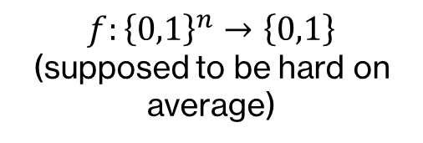
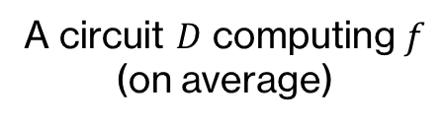


Reconstruction Paradigm
[NW94]: Nisan-Wigderson PRG
$$f:{\left\{0,1\right\}}^{n}→\left\{0,1\right\}$$
(supposed to be hard on average)
$$⇒$$
Nisan-Wigderson PRG ${NW}^{f}$
Combinatorial Designs
Yao’s Lemma
A circuit $D$ computing $f$
(on average)
Predictor $P$ for NW$f$
Distinguisher $C$ of NW$f$
Randomized
Randomized
Extractor [Tre01], Expanders [TSUZ07], Error-Correcting Codes [STV01]
Notes:
Another standard tool in the theory of pseudorandomness is the reconstruction paradigm.
One of the most notable example is Nisan-Widgerson’s pseudorandom generator from hard truth tables
[Click] Suppose that we are given a function $f$ that is hard on average against circuits,
[Click] we can construct a pseudorandom generator from it
The correctness is proved by a reconstruction algorithm.
[Click]. Suppose that there is a distinguisher C of Nisan-Wigderson PRG using f
[Click]. By Yao’s Lemma, we can obtain a predictor of the PRG,
[Click]. Subsequently, we can use the predictor and the combinatorial design in the PRG to construct a small circuit computing f, refuting the assumption that f is hard on average
[Click]. Similar framework is also used in construction of extractors, expanders, and error-correcting codes
[Click]. We should note that both steps in the reconstruction of Nisan-Widgerson PRG requires randomness

Slide 4


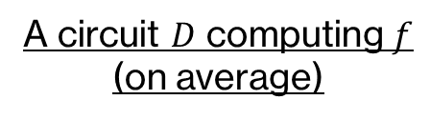

Reconstruction Paradigm
$$f:{\left\{0,1\right\}}^{n}→\left\{0,1\right\}$$
(supposed to be hard on average)
$$⇒$$
Nisan-Wigderson PRG ${NW}^{f}$
Combinatorial Designs
Yao’s Lemma
A circuit $D$ computing $f$
(on average)
Predictor $P$ for NW$f$
Distinguisher $C$ of NW$f$
Randomized
Randomized
Hardness of $f$
$$=$$
$$+$$
Derandomization task
The complexity of the reconstruction algorithm
Notes:
An interesting question is the complexity of the reconstruction algorithm.
This is because the hardness assumption we need for the function f depends on two parts.
[Click]. The complexity of the distinguisher C of the PRG, which depends on the derandomization task.
[Click]. And the complexity of the reconstruction algorithm, which, in the example of Nisan-Widgerson PRG, includes Yao’s transformation from distinguishers to predictors, and the construction of circuit D from the predictor and combinatorial design.

Slide 5




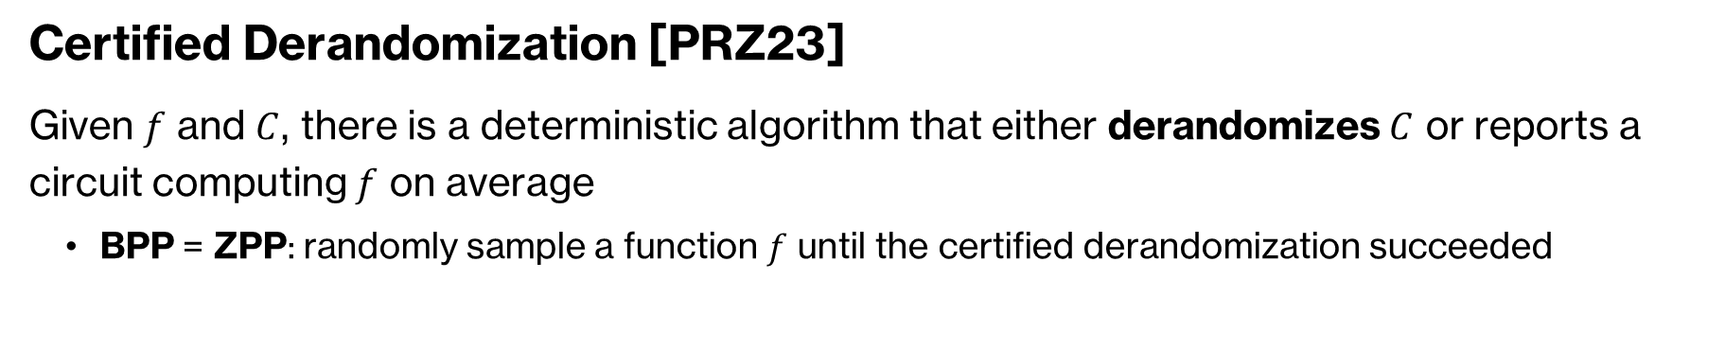
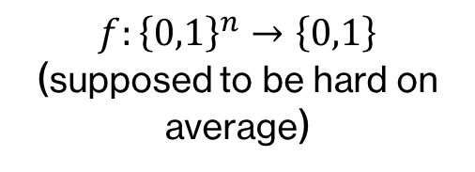
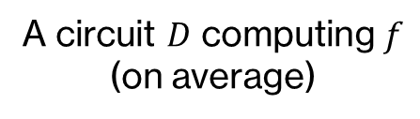
Suppose We Have ……
$$f:{\left\{0,1\right\}}^{n}→\left\{0,1\right\}$$
(supposed to be hard on average)
$$⇒$$
$$\text{Nisan}\text{−}\text{Wigderson} \text{PRG} {NW}^{f}$$
A circuit $D$ computing $f$
(on average)
Predictor $P$ for NW$f$
Distinguisher $C$ of NW$f$
Deterministic
Deterministic
Certified Derandomization [PRZ23]
Given $f$ and $C$, there is a deterministic algorithm that either derandomizes $C$ or reports a circuit computing $f$ on average
BPP = ZPP: randomly sample a function $f$ until the certified derandomization succeeded
Notes:
Specifically, suppose that both steps of Nisan-Widgerson’s reconstruction can be derandomized, we will be able to obtain a “certified derandomization” algorithm defined by Pyne, Raz, and Zhan.
[Click] That is, given $f$ and a circuit $C$, the deterministic algorithm either outputs the approximate acceptance probability of $C$, or reports a circuit computing $f$ on average.
[Click] We note that certified derandomization implies the collapse of BPP to ZPP, as, with a certified derandomization algorithm, we can randomly sample a function $f$ until the certified derandomization succeeded, which is a zero-error poly-time algorithm since most functions are hard.

Slide 6


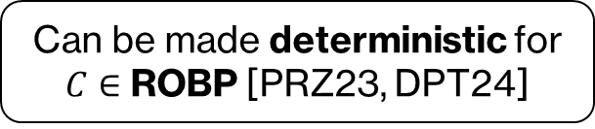
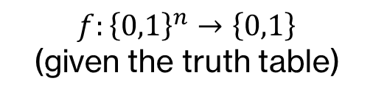
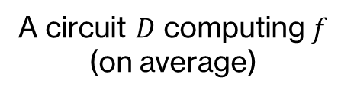


Recent Development on BPL vs L
$$f:{\left\{0,1\right\}}^{n}→\left\{0,1\right\}$$
(given the truth table)
$$⇒$$
$$\text{Nisan}\text{−}\text{Wigderson} \text{PRG} {NW}^{f}$$
Combinatorial Designs
Yao’s Lemma
A circuit $D$ computing $f$
(on average)
Predictor $P$ for NW$f$
Distinguisher $C$ of NW$f$
Can be made deterministic! [PRZ23, DPT24]
Can be made deterministic for $C∈$ ROBP [PRZ23, DPT24]
[PRZ23]: Certified derandomization of BPL
[DPT24]: BPL = L from uniform assumptions
Can we extend these results to stronger classes?
Notes:
Indeed, such derandomization has been shown possible in a less general setting.
[Click] Recent works show that the second step of Nisan-Wigderson reconstruction can be made deterministic
[Click] Moreover, the first step, namely Yao’s transformation from distinguishers to predictors can be made deterministic, if the input circuit C is a read-once branching program
[Click] Using these results, we can show certified derandomization in space-bounded setting, and obtain BPL = L from uniform hardness assumptions.
[Click]. A natural question is, therefore, whether we can extend these results to classes stronger than ROBPs.

Slide 7
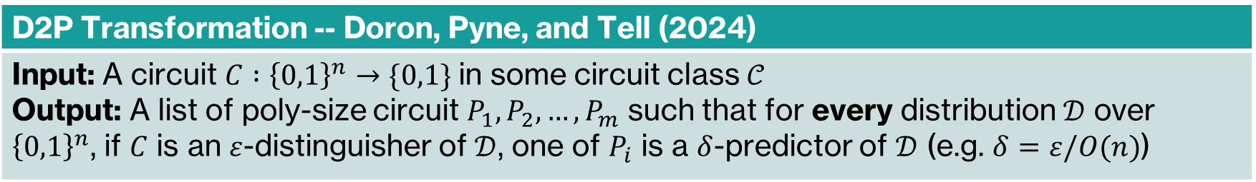
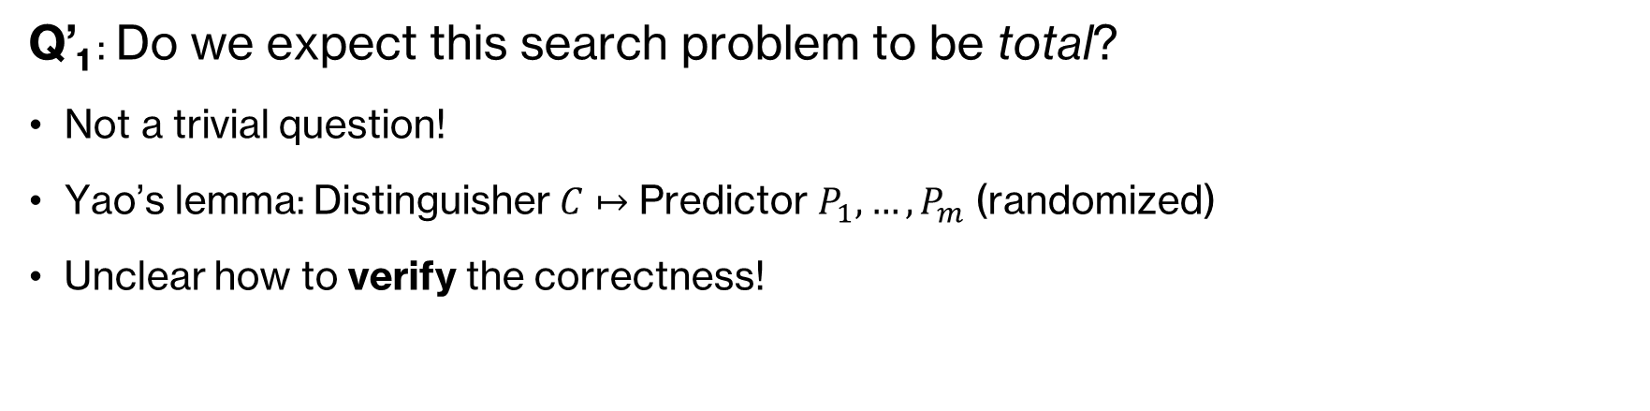
Deterministic D2P
D2P Transformation -- Doron, Pyne, and Tell (2024)
Input: A circuit $C :{\left\{0,1\right\}}^{n}→\{0,1\}$ in some circuit class $𝒞$ Output: A list of poly-size circuit $P_{1}, P_{2}, …,P_{m}$ such that for every distribution $𝒟$ over ${\left\{0,1\right\}}^{n}$, if $C$ is an $ε$-distinguisher of $𝒟$, one of $P_{i}$ is a $δ$-predictor of $𝒟$ (e.g. $δ=ε/O(n)$)
Q’₁ : Do we expect this search problem to be total?
Not a trivial question!
Yao’s lemma: Distinguisher $C$ $↦$ Predictor $P_{1}, …,P_{m}$ (randomized)
Unclear how to verify the correctness!
Notes:
The distinguisher-to-predictor transformation, or D2P transformation, is formally introduced by Doron, Pyne, and Tell.
Given a circuit C from some circuit class C, we are required to output a list P1, P2, …, Pm of candidate predictors, such that for every distribution D, if C is an epsilon-distinguisher of D, one of Pi is an delta-predictor of D, where delta is usually epsilon / O(n).
Before asking whether there is a deterministic D2P transformation, we should first ask a simpler question: Do we expect the search problem to be total.
[Click]. Perhaps surprisingly, this is indeed not a trivial question.
[Click]. Yao’s lemma provides a randomized transformation from distinguisher C to a list of candidate predictors P1, …, Pm
[Click]. However, since it is unclear how to verify the correctness, we cannot easily derandomize the transformation using standard techniques.

Slide 8
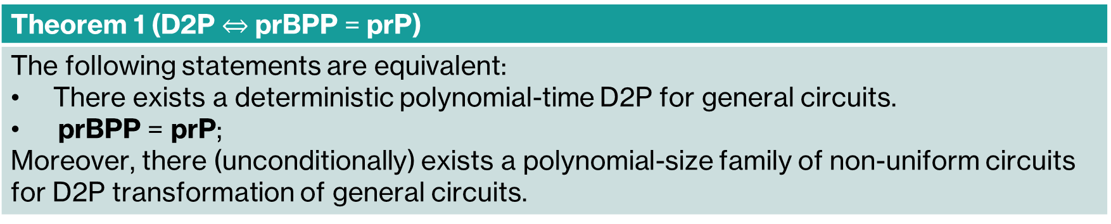

Main Result
D2P Transformation -- Doron, Pyne, and Tell (2024)
Input: A circuit $C :{\left\{0,1\right\}}^{n}→\{0,1\}$ in some circuit class $𝒞$ Output: A list of poly-size circuit $P_{1}, P_{2}, …,P_{m}$ such that for every distribution $𝒟$ over ${\left\{0,1\right\}}^{n}$, if $C$ is an $ε$-distinguisher of $𝒟$, one of $P_{i}$ is a $δ$-predictor of $𝒟$ (e.g. $δ=ε/O(n)$)
Theorem 1 (D2P $⇔$ prBPP = prP)
The following statements are equivalent: There exists a deterministic polynomial-time D2P for general circuits. prBPP = prP; Moreover, there (unconditionally) exists a polynomial-size family of non-uniform circuits for D2P transformation of general circuits.
Notes:
In this work, we show that the answers to this question is positive.
The problem is total and we expect that a deterministic algorithm exists.
Indeed, we show that there is a deterministic algorithm for this search problem if and only if derandomization is possible, namely prBPP = prP. Therefore derandomizing Yao’s lemma is exactly what we need for derandomizing prBPP.

Slide 9
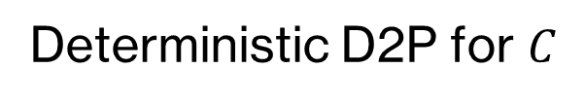

One Simple Idea
D2P Transformation -- Doron, Pyne, and Tell (2024)
Input: A circuit $C :{\left\{0,1\right\}}^{n}→\{0,1\}$ in some circuit class $𝒞$ Output: A list of poly-size circuit $P_{1}, P_{2}, …,P_{m}$ such that for every distribution $𝒟$ over ${\left\{0,1\right\}}^{n}$, if $C$ is an $ε$-distinguisher of $𝒟$, one of $P_{i}$ is a $δ$-predictor of $𝒟$ (e.g. $δ=ε/O(n)$)
Prefix-CAPP:
Given $x_{<}$, estimate $\underset{y}{Pr}{[C(x_{<}∘y)]}$ with error $1/O(n)$
prBPP = prP $⇒$ D2P given any input circuit $C$
Deterministic D2P for $C$
For specific $C$, prefix-CAPP could be easy!

Slide 10

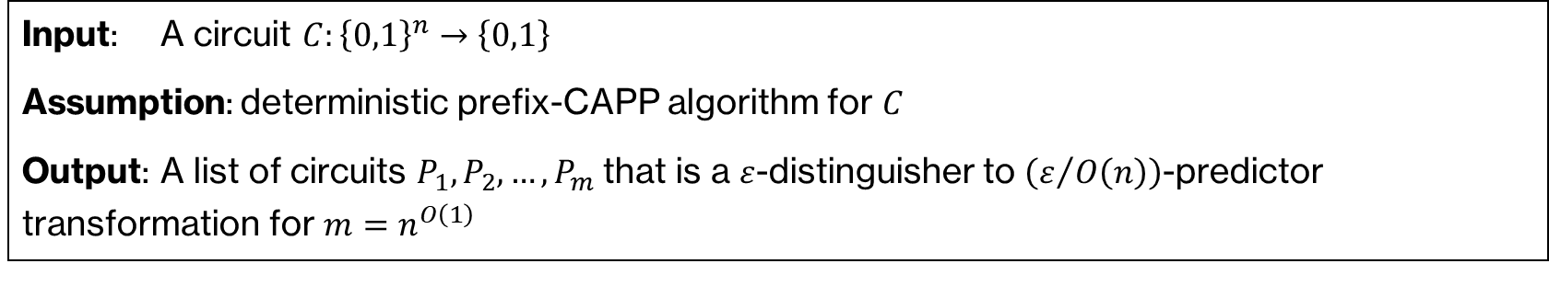

D2P $⇐$ Derandomization
Input: A circuit $C:{\left\{0,1\right\}}^{n}→\left\{0,1\right\}$
Assumption: deterministic prefix-CAPP algorithm for $C$
Output: A list of circuits $P_{1},P_{2},…,P_{m}$ that is a $ε$-distinguisher to $\left(ε/{O\left(n\right)}\right)$-predictor transformation for $m=n^{O\left(1\right)}$
Derandomize the Probabilistic D2P Transformation from Yao’s Lemma!
Appendix of [Goldreich11]

Slide 11

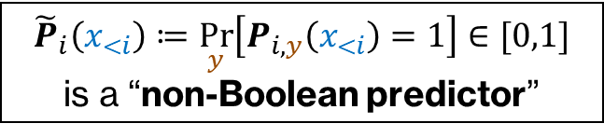

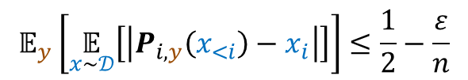
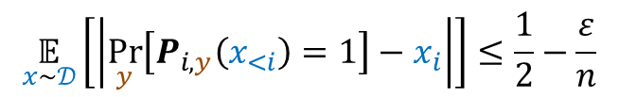

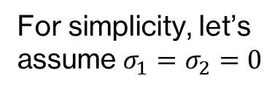

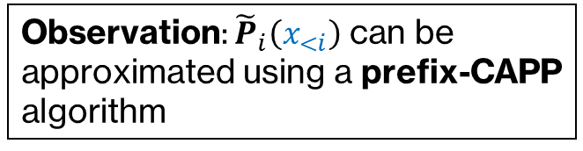
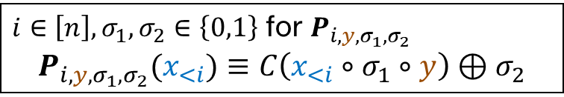
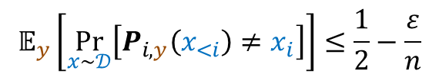
D2P $⇐$ Derandomization
Derandomize the Probabilistic D2P Transformation from Yao’s Lemma!
$$\operatorname{Pr}\left[C\left(𝒰_{n}\right)=1\right]$$
$i∈\left[n\right], σ_{1},σ_{2}∈\left\{0,1\right\}$ for $P_{i,y,σ_{1},σ_{2}}$
$$P_{i,y,σ_{1},σ_{2}}(x_{<i})≡C\left(x_{<i}∘σ_{1}∘y\right)⊕σ_{2}$$
For simplicity, let’s assume $σ_{1}=σ_{2}=0$
$$−$$
$$≥ε$$
$$\operatorname{Pr}\left[C\left(𝒟\right)=1\right]$$
$$𝔼_{y}\left[\underset{x∼𝒟}{Pr}\left[P_{i,y}\left(x_{<i}\right)≠x_{i}\right]\right]≤\frac{1}{2}−\frac{ε}{n}$$
$${\tilde{P}}_{i}\left(x_{<i}\right)≔\underset{y}{Pr}\left[P_{i,y}\left(x_{<i}\right)=1\right]∈[0,1]$$
is a “non-Boolean predictor”
$$𝔼_{y}\left[\underset{x∼𝒟}{𝔼}\left[\left|P_{i,y}\left(x_{<i}\right)−x_{i}\right|\right]\right]≤\frac{1}{2}−\frac{ε}{n}$$
Observation: ${\tilde{P}}_{i}\left(x_{<i}\right)$ can be approximated using a prefix-CAPP algorithm
$$\underset{x∼𝒟}{𝔼}\left[\left|\underset{y}{Pr}\left[P_{i,y}\left(x_{<i}\right)=1\right]−x_{i}\right|\right]≤\frac{1}{2}−\frac{ε}{n}$$
Notes:
For each i and each sigma1 sigma2, we define the function P i y sigma1 sigma2 as follows:
We evaluate C on the concatenation of the first i-1 bits of x, sigma 1, and the y, and output the xor of the output of C and sigma 2
[Click] Here, the two bits sigma 1 and sigma 2 are used to deal with say the absolute value, so for simplicity we assume that both of them are zero.
[Click] What Yao’s lemma really gives us is that for some i and over a uniform random y, the probabilistic that the predictor P i y fails is bounded away from ½
[Click] In other words, the difference between the expectation of the output of P and xi is smaller then ½ - eps / n
[Click] By swapping the expectation symbols, this further indicates that over a random x from D, the expectation of the difference between xi and the acceptance probability of P i y over a random y is smaller then ½ - eps / n.
[Click] Let tilde P i be the function outputting the acceptance probability of P i y over a random y, we can notice that tilde P is a non-Boolean predictor, in the sense that it outputs a number between 0 and 1 that is close to xi in expectation, when x is from the distribution D.
Crucially, we can observe that the non-Boolean predictor tilde P can be approximated using a deterministic CAPP algorithm, which follows from the assumption that prBPP = prP.

Slide 12
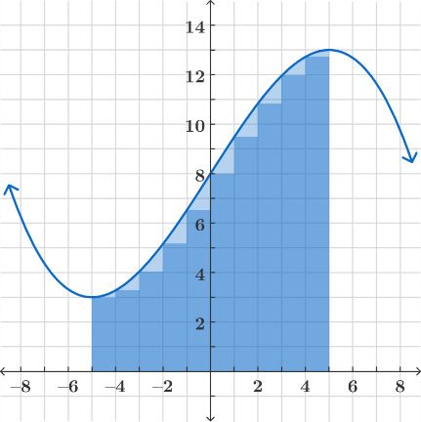
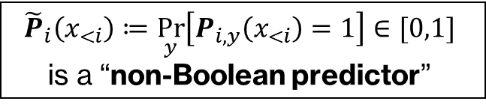
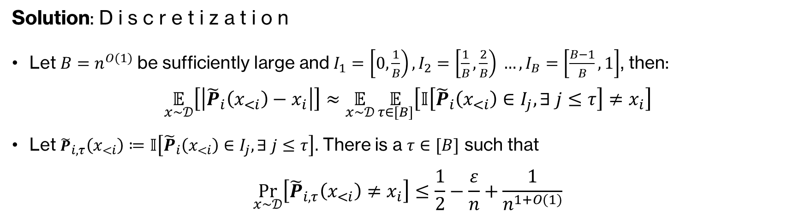

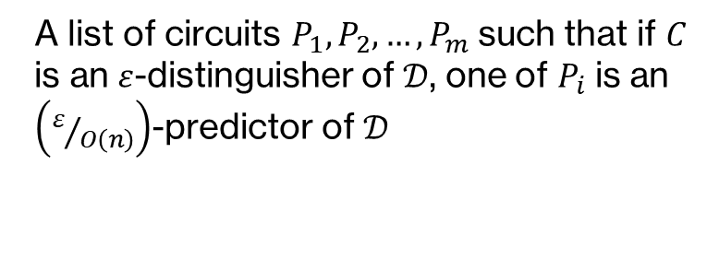
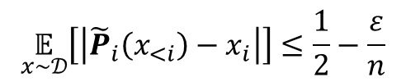
Non-Boolean $⇒$ Boolean Predictor
$${\tilde{P}}_{i}\left(x_{<i}\right)≔\underset{y}{Pr}\left[P_{i,y}\left(x_{<i}\right)=1\right]∈[0,1]$$
is a “non-Boolean predictor”
A list of circuits $P_{1}, P_{2}, …,P_{m}$ such that if $C$ is an $ε$-distinguisher of $𝒟$, one of $P_{i}$ is an $\left(ε/{O\left(n\right)}\right)$-predictor of $𝒟$
$$\underset{x∼𝒟}{𝔼}\left[\left|{\tilde{P}}_{i}\left(x_{<i}\right)−x_{i}\right|\right]≤\frac{1}{2}−\frac{ε}{n}$$
Solution: D i s c r e t i z a t i o n
Let $B=n^{O(1)}$ be sufficiently large and $I_{1}=\left[0,\frac{1}{B}\right),I_{2}=\left[\frac{1}{B},\frac{2}{B}\right) …,I_{B}=\left[\frac{B−1}{B},1\right]$, then:
$$\underset{x∼𝒟}{𝔼}\left[\left|{\tilde{P}}_{i}\left(x_{<i}\right)−x_{i}\right|\right]≈\underset{x∼𝒟}{𝔼}{\underset{τ∈[B]}{𝔼}\left[𝕀\left[{\tilde{P}}_{i}\left(x_{<i}\right)∈I_{j},∃ j≤τ\right]≠x_{i}\right]}$$
Let ${\tilde{P}}_{i,τ}\left(x_{<i}\right)≔𝕀\left[{\tilde{P}}_{i}\left(x_{<i}\right)∈I_{j},∃ j≤τ\right].$ There is a $τ∈[B]$ such that
$$\underset{x∼𝒟}{Pr}\left[{\tilde{P}}_{i,τ}\left(x_{<i}\right)≠x_{i}\right]≤\frac{1}{2}−\frac{ε}{n}+\frac{1}{n^{1+O(1)}}$$
Notes:
After obtaining a non-Boolean predictor tilde P_i,
[Click] We need to transform it into a Boolean predictor, namely a list of circuits P1 to Pm such that if C is an epsilon-distinguisher of D, one of Pi is an eps / O(n) predictor of D.
[Click] The solution is to use the trick of discretization.
[Click] Let B be a sufficiently large polynomial in n, we evenly divide the interval [0,1], into B subintervals, each of which is of length 1/B.
[Click] One can observe that the expected difference between the output of the non-Boolean predictor and xi, is roughly the same to the “discretized” predictor, where we randomly sample a positive integer tau smaller or equal to B, and output 1 if and only if the output of the non-Boolean predictor falls into the first tau intervals.
[Click] In some sense, the idea is similar to the approximate calculation the definite integral of a function.
[Click] Concretely, let tilde P i tau be the Boolean-output function that outputs 1 if and only if the output of the non-Boolean predictor falls into the first tau intervals, by an averaging argument, we know that there is a tau such that
[Click] P i tau fails to predict the i-th bit of x with probably ½ - eps / n + a high order term.

Slide 13

Non-Boolean $⇒$ Boolean Predictor
$${\tilde{P}}_{i}\left(x_{<i}\right)≔\underset{y}{Pr}\left[P_{i,y}\left(x_{<i}\right)=1\right]∈[0,1]$$
is a “non-Boolean predictor”
A list of circuits $P_{1}, P_{2}, …,P_{m}$ such that if $C$ is an $ε$-distinguisher of $𝒟$, one of $P_{i}$ is an $\left(ε/{O\left(n\right)}\right)$-predictor of $𝒟$
$$\underset{x∼𝒟}{𝔼}\left[\left|{\tilde{P}}_{i}\left(x_{<i}\right)−x_{i}\right|\right]≤\frac{1}{2}−\frac{ε}{n}$$
Solution: D i s c r e t i z a t i o n
Let $B=n^{O(1)}$ be sufficiently large and $I_{1}=\left[0,\frac{1}{B}\right),I_{2}=\left[\frac{1}{B},\frac{2}{B}\right) …,I_{B}=\left[\frac{B−1}{B},1\right]$, then:
$$\underset{x∼𝒟}{𝔼}\left[\left|{\tilde{P}}_{i}\left(x_{<i}\right)−x_{i}\right|\right]≈\underset{x∼𝒟}{𝔼}{\underset{τ∈[B]}{𝔼}\left[𝕀\left[{\tilde{P}}_{i}\left(x_{<i}\right)∈I_{j},∃ j≤τ\right]≠x_{i}\right]}$$
Let ${\tilde{P}}_{i,τ}\left(x_{<i}\right)≔𝕀\left[{\tilde{P}}_{i}\left(x_{<i}\right)∈I_{j},∃ j≤τ\right].$ There is a $τ∈[B]$ such that
$$\underset{x∼𝒟}{Pr}\left[{\tilde{P}}_{i,τ}\left(x_{<i}\right)≠x_{i}\right]≤\frac{1}{2}−\frac{ε}{n}+\frac{1}{n^{1+O(1)}}$$
${\tilde{P}}_{i,τ}$ for $i∈\left[m\right]$, $τ∈[B]$ is a valid list of predictors
Notes:
Subsequently, tilde P i tau for i in [m] and tau in [B] is a valid list of predictors for any distribution D that is distinguishable from uniformly random by C.
This completes the proof, as tilde P i tau can be implemented by a uniform deterministic algorithm given the circuit C, as,
[Click] By the definition of the non-Boolean predictor and its discretized version tilde P i tau, we only need to estimate the acceptance probability of Yao’s predictor P i y, which reduces to prefix-CAPP algorithm

Slide 14
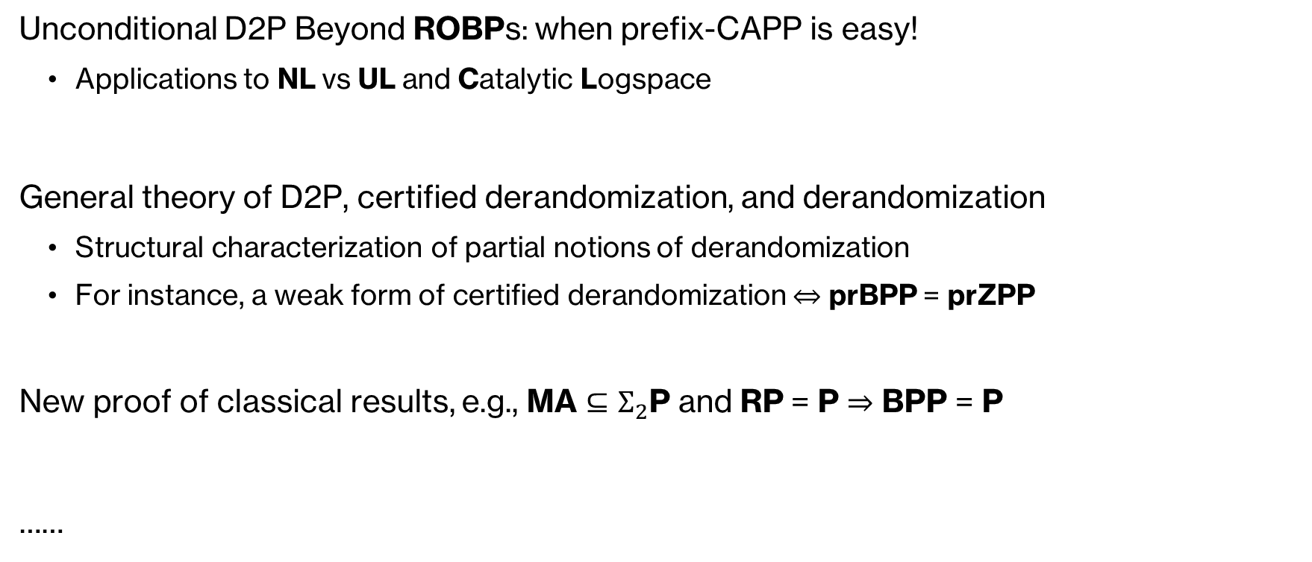
Other Results
Unconditional D2P Beyond ROBPs: when prefix-CAPP is easy!
Applications to NL vs UL and Catalytic Logspace
General theory of D2P, certified derandomization, and derandomization
Structural characterization of partial notions of derandomization
For instance, a weak form of certified derandomization $⇔$ prBPP = prZPP
New proof of classical results, e.g., MA $⊆Σ_{2}$P and RP = P $⇒$ BPP = P
……

Slide 15

Open Questions
More examples of unconditional D2P transformation
Any other consequences from the proof of D2P $⇔$ prBPP = prP
Further study of certified derandomization and its structural characterization

Slide 16


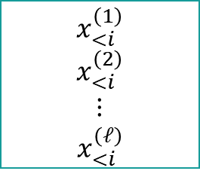


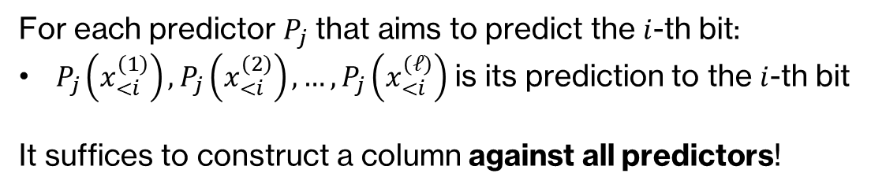
D2P $⇒$ Derandomization
Input: $C :{\left\{0,1\right\}}^{n}→\{0,1\}$ and an $ε$-distinguisher to $δ$-predictor transformation $P_{1},P_{2},…,P_{m}$ of $C$
Goal: Estimate $\operatorname{Pr}\left[C\left(𝒰_{n}\right)=1\right]$ up to an error $≤ε \text{in} \text{time} poly\left(n,m\right)$
[GW00]: Construct column by column
Not $δ$-predictable by $P_{1},…,P_{m}$
$$x_{<i}^{\left(1\right)}$$
$$x_{<i}^{\left(2\right)}$$
$$⋮$$
$$x_{<i}^{\left(ℓ\right)}$$
$$𝒟_{<i}≔$$
Correctness of D2P transformation
For each predictor $P_{j}$ that aims to predict the $i$-th bit:
$P_{j}\left(x_{<i}^{\left(1\right)}\right),P_{j}\left(x_{<i}^{\left(2\right)}\right),…,P_{j}\left(x_{<i}^{\left(ℓ\right)}\right)$ is its prediction to the $i$-th bit
It suffices to construct a column against all predictors!
Not $ε$-distinguishable by $C$
Notes:
We will use an idea from the work of Goldreich and Wigderson: construct the distribution column by column
[Click] Suppose that we have already obtained the first i-1 bits of the distribution D,
[Click] Our goal is to find a vector of length $ℓ$ for the i-th bit of D
[Click] For each predictor Pj that aims to predict the i-th bit, we can, from the first i-1 bits of D, calculate the prediction of Pj to the i-th bit
[Click] Therefore, it suffices to construct a column against all predictors!

Slide 17
Two Questions
Q₁: Can we obtain deterministic transformation from distinguishers to predictor beyond ROBPs, e.g., for general circuits, possibly under assumptions.
Q₂: What is the relative strength of derandomization, certified derandomization, and distinguisher-to-predictor transformation?

Slide 18
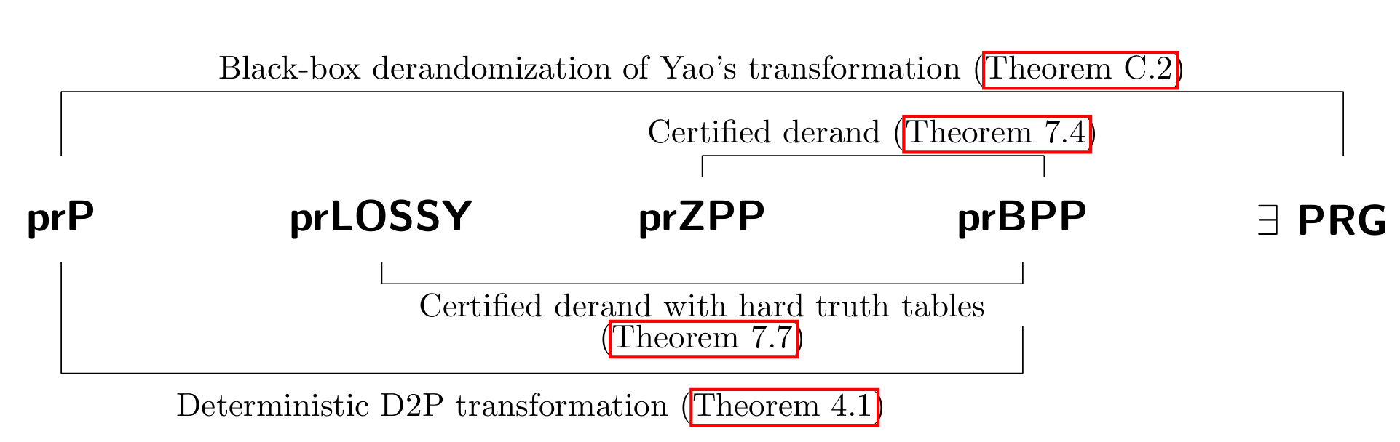
Two Questions
Q₁: Can we obtain deterministic transformation from distinguishers to predictor beyond ROBPs, e.g., for general circuits, possibly under assumptions.
YES! Indeed, D2P is equivalent to derandomization
Unconditional D2P beyond ROBPs, with application on NL vs UL and catalytic computation
Q₂: What is the relative strength of derandomization, certified derandomization, and distinguisher-to-predictor transformation?

Slide 19
Distinguishing Predicting Certifying
Yao’s Lemma
Deterministic transformation from distinguishers to predictors beyond ROBPs
Notes:
In this work, we will consider both questions.
Let’s first considers the first question, namely, whether there is a deterministic transformation from distinguishers to predictors beyond ROBPs.

