Slide 1



Maximum Circuit Lower Bounds for Exponential-time Arthur Merlin
Or: The art of
win-win-(win…)
Lijie Chen
UC Berkeley
Jiatu Li
MIT
Jingxun Liang*
CMU
*: Slides credit to Jingxun ☺

Slide 2
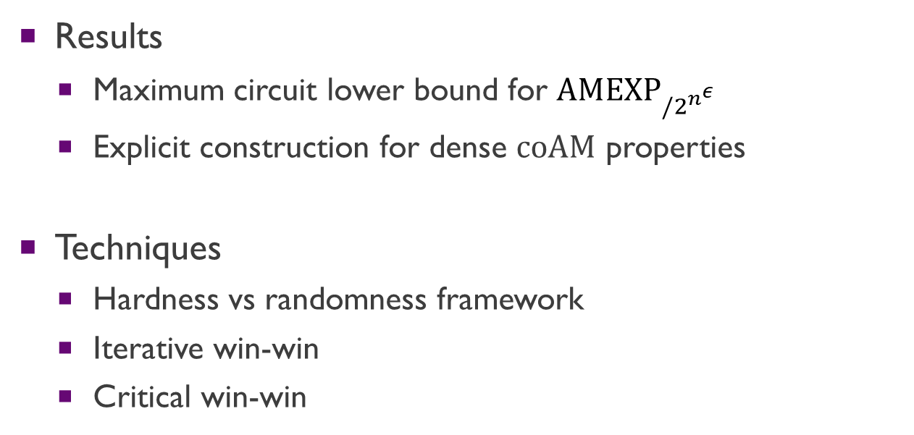
Plan of today
Results
Maximum circuit lower bound for $\text{AMEX}{\text{P}}_{/2^{n^{ε}}}$
Explicit construction for dense $\text{coAM}$ properties
Techniques
Hardness vs randomness framework
Iterative win-win
Critical win-win
Notes:
In this talk, I will introduce our two results: maximum circuit lower bound for AMEXP, and explicit construction for coAM properties.
These two results follow form two distinct lines of work, but they eventually converge to a same perspective by some recent work.
Then, in the second part of this talk, I will introduce our proof detail.
Starting from the classical half-exponential barrier of the hardness vs randomness framework, our two proofs utilizing two different techniques invented recently to overcome the barrier.
We name them iterative win-win and critical win-win

Slide 3

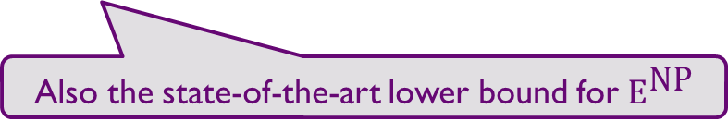
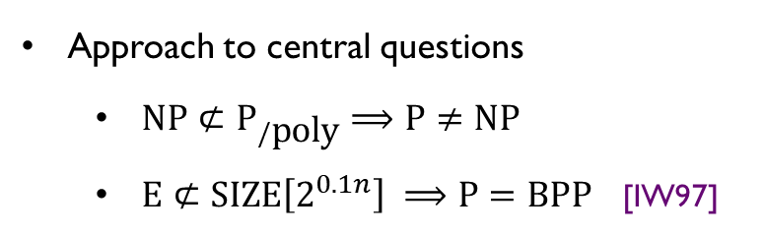
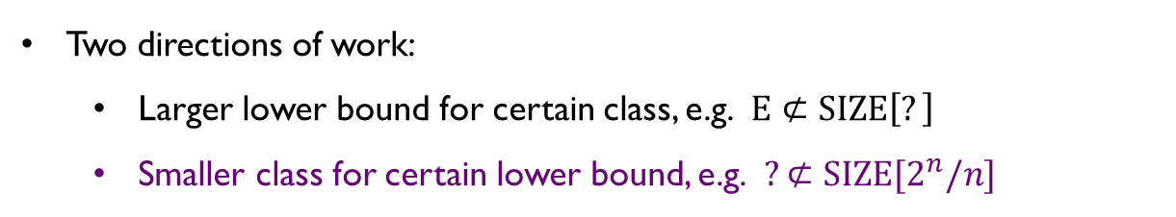
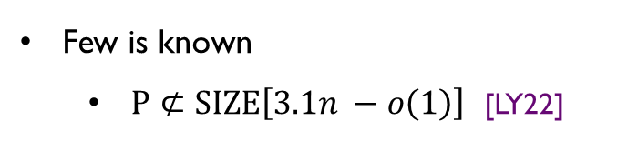

Maximum Circuit Lower Bounds
Circuit lower bound
Uniform vs non-uniform computation
Circuit lower bounds:
Complexity theory’s
Waterloo
Approach to central questions
$\text{NP}⊄{\text{P}}_{/\text{poly}}$ $⟹\text{P}≠\text{NP}$
$\text{E}⊄\text{SIZE}\left[2^{0.1n}\right] ⟹\text{P}=\text{BPP}$ [IW97]
$$\text{E}=\text{DTIME}\left[2^{O\left(n\right)}\right]$$
Few is known
$\text{P}⊄\text{SIZE}\left[3.1n −o\left(1\right)\right]$ [LY22]
Two directions of work:
Larger lower bound for certain class, e.g. $\text{E}⊄\text{SIZE}\left[?\right]$
Smaller class for certain lower bound, e.g. $?⊄\text{SIZE}[2^{n}/n]$
Also the state-of-the-art lower bound for ${\text{E}}^{\text{NP}}$
Notes:
OK, let’s start from the maximum circuit lower bound. Circuit lower bound is a central open question in complexity theory.
It studies the non-uniform computation complexity of a uniform computational class.
Because of the clear structure of circuits, circuit lower bound is conjectured to be the approach to several central open questions:
Proving a super-polynomial circuit lower bound for NP will imply the breakthrough P != NP
Proving a exponential circuit lower bound for E, the uniform single exponential time class, will imply derandomization: P = BPP
However, comparing to these fascinating goals, few is known regarding circuit lower bound.
The famous textbook, Computational Complexity A Modern Approach, said circuit lower bound is complexity theory’s Waterloo.
One example of current situation is that, the best known circuit lower bound for polynomial time algorithm is only 3.1n, and this is also the state-of-the-art lower bound for even the much class E^NP, which means we are still super-polynomially far away from the desired goals
To tackle on this notorious hard problem, there are two directions: One is trying to get larger and larger lower bound for a fixed class, e.g. consider what is the largest circuit lower bound we can prove for E; another is trying to prove smaller and smaller class having a fixed circuit lower bound, which is what we do in this work: considering the smallest class with maximum circuit lower bound.

Slide 4




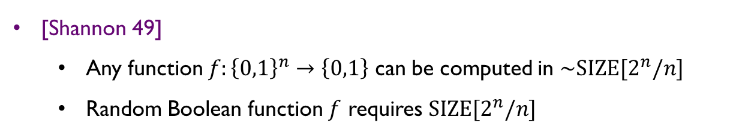





Maximum Circuit Lower Bounds
Maximum Circuit lower bound
[Shannon 49]
Any function $f:{\left\{0,1\right\}}^{n}→\left\{0,1\right\}$ can be computed in $\sim \text{SIZE}[2^{n}/n]$
Random Boolean function $f$ requires $\text{SIZE}[2^{n}/n]$
[Kannan 82] $Σ_{3}\text{E}⊄\text{SIZE}[2^{n}/n]$
($Σ_{1}$-type)
($Σ_{3}$-type)
$$Σ_{3}\text{E}$$
$$NE$$
$$⊆$$
$$3.1n −o\left(n\right)$$
$$2^{n}/n$$
[LY22]
[Kannan 82]
Notes:
According to Shannon, any n-bit Boolean function can be computed by circuit of size roughly 2^n/n, and a random Boolean function requires 2^n/n circuits. So 2^n/n circuit lower bound is essentially the maximum circuit lower bound we can prove for any Boolean function.
The first maximum circuit lower bound is proven by Kannan, he showed that Sigma_3 E has circuit lower bound by some diagonalization argument.

Slide 5





Maximum Circuit Lower Bounds
Maximum Circuit lower bound
[Shannon 49]
Any function $f:{\left\{0,1\right\}}^{n}→\left\{0,1\right\}$ can be computed in $\sim \text{SIZE}[2^{n}/n]$
Random Boolean function $f$ requires $\text{SIZE}[2^{n}/n]$
[MVW99] ${\text{E}}^{Σ_{2}}⊄\text{SIZE}[2^{n}/n]$
($Σ_{1}$-type)
($Σ_{2}$-type)
($Σ_{3}$-type)
$${\text{E}}^{Σ_{2}}$$
$$Σ_{3}\text{E}$$
$$NE$$
$$⊆$$
$$⊆$$
$$3.1n −o\left(n\right)$$
$$2^{n}/n$$
$$2^{n}/n$$
[LY22]
[MVW 99]
[Kannan 82]
Notes:
Later on, this result is improved by [MVW99] to maximum circuit lower bound of E^Sigma2

Slide 6


Maximum Circuit Lower Bounds
Maximum Circuit lower bound
[Shannon 49]
Any function $f:{\left\{0,1\right\}}^{n}→\left\{0,1\right\}$ can be computed in $\sim \text{SIZE}[2^{n}/n]$
Random Boolean function $f$ requires $\text{SIZE}[2^{n}/n]$
[CHR24] [Li 24] $S_{2}E⊄\text{SIZE}[2^{n}/n]$
($Σ_{1}$-type)
($Σ_{2}$-type)
($Σ_{3}$-type)
$${\text{S}}_{2}\text{E}$$
$${\text{E}}^{Σ_{2}}$$
$$Σ_{3}\text{E}$$
$$NE$$
$$⊆$$
$$⊆$$
$$⊆$$
$$3.1n −o\left(n\right)$$
$$2^{n}/n$$
$$2^{n}/n$$
$$2^{n}/n$$
[LY22]
[CHR24] [Li 24]
[MVW 99]
[Kannan 82]
Notes:
As a recent breakthrough, [CHR24] and [Li24] further improve the result to maximum circuit lower bound of S_2E, which is a subclass of both Sigma_2 E and Pi_2 E.

Slide 7





Maximum Circuit Lower Bounds
Maximum Circuit lower bound
[Shannon 49]
Any function $f:{\left\{0,1\right\}}^{n}→\left\{0,1\right\}$ can be computed in $\sim \text{SIZE}[2^{n}/n]$
Random Boolean function $f$ requires $\text{SIZE}[2^{n}/n]$
Open Question: Maximum circuit lower bound for $Σ_{1}$-type class?
($Σ_{1}$-type)
($Σ_{2}$-type)
($Σ_{3}$-type)
$${\text{S}}_{2}\text{E}$$
$${\text{E}}^{Σ_{2}}$$
$$Σ_{3}\text{E}$$
$$NE$$
$$⊆$$
$$⊆$$
$$⊆$$
$$⊆$$
$$⊆$$
$$3.1n −o\left(n\right)$$
$$2^{n}/n$$
e.g.,
$$\text{AME}$$
$$2^{n}/n?$$
Notes:
Although S_2 E is reasonably small class, it still essentially uses two levels of alternation.
It is natural to ask that whether we can prove maximum circuit lower bound for Sigma_1-type class.
As the best known circuit lower bound for any Sigma_1-type class is only 3.1n, the maximum circuit lower bound on it can be regarded as some breakthrough in this sense.
A candidate class is AME, which contains NE and is subset of E^Sigma_2, but is incomparable with S_2E.

Slide 8
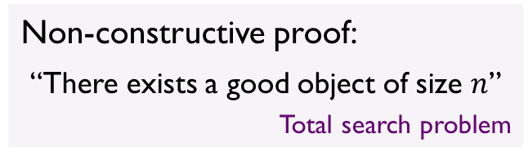
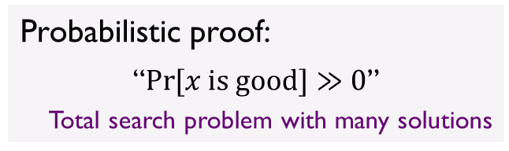
Explicit Constructions
Explicitly construct objects that are (only) proved to exist
especially by counting argument
Graphs:
Expanders
Superconcentraters
Ramsey graphs
Non-constructive proof:
“There exists a good object of size $n$”
Total search problem
Boolean functions:
Hard truth tables
Extractors / Dispersers
Probabilistic proof:
“$\operatorname{Pr}{[x \text{is} \text{good}]}≫0$”
Total search problem with many solutions
Matrices:
Rigid
Good linear code
Notes:
Independent to circuit lower bound, there is another recent line of work studies explicit constructions.
Specifically, in line of work, people try to get some systematical way to explicitly construct objects that are only proved to exist, especially by some counting argument.
There are a lot of important objects that people want have explicit construction, including expanders, superconcentraters, Ramsey graphs are graphs; hard truth tables, extractors or dispersers as Boolean functions; rigid matrix and good linear code as matrices.
All of these objects admit a non-constructive proof: it only shows the existence of the object. Based on such non-constructive proof, the best explicit construction we can do is to do total search.
Fortunately, the existence of most of them is actually a probabilistic proof, which shows the desired object is actually “dense”, and we can construct such a object by randomized algorithm.

Slide 9
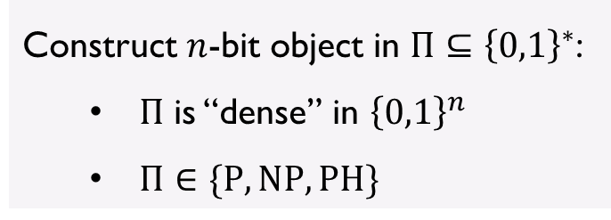
Explicit Constructions
Explicitly construct objects that are (only) proved to exist
especially by counting argument
Graphs:
Expanders
Superconcentraters
Ramsey graphs
Classifying by complexity
Construct $n$-bit object in $Π⊆{\left\{0,1\right\}}^{∗}$:
$Π$ is “dense” in ${\left\{0,1\right\}}^{n}$
$Π∈\{\text{P}, \text{NP}, \text{PH}\}$
Boolean functions:
Hard truth tables
Extractors / Dispersers
Matrices:
Rigid
Good linear code
Notes:
To further classify these problems, we formalize the problem as follows:
All the “good” objects that we want to construct form a set Pi.
First, the set Pi need to be dense on input length n
The, regarding the complexity of deciding Pi, we classify explicit construction problem as hitting dense P property, hitting dense NP property, …

Slide 10


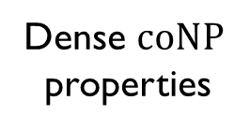
Explicit Constructions
Classifying by complexity
[OS17] Construction for dense P property in half-exponential time
$$f\left(f\left(n\right)\right)=2^{n}$$
Hard truth table
[OS17] Half EXP (i.o.,
pseudodeterministic)
Dense $\text{P}$ properties
Rigid matrix
Prime numbers
Range-avoidance- type properties
[KKMP21,Korten22,…]
Dense $\text{coNP}$ properties
Notes:
Clearly, constructing prime numbers is to hit dense P property, as we have deterministic polynomial time primal test.
Constructing hard truth table is to hit dense coNP property, as an easy truth table can be verified given its small circuit as witness. So is rigid matrix.
Among all the dense coNP properties, there is a special subset formed by all the range-avoidance-type property, where all the bad objects are in the image of a small circuit with input length n-1, and getting a non-output of such circuit will yield an explicit construction of a good object. It is not hard to see both hard truth table and rigid matrix are actually range-avoidance-type properties.
Regarding systematic explicit construction, [OS17] first obtain an explicit construction for dense P property in half-exponential time, where half exponential means a function f such that the second iteration of f becomes exponential.

Slide 11
Explicit Constructions
Classifying by complexity
[CLORS23] Construction for dense P property in polynomial time
Hard truth table
[OS17] Half EXP (i.o.,
pseudodeterministic)
Dense $\text{P}$ properties
Rigid matrix
Prime numbers
Range-avoidance- type properties
[KKMP21,Korten22,…]
Dense $\text{coNP}$ properties
[CLORS23] poly-time
(i.o., pseudo-deterministic)
Notes:
This result is improved by the breakthrough result in [CLORS23], showing an algorithm to construct dense P property in polynomial time, completely solving the explicit construction for dense P properties.

Slide 12
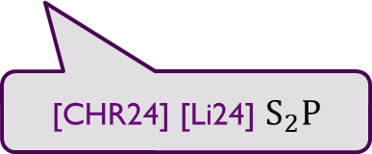
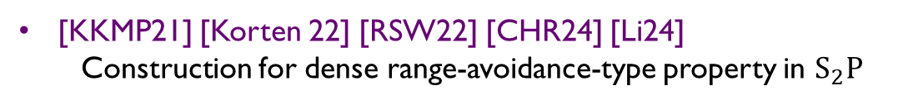
Explicit Constructions
Classifying by complexity
[KKMP21] [Korten 22] [RSW22] [CHR24] [Li24]
Construction for dense range-avoidance-type property in ${\text{S}}_{2}\text{P}$
Hard truth table
[OS17] Half EXP (i.o.,
pseudodeterministic)
Dense $\text{P}$ properties
Rigid matrix
Prime numbers
Range-avoidance- type properties
[KKMP21,Korten22,…]
Dense $\text{coNP}$ properties
[CLORS23] poly-time
(i.o., pseudo-deterministic)
[CHR24] [Li24] ${\text{S}}_{2}\text{P}$
Notes:
Regarding range-avoidance type property, there is a long line of recent work on it, and [CHR24] [Li24] obtain an explicit construction in S2P.
It is also believed by these works that it is unlikely to improve the S2P construction to further single-valued AM construction, which suggests the S2P construction is reasonably good.

Slide 13

Explicit Constructions
Classifying by complexity
Open Question: Construction for dense properties in larger classes
e.g., dense $\text{coNP}$ or $\text{co}\text{AM}$ properties
Hard truth table
[OS17] Half EXP (i.o.,
pseudodeterministic)
Dense $\text{P}$ properties
Rigid matrix
Prime numbers
Range-avoidance- type properties
[KKMP21,Korten22,…]
Dense $\text{coNP}$ properties
[CLORS23] poly-time
(i.o., pseudo-deterministic)
[CHR24] [Li24] ${\text{S}}_{2}\text{P}$
Notes:
Following this line of work, it is natural to ask that whether we can further get systematic explicit construction for larger classes like coNP or coAM properties. This will be meaningful as they will also provide new perspective of explicitly constructing hard truth tables and rigid matrices that we originally constructed by range avoidance.

Slide 14







Connecting two lines of work
Circuit lower bounds
Explicit constructions
($Σ_{3}$-type)
$$Σ_{3}\text{E}⊄\text{SIZE}[2^{n}/n]$$
Dense $\text{P}$ properties
[Kannan 82]
[OS17] [CLORS23]
($Σ_{2}$-type)
implies
$$S_{2}E⊄\text{SIZE}[2^{n}/n]$$
Range-avoidance-type properties
[CHR24] [Li 24]
[KKMP21] [Korten 22] …
($Σ_{1}$-type)
Larger class
View circuit lower bound as:
Uniformly and explicitly constructing hard truth table
Notes:
This two lines of works, maximum circuit lower bound and explicit constructions, are also connected closely by recent works.
Actually, the state-of-the-art maximum circuit lower bound, is a corollary of the explicit construction of range-avoidance-type properties.
The reason is that, we can view circuit lower bound as uniformly and explicitly constructing hard truth table, which is a range-avoidance-type explicit construction problem. Any uniform algorithm that explicitly output hard truth table must also have large circuit complexity.
Along these lines of work, we want further Sigma_1 type maximum circuit lower bound and explicit constructions for larger class,

Slide 15


Our Results
Circuit lower bounds
Explicit constructions
($Σ_{3}$-type)
$$Σ_{3}\text{E}⊄\text{SIZE}[2^{n}/n]$$
Dense $\text{P}$ properties
[Kannan 82]
[OS17] [CLORS23]
($Σ_{2}$-type)
implies
$$S_{2}E⊄\text{SIZE}[2^{n}/n]$$
Range-avoidance-type properties
[CHR24] [Li 24]
[KKMP21] [Korten 22] …
($Σ_{1}$-type)
Larger class
implies
$$\text{AMEX}{\text{P}}_{/2^{n^{ε}}}⊄\text{SIZE}[2^{n}/n]$$
Dense $co\text{AM}$ properties
This work
This work
Notes:
Which is obtained in this work: we get circuit lower bound for AMEXP and explicit construction for dense coAM properties. Our circuit lower bound is also a corollary of our explicit construction.

Slide 16

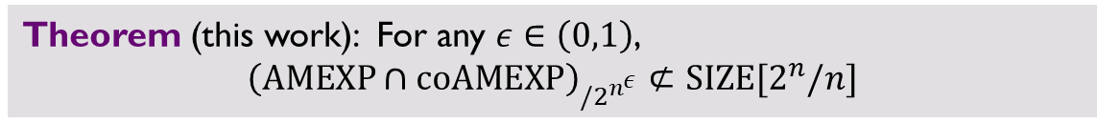

Our Results
Circuit lower bounds
Explicit constructions
implies
$$\text{AMEX}{\text{P}}_{/2^{n^{ε}}}⊄\text{SIZE}[2^{n}/n]$$
Dense $co\text{AM}$ properties
Theorem (this work): For any $ε∈\left(0,1\right)$,
$${\left(\text{AMEXP}∩\text{coAMEXP}\right)}_{/2^{n^{ε}}}⊄\text{SIZE}[2^{n}/n]$$
Notes:
Specifically, we show that for any constant eps in (0,1), …

Slide 17
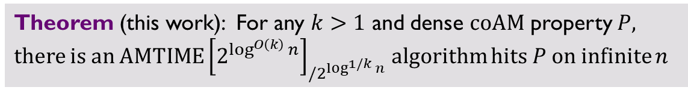
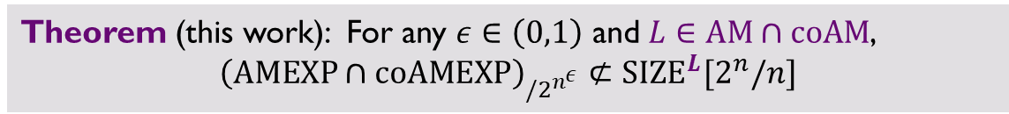
Our Results
Circuit lower bounds
Explicit constructions
implies
$$\text{AMEX}{\text{P}}_{/2^{n^{ε}}}⊄\text{SIZE}[2^{n}/n]$$
Dense $co\text{AM}$ properties
Theorem (this work): For any $ε∈\left(0,1\right)$ and $L∈\text{AM}∩\text{coAM}$,
$${\left(\text{AMEXP}∩\text{coAMEXP}\right)}_{/2^{n^{ε}}}⊄{\text{SIZE}}^{L}[2^{n}/n]$$
Theorem (this work): For any $k>1$ and dense $\text{coAM}$ property $P$, there is an $\text{AMTIME}{\left[2^{\log^{O\left(k\right)}{n}}\right]}_{/2^{\log^{1/k}{n}}}$ algorithm hits $P$ on infinite $n$
Single-valued: Output a canonical solution when accept
Advice bits: Technically needed as hard to verify $\text{coAM}$ property in $\text{AM}$
Notes:
Moreover, our lower bound holds even if the circuit can access to an oracle in AM \cap coAM.
For our explicit construction result, we show that for any…
There is an Arthur Merlin algorithm runs in quasipoly time … , taking sublinear bis of advice, outputting in n-bit string with property P on infinitely many n
Here, we say a AM algorithm output a string in the single-valued sense: the AM algorithm should output a canonical string in any computational path to accept.
Technically, our algorithm requires several advice bits. This is because the coAM property P cannot be efficiently verified in AM algorithm. It means, even if algorithm outputs a small set of candidates containing the desired element, we still need several bits of advice to help us locate true output among the small set of candidates.

Slide 18
Part 2: Techniques
Notes:
OK, now let’s go to the technical part

Slide 19



Win-Win using Hardness vs Randomness
Classical framework for derandomization
Key point: suitable interpretation of “computation history” and “H to R transform”
Problem 1
Problem 2
“hard”
with randomized algorithm $A$
“Brute-force computation history”
“Hardness to Randomness”
“Randomness”
e.g. PRG, HSG
Case 1:
(Derandomize)
Good randomness + $A$
Deterministic algo for Prob 2
“Distinguisher” $A$
Case 2:
(Reconstruct)
Reconstruction algo
Efficient algo for Prob 1
Notes:
As the starting point, let’s review thte classical hardness vs randomness framework for derandomization, which is intensively used in explicit constructions in recent works.
In the hardness vs randomness framework, suppose we have two problems, where problem 1 is supposed to be hard and the problem 2 admits a randomized algorithm.
Then, the idea of hardness vs randomness is to use the hard truth table of problem 1 to construct some PRG or HSG, to transform hardness to some randomness.
Depending on how hard the hard truth table of problem 1 is, there are two cases:
If the hard truth table is really hard enough, then we can get good randomness from the PRG or HSG, which can used to derandomize the algorithm A, and we can get a deterministic algorithm for Problem 2.
Otherwise, if the hard truth table is not really hard, it suggests that we should have efficient algorithm for Problem 1. This efficient algorithm is often provided by the reconstruction algorithm for the PRG or HSG, where we use algorithm A as the predictor of the predictor of the pseudorandomness outputted by the PRG.
In conclusion, by this hardness vs randomness framework, we can either get deterministic algorithm for Problem 2, or get efficient algorithm for Problem 1.
This hardness vs randomness framework is heavily used in a lot derandomization work, where the key point of each application is to specify a suitable interpretation of “hard truth table” and use a suitable “H to R transformation”

Slide 20

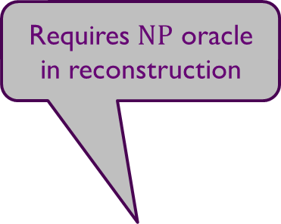


Hardness vs Randomness
Requires $\text{NP}$ oracle in reconstruction
Key point: suitable interpretation of “computation history” and “H to R transform”
 | Computation history | Hardness to Randomness
[CLORS23] | inefficient parallel computation | HSG [CT22] (for P, w/ P reconstruction)
[CHR24] | BF range avoidance algorithm | Hardness condenser [Kor22]
This work | PCP of EXP computation history | HSG [vMS23] (for coAM, w/ AM reconstruction)
Problem 1
Problem 2
“hard”
with randomized algorithm $A$
“Brute-force
computation history”
“Hardness to Randomness”
“Randomness”
e.g. PRG, HSG
Case 1:
(Derandomize)
Good randomness + $A$
Deterministic algo for Prob 2
Case 2:
(Reconstruct)
“Distinguisher” $A$
Reconstruction algo
Efficient algo for Prob 1
Notes:
For example, in [CLORS23], which is the paper for polynomial time construction of dense P property, the hard truth table is interpret as a kind of “inefficient parallel computation”, with Chen Tell generator as its hardness to randomness transformation.
In [CHR24], which is the paper for S2P construction of range-avoidance-type property, the hard truth table is interpret as the exponential-time computational history for the brute-force search algorithm to output a string with desired property. They also used a special type of hardness condenser introduced in [Kor22] as the hardness to randomness transformation, which works specifically to range-avoidance.
As their hardness condenser requires NP oracle in the reconstruction, there is no chance to get any Sigma_1 type algorithm from this hardness to randomness transformation.
In this work, in order to get explicit construction for coAM property in Sigma_1 type class, we use the HSG in [vMS23], which only requires AMquasipolytime reconstruction. The reconstruction of this HS will only provide oracle access to the hard truth table. Hence, we interpret the hard truth table as the PCP of the exponential time computation history, such that we can efficiently simulate the computation history with only oracle access to it.

Slide 21



Win-win argument
Classical perspective: Win-win between two worlds
Regard Problem 1, 2 as the same problem in two different worlds
Set parameters such that both cases provide desired algorithms
At least one case holds for infinite input lengths $n$
Problem (world 1)
Problem (world 2)
Problem 1
Problem 2
“hard”
with randomized algorithm $A$
“Brute-force computation history”
“Hardness to Randomness”
“Randomness”
e.g. PRG, HSG
Case 1:
(Derandomize)
Good randomness + $A$
Deterministic algo for Prob 2
the Prob
“Distinguisher” $A$
Case 2:
(Reconstruct)
Reconstruction algo
Efficient algo for Prob 1
the Prob
Notes:
Almost all the previous work use this hardness vs randomness framework via a win-win argument.
In the classical perspective, we regard the Problem 1 and 2 as the same problem that we want to solve in two different worlds.
Then, both case 1 and case 2 will provide some algorithm for this Problem.
By setting suitable parameter, we balance the efficiency of these algorithm so that both of them are efficient as we desired.
Then, when we always run the reconstruction algorithm in the first world, and always run the derandomization algorithm in the second world, by the guarantee of the hardness vs randomness framework, at least in one world, the algorithm will be correct on infinitely many input length n, and we win in that world.

Slide 22


Win-win argument
Classical perspective: Win-win between two worlds
New perspective: Win-win between two input lengths [OS17] [LOS21]
One algorithm unifying algorithms for two worlds
Problem (world 1)
Problem (world 2)
Problem 1
Problem 2
“hard”
with randomized algorithm $A$
“Brute-force computation history”
“Hardness to Randomness”
“Randomness”
e.g. PRG, HSG
Case 1:
(Derandomize)
Good randomness + $A$
Deterministic algo for Prob 2
the Prob
“Distinguisher” $A$
Case 2:
(Reconstruct)
Reconstruction algo
Efficient algo for Prob 1
the Prob
Notes:
A recent line of work tends to consider a new perspective of win-win argument, where instead of designing two algorithms for two worlds, we will design a single unified algorithm. This new perspective is shown to be more flexible and easier to generalize, leading to several successes such as [OS17] and [LOS21].

Slide 23

Win-win argument
Classical perspective: Win-win between two worlds
New perspective: Win-win between two input lengths [OS17] [LOS21]
One algorithm unifying algorithms for two worlds
$$A$$
input lengths
two disjoint sets of input lengths
Run Case 2
input lengths
Run Case 1
input lengths
Correct on at least one
Notes:
The new win-win argument is input-wise:
We will only consider a subset of input length, and divide them into two disjoint sets.
We will making pair between this two sets of inputs and perform a win-win argument within each pair.
At the red input length, we always run the reconstruction algorithm and at the blue input length, we always run the derandomization algorithm.
The hardness vs randomness framework guarantees that algorithm is correct in at least one point in each pair of input length, hence we get a unified algorithm which is correct in infinitely many input lengths.

Slide 24

Efficiency Issue: Half-exponential Barrier
Half-exponential barrier:
(Direct) win-win argument only implies half-exponential-time construction
$$f\left(f\left(n\right)\right)=2^{n}$$
Check time complexity in detail
$$A$$
input lengths
two disjoint sets of input lengths
Run Case 2
input lengths
Run Case 1
input lengths
Correct on at least one
Notes:
In many previous work based on the previous win-win argument, people are stuck by so-called half-exponential barrier:
If we check carefully, we will found that the time complexity of the algorithm constructed from the naïve win-win argument is at least half exponential.

Slide 25











Efficiency Issue: Half-exponential Barrier
Problem (on $n_{1}$)
Problem (on $n_{2}$)
Problem 1
Problem 2
“hard”
with randomized algorithm $A$
“Brute-force computation history”
“Hardness to Randomness”
“Randomness”
$$\exp\left(n_{1}\right)$$
e.g. PRG, HSG
Case 1:
(Derandomize)
Good randomness + $A$
$$\text{poly}\left(n_{2}\right)$$
Deterministic algo for Prob 2
on $n_{2}$
“Distinguisher” $A$
Time complexity?
Case 2:
(Reconstruct)
Reconstruction algo
Efficient algo for Prob 1
on $n_{1}$
Run Case 2
$$n_{1}$$
input lengths
Run Case 1
$$n_{2}$$
input lengths
Notes:
To see why this is the case, we first consider the time of derandomization algorithm.
Suppose we are applying win-win argument between input length n_1 and n_2.
Recall that the first step in the derandomization is to apply the hardness to randomness transformation and obtain good randomness. As the hard truth table itself is often exponentially long, it takes at least exponential(n_1) time to get good randomness.
Then, in the second step, we will use the good pseudorandomness to simulate the randomized algorithm A and derandomize. This step takes at least the running time poly(n_2).

Slide 26
Efficiency Issue: Half-exponential Barrier
Problem (on $n_{1}$)
Problem (on $n_{2}$)
Problem 1
Problem 2
“hard”
with randomized algorithm $A$
“Brute-force computation history”
“Hardness to Randomness”
“Randomness”
$$\exp\left(n_{1}\right)$$
e.g. PRG, HSG
Case 1:
(Derandomize)
Good randomness + $A$
$$\text{poly}\left(n_{2}\right)$$
Deterministic algo for Prob 2
on $n_{2}$
“Distinguisher” $A$
Time complexity?
Case 2:
(Reconstruct)
Reconstruction algo
Efficient algo for Prob 1
on $n_{1}$
Run Case 2
$$n_{1}$$
input lengths
Run Case 1
$$n_{2}$$
input lengths
Notes:
Combining the two parts together, the total running time of the derandomization algorithm is at least exponential(n_1) + poly(n_2).
By plugging in our specific interpretation of the hard truth table and HSG, we can see the red plus blue bar is not only a lower bound of the running time, but describe the exact time complexity, which is exponential(n_1) + poly(n_2).

Slide 27


Efficiency Issue: Half-exponential Barrier
Problem (on $n_{1}$)
Problem (on $n_{2}$)
Problem 1
Problem 2
“hard”
with randomized algorithm $A$
“Hardness to Randomness”
“Hard truth table”
“Randomness”
e.g. PRG, HSG
Case 1:
(Derandomize)
Good randomness + $A$
Deterministic algo for Prob 2
on $n_{2}$
“Distinguisher” $A$
Case 2:
(Reconstruct)
Reconstruction algo
Efficient algo for Prob 1
on $n_{1}$
$$\exp{(n_{1})}$$
Run Case 2
$$n_{1}$$
input lengths
$$\text{poly}\left(n_{2}\right)$$
Run Case 1
$$n_{2}$$
input lengths
Notes:
We draw this time complexity bar on input length n_2

Slide 28

Efficiency Issue: Half-exponential Barrier
Problem (on $n_{1}$)
Problem (on $n_{2}$)
Problem 1
Problem 2
“hard”
with randomized algorithm $A$
“Hardness to Randomness”
“Hard truth table”
“Randomness”
e.g. PRG, HSG
HSG [vMS23]
Case 1:
(Derandomize)
Good randomness + $A$
Deterministic algo for Prob 2
on $n_{2}$
“Distinguisher” $A$
in coAM
Case 2:
(Reconstruct)
Reconstruction algo
$$\text{quasipoly}\left(n_{2}\right)$$
Efficient algo for Prob 1
on $n_{1}$
Time complexity?
in AM
Run Case 2
$$n_{1}$$
input lengths
Run Case 1
$$n_{2}$$
input lengths
Notes:
Similarly, we consider the time complexity of the reconstruction algorithm.
For many classical PRG or HSG, the reconstruction time is mainly dominated by time for running the predictor A, which is polynomial in n_2.
But in our problem, we use the HSG from [vMS23], which inherently requires a quasipoly reconstruction time in n_2.

Slide 29
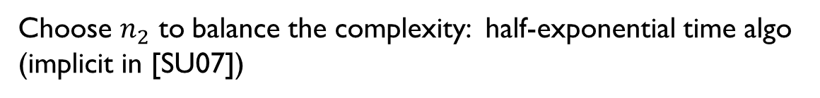










Efficiency Issue: Half-exponential Barrier
Choose $n_{2}$ to balance the complexity: half-exponential time algo
(implicit in [SU07])
Addressing the issue:
Iterative win-win [CLORS23,CHR24]
Two different proofs!
Critical win-win [San09,LOS21,HLR23]
$$\text{quasipoly}\left(n_{2}\right)$$
$$\exp{(n_{1})}$$
$$\exp{(n_{1})}$$
$$\exp{(n_{1})}$$
Run Case 2
$$n_{1}$$
input lengths
$$\text{poly}\left(n_{2}\right)$$
$$\text{poly}\left(n_{2}\right)$$
$$\text{poly}\left(n_{2}\right)$$
Run Case 1
$$n_{2}$$
$$n_{2}$$
$$n_{2}$$
input lengths
Notes:
Based on these time complexity we obtained, to balance the complexity at n_1 and n_2, we will pick n_2 being half-exponential to amortize the time bottleneck, the exponential(n_1), which yields a half-exponential running time.
To address this half-exponential barrier, we utilized two different techniques, iterative win-win and critical win-win. This two techniques are invented by some recent works, and yield our proofs of the main theorem.

Slide 30

Iterative win-win
Idea: Apply win-win between more input lengths to “amortize” the cost
[CLORS23] [CHR24]
Win-win between $ω\left(1\right)$ input lengths
Motivation for the new perspective of win-win
$$A$$
input lengths
input lengths
input lengths
input lengths

Slide 31







Iterative win-win
Win-win between $l$ input lengths
$$n_{1}, n_{2}, …, n_{l}$$
$$n_{i}=\text{quasipoly}\left(n_{i−1}\right)$$
Starting with the brute-force algorithm at $n_{1}$
Win-win between $n_{1}$ and $n_{2}$
“computation history”
$$\exp{(n_{1})}$$
Brute-force
$$n_{1}$$
input lengths
$$n_{2}$$
input lengths
$$n_{3}$$
input lengths

Slide 32



Iterative win-win
Win-win between $l$ input lengths
$$n_{1}, n_{2}, …, n_{l}$$
$$n_{i}=\text{quasipoly}\left(n_{i−1}\right)$$
Starting with the brute-force algorithm at $n_{1}$
Win-win between $n_{1}$ and $n_{2}$
(Win): correct $\text{quasipoly}\left(n_{2}\right)$ time reconstruction
(Improve): faster algorithm on $n_{2}$ than brute-force
$$\exp{(n_{1})}$$
$$\text{quasipoly}\left(n_{2}\right)$$
Reconstruction
$$n_{1}$$
input lengths
$$\text{poly}\left(n_{2}\right)$$
Derandomization
$$n_{2}$$
input lengths
$$n_{3}$$
input lengths

Slide 33
Iterative win-win
Win-win between $l$ input lengths
$$n_{1}, n_{2}, …, n_{l}$$
$$n_{i}=\text{quasipoly}\left(n_{i−1}\right)$$
Starting with the brute-force algorithm at $n_{1}$
Win-win between $n_{1}$ and $n_{2}$
Win-win between $n_{2}$ and $n_{3}$
$$\exp{(n_{1})}$$
$$\text{quasipoly}\left(n_{2}\right)$$
Reconstruction
$$n_{1}$$
input lengths
$$\text{poly}\left(n_{2}\right)$$
Derandomization
$$n_{2}$$
input lengths
$$n_{3}$$
input lengths

Slide 34




Iterative win-win
Win-win between $l$ input lengths
$$n_{1}, n_{2}, …, n_{l}$$
$$n_{i}=\text{quasipoly}\left(n_{i−1}\right)$$
Starting with the brute-force algorithm at $n_{1}$
Win-win between $n_{1}$ and $n_{2}$
Win-win between $n_{2}$ and $n_{3}$
…
Case 1 is efficient enough when $n_{l}≫\exp\left(n_{1}\right)$
$$\exp{(n_{1})}$$
$$\text{quasipoly}\left(n_{2}\right)$$
Reconstruction
$$n_{1}$$
input lengths
$$\text{quasipoly}\left(n_{3}\right)$$
$$\text{poly}\left(n_{2}\right)$$
Reconstruction
$$n_{2}$$
input lengths
$$\text{poly}\left(n_{3}\right)$$
Derandomization
$$n_{3}$$
input lengths

Slide 35
Iterative win-win
Win-win between $l$ input lengths
$$n_{1}, n_{2}, …, n_{l}$$
$$n_{i}=\text{quasipoly}\left(n_{i−1}\right)$$
Advice bits:
Needed in “derandomization”
Passed along the win-win (“instance-wise” H vs R)
# is dominated by the first win-win: $O\left(n_{1}\right)$ bits
$$\exp{(n_{1})}$$
$$\text{quasipoly}\left(n_{2}\right)$$
Reconstruction
$$n_{1}$$
input lengths
$$\text{quasipoly}\left(n_{3}\right)$$
$$\text{poly}\left(n_{2}\right)$$
Reconstruction
$$n_{2}$$
input lengths
$$\text{poly}\left(n_{3}\right)$$
Derandomization
$$n_{3}$$
input lengths

Slide 36



Critical win-win
[San09] [LOS21] [HLR23]
Idea 1: Consider the exact “amount of hardness”
Consider the maximum $m$ s.t. the hitting set can hit
Reconstruction algo at $m+1$ provides computation history at $n$
Idea 2: Locality of HSG
Time bottleneck at $m$: computing HSG from the $2^{O\left(n\right)}$ history at $n$
Obs: HSG allows efficiently compute a single element
require oracle access to computation history
$$n$$
input lengths
$$m$$
$$m+1$$
input lengths
hit
reconstruct

Slide 37


Critical win-win
Suppose $quasipoly\left(n\right)<m<\exp\left(n\right)$
uniqueness
PCP of $\text{BF}\left(1^{n}\right)$
“format match”
Obtain oracle access $O$ to history at $n$ by $\text{Reconstruct}(m+1)$
commit-and-evaluation protocol
(commitment with locol opening)
Compute an element in $m$’s hitting set via oracle $O$
$$n$$
input lengths
$$m$$
$$m+1$$
input lengths
hit
reconstruct

Slide 38


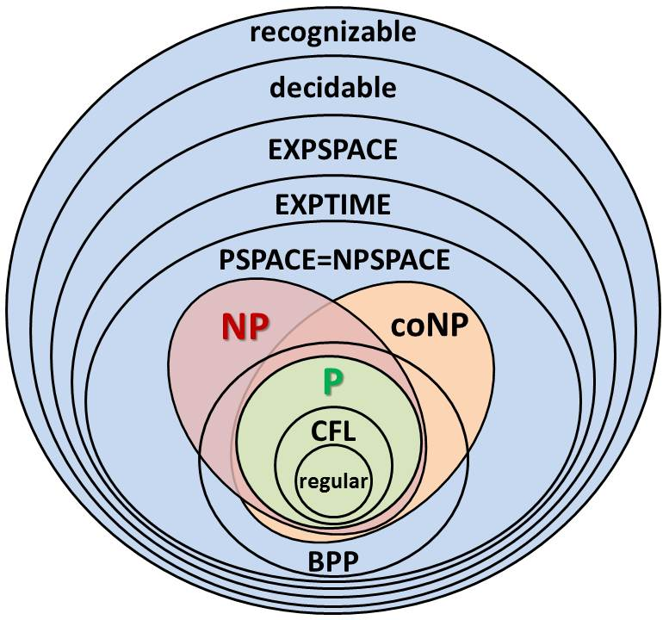
meme time!
复杂性
复杂度
动物园
We don’t produce hardness. We are porters of the complexity zoo.

Slide 39

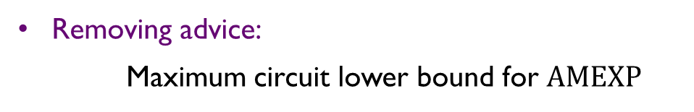
Open Problems
Removing advice:
Maximum circuit lower bound for $\text{AMEXP}$
Reducing to AME = AMTIME[$2^{O(n)}$]:
Maximum circuit lower bound for ${\text{AME}}_{/2^{n^{ε}}}$
More applications for Iterative win-win and Critical win-win
Thank you!

