Slide 1
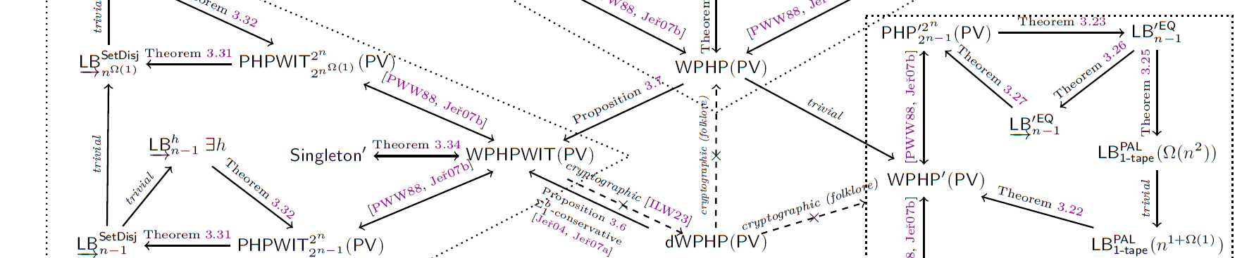
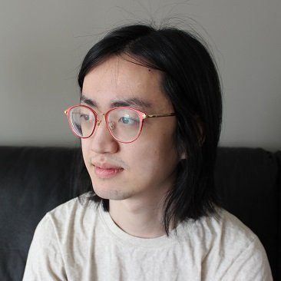
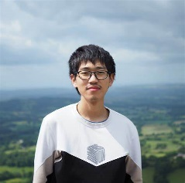
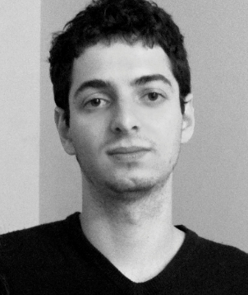
Reverse mathematics of complexity lower bounds
Lijie Chen
UC Berkeley
Jiatu Li
MIT
Igor C. Oliveira
University of Warwick

Slide 2
Background and Motivation

Slide 3

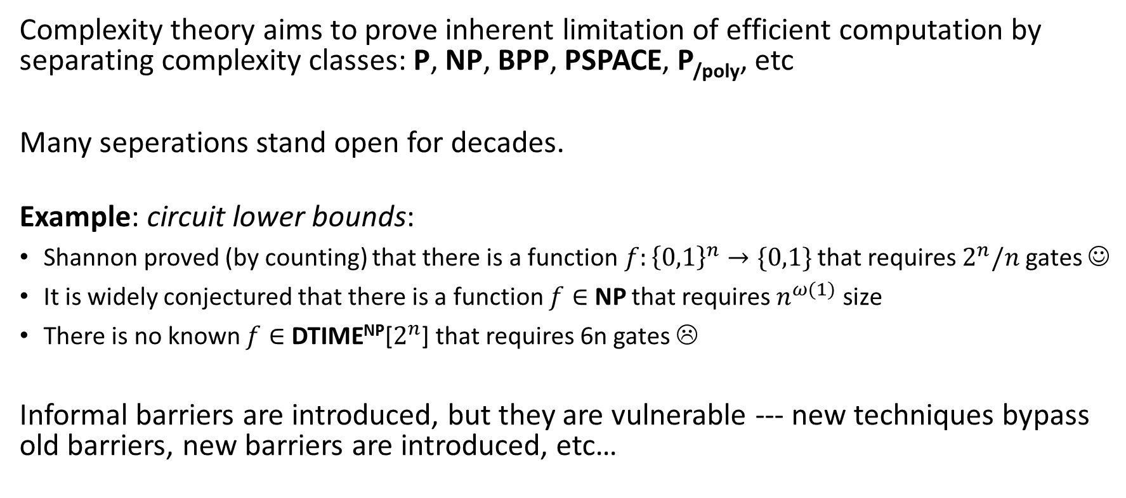
Complexity-Theoretic Conjectures
Complexity theory aims to prove inherent limitation of efficient computation by separating complexity classes: P, NP, BPP, PSPACE, P_{/poly}, etc
Many seperations stand open for decades.
Example: circuit lower bounds:
Shannon proved (by counting) that there is a function$f:{\left\{0,1\right\}}^{n}→\{0,1\}$ that requires $2^{n}/n$ gates ☺
It is widely conjectured that there is a function $f∈$ NP that requires $n^{ω(1)}$ size
There is no known $f∈$ DTIME^{NP}[$2^{n}$] that requires 6n gates ☹
Informal barriers are introduced, but they are vulnerable --- new techniques bypass old barriers, new barriers are introduced, etc…

Slide 4


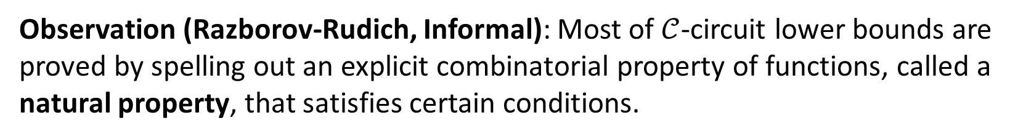
Informal Barriers
Observation (Razborov-Rudich, Informal): Most of $𝒞$-circuit lower bounds are proved by spelling out an explicit combinatorial property of functions, called a natural property, that satisfies certain conditions.
Theorem (Razborov-Rudich): Assuming plausible cryptographic assumptions, there is no natural property useful for proving general circuit lower bounds.
Known Complexity
Lower Bounds from Natural Proofs
Natural Proof
$$P≠NP$$

Slide 5
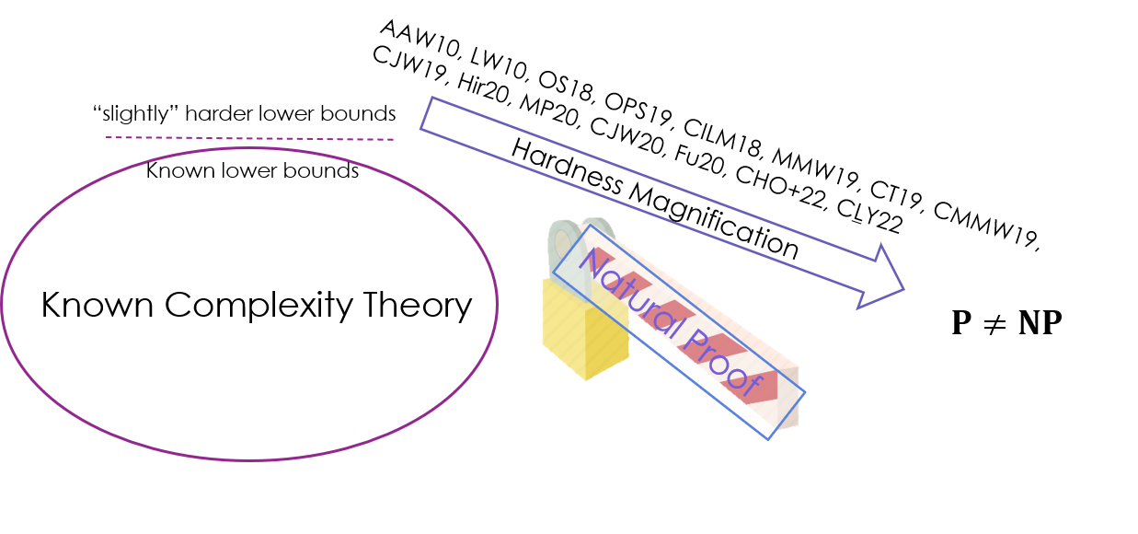





What is the next step?
New barriers [CHO+22, FLY22, Pich24]
Bypassing new barriers
New barriers
Bypassing new barriers
……
Intriguing possibility: complexity lower bounds might be unprovable
A strong mathematical theory with solid logical foundation
Known Complexity Theory
$$⊬$$
$$P≠NP$$
Notes:
Despite of being an intuitive and strong barrier, the natural proof barrier does not quite explain the limitation of several recently developed techniques in complexity theory such as hardness magnification.
It is unclear whether these techniques are indeed bringing us closer to the open problems, or simply hack across existing informal barriers in an ad-hoc way.
For hardness magnification, in particular, people are introducing new barriers, while these new barriers may also be bypassed at some point, which hopefully improves our understanding of complexity theory.
At the same time, people are aware of an intriguing possibility that complexity lower bounds might be unprovable from a strong mathematical theory with solid logical foundation,
which, through a systematic logical study, will be less vulnerable to ad-hoc tricks and reveal the inherent hardness of the open problems.
And this is the main motivation of our work.

Slide 6
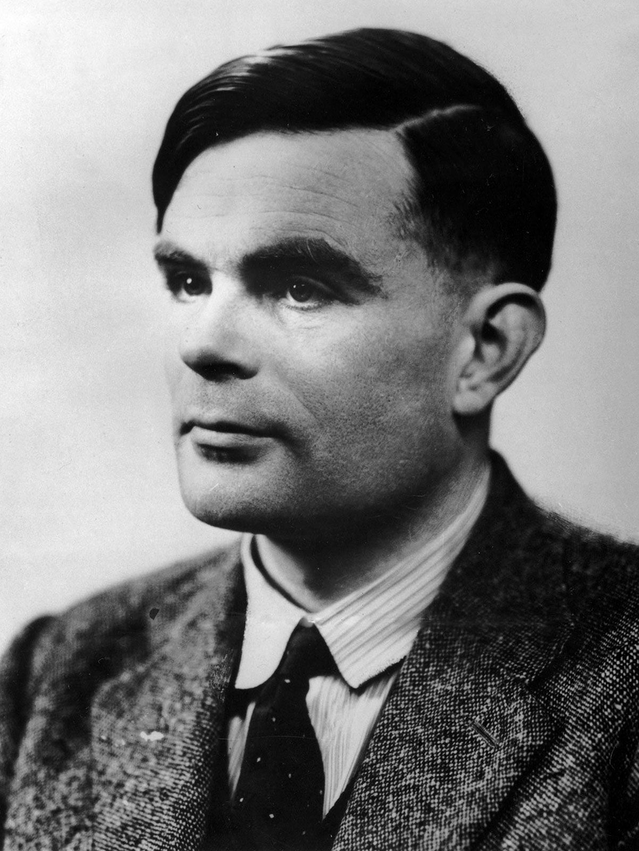
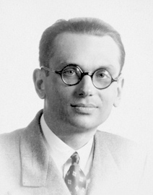
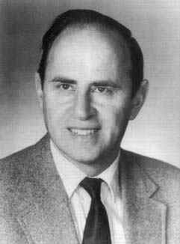
An Intriguing Possibility
Identify a theory T able to formalize all known results from algorithms and complexity, and determine if complexity lower bounds of interest are (un)provable in T
Alan Turing
Kurt Gödel
Paul Cohen
Uncomputable Functions
Incompleteness Theorem
Continuum Hypothesis vs ZFC set theory
Notes:
Ideally, we would like to identify a theory that is able to formalize all known results from algorithms and complexity, and determine if complexity lower bounds of interest are unprovable in T.

Slide 7
A less ambitious goal
many
Identify a theory T able to formalize all known results from algorithms and complexity, and determine if complexity lower bounds of interest are (un)provable in T
perhaps conditionally
Notes:
A less ambitious goal, which is probably more tractable, is to consider a theory that formalizes many known results and determine the unprovability of complexity lower bounds from it, possibly under assumptions.

Slide 8
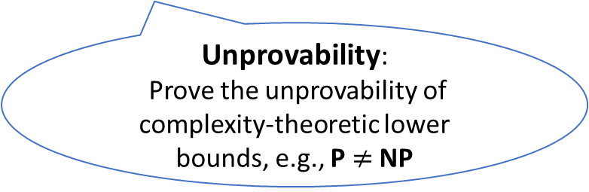
Reverse Mathematics:
Which axioms should we include in T?
A less ambitious goal
many
Identify a theory T able to formalize all known results from algorithms and complexity, and determine if complexity lower bounds of interest are (un)provable in T
perhaps conditionally
Unprovability:
Prove the unprovability of complexity-theoretic lower bounds, e.g., P $≠$ NP
A vast body of work has highlighted certain fragments of Peano Arithmetic (Bounded Arithmetic)
as a natural and robust class of theories for the formalization of
both basic and advanced results from algorithms and complexity theory
Notes:
There are two sides of the goal.
As the first half of the goal, we need to identify theory T that is strong enough for complexity theorists, which falls into the program of reverse mathematics:
Starting from the theorems that we care about, we need to find a suitable set of axioms to prove these theorems.
Then, we will show the unprovability of lower bounds from the theory T.
A vast body of work has highlighted certain fragments of Peano Arithmetic (Bounded Arithmetic)
as a natural and robust class of theories for the formalization of both basic and advanced results from algorithms and complexity theory
In this work, we consider the first half of the goal, namely reverse mathematics of complexity lower bounds in bounded arithmetic.

Slide 9
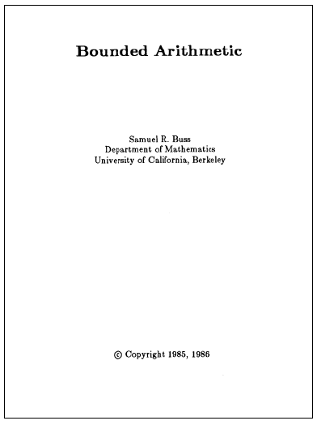
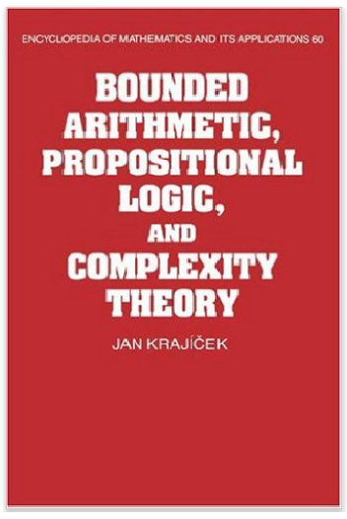

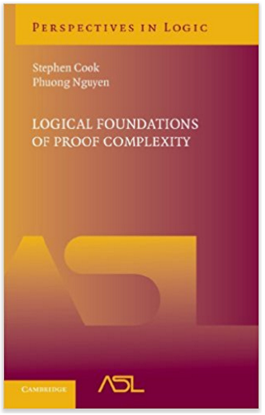

Bounded Arithmetic
Fragments of Peano Arithmetic capturing proofs that manipulate concepts from a given complexity class
A few notable examples:
- Cook’s theory PV₁ (1975), which formalizes poly-time reasoning
i
- Buss’s theories T (1986), corresponding to the levels of the polynomial hierarchy
2
- Jeřábek’s theory APC₁ (2007) for probabilistic reasoning

Slide 10



Reverse Mathematics
Probabilistic Reasoning
APC₁
$$⊢$$
AC⁰ lower bounds
Monotone lower bounds
AC⁰[p] lower bounds
Deterministic Poly Time
PV₁
$$⊢$$
PCP Theorem
Expander Graphs
“Informal” Reverse Mathematics of Complexity Theory:
Explicit Obstruction [CJW20, CLY22]
Refutation of Lower Bounds [CJSW24, CTW23]
Notes:
Prior to our work, there has been a rich literature on formalizing complexity theory in bounded arithmetic, here we mention some of the results.
For instance, the theory PV for deterministic poly time reasoning proves PCP Theorem and the existence of expander graphs.
The theory APC1 for probabilistic reasoning formalizes best known lower bounds against constant-depth circuits and monotone circuits.
These formalization results support our intuition that bounded theories are reasonably strong.
However, a major limitation of existing results is that they do not highlight reversals, and thus do not justify the necessity of introducing certain axioms.
For instance, it is unclear whether the extension from PV to APC1 is necessary for proving the circuit lower bounds.

Slide 11
Reverse Mathematics
many
Identify a theory T able to formalize all known results from algorithms and complexity, and determine if complexity lower bounds of interest are (un)provable in T
perhaps conditionally
Q₁: Are bounded theories PV₁ and APC₁ sufficient to prove the lower bounds we care about?
Some researchers believed this is TRUE!
The stronger the theory is, the stronger the unprovability results are!
Q₂: If not, what additional axioms should we add?
The stronger the theory is, the harder the unprovability results are (to be proved) ☹
Only add necessary axioms!
Notes:
Specifically, we can ask the following two questions:
Are bounded theories PV1 and APC1 sufficient to prove lower bounds we care about?
Indeed, some researchers believed that this is true
Note that the question is important, as the stronger the theory is, the stronger the unprovability results are
Moreover, if it is not the case, what axioms we should add?
Recall that in the second part of the goal, we will prove the unprovability of lower bounds
The stronger the theory is, the harder the unprovability results are
Therefore, a wise choice is to only add necessary axioms to make our life easier

Slide 12
Our Results

Slide 13
This Work: Reverse Math of Complexity Lower Bounds
To pinpoint the exact strength of the theories/axioms needed to prove lower bound statements of interest, we systematically investigate the reverse mathematics of lower bounds.
We aim to determine the fundamental principles needed to establish lower bounds, by showing (over a weak base theory) that the lower bound and the principle are equivalent.
Notes:
To pinpoint the exact strength of the theories/axioms needed to prove lower bound statements of Interest, we systematically investigate the reverse mathematics of lower bounds.
We aim to determine the fundamental principles needed to establish lower bounds, by showing (over a weak base theory) that the lower bound and the principle are equivalent.
That is, the lower bound can be proved from the base theory and the combinatorial principle, while at the same time
the combinatorial principle can be proved from the base theory and the lower bound statements.

Slide 14



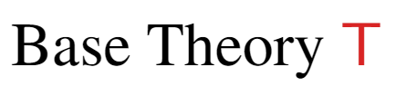
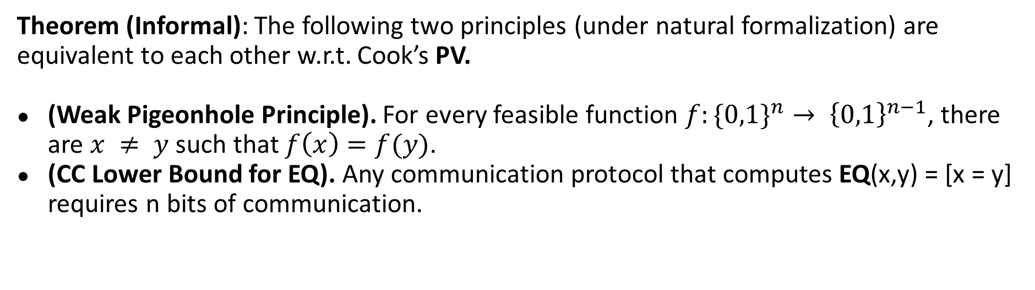
(One of) Our Results
Theorem (Informal): The following two principles (under natural formalization) are equivalent to each other w.r.t. Cook’s PV.
(Weak Pigeonhole Principle). For every feasible function $f:\{0,1\}^{n}→ {\left\{0,1\right\}}^{n−1}$, there are $x ≠ y$ such that $f\left(x\right)=f(y)$.
(CC Lower Bound for EQ). Any communication protocol that computes EQ(x,y) = [x = y] requires n bits of communication.
Notes:
One of our main results can be informally stated as follows.
With respect to Cook’s theory PV that captures reasoning in polynomial time, the weak pigeonhole principle, i.e., each shrinking function has a pair of colliding inputs,
is equivalent to the deterministic communication complexity lower bound of EQ.
In some sense, it means that from the perspective of polynomial-time agents, the weak pigeonhole principle is as hard as communication complexity lower bound for EQ

Slide 15
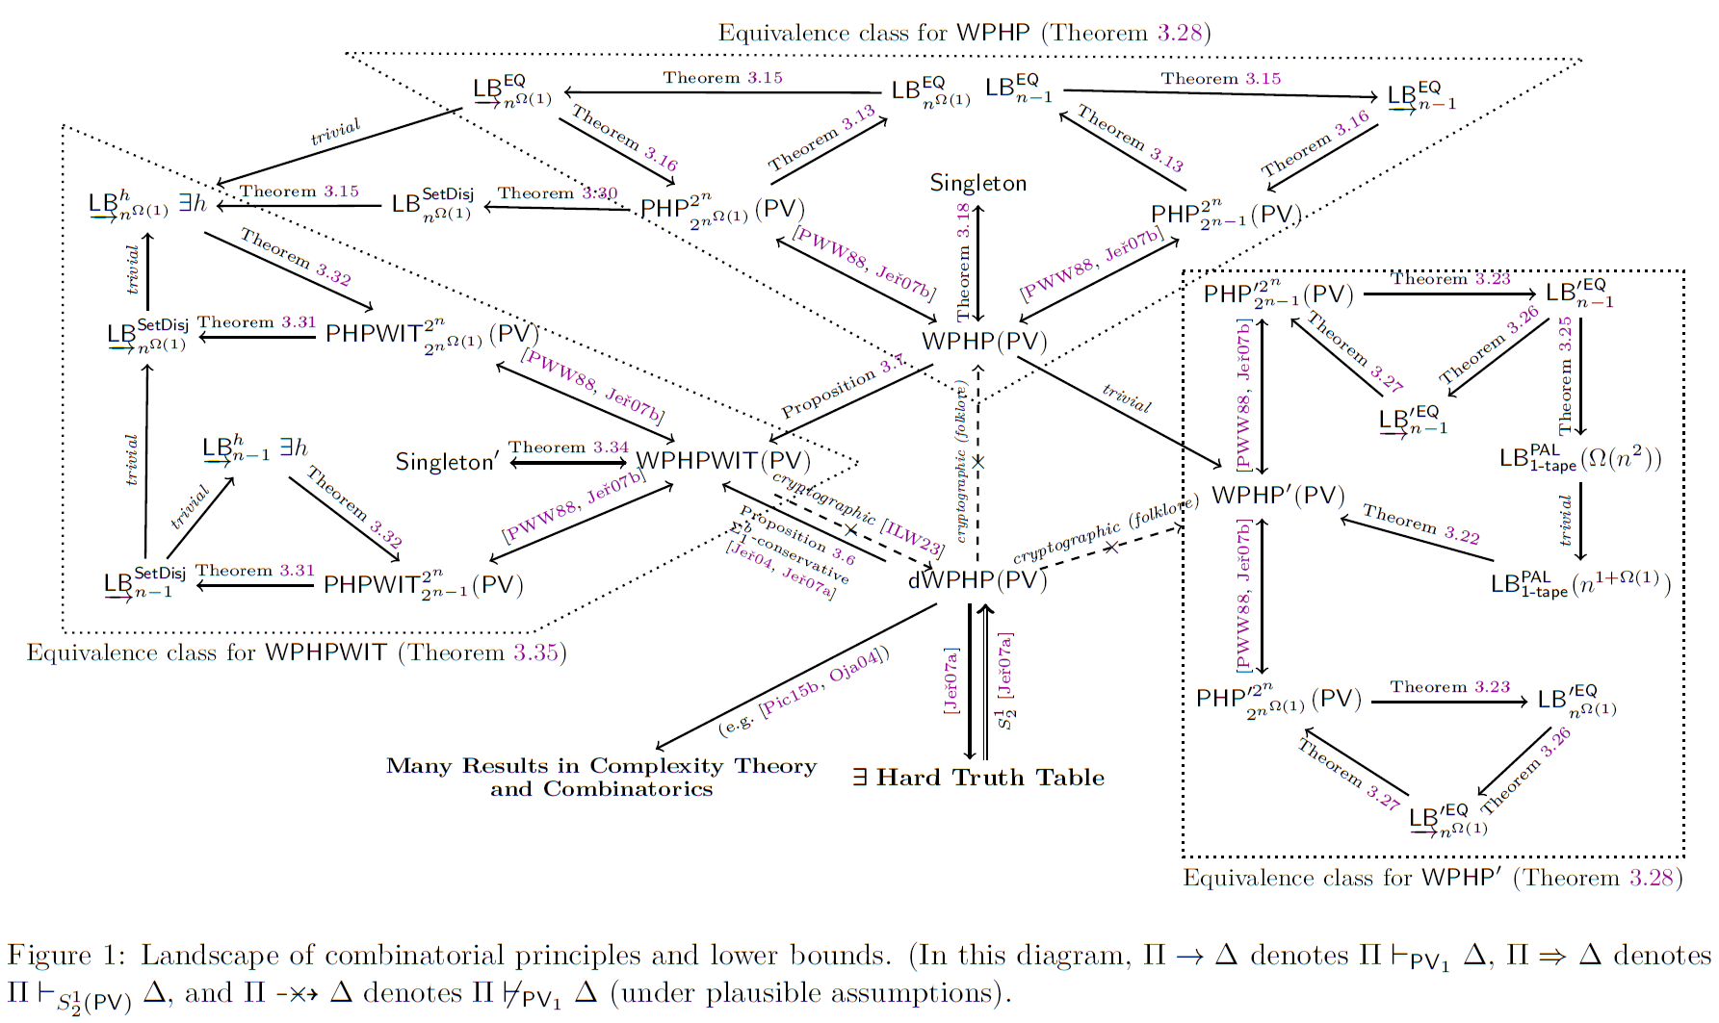
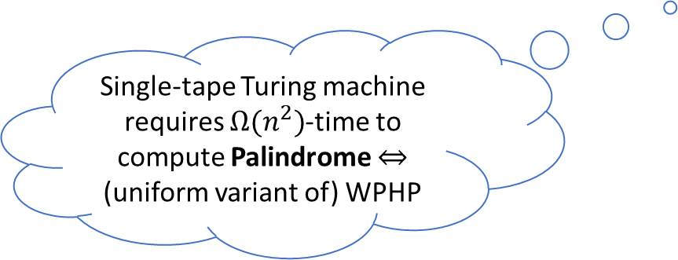
Single-tape Turing machine requires $Ω(n^{2})$-time to compute Palindrome $⇔$ (uniform variant of) WPHP
Notes:
Indeed, we identify three equivalence classes of variants of the pigeonhole principle, and put several results of interests into the picture,
including singleton bound for error-correcting codes, Palindrome lower bound against single-tape Turing machines,
And communication complexity lower bound for Set Disjointness against one-way protocols.

Slide 16
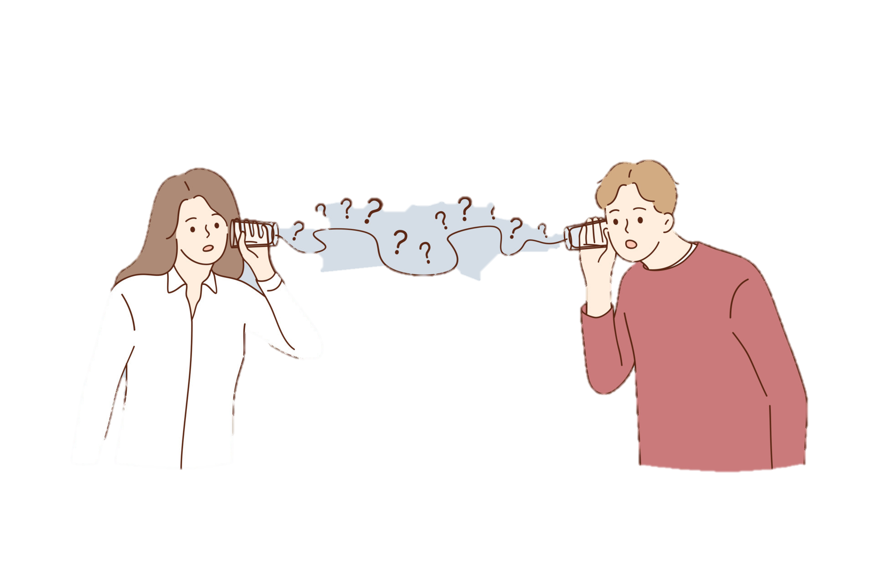


Philosophy of Our Results
The standard textbook proof is constructive
PV (poly-time) reasoning
Towards a contradiction, assume that weak pigeonhole principle is wrong
Breaking lower bounds using the “perfect hash function”
$f:{\left\{0,1\right\}}^{n}→{\left\{0,1\right\}}^{n−1}$ being injective
“Perfect hash function” that does not exist in real world

Slide 17


This Work: Reverse Math of Complexity Lower Bounds
Q₁: Are bounded theories PV₁ and APC₁ sufficient to prove the lower bounds we care about?
A: Under plausible cryptographic assumption, PV₁ and APC₁ cannot prove classical lower bounds about communication complexity, error-correcting codes, and single-tape Turing machines!
PV reasoning
Q₂: If not, what additional axioms should we add?
A: Indeed, aforementioned lower bounds are equivalent to combinatorial principles like pigeonhole principles with respect to PV₁.
Other Consequences ☺
Explanation of the motivation, setting, and technical details targeted to readers with little prior exposure to logic ☺
Notes:
Our results brought new insights on the questions we posted.
Firstly, the reverse mathematics of lower bounds show that under plausible cryptographic assumption, PV₁ and APC₁
cannot prove classical lower bounds about communication complexity, error-correcting codes, and single-tape Turing machines!
This is from a rather counter-intuitive argument.
By the reversals, we know that the weak pigeonhole principle is necessary for proving communication lower bounds.
It is well-known that under cryptographic assumptions, the weak pigeonhole principle is unprovable in PV₁ and APC₁
And therefore the communication complexity lower bounds are also unprovable.
This corrects the previous belief that “simple” lower bounds are likely provable in PV₁ and APC₁
Secondly, as the lower bounds are equivalent to combinatorial principles, we also know that the principles are exactly what we need
to add to our theory to derive the lower bounds we want.

Slide 18
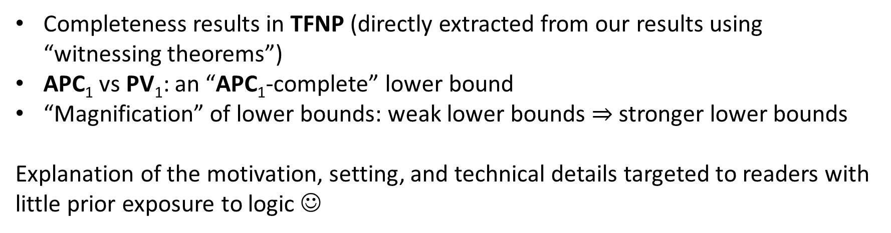
Other Consequences
Completeness results in TFNP (directly extracted from our results using “witnessing theorems”)
APC₁ vs PV₁: an “APC₁-complete” lower bound
“Magnification” of lower bounds: weak lower bounds $⇒$ stronger lower bounds
Explanation of the motivation, setting, and technical details targeted to readers with little prior exposure to logic ☺

Slide 19
Open Problems
Can we derive most complexity lower bounds from PV₁ + pigeonhole principles? Or do we need other combinatorial/algebraic principles?
Can we consider lower bounds against randomized computation? What base theory should we choose? What principles should we consider?
Can we consider mathematics beyond complexity theory (for bounded reverse mathematics)? Would that lead to any interesting consequences?

