Slide 1

Unprovability of strong complexity lower bounds in bounded arithmetic*
Jiatu Li
Igor Carboni Oliveira
Tsinghua University $→$ MIT
University of Warwick
STOC 2023
June/2023
* Based on earlier slides of Igor
1

Slide 2
Overview
The story of frustrated complexity theorists
Bounded Arithmetic: the minimal logic for complexity theorists
Witnessing: extracting algorithms from proofs
Unprovability of complexity lower bounds

Slide 3
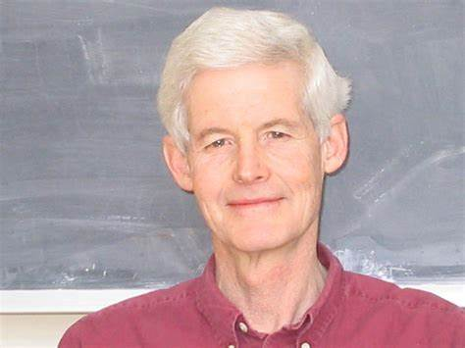
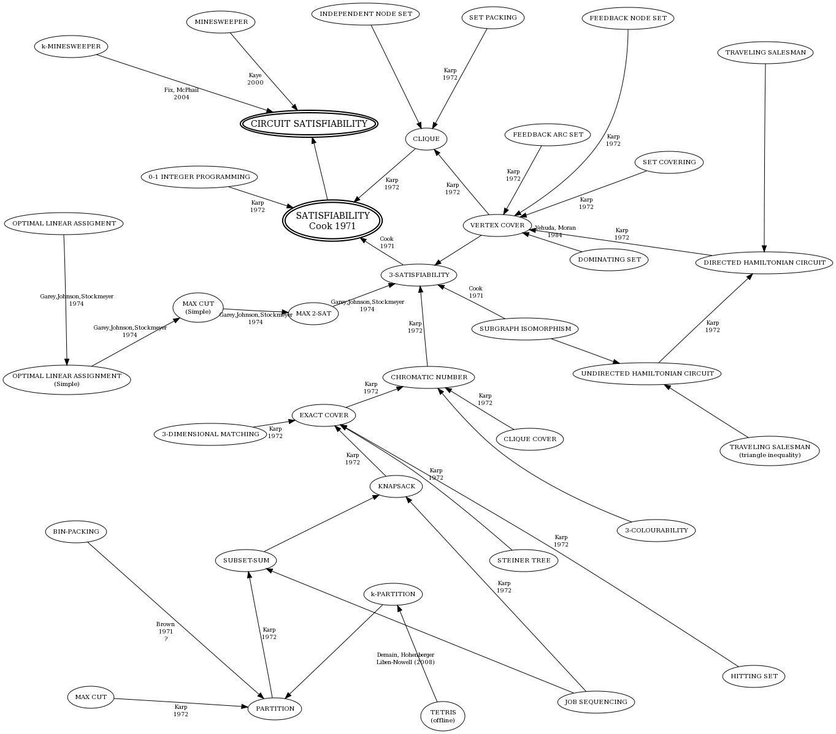

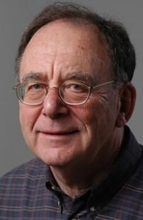
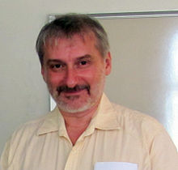
The Adventure of Complexity Theorists
Stephen Cook
Are they hard?
Richard Karp
Leonid Levin
A (partial) map of NP-complete problems

Slide 4
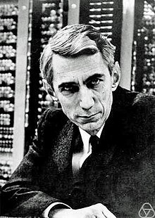
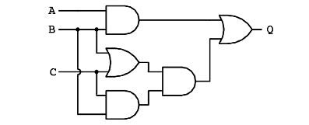
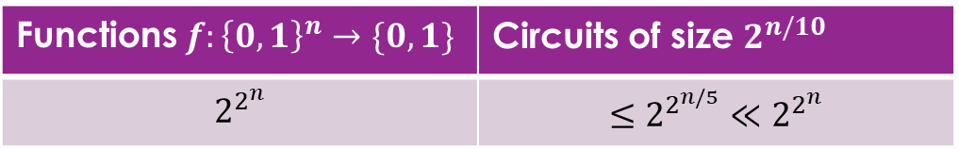
The Adventure of Complexity Theorists
Let’s count!
Most of functions are hard! Let’s find one.
Functions $f:{\left\{0,1\right\}}^{n}→\{0,1\}$ | Circuits of size $2^{n/10}$
$$2^{2^{n}}$$ | $$≤2^{2^{n/5}}≪2^{2^{n}}$$
Claude Elwood Shannon (1950s)

Slide 5
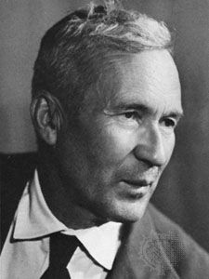
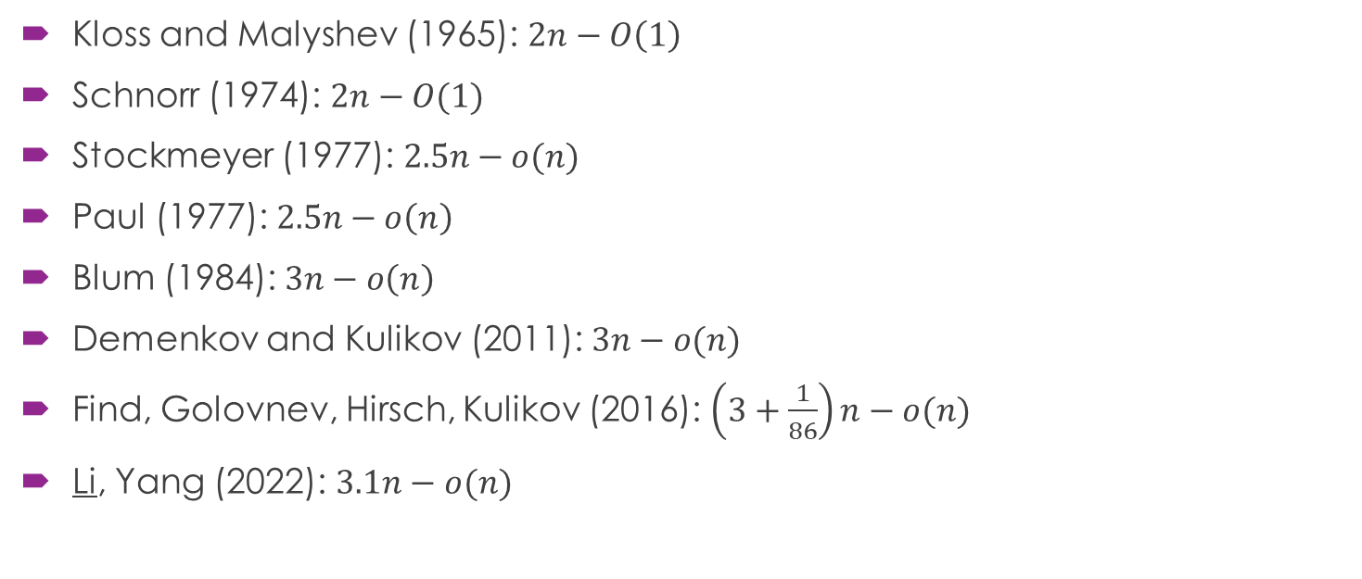
The Adventure of Complexity Theorists
Life is so hard. I now believe that P has linear-size circuits!
Kloss and Malyshev (1965): $2n−O\left(1\right)$
Schnorr (1974): $2n−O(1)$
Stockmeyer (1977): $2.5n−o(n)$
Paul (1977): $2.5n−o\left(n\right)$
Blum (1984): $3n−o\left(n\right)$
Demenkov and Kulikov (2011): $3n−o(n)$
Find, Golovnev, Hirsch, Kulikov (2016): $\left(3+\frac{1}{86}\right)n−o(n)$
Li, Yang (2022): $3.1n−o(n)$
Andrey Nikolayevich Kolmogorov

Slide 6
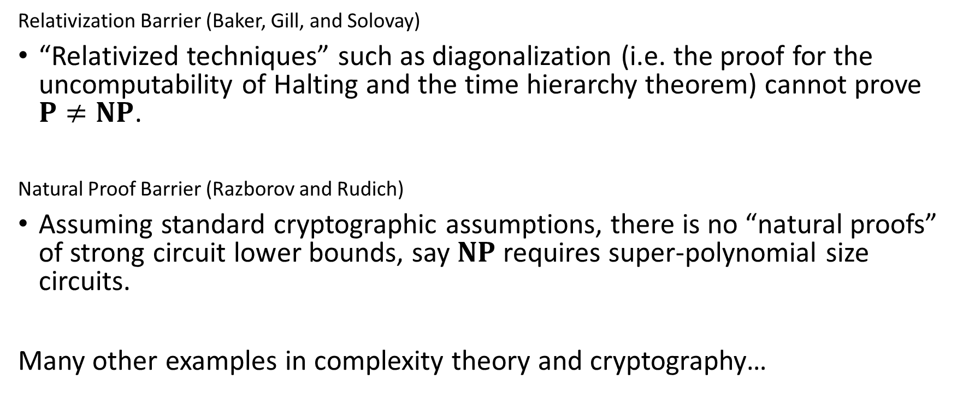
Understanding the Failure
Relativization Barrier (Baker, Gill, and Solovay)
“Relativized techniques” such as diagonalization (i.e. the proof for the uncomputability of Halting and the time hierarchy theorem) cannot prove $P≠NP$.
Natural Proof Barrier (Razborov and Rudich)
Assuming standard cryptographic assumptions, there is no “natural proofs” of strong circuit lower bounds, say $NP$ requires super-polynomial size circuits.
Many other examples in complexity theory and cryptography…

Slide 7


However……
Informal barriers are ad-hoc and can be easily circumvented!
“slightly” harder lower bounds
AAW10, LW10, OS18, OPS19, CILM18, MMW19, CT19, CMMW19, CJW19, Hir20, MP20, CJW20, Fu20, CHO+22, CLY22
Known lower bounds
Hardness Magnification
Known Complexity Theory
$$P≠NP$$
Natural Proof

Slide 8
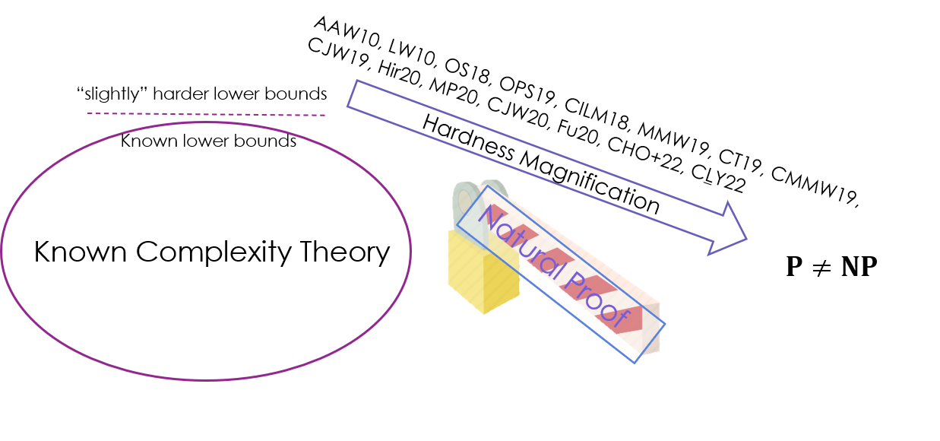





What is the next step?
New barriers
Bypassing new barriers
New barriers
Bypassing new barriers
……
A strong mathematical theory with solid logical foundation
Known Complexity Theory
$$⊬$$
$$P≠NP$$

Slide 9
Overview
The story of frustrated complexity theorists
Bounded Arithmetic: the minimal logic for complexity theorists
Witnessing: extracting algorithms from proofs
Unprovability of complexity lower bounds

Slide 10

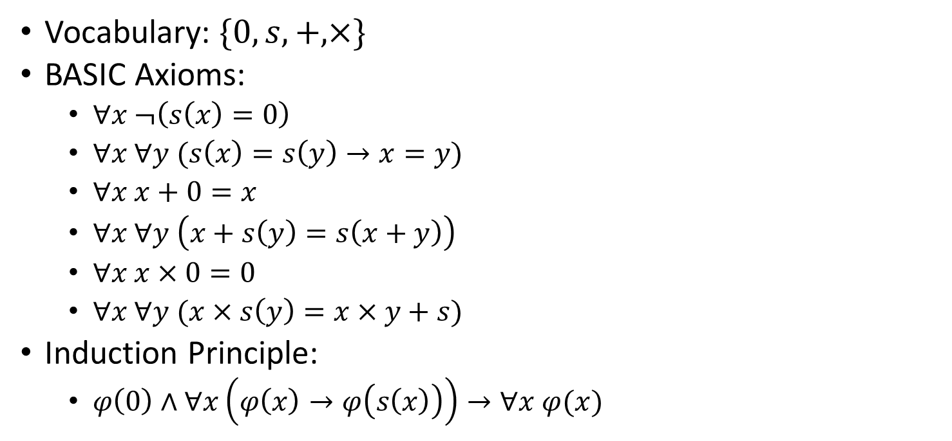


Review: Peano Arithmetic
Vocabulary: $\{0, s, +,×\}$
BASIC Axioms:
$∀x ¬\left(s\left(x\right)=0\right)$
$∀x ∀y (s\left(x\right)=s\left(y\right)→x=y)$
$∀x x+0=x$
$∀x ∀y \left(x+s\left(y\right)=s\left(x+y\right)\right)$
$∀x x×0=0$
$∀x ∀y (x×s\left(y\right)=x×y+s)$
Induction Principle:
$φ\left(0\right)∧∀x\left(φ\left(x\right)→φ\left(s\left(x\right)\right)\right)→∀x φ(x)$
Axioms for $s(⋅)$
Axioms for $+$
Axioms for $×$

Slide 11
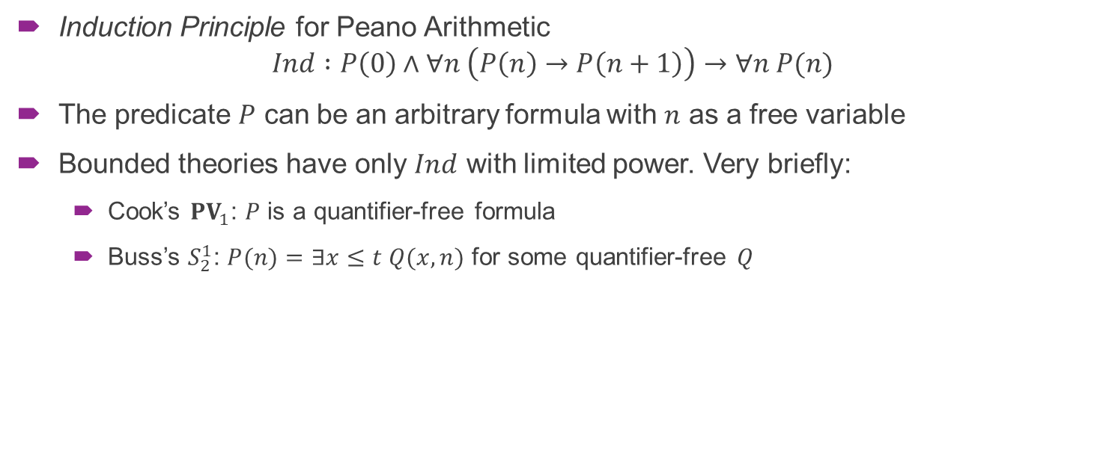
Bounded Arithmetic
Induction Principle for Peano Arithmetic
$$Ind :P\left(0\right)∧∀n \left(P\left(n\right)→P\left(n+1\right)\right)→∀n P(n)$$
The predicate $P$ can be an arbitrary formula with $n$ as a free variable
Bounded theories have only $Ind$ with limited power. Very briefly:
Cook’s ${PV}_{1}$: $P$ is a quantifier-free formula
Buss’s $S_{2}^{1}$: $P(n)=∃x≤t Q(x,n)$ for some quantifier-free $Q$

Slide 12
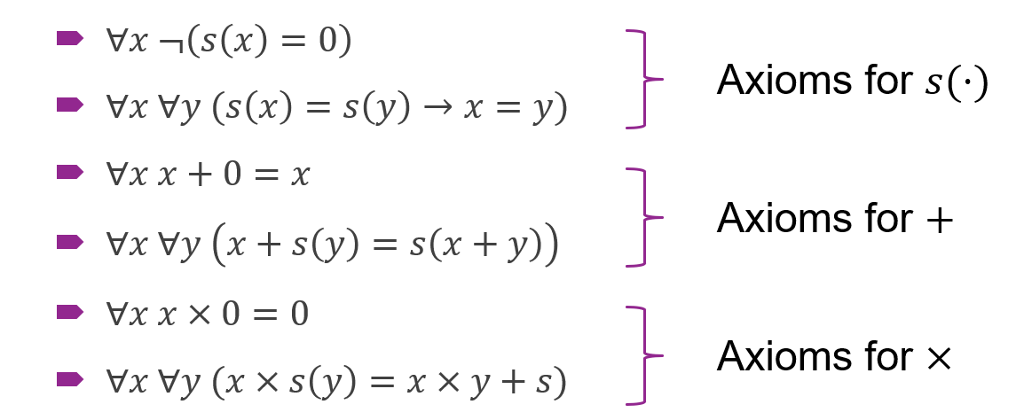
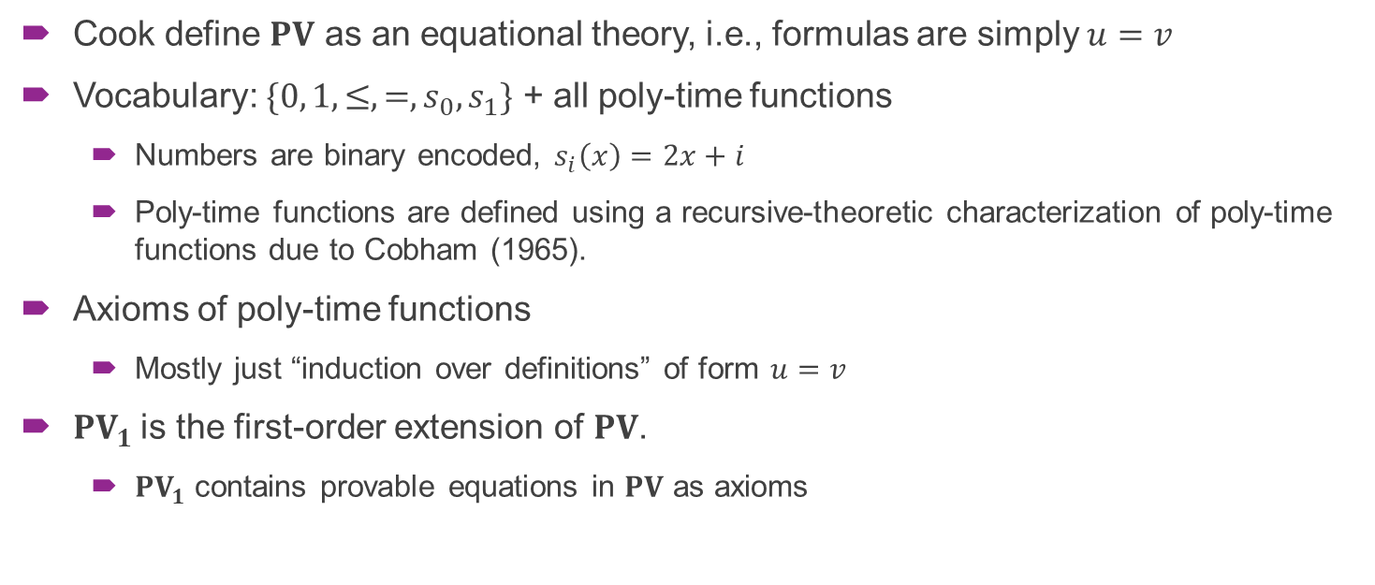

Cook’s ${PV}_{1}$ for Poly-Time Reasoning
Cook define $PV$ as an equational theory, i.e., formulas are simply $u=v$
Vocabulary: $\{0, 1, ≤,=,s_{0},s_{1}\}$ + all poly-time functions
Numbers are binary encoded, $s_{i}\left(x\right)=2x+i$
Poly-time functions are defined using a recursive-theoretic characterization of poly-time functions due to Cobham (1965).
Axioms of poly-time functions
Mostly just “induction over definitions” of form $u=v$
$PV_{1}$ is the first-order extension of $PV$.
$PV_{1}$ contains provable equations in $PV$ as axioms

Slide 13

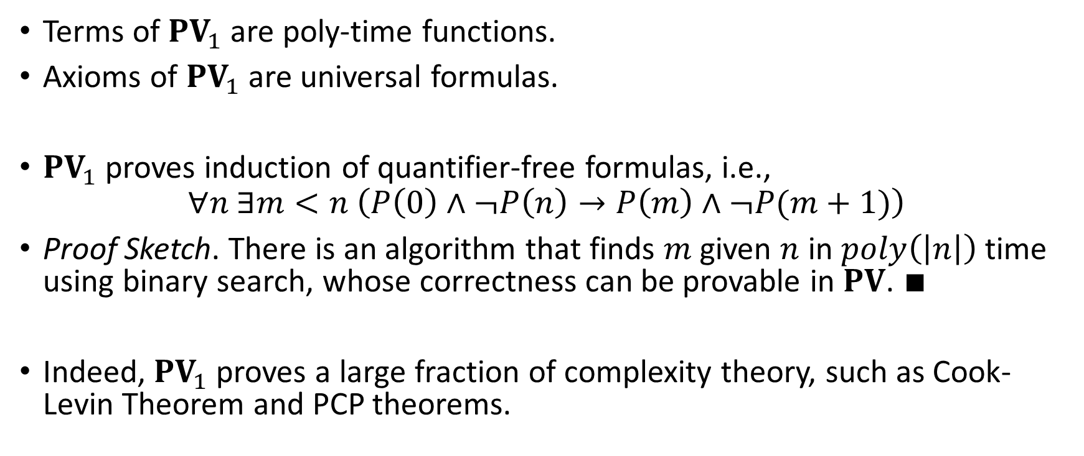

The Power of ${PV}_{1}$
Terms of ${PV}_{1}$ are poly-time functions.
Axioms of ${PV}_{1}$ are universal formulas.
${PV}_{1}$ proves induction of quantifier-free formulas, i.e.,
$$∀n ∃m<n \left(P\left(0\right)∧¬P\left(n\right)→P\left(m\right)∧¬P(m+1)\right)$$
Proof Sketch. There is an algorithm that finds $m$ given $n$ in $poly\left(\left|n\right|\right)$ time using binary search, whose correctness can be provable in $PV$. $∎$
Indeed, ${PV}_{1}$ proves a large fraction of complexity theory, such as Cook-Levin Theorem and PCP theorems.

Slide 14
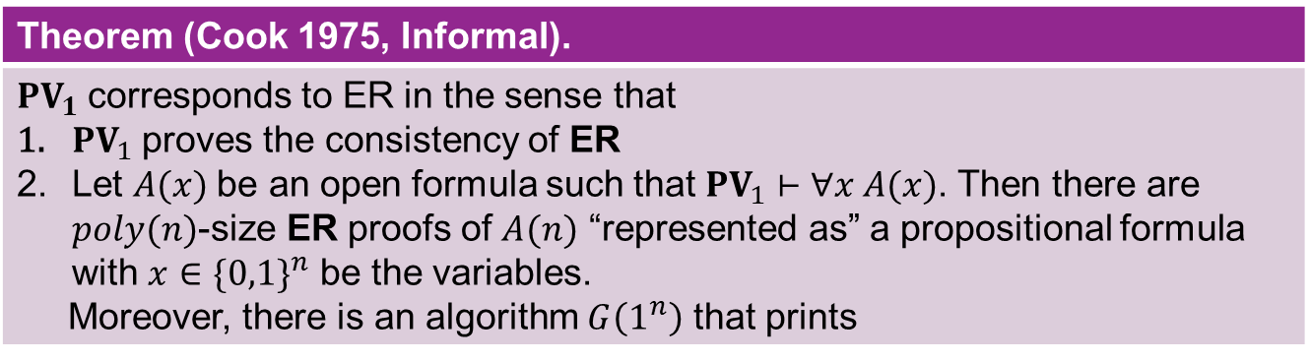

Two Aspects of Bounded Arithmetic
Correspondence to propositional proof complexity
Extended Resolution (ER)
Standard resolution system for propositional logic
An extension rule: $z↔φ$ for a fresh variable $z$
Theorem (Cook 1975, Informal).
${PV}_{1}$ corresponds to ER in the sense that $PV_{1}$ proves the consistency of ER Let $A(x)$be an open formula such that ${PV}_{1}⊢∀x A(x)$. Then there are $poly(n)$-size ER proofs of $A(n)$ “represented as” a propositional formula with $x∈\{0,1\}^{n}$ be the variables. Moreover, there is an algorithm $G\left(1^{n}\right)$ that prints

Slide 15
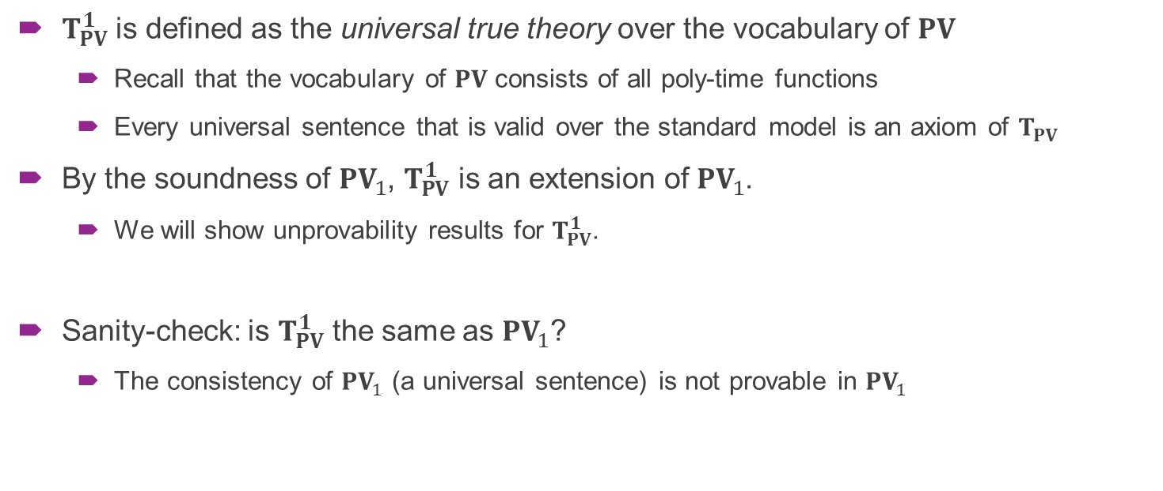
Everything Needed for Today
$T_{PV}^{1}$ is defined as the universal true theory over the vocabulary of $PV$
Recall that the vocabulary of $PV$ consists of all poly-time functions
Every universal sentence that is valid over the standard model is an axiom of $T_{PV}$
By the soundness of $PV_{1}$, $T_{PV}^{1}$ is an extension of $PV_{1}$.
We will show unprovability results for $T_{PV}^{1}$.
Sanity-check: is $T_{PV}^{1}$ the same as $PV_{1}$?
The consistency of $PV_{1}$ (a universal sentence) is not provable in $PV_{1}$

Slide 16
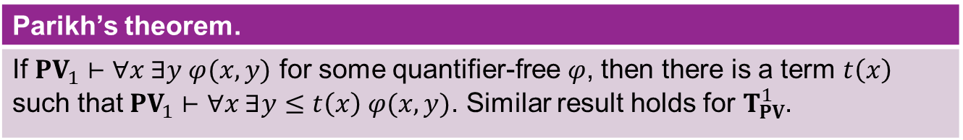
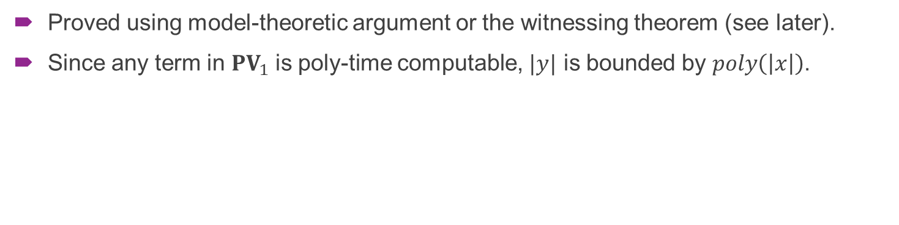
Parikh’s theorem (“bounded”)
Parikh’s theorem.
If ${PV}_{1}⊢∀x ∃y φ(x,y)$ for some quantifier-free $φ$, then there is a term $t\left(x\right)$ such that ${PV}_{1}⊢∀x ∃y≤t\left(x\right) φ(x,y)$. Similar result holds for $T_{PV}^{1}$.
Proved using model-theoretic argument or the witnessing theorem (see later).
Since any term in ${PV}_{1}$ is poly-time computable, $|y|$ is bounded by $poly\left(\left|x\right|\right)$.

Slide 17
Overview
The story of frustrated complexity theorists
Bounded Arithmetic: the minimal logic for complexity theorists
Witnessing: extracting algorithms from proofs
Unprovability of complexity lower bounds

Slide 18
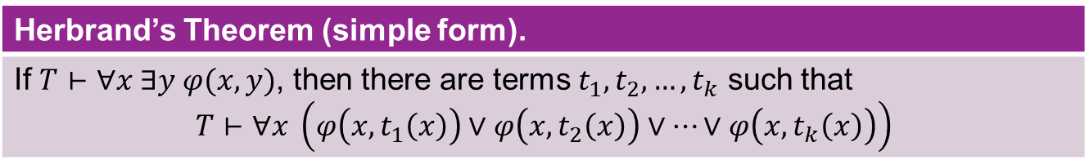


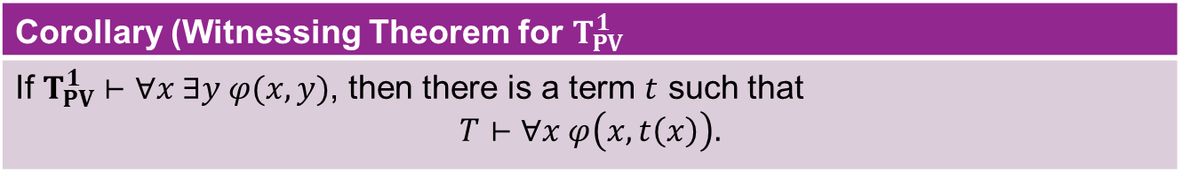
Herbrand’s Theorem (simple form)
Let $T$ be a universal theory and $φ(x,y)$ be quantifier-free.
Herbrand’s Theorem (simple form).
If $T⊢∀x ∃y φ(x,y)$, then there are terms $t_{1},t_{2},…,t_{k}$ such that $$T⊢∀x \left(φ\left(x,t_{1}\left(x\right)\right)∨φ\left(x,t_{2}\left(x\right)\right)∨…∨φ\left(x,t_{k}\left(x\right)\right)\right)$$
Function definable in $T_{PV}^{1}$ with quantifier-free predicate
Polynomial-time algorithm for the function
Corollary (Witnessing Theorem for $T_{PV}^{1}$
If $T_{PV}^{1}⊢∀x ∃y φ(x,y)$, then there is a term $t$ such that $$T⊢∀x φ\left(x,t\left(x\right)\right).$$

Slide 19
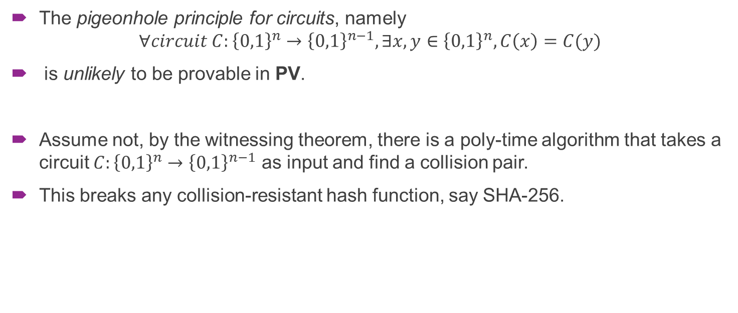
Example: (un)provability of PHP
The pigeonhole principle for circuits, namely
$$∀circuit C:{\left\{0,1\right\}}^{n}→{\left\{0,1\right\}}^{n−1}, ∃x,y∈{\left\{0,1\right\}}^{n}, C\left(x\right)=C(y)$$
is unlikely to be provable in PV.
Assume not, by the witnessing theorem, there is a poly-time algorithm that takes a circuit $C:{\left\{0,1\right\}}^{n}→{\left\{0,1\right\}}^{n−1}$ as input and find a collision pair.
This breaks any collision-resistant hash function, say SHA-256.

Slide 20
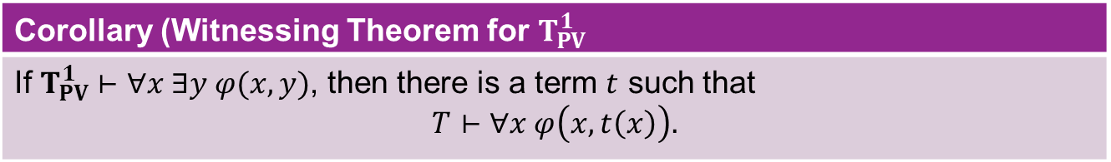
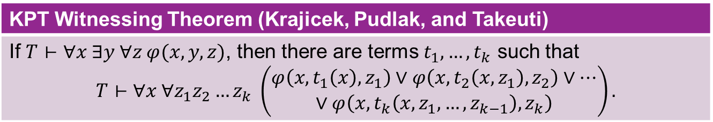

KPT Witnessing Theorem
Function definable in $T_{PV}^{1}$ with quantifier-free predicate
Polynomial-time algorithm for the function
Corollary (Witnessing Theorem for $T_{PV}^{1}$
If $T_{PV}^{1}⊢∀x ∃y φ(x,y)$, then there is a term $t$ such that $$T⊢∀x φ\left(x,t\left(x\right)\right).$$
KPT Witnessing Theorem (Krajicek, Pudlak, and Takeuti)
If $T⊢∀x ∃y ∀z φ(x,y,z)$, then there are terms $t_{1},…,t_{k}$ such that $$T⊢∀x ∀z_{1}z_{2}…z_{k} \left(\begin{aligned}φ\left(x,t_{1}\left(x\right),z_{1}\right)∨φ\left(x,t_{2}\left(x,z_{1}\right),z_{2}\right)∨… \\ ∨φ\left(x,t_{k}\left(x,z_{1},…,z_{k−1}\right),z_{k}\right)\end{aligned}\right).$$

Slide 21

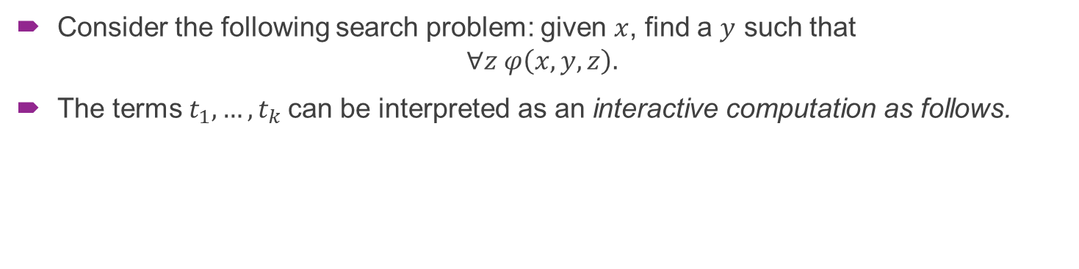
KPT Witnessing Theorem
KPT Witnessing Theorem (Krajicek, Pudlak, and Takeuti)
If $T⊢∀x ∃y ∀z φ(x,y,z)$, then there are terms $t_{1},…,t_{k}$ such that $$T⊢∀x ∀z_{1}z_{2}…z_{k} \left(\begin{aligned}φ\left(x,t_{1}\left(x\right),z_{1}\right)∨φ\left(x,t_{2}\left(x,z_{1}\right),z_{2}\right)∨… \\ ∨φ\left(x,t_{k}\left(x,z_{1},…,z_{k−1}\right),z_{k}\right)\end{aligned}\right).$$
Consider the following search problem: given $x$, find a $y$ such that
$$∀z φ\left(x,y,z\right).$$
The terms $t_{1},…,t_{k}$ can be interpreted as an interactive computation as follows.

Slide 22




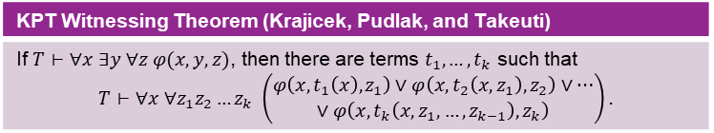






KPT Witnessing Theorem
KPT Witnessing Theorem (Krajicek, Pudlak, and Takeuti)
If $T⊢∀x ∃y ∀z φ(x,y,z)$, then there are terms $t_{1},…,t_{k}$ such that $$T⊢∀x ∀z_{1}z_{2}…z_{k} \left(\begin{aligned}φ\left(x,t_{1}\left(x\right),z_{1}\right)∨φ\left(x,t_{2}\left(x,z_{1}\right),z_{2}\right)∨… \\ ∨φ\left(x,t_{k}\left(x,z_{1},…,z_{k−1}\right),z_{k}\right)\end{aligned}\right).$$
Consider the following search problem: given $x$, find a $y$ such that
$$∀z φ\left(x,y,z\right).$$
The terms $t_{1},…,t_{k}$ can be interpreted as an interactive computation as follows.
Is $y_{1}=t_{1}(x)$ correct?
No. $φ(x,y_{1},z_{1})$ is not true
Is $y_{2}=t_{2}(x,z_{1})$ correct?
No. $φ(x,y_{2},z_{2})$ is not true
$$⋮$$
Is $y_{k}=t_{k}(x,z_{1},…,z_{k})$ correct?
Yes. For every $z_{k}$, $φ\left(x,y_{k}, z_{k}\right)$ is true

Slide 23
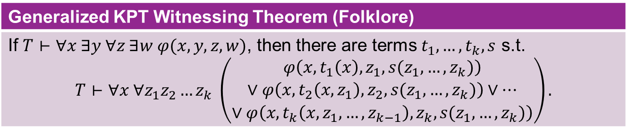
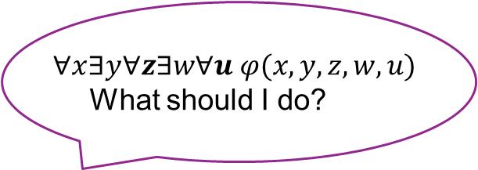
What about more quantifier?
Generalized KPT Witnessing Theorem (Folklore)
If $T⊢∀x ∃y ∀z ∃w φ(x,y,z,w)$, then there are terms $t_{1},…,t_{k},s$ s.t. $$T⊢∀x ∀z_{1}z_{2}…z_{k} \left(\begin{aligned}φ\left(x,t_{1}\left(x\right),z_{1}, s(z_{1},…,z_{k})\right) \\ ∨φ\left(x,t_{2}\left(x,z_{1}\right),z_{2},s(z_{1},…,z_{k})\right)∨… \\ ∨φ\left(x,t_{k}\left(x,z_{1},…,z_{k−1}\right),z_{k},s(z_{1},…,z_{k})\right)\end{aligned}\right).$$
3, 4, 5! Let’s try 5!
$$∀x∃y∀z∃w∀u φ(x,y,z,w,u)$$
What should I do?

Slide 24


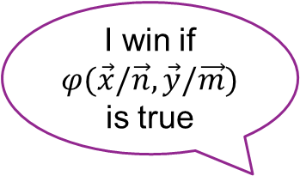






Our results: Witnessing for all formulas
Let $T$ be a universal theory, $φ\left(x,x_{1},…x_{k},y_{1},…, y_{k}\right)$ be quantifier-free, and
$$φ\left(x\right)≔∃y_{1}∀x_{1}∃y_{2}∀x_{2}…∃y_{k}∀x_{k}φ\left(x,x_{1},…,x_{k}, y_{1},…,y_{k}\right).$$
Let $M$ be a model over the vocabulary of $T$ and $n_{0}∈M$.
Evaluation Game over $(M, n_{0})$:
I win if $φ(\vec{x}/\vec{n},\vec{y}/\vec{m})$ is true
Set $y_{1}$ to be $m_{1}∈M$
Set $x_{1}$ to be $n_{1}∈M$
Set $y_{2}$ to be $m_{2}∈M$
Set $x_{2}$ to be $n_{2}∈M$
$$⋮$$
Set $y_{k}$ to be $m_{k}∈M$
Truthifier
Set $x_{k}$ to be $n_{k}∈M$
Falsifier

Slide 25
Our results: Witnessing for all formulas
Consider the whole game tree of the Evaluation Game.
The Tree Evaluation Game is as follows.
The truthifier “explores” one node in each time.
Go left
Go left
Go left
Go right
Back to last step; Go right
Go left
I win! A winning node explored.
Winning nodes of the Evaluation Game
Truthifier
Falsifier

Slide 26
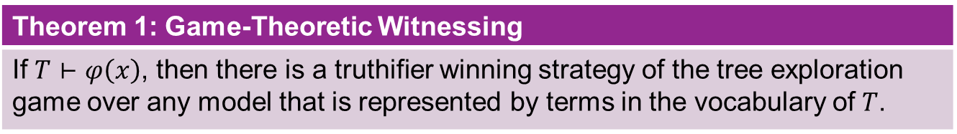

Our results: Witnessing for all formulas
Sanity check: As the truthifier, there is a winning strategy of the evaluation game iff there is a winning of the tree exploration game.
$(⇒)$ is trivial; $(⇐)$ by contradiction.
For resource-bounded truthifier…
Theorem 1: Game-Theoretic Witnessing
If $T⊢φ\left(x\right)$, then there is a truthifier winning strategy of the tree exploration game over any model that is represented by terms in the vocabulary of $T$.

Slide 27


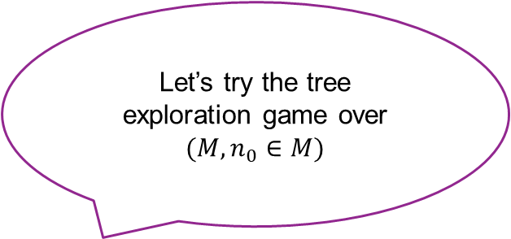
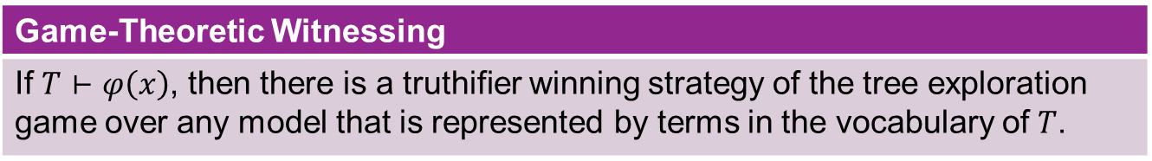
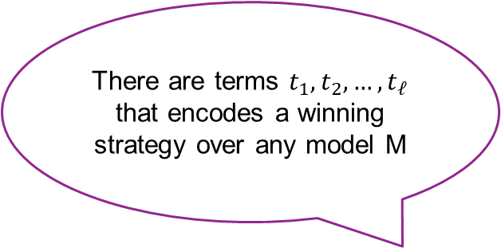
Our results: Witnessing for all formulas
There are terms $t_{1},t_{2},…,t_{ℓ}$ that encodes a winning strategy over any model M
Game-Theoretic Witnessing
If $T⊢φ\left(x\right)$, then there is a truthifier winning strategy of the tree exploration game over any model that is represented by terms in the vocabulary of $T$.
Let’s try the tree exploration game over $(M,n_{0}∈M)$
Do $t_{1}^{M}(n_{0})$
Response $n_{1}$
Do $t_{2}^{M}(n_{0},n_{1})$
Response $n_{2}$
$$…$$
Do $t_{ℓ}^{M}(n_{1},…,n_{ℓ−1})$
Response $n_{ℓ}$
See, I win!
Truthifier
Falsifier

Slide 28
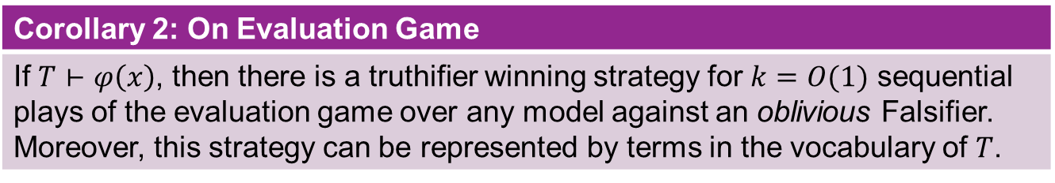
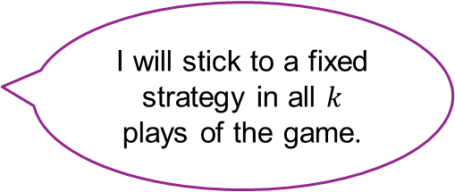
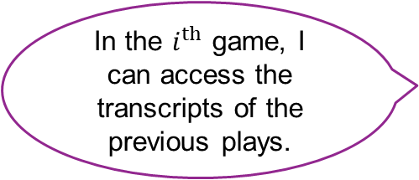
Special Case: Against Oblivious Falsifier
Can we say something about the simpler evaluation game?
Corollary 2: On Evaluation Game
If $T⊢φ\left(x\right)$, then there is a truthifier winning strategy for $k=O(1)$ sequential plays of the evaluation game over any model against an oblivious Falsifier. Moreover, this strategy can be represented by terms in the vocabulary of $T$.
In the $i^{th}$ game, I can access the transcripts of the previous plays.
I will stick to a fixed strategy in all $k$ plays of the game.
Truthifier
Falsifier

Slide 29
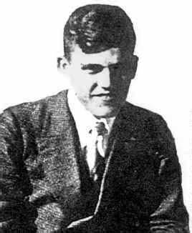
Proof overview, in one page
Assume that $T⊢φ\left(x\right)$
Assume that 𝑇⊢𝜑(𝑥)
There is a proof of $T⊢φ\left(x\right)$ in some “good” proof system
There is a proof of 𝑇⊢𝜑(𝑥) in some “good” proof system
Read out the game and the stategy from the proof
A proof-theoretic technique.
Sequent Calculus
“Cut Elimination Theorem”
or “Gentzen’s Hauptsatz”
Gerhard Gentzen

Slide 30
Overview
The story of frustrated complexity theorists
Bounded Arithmetic: the minimal logic for complexity theorists
Witnessing: extracting algorithms from proofs
Unprovability of complexity lower bounds

Slide 31
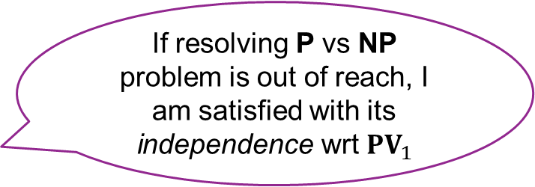
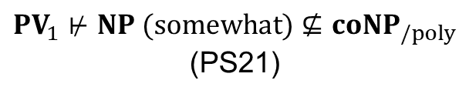
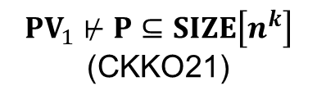
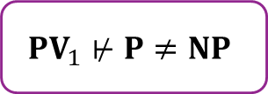
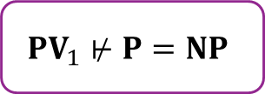
Cook’s proposal
If resolving P vs NP problem is out of reach, I am satisfied with its independence wrt ${PV}_{1}$
Stephen Cook
$${PV}_{1}⊬P=NP$$
$${PV}_{1}⊬P≠NP$$
Unprovability of upper bounds
Unprovability of lower bounds
$${PV}_{1}⊬P⊆SIZE\left[n^{k}\right]$$
(CKKO21)
$${PV}_{1}⊬NP (somewhat)⊈coNP_{/poly}$$
(PS21)
Known results:

Slide 32

Nondeterministic circuits
As $NP$ and $P$, we can define a nondeterministic circuit $C\left(x\right)$ as:
A circuit $C′(x,y)$, where $x$ is the input and $\left|y\right|=p\left(\left|x\right|\right)=poly\left(\left|x\right|\right).$
$C\left(x\right)=1$ iff there is an $y∈\{0,1\}^{p\left(\left|x\right|\right)}$ such that $C^{′}\left(x,y\right)=1$.
Similarly, we can define a co-nondeterministic circuit $D(x)$ as:
A circuit $D′(x,y)$, where $x$ is the input and $\left|y\right|=p\left(\left|x\right|\right)=poly\left(\left|x\right|\right).$
$D\left(x\right)=1$ iff for every $y∈\{0,1\}^{p\left(\left|x\right|\right)}$, we have $D^{′}\left(x,y\right)=1$.

Slide 33

Pich-Santhanam’s result
Theorem 3 (Pich and Santhanam, 2021, informal)
Under any reasonable formalization, for any $L∈NTIME\left[2^{n^{o\left(1\right)}}\right]$, $n_{0}∈ℕ$, and $δ>0$, ${PV}_{1}$ cannot prove the following: For every $n>n_{0}$, any co-nondeterministic circuit $D$ of size $2^{n^{δ}}$, $$\underset{x∈{\left\{0,1\right\}}^{n}}{Pr}\left[L_{n}\left(x\right)=D\left(x\right)\right]≤1−\frac{1}{n}$$
A strong almost-everywhere, average-case, NP-vs-coNP style lower bound
Interpreted as the hardness of proving lower bounds

Slide 34



Pich-Santhanam’s proof, in one page
$x∉L∧D\left(x\right)=1$ or
$$x∈L∧D\left(x\right)=0$$
Theorem 3 (Pich and Santhanam, 2021, informal)
Under any reasonable formalization, for any $L∈NTIME\left[2^{n^{o\left(1\right)}}\right]$, $n_{0}∈ℕ$, and $δ>0$, ${PV}_{1}$ cannot prove the following: For every $n>n_{0}$, any co-nondeterministic circuit $D$ of size $2^{n^{δ}}$, $$\underset{x∈{\left\{0,1\right\}}^{n}}{Pr}\left[L_{n}\left(x\right)=D\left(x\right)\right]≤1−\frac{1}{n}$$
$$∀n D, ∃x, L_{n}\left(x\right)≠D(x)$$
Assume the sentence is provable
By KPT witnessing, we can analyze co-nondet. circuits
Obtain strong upper bound, a contradiction
Then the worst-case lower bound hold

Slide 35




Limitations of Pich-Santhanam
${PV}_{1}$ is not so strong… In particular, ${PV}_{1}$ is not likely to prove PHP
The hard language is quantified outside of the theory…
Theorem 3 (Pich and Santhanam, 2021, informal)
Under any reasonable formalization, for any $L∈NTIME\left[2^{n^{o\left(1\right)}}\right]$, $n_{0}∈ℕ$, and $δ>0$, ${PV}_{1}$ cannot prove the following: For every $n>n_{0}$, any co-nondeterministic circuit $D$ of size $2^{n^{δ}}$, $$\underset{x∈{\left\{0,1\right\}}^{n}}{Pr}\left[L_{n}\left(x\right)=D\left(x\right)\right]≤1−\frac{1}{n}$$
We want a single model in which $NTIME\left[2^{n^{o\left(1\right)}}\right]$ has an upper bound.
Recall that: $Γ⊢φ$ iff for every model $M$ such that every sentence in $Γ$ is true, $φ$ is also a true sentence.
This theorem says that for every $L∈NTIME\left[2^{n^{o\left(1\right)}}\right]$, there is a model $M$ for ${PV}_{1}$, in which $L$ has an average-case upper bound.

Slide 36

Stronger Theories
$T_{PV}^{i}$ be the theory containing every true (over standard model) sentences of form
$$∀x_{1} ∃x_{2}≤t_{1}\left(x_{1}\right) ∀x_{3}≤t_{2}\left(x_{1}\right)…Q x_{i}≤t_{i}\left(x_{1}\right) φ(x_{1},…,x_{i})$$
For instance, we have
$T_{PV}^{2}$ proves PHP: $∀ n ∀ circuit C:{\left\{0,1\right\}}^{n}→{\left\{0,1\right\}}^{n−1}, ∃ x, y∈{\left\{0,1\right\}}^{n} C\left(x\right)=C\left(y\right).$
$T_{PV}^{3}$ proves dPHP: $∀ n ∀ circuit C:{\left\{0,1\right\}}^{n}→{\left\{0,1\right\}}^{n+1}, ∃y∈{\left\{0,1\right\}}^{n+1},∀x∈{\left\{0,1\right\}}^{n}, C\left(x\right)≠y$
……
We will show unprovability of lower bounds from $T_{PV}^{i}$.

Slide 37


Our results
Pro: stronger theory
Theorem 4 (Unprovability of lower bounds, informal)
Under any reasonable formalization, for any $n_{0}∈ℕ$, $δ>0$, and $d≥1$, $T_{PV}^{i}$ cannot prove the following: For every $n>n_{0}$, there is a $Π_{i}$-circuit of size $n^{d}$, such that for any $Σ_{i}$-circuit $D$ of size $2^{n^{δ}}$, $$\underset{x∈{\left\{0,1\right\}}^{n}}{Pr}\left[L_{n}\left(x\right)=D\left(x\right)\right]≤1−\frac{1}{n}$$
Pro: hard language within the theory
Con: lower bound is stronger
A $Σ_{i}$-circuit $C(x)$ is a circuit $C′(x,y_{1},…,y_{i})$ such that $C\left(x\right)=1$ iff
$$∃y_{1} ∀y_{2}…Q y_{i} C\left(x,y_{1},…,y_{i}\right)=1,$$
where the length of each $y_{i}$ is bounded by $poly\left(\left|x\right|\right).$

Slide 38




A closer look at the lower bound sentences…
Theorem 3 (Pich and Santhanam, 2021, informal)
Under any reasonable formalization, for any $L∈NTIME\left[2^{n^{o\left(1\right)}}\right]$, $n_{0}∈ℕ$, and $δ>0$, ${PV}_{1}$ cannot prove the following: For every $n>n_{0}$, any co-nondeterministic circuit $D$ of size $2^{n^{δ}}$, $$\underset{x∈{\left\{0,1\right\}}^{n}}{Pr}\left[L_{n}\left(x\right)=D\left(x\right)\right]≤1−\frac{1}{n}$$
This sentence is $∀∃∀$
suitable for KPT thm
For $i=1$, this sentence is $∀∃∀∃∀$: need new witnessing theorem
Theorem 4 (Unprovability of lower bounds, informal)
Under any reasonable formalization, for any $n_{0}∈ℕ$, $δ>0$, and $d≥1$, $T_{PV}^{i}$ cannot prove the following: For every $n>n_{0}$, there is a $Π_{i}$-circuit of size $n^{d}$, such that for any $Σ_{i}$-circuit $D$ of size $2^{n^{δ}}$, $$\underset{x∈{\left\{0,1\right\}}^{n}}{Pr}\left[L_{n}\left(x\right)=D\left(x\right)\right]≤1−\frac{1}{n}$$

Slide 39

Proof overview, in one page
To deal with $T_{PV}^{i}$, which is not universal, we construct a universal theory that contains $T_{PV}^{i}$ as a sub-theory.
We apply the original Pich-Santhanam’s proof, with KPT witnessing theorem replaced by our new witnessing theorem!
Check our (upcoming) paper for details ☺
A clever use of the Nisan-Wigdersan’s PRG

Slide 40

END
Thanks:
THE
audience

