Slide 1
Hyper OS
提前上学 杨天祺
提前上学 李嘉图

Slide 2
Progress
Improve the documentation and demonstrations
Complete screen service, which can show console and messages clearly
Implement blocking the process while waiting for input, and waking up at receiving one
Implement input buffer, which can support backspace, arrow-left, arrow-right
Kill the current process at receiving <ctrl-c> from keyboard (may change to sending a SIGINT signal in the future)
Fix the bug of cannot link on WSL, but still cannot build on MinGW (due to the issue on std::thread)

Slide 3
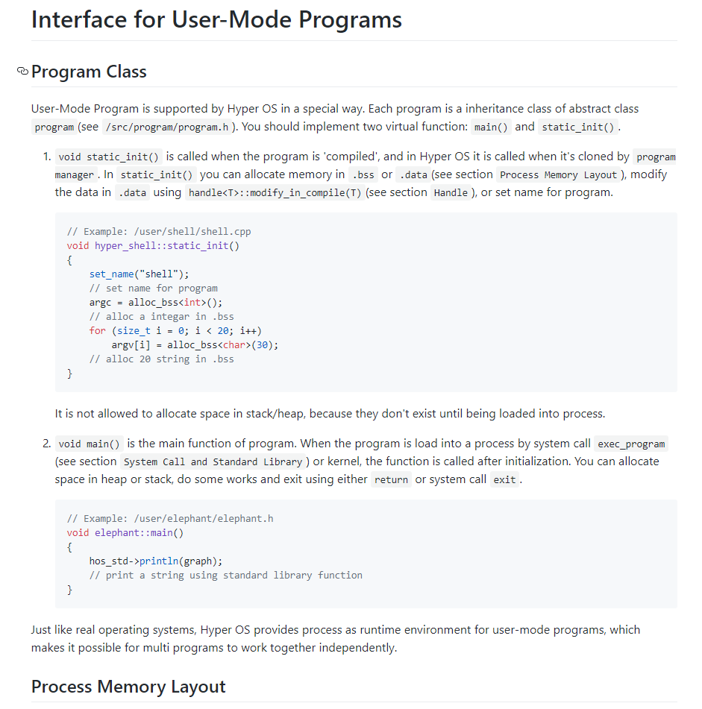
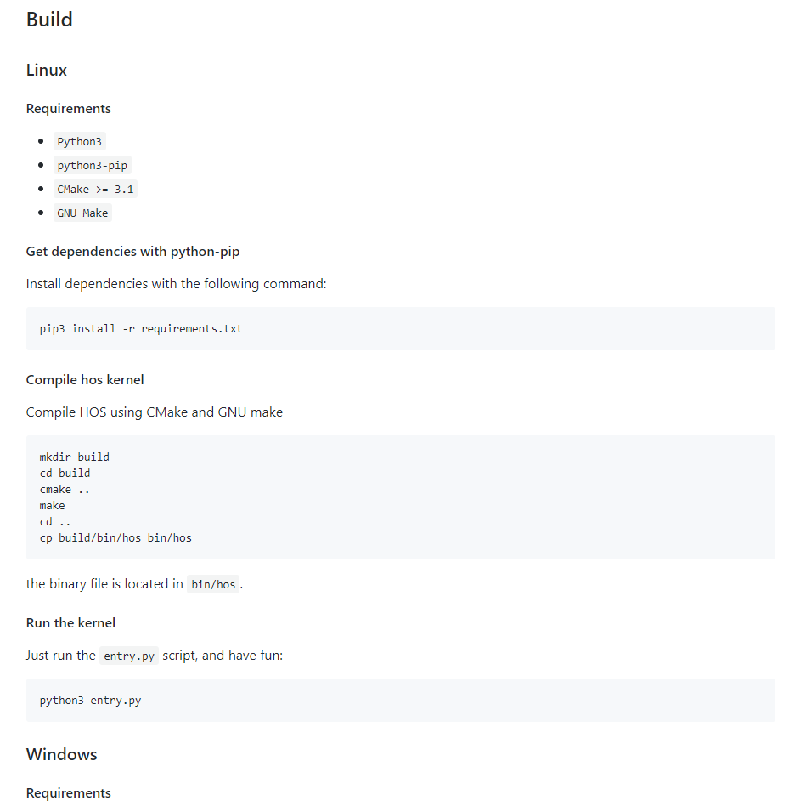
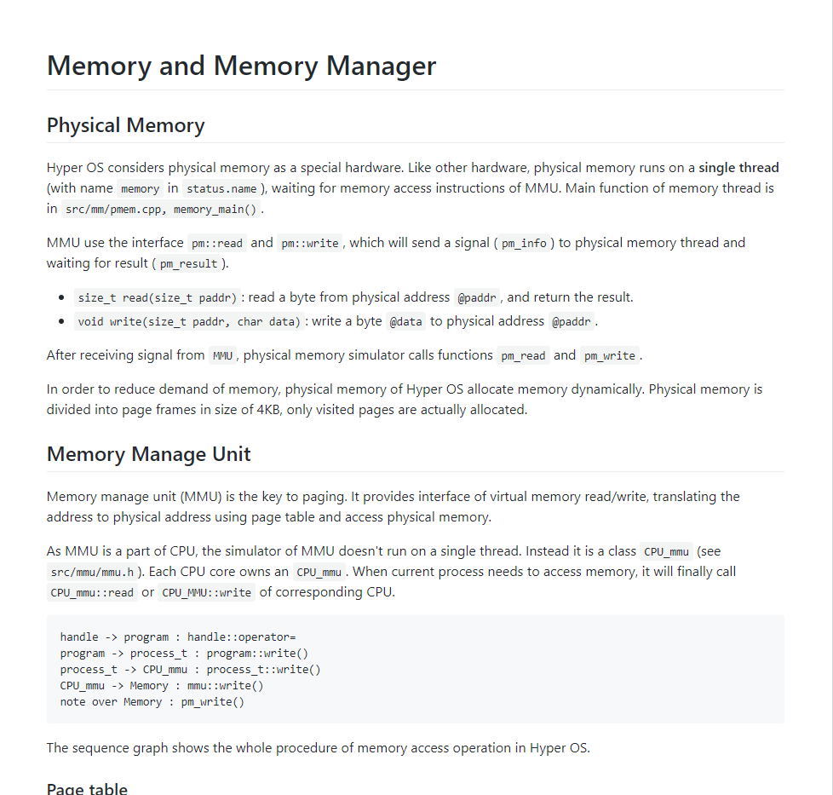
Documentations

Slide 4
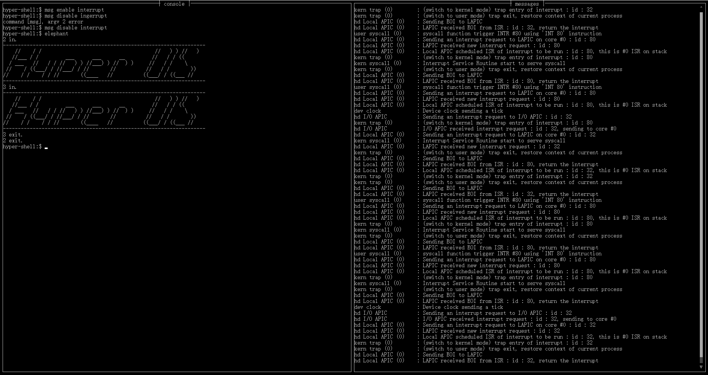
Screen service

Slide 5
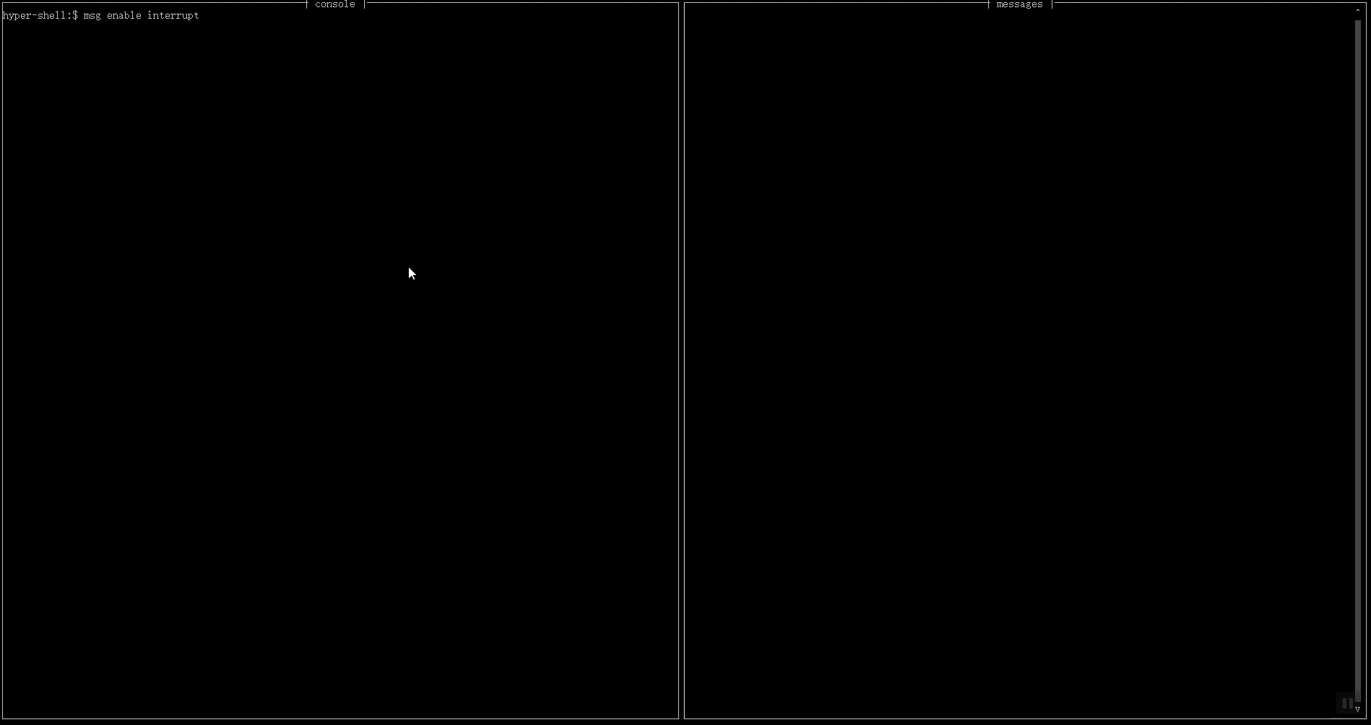
Blocking input

Slide 6

Input buffer

Slide 7
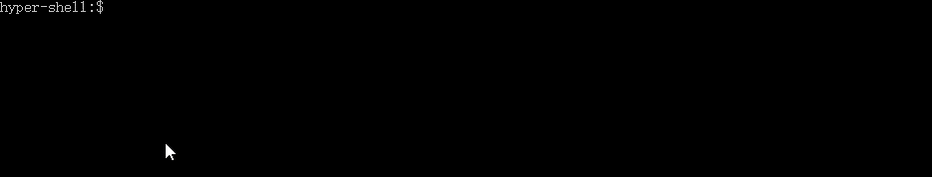
Kill process on <ctrl-c>

Slide 8
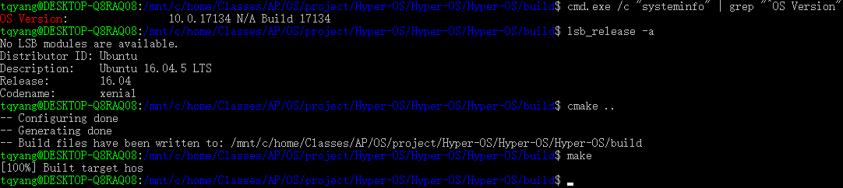
Build on WSL

Slide 9
Demonstrations

Slide 10
Questions are welcome

