Slide 1
A Multiple Feature Approach for Disorder Normalization in Clinical Notes
Presented by:
Lasang Jimba Tamang
University of Memphis

Slide 2
About Paper: A Multiple Feature Approach for Disorder Normalization in Clinical Notes
By :
Lu Chen, Chen Bo
Lu Chaozhen, Qiu Likun, Ji Donghong

Slide 3
Scenario
Doctor A’s Note
This was in fact due to Left Ventricular Failure
Doctor B’s Note
This was in fact due to Left–sided Heart Failure
Doctor B’s Note
This was in fact due to Left–ventricle malfunction
Requirement: Uniformity to process such electronic data.
Not Possible: Asking doctor to write in same way.
Effort Made : US National Library of Medicine maintains standard vocabulary i.e. concept unique identifier (CUI) in Unified medical language system( UMLs). Example: C0023212: Left-Sided Heart Failure for above three different representation for same concept.
Question : How can we identify such disorder mentioned in those note and map them to CUI?

Slide 4
Problem: How to identify DM and map to CUI?
Doctor A’s Note
This was in fact due to Left Ventricular Failure
Doctor B’s Note
This was in fact due to Left–sided Heart Failure
Doctor B’s Note
This was in fact due to Left–ventricle malfunction
C0023212: Left-Sided Heart Failure
Step 1 : Identify disorder mention (DM)
Step 2 : Map DM -> CUI.

Slide 5
Interest: What we are interested in this presentation?
Step 1 : Identify disorder mention (DM) (not interested). Assume somebody does it for you ☺.
Step 2 : Map DM -> CUI. ( We are interested on this )
Normalization is what we are interested.

Slide 6
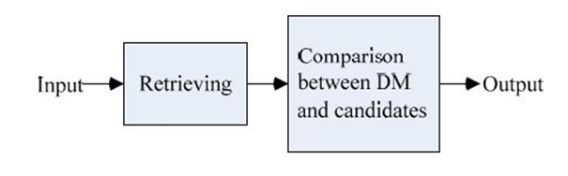
Overview: Modeling the problem
Disorder mention normalization as a ranking problem.
Query = Disorder entity(DM), E.g.: Red , Documents = candidates terms in UMLS, E.g., Redness , Red Color.
Step 1 : Generate candidate CUIs from UMLS .
Step 2 : Calculate similarity score between DM and each CUI. Rank candidate CUIs and then choose the top ranked CUI.
Multiple Feature Approach : Treat finding similarity as Classification problem. Use multiple features (string feature, ranking feature, similarity feature, and contextual feature) for the classification task.

Slide 7
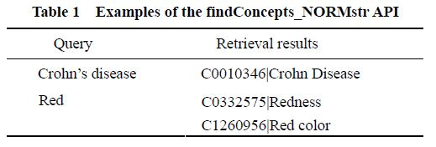
Step 1: Generating Candidate CUI for DM
findConcepts_NORMstr API: Provided by UMLS to acquire the candidate results.
US National Library Of Medicine's Rest API provides those Rest API

Slide 8
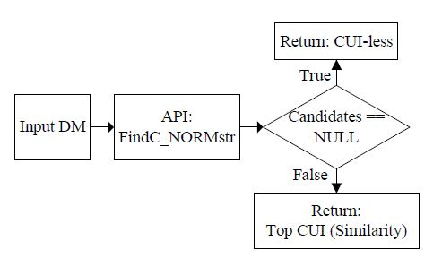
Step 2: Choosing Right Candidate
Map one character DM to “CUI-less”.
If no candidate returned by API, map to “CUI-less”.
If API return more than one candidate CUI, apply classification model to choose right candidate.

Slide 9
Classification Problem
Class: Correct answer in the candidate : positive instance, other: negative instance.
Given : a) DM (red) , b)Candidates retrieved by API (Redness, Red Color)
Classification Problem : Decide which candidate is correct CUI for the DM mentioned in the note.
Red color or Redness is correct?
Solution :
If only 1 DM mentioned as Positive, it is correct answer the DM.
If all candidate labelled as negative, label DM as “CUI-less”
If more than one candidate CUI is labelled as positive, choose the candidate which ranks first in the retrieved result.
Use Support Vector Machine for classification task.

Slide 10
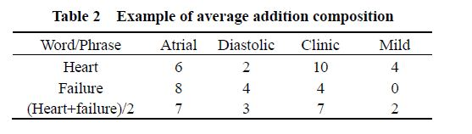

Multiple feature Approach for classification
Ranking Feature: API returns list of candidate and their Rank. We use this rank as feature.
Similarity Feature: Similarity Feature computed by Levenshtein distance semantic composition method. Eg : Distance in “hypokinesis” and “hypokinesia” is 1.
Similarity between the DM and the candidates CUIs computed by Levenshtein distance.
Similarity between the DM and the candidate CUIs computed by semantic composition method using CW word embedding's.
Similarity between the DM and the candidates CUIs computed by semantic composition method using word2vec word embedding's.

Slide 11
Multiple feature approach for classification
Contextual features : similarity between context DM context and the candidate CUIs. (window size , t = 3, for this experiment)
Similarity between the context and the candidate CUIs computed by semantic composition method using CW word embedding's.
Similarity between the context and the candidates CUIs computed by semantic composition method usingword2vec word embedding's.
String feature: idea -> if the surface string of the DM is very similar to that of the candidate CUIs, it is an indication of being same.
If the DM is part of the candidate CUIs, the feature is 1. Otherwise, the feature is 0.
If the candidate CUI starts with the DM, the feature is 1. Otherwise, the feature is 0.
If the candidate ends with the DM, the feature is 1. Otherwise, the feature is 0
If feature(1) = 1, feature(2) = 0, and feature(3) = 0, the feature is 1. Otherwise, the feature is 0.

Slide 12
Experiment: Setting
Data set: Semeval-2014 task 7
Training set and development set with gold standard are used since organized did not release gold standard test the point.
Contains 302 clinical documents and 11380 disorder mention (380)
Two embedding,
CW word : provided by Huang, trained on Wikipedia corpus.
Word2vec : trained on the unannotated clinical note reports provided in the task.
Accuracy = No. of DM whose CUIs are correctly acquired / No. of all DM.
Calculated top 3 accuracy with assumption that if top-3 result contains the true answer, it is regarded as the correct retrieval.
4095 DM is labelled as ‘CUI-less” and rest 7285 processed by Multiple feature approach.
Use 10-fold cross validation
Feature extraction : SC add for the semantic composition

Slide 13
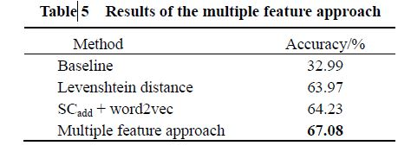
Experiment: Result
Multiple feature approach improves the accuracy from 32.99 % to 76.08 %
Baseline: MetaMap as baseline system( Maps biomedical text to concepts in the UMLS Met athesaurus)

Slide 14
Major challenges, issues and open question
“CUI-less ” DM: If label of all CUI is negative, result of DM is “CUI-less” .
Obviously this is wrong.
Ratio of “CUI-less” DM in the error of multiple feature approach is 19.75 (needs improvement)
Acronyms: Example, correct answer for “CHI” is “C0085094, closed head injuries”. But, API do no return it.
Ratio of acronym in the error is 18.77%
This is major source of error.
One character DM .
Correct CUI for DM C in one doc is “C0149651|Clubbing” and “C0010520|Cyanosis” in another doc.
API may not return appropriate candidates for one character DM.
40 .8 %of one character DM annotated as “CUI-less”. Still only 2.7 % error in the result.
So, One character DM is not major source of error.
Dependency in API : Dependent on API provided by UMLS. If the candidate provided by API do not contain correct answer, it gives wrong answer.

Slide 15
Queries??

Slide 16
Appreciate for your time!!

