Slide 1
A Multiple Feature Approach for Disorder Normalization in Clinical Notes
Presented by:
Lasang Jimba Tamang
University of Memphis

Slide 2
About Paper: A Multiple Feature Approach for Disorder Normalization in Clinical Notes
By :
Lu Chen, Chen Bo
Lu Chaozhen, Qiu Likun, Ji Donghong

Slide 3
Scenario and Problem
Doctor A’s Note
This was in fact due to Left Ventricular Failure
Doctor B’s Note
This was in fact due to Left–sided Heart Failure
Doctor B’s Note
This was in fact due to Left–ventricle malfunction
Requirement: Uniformity to process such electronic data.
Not Possible: Asking doctor to write in same way.
Effort Made : US National Library of Medicine maintains standard vocabulary i.e. concept unique identifier (CUI) in Unified medical language system( UMLs). Example: C0023212: Left-Sided Heart Failure for above three different representation for same concept.
Question : How can we identify such disorder mentioned in those note and map them to CUI?

Slide 4
How to identify disorder mentioned and map to CUI?
Doctor A’s Note
This was in fact due to Left Ventricular Failure
Doctor B’s Note
This was in fact due to Left–sided Heart Failure
Doctor B’s Note
This was in fact due to Left–ventricle malfunction
C0023212: Left-Sided Heart Failure
Step 1 : Identify disorder mention (DM)
Step 2 : Map DM -> CUI.

Slide 5
What we are interested in this presentation?
Step 1 : Identify disorder mention (DM) (not interested). Assume somebody does if for you ☺.
Step 2 : Map DM -> CUI. ( We are interested on this )
Normalization is what we are interested.

Slide 6
How do we map DM to CUI (Normalize)?
Step 1 : Given Disorder Mention(DM1), find candidate list of CUI:CUI1, CUI2,….,CUIn.
Use FindConcept_NORMstr API -> Takes DM and return list of CUI.
Step 2 : Calculate similarity score between DM and each CUI. Rank candidate CUIs and then choose the top ranked CUI.
Formulate similarity calculation step as classification problem and use multiple features (string feature, ranking feature, similarity feature, and contextual feature).

Slide 7
How do we solve this problem?
Motivation: In this digital world, candidate have appearance on Facebook and LinkedIn, if not, they will be sooner. According to www.work4labs.com , 60 % of candidate are only on Facebook.
Solution: Exploit this data to know about user and recommend them the job they are most interested in.
User profile Build from social media data
Job profile from companies
Recommendation System
Recommended Job

Slide 8
Before Moving Ahead: About Recommendation System
Rating-based : focus on predicting the absolute values of ratings that individual users would give to the unseen items.
For instance, someone who rated the movies “Star Wars” 9/10 and “The Matrix” 7/10 would rate “X-Men Origins” 6/10
Preference-based : predict the correct relative order of items for a given user.
For instance, let assume the preferences of a given user: iPad 3-> Galaxy S III ->Galaxy tab 2, predict that user’s new preferences would be: iPhone 5 ->iPad 3 -> Galaxy S III->Galaxy tab 2, after release of iPhone 5.

Slide 9
Solution Modeling with IR knowledge
User Profile: Vector representing user
Job Profiles: Vector Representing job
Recommendation System: Find cosine similarity score
Recommended Job: N job in descending order of cosine similarity score
This means you need to build
User Vector
Job vector
Then find cosine similarity between user and jobs. Recommend n job in descending order of similarity score
Our Approach:

Slide 10
What type of recommendation system are we using?
Rating Based System: focus on predicting the absolute values of ratings that individual users would give to the unseen jobs.

Slide 11
Building User Vector
User vector is build from user social interaction data : user post and user interaction record such as publications, comments, like, time spent and viewed resources.
Facebook Data Field: Work history, education history, Quote, about me, Interests, etc.
LinkedIn Data Field: Headline, Education, positions, etc.
Concatenate all these data field to form text that describe the user.
Finally, convert this text data into vector using weighting function and give equal importance to all field.
Weighting function: Generally TF-IDF works best.

Slide 12
Building Job Vector
Job vector is build from job: Title of the job, job description, responsibilities, skills and education required etc.
Job data source can be specific company, company pages, websites, etc.
Finally, convert this text data into vector using weighting function and give equal importance to all field.
Weighting function: Generally TF-IDF works best.

Slide 13

Building Recommendation System
Given user vector u, job vector v, k be number of TF-IDF weighted term, in the vector, calculate cosine similarity as:
To find suitable job for user, repeat the process changing different job.
To find suitable user for job, repeat the process changing different user.
Sort result in descending order of similarity score and present result.
We may also allow certain threshold value.

Slide 14
Some issues with this approach
Set of term in user profile and job profile may differ.
Therefore, the cosine similarity score can be 0 though the job is highly suitable in reality.
All the fields in user profile or job profile is given same importance which is not true.
For example, Work history is more important than interest or quote field in Facebook.

Slide 15

Addressing issue of importance of fields
The vector u(α) of a user u using the importance vector α of users fields is defined as the weighted sum of his fields vectors; formally it is defined as follows:
where α = (α⁰, α¹)
α⁰ = (α⁰₁, . . . , α⁰_{f0u}) and α1 = (α¹₁, . . . , α¹_{f1u}) are respectively the importance of Facebook and LinkedIn users fields, f⁰_{u} and f¹u are respectively the numbers of Facebook and LinkedIn users fields in the training set, u⁰_{f} and u¹_{f} are respectively the vectors of the Facebook and LinkedIn field f for the user u and finally α⁰_{f} and α¹_{f} are the importance of the Facebook and LinkedIn field f.

Slide 16

Addressing issue of importance of fields
The vector v(β) of a job v using the importance vector β of jobs fields is defined as the weighted sum of its fields vectors; formally it is defined as follows:
where β = (β₁, . . . , β_{fj} ) , f_{j} is the number of jobs fields in the training set, v_{f} is the vector of the field f for the job v and β_{f} is the importance of the field f

Slide 17
Addressing issue of importance of fields
Now, compute the cosine similarity between this new vector that take importance into consideration.
Cos(u(α), v(β) )

Slide 18
Experiment with Work4 test data: Data Type
Candidates Dataset: users can use Work4 applications to apply to jobs. Work4 records the associated data (user and job chosen). We assume that users only apply to the jobs that match with them, so this dataset contains15, 625 positive examples (label = 1)
Random Dataset: This dataset contains couples of users and jobs that have been randomly drawn from Work4 databases and manually annotated. It contains 3, 394 entries.
Feedback Dataset: Feedback from Work4 applications users are stored; this leads to the third dataset: Feedback Dataset with 6, 650 entries.

Slide 19
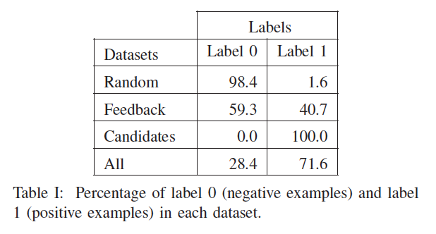
Experiment with Work4 test data: Label
We can see that Random Dataset is highly unbalanced but it is the only dataset whose proportion label 0 / label 1 is close to the real distribution

Slide 20
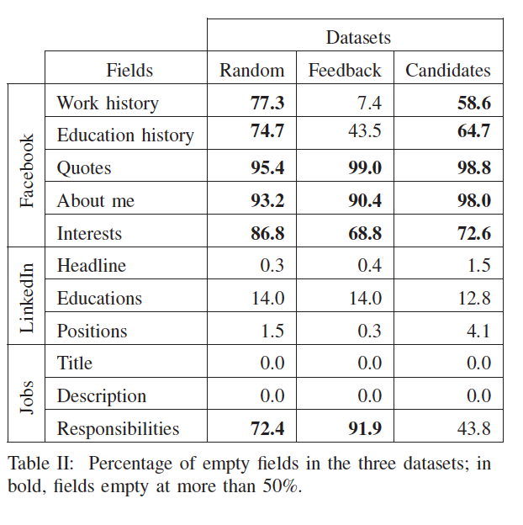
Experiment with Work4 test data: Empty fields

Slide 21
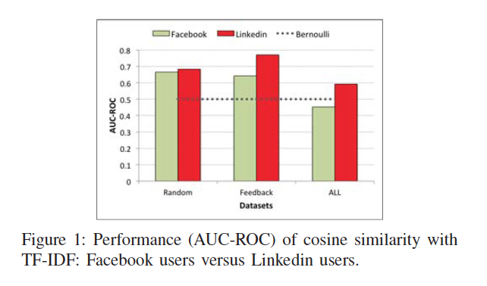
Result: Facebook VS LinkedIn
LinkedIn has more accuracy because they have more job related term.
All Data: Artificially created data by union all type of data we have.

Slide 22
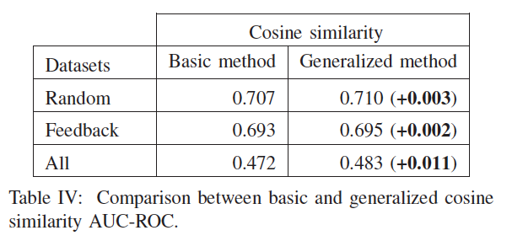
Result: Basic method VS Method with field importance
Field importance yielded in performance gain.
Note: Generalized method is method with term importance

Slide 23
Major Challenges
Privacy : Due to privacy setting, the field from the Facebook and LinkedIn may not be available, thus, making incomplete representation of user profile.
Different vocabulary for same term: CEO/Chief Executive Officer
Term importance optimization: How do we give optimal term importance?
Not surprisingly, the most relevant fields for users are “Work history” (Facebook) and “Headline” (LinkedIn). On jobs, the is “Title” brings the most important information.
For instance, given a Facebook or LinkedIn user and a job description, if one tries to tell whether this user matches with this job, one will probably first compare the user’s work history (Facebook) or headline (LinkedIn) field information to the title of the job.

Slide 24
Some Facts
LinkedIn users vocabulary seems closer to the vocabulary of jobs than Facebook.
Most of Facebook fields are empty.

Slide 25
People working on it
www.work4labs.com
They have built recruitment solution on the top of it and provides many solutions.
Amazon, Netflix and many other are working, but, they focus more on selling commercial item instead of job.

Slide 26
Queries??

Slide 27
Appreciate for your time!!

